Slide 1
Motivation and Overview (China AShares)
For equity portfolio management, mean-variance framework is often used.
Traditional analysis focuses on constant linear dependence between the factors. Normality implicitly assumed (Gaussian Copula).
But normal sucks...
Asymmetric Dependence: Research on the dependence structure of equities has shown that negative returns are more dependent than positive returns.
Heavy Tails.
Structural breaks exist. Dependence structural should be examined in different regime.
2008 - 2016.1 (Small Cap)
2016.2 - 2018.1 (Momentum Crash with large drawdown in value)
2018.2 – 2018.11 (IVol outperforms, chaos in others)

Slide 2
Model used for China AShares
Custom Risk Model (Similar to Barra CNE5S)
Risk Factors
Value: BP_LF
Earnings Yield: 1/PE_FTM
Momentum: 12-1MOM (63 half-life)
Reversal: 1M
Volatility: IVol(252-63 CAPM)
Leverage/SIZE/NL-SIZE/Beta/Liquidity
SW industry classification (Not GICS)
Universe: 000985 (ST,IPO excluded)
Factor Return: portfolios with exposure = 1 for specific factor, and =0 for others
Correlation within Factor Returns
Newey-West Adjustment
Regime Adjustment

Slide 3
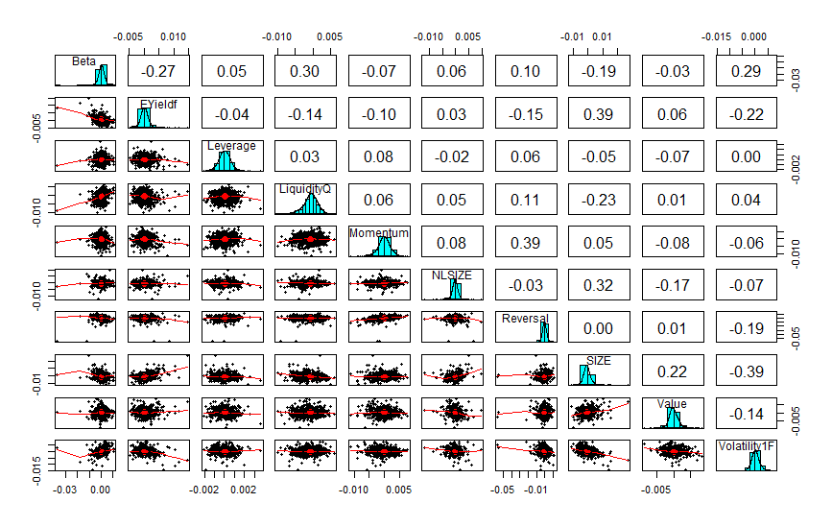
EDA

Slide 4
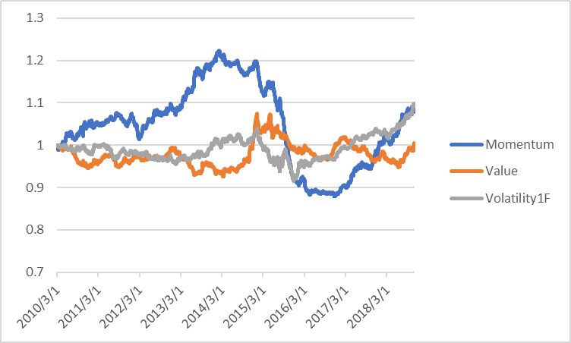
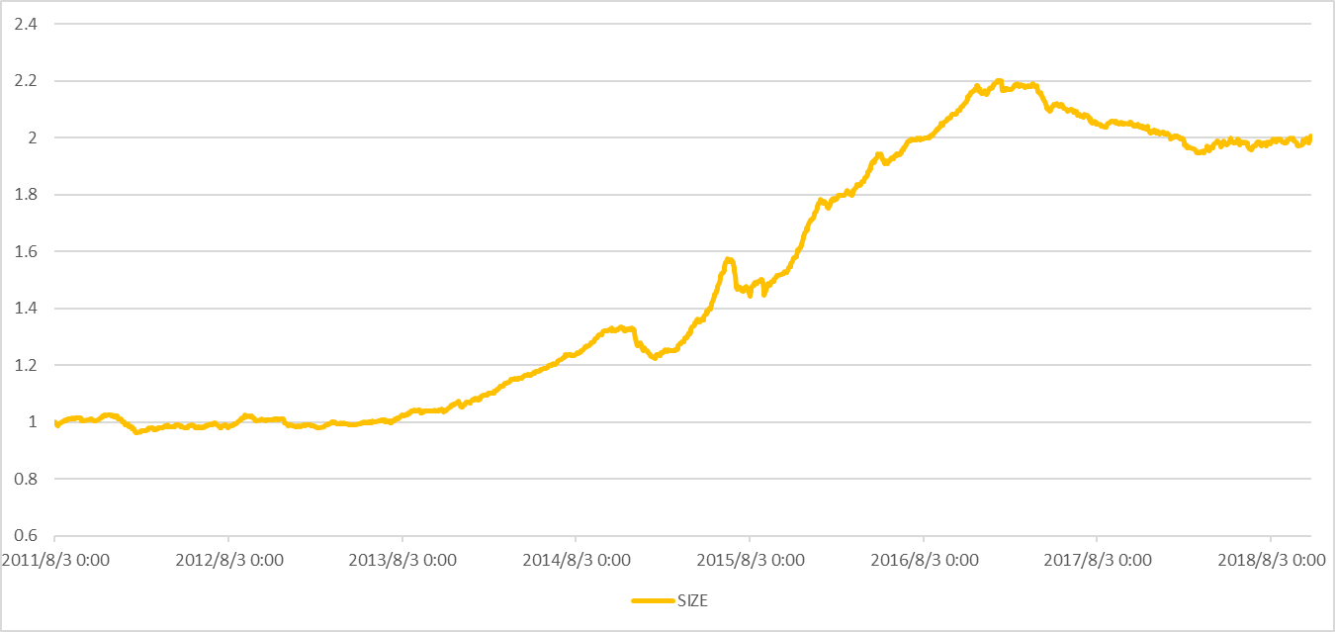
Why by different period: Structural Break!
Chaos in CSI800
Large Cap became outperform since 2017

Slide 5
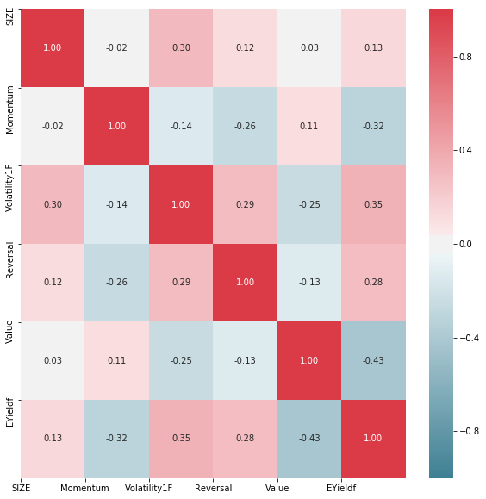
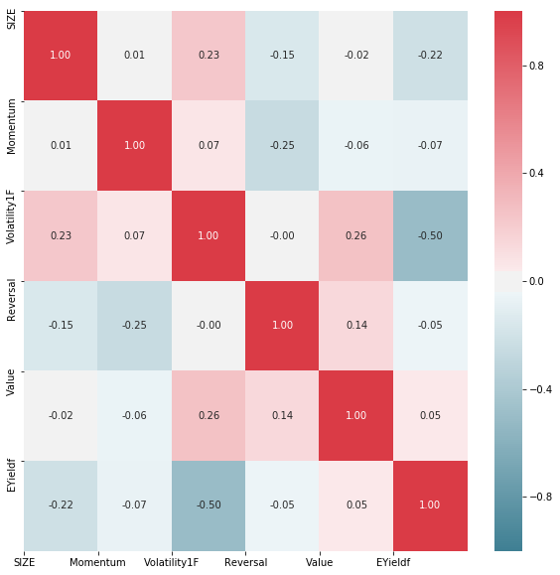
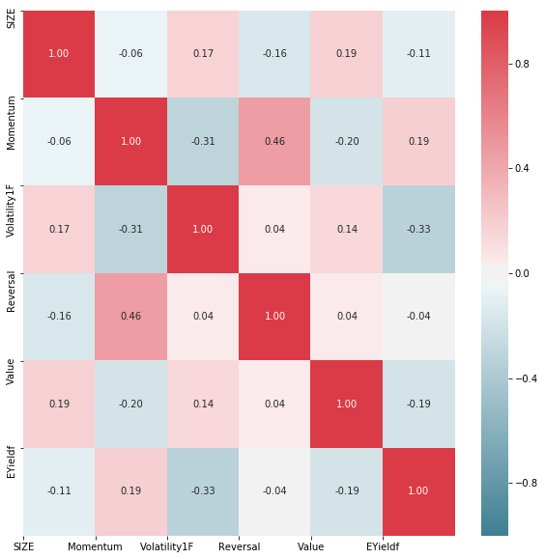
Structural Break
2008 - 2016.1 (Small Cap)
2016.2 - 2018.1 (Momentum Crash with large drawdown in value）
2018.2 – 2018.11 (IVol outperforms, chaos in others)

Slide 6
CIC | gumbel | frank | joe | clayton | normal | t
Peiord 1 | -0.48 | -0.41 | 0.00 | 44.24 | 0.20 | 450.89
Period 2 | 3.25 | 5.46 | -0.52 | 14.21 | 8.56 | 147.23
Period 3 | -0.83 | -0.18 | -0.86 | 0.37 | 0.01 | 32.08
Though cross different periods:
Clayton > Gaussian -> Asymmetric Dependence
Student’t > Gaussian -> Heavy Tails

Slide 7
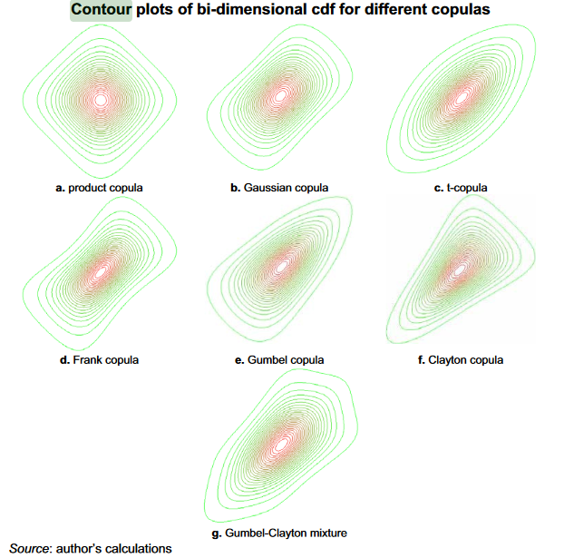

Slide 8
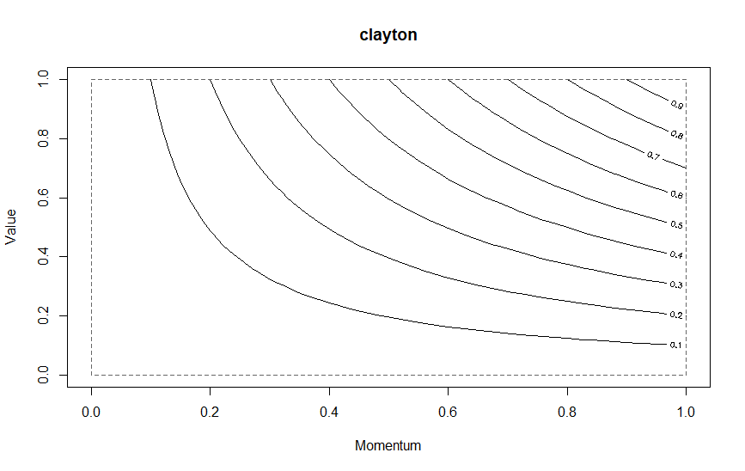
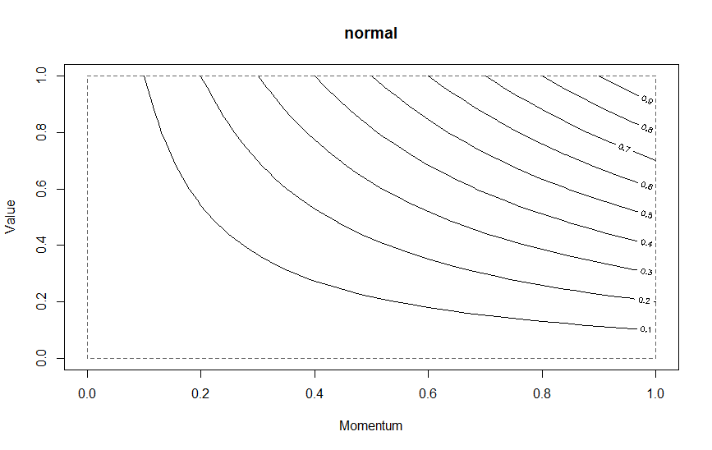

Slide 9
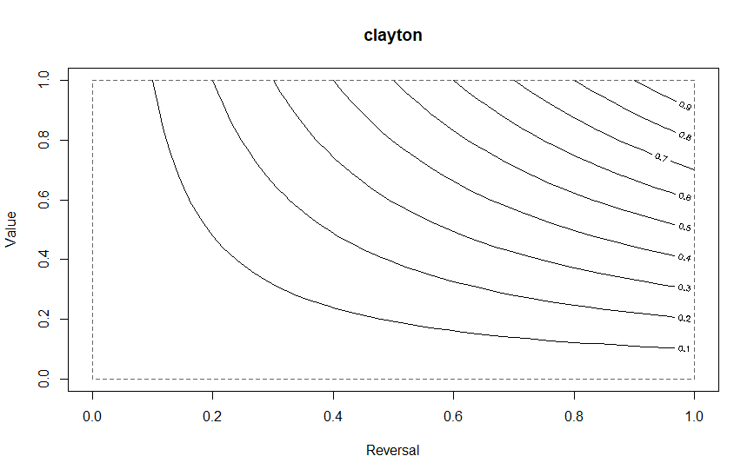


Slide 10
