Slide 1


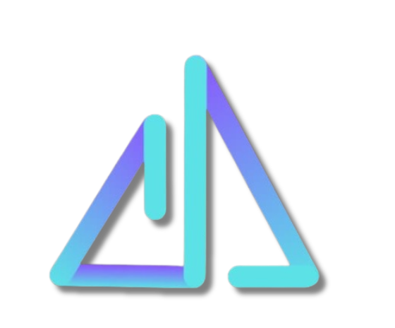
SHRI VILE PARLE KELAVANI MANDAL’S
SHRI BHAGUBHAI MAFATLAL POLYTECHNIC AND COLLEGE OF ENGINEERING
SPECTRUM
SBMP
HACKATHON

Slide 2





PS-Name: TaskSphere
PS-Domain: Full Stack Domain
Team Leader Name: Harsh Mane
Team name: Code Reapers
College Name:
Shri Bhagubhai Mafatlal Polytechnic and College of Engineering

Slide 3

🧠
Approach and Solution
Problem & Our Approach
Today, students and small teams use different apps for tasks, reminders, and communication. This leads to confusion, missed deadlines, and no clear accountability. Personal and professional work often overlaps, making it harder to stay organized and productive.
Our Approach
Build one centralized platform instead of many scattered tools
Separate Personal and Professional workspaces clearly
Focus on clarity, responsibility, and ease of use
Design the system around real daily workflows

Slide 4
📝
Approach and Solution
Our Solution – Tasker
Tasker is a smart task management platform designed for both individuals and teams. It helps users plan their work, track progress, and complete tasks on time with less stress.
What Tasker Offers
Personal Mode → for self-productivity and goal tracking
Professional Mode → for team collaboration and accountability
Task creation, assignment, and progress tracking
Built-in communication and reminders
The purpose of Tasker is simple: help people work smarter, not harder.

Slide 5
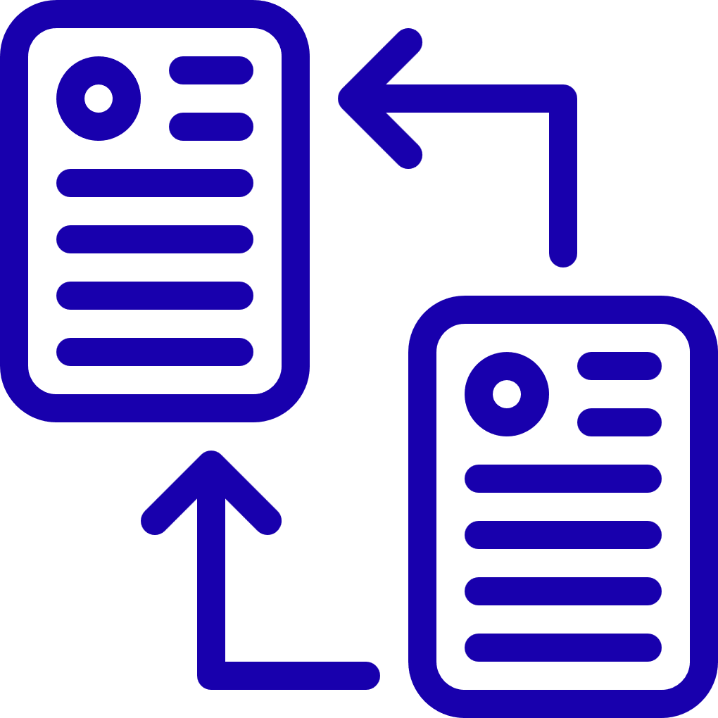
⚖️
Techstack And Dependencies
Technology Behind Tasker
Tasker is built using modern full-stack technologies to ensure performance, security, and scalability.
Core Stack
Frontend: HTML, CSS, JavaScript, React
Backend: Node.js, Express
Database: MongoDB
Supporting Tools
Chart libraries for statistics and insights
Calendar components for deadline tracking
Real-time services for chat and notification

Slide 6
Strengths and Weaknesses
Title: Strengths, Weakness & Improvements
Tasker’s biggest strength is its clear separation between personal productivity and professional collaboration. It also emphasizes accountability through features like audit trails, statistics, and dashboards.
Strengths
Dual-mode system (Personal + Professional)
Built-in accountability and transparency
Clean, visual task tracking
Current Gaps
Limited AI automation
No mobile app yet
How We Bridge the Gap
Improve smart scheduling and recommendations
Enhance UI/UX performance
Expand to mobile and cloud platforms
💪🏻

Slide 7

🚀
Future Scope
Future Scope
Tasker is designed to grow beyond a simple task manager into a complete productivity ecosystem.
Planned Enhancements
AI-based task planning and prioritization
Voice input and smart assistants
Advanced analytics and performance insights
Vision
Help students, teams, and organizations work efficiently
Make Tasker a trusted, intelligent productivity platform

