Slide 1

Password Cracking in Parallel
CMP202 Jake Bretherton 1800231

Slide 2
The Problem:
Find an unknown password from a given hash.
Passwords are stored in a hashed format, meaning if there is a leak of a website’s databases raw passwords will not be visible.
A password cracker will take a hash, and by brute force try possible passwords until one hashes into the provided hash.
Guess | Hash | Same As Leak?
Pass0 | 348468795 | No
Pass1 | 487314782 | Yes
(Actual Password) | Leaked Hash
Pass1 | 487314782
Found!

Slide 3
Simplifications
This is a toy model:
The hashes will not be salted
The hash algorithm used will not be cryptographically secure
It the principle is the same but the program will run significantly faster
C++ has a built in hash function for dictionary keys
Ethically, this will not be usable on actual leaks

Slide 4
Breaking down the problem
Crack the password:
Generate Password guesses
Hash the Password guess
Compare generated hash to provided hash
Return found password

Slide 5
Note on generating password guesses
There are 95 commonly used Unicode characters in passwords
a-z
A-Z
0-9
!"# $%&'()*+,-./:;<=>?@[\]^_`{|}~
Complete sequential block of characters from space to tilde, ‘ ‘ to ‘~’, char 32 to 126
Therefore 98.9%* of generation is taking the last character and incrementing it by 1
*(1 – 1/96)
aFeg
aFeh
aFei
aFej
aFek
aFel
aFem
aFen
aFeo
aFep
aFeq
aFer
aFes
aFet
aFeu

Slide 6
Breaking down generation
Expensive algorithm to increment the password root
Can handle if last character of root is largest char
Can handle adding new character to root if whole root is largest char
Cheap algorithm to increment the last character
Increment char and store it along with the root
Signal to expensive algorithm if char is largest char
98.9% of generations use only cheap algorithm
aFe- | -p | aFep
Root | Last character | Password

Slide 7
Breaking down the problem
Crack the password:
Generate Password guesses
Increment password root
Increment the last character
Hash the Password guess
Compare generated hash to provided hash
Return found password

Slide 8
Model
Thread
Generator
Single character
Channel
Plain Text Password
Thread
Perform Hash
Channel
Password Hash Pair
Thread
Compare Hash to Target
Write
Read
Write
Read
Signal
Barrier
Update
Write
If Match
Thread
Generator
Root word
Thread
Wait for end of Search
Channel
Found Password
Read
Begin
Provide Hash
End
Return Password

Slide 9
Thread managing tools
Need:
Barrier
Suspends threads that reach barrier until specified number of threads reach barrier, at which point all are awoken
Channel
Pipe to pass data between threads
Reading threads suspend until data is available, writing threads suspend until there is room in the channel
These require a semaphore
Semaphore
Signal a count between threads
If count > 0, threads waiting for signal will decrement count and continue
If count = 0, threads waiting for signal will suspend until count > 0, when they will wake up
A thread signalling the semaphore will increment the count and wake up a sleeping thread waiting on the semaphore
None of these are available in the current version of C++ so they had to be written

Slide 10
Barrier

Slide 11
Semaphore

Slide 12
Channel

Slide 13
Generator threads
Last Character Thread
Root Password Thread
Take root and add character to it, write this to channel and increment character
When exhausted characters, arrive and wait to signal the root should be updated
Arrive and wait for root password to be updated
Arrive and wait for generation to finish
Update the root password
Once finished arrive and wait to signal generation may begin again

Slide 14
Generation to hashing
Hashing thread initially tries to read the password plaintext channel
This channel is empty so the thread suspends
The last character generator thread writes a string to the channel
This causes the hash thread to wake up and hash the password
Thread
Generator
Single character
Channel
Plain Text Password
Thread
Perform Hash
Write
Read

Slide 15
Hash to comparison
Comparison thread tries to read the hash channel
This channel is empty so the thread suspends
Hash channel writes both the hash it has generated and the plaintext used to generate it to the hash channel
This causes the comparison thread to wake up and compare this hash to the provided search hash
Thread
Perform Hash
Channel
Password Hash Pair
Thread
Compare Hash to Target
Write
Read

Slide 16
Comparison to end search
End search thread tries to read the hash channel
This channel is empty so the thread suspends
If the comparison thread finds the hash did not match the target, it discards the hash and password
If they match then the comparison thread writes the associated password to the end search channel
This causes the end search thread to wake up and stop and join the rest of the threads
Thread
Compare Hash to Target
Channel
Found Password
Thread
Wait for end of Search
Write
Read

Slide 17

Function Timings

Slide 18
Specs of machine timed on
Processor: Intel Core i5-1035G1, quad core 1GHz
Cache 6MB

Slide 19
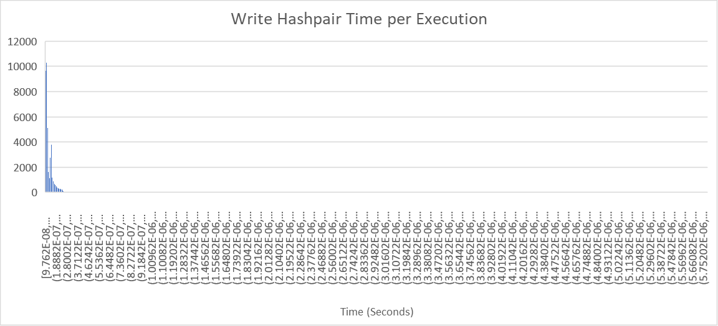
Issues with timings
Because the entire solution is fairly complex with many threads that likely spend a significant amount of execution suspended, it was decide to time each task independently. Reading / writing to each channel, and each thread’s work were timed.
Because timing such small segments of code, the high-resolution clock often would not register any time having passed between executions, so many executions were done per timing, and this was repeated many times.
Outliers made histogram graphing difficult, this is a naïve attempt with evenly spaced buckets from the minimum to maximum value

Slide 20
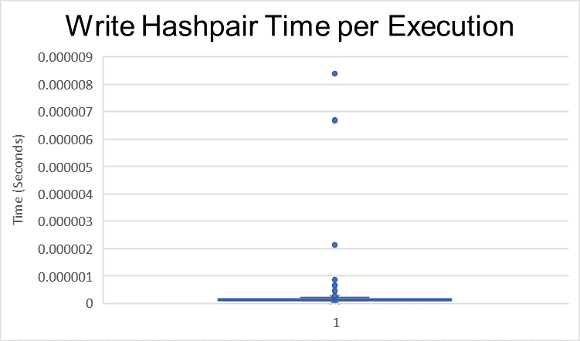
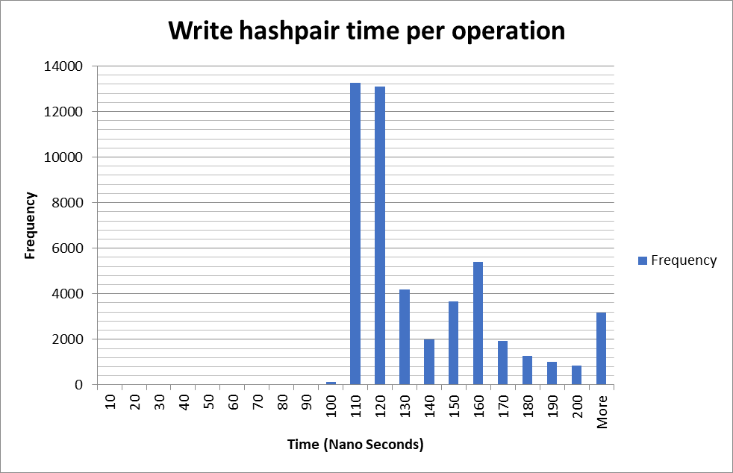
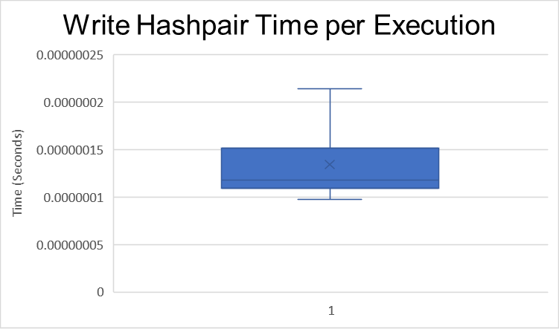
Issues with timings - Solution
The outliers were so extreme they dwarf the rest of the data
Box and whisker plots were used to visualise the data excluding these outliers.
The Minimum (Q1–1.5*IQR) and Maximum (Q3+1.5*IQR) were then used for the histogram extremes, and outliers all grouped in ‘more’
Median Time: 118 Nanoseconds

Slide 21
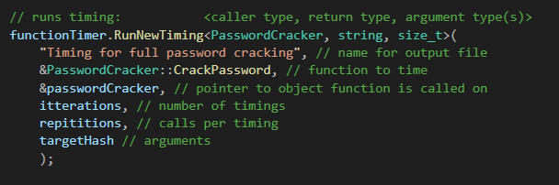
Function timer
Wrote a function timer object to run timings on various methods of the program
You can specify the number of timings to perform, and the number of calls to that function per timing

Slide 22
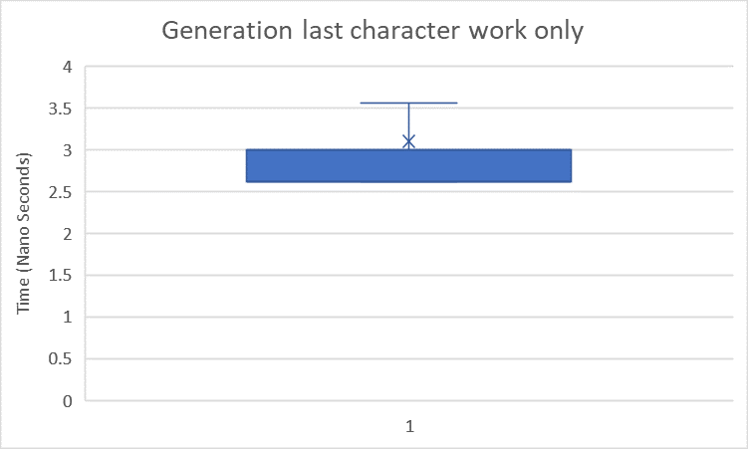
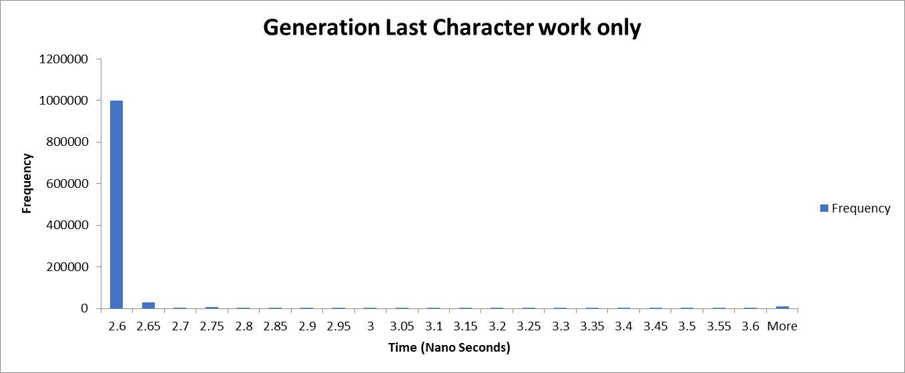
Generation last character
50,000 timings of 50,000 executions of the last character generation only (no channel writing) Theoretical time per execution
Median Time: 2.62 Nanoseconds

Slide 23
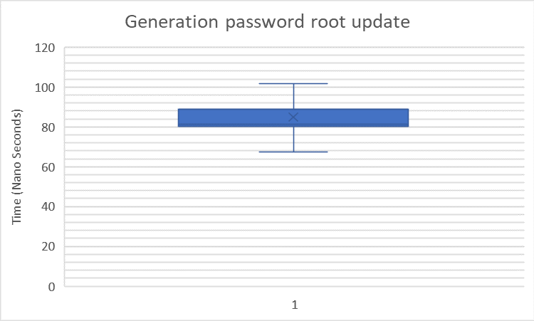
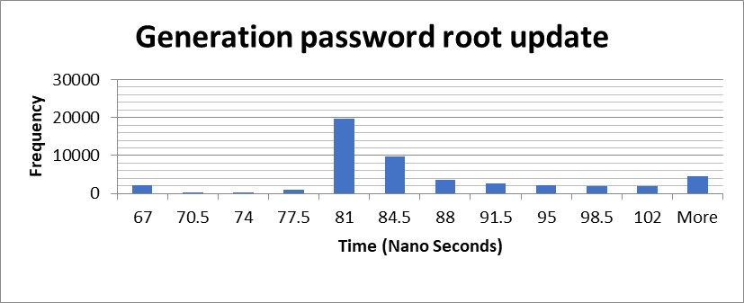
Generation password root
50,000 timings of 50,000 executions of the password root only (no channel writing) Theoretical time per execution
Median Time: 81.3 Nanoseconds

Slide 24
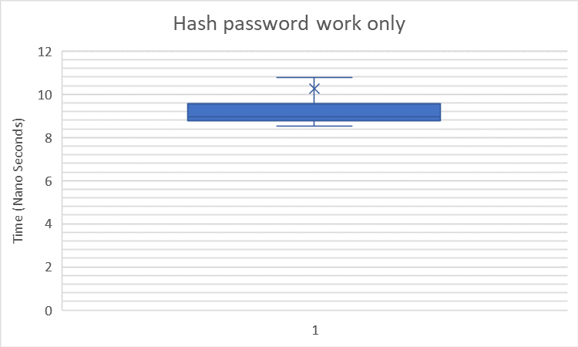
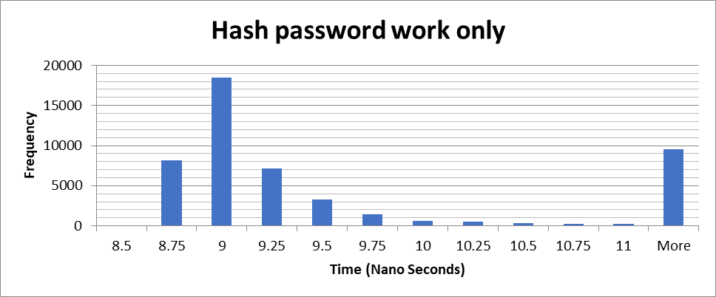
Hash password
50,000 timings of 50,000 executions of password hashing only (no channel read/writing) Theoretical time per execution
Median Time: 8.94 Nanoseconds

Slide 25
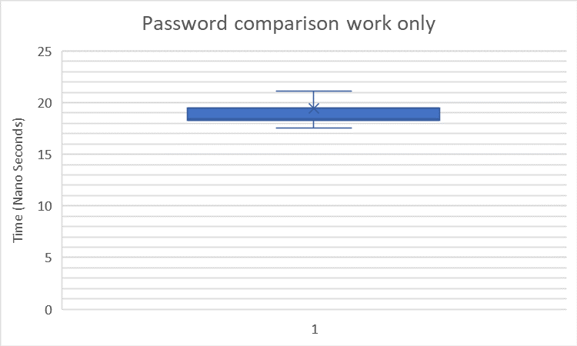
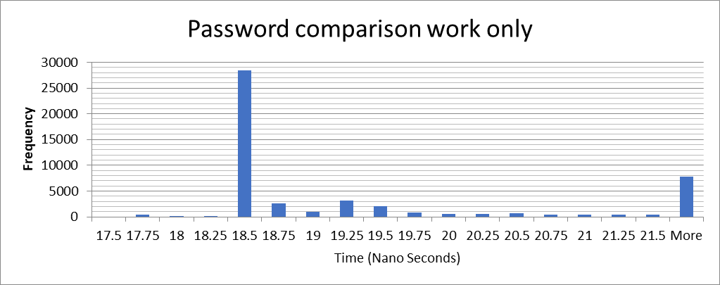
Hash comparison
50,000 timings of 50,000 executions of hash comparison work only (no channel reading) Theoretical time per execution
Median Time: 18.44 Nanoseconds

Slide 26
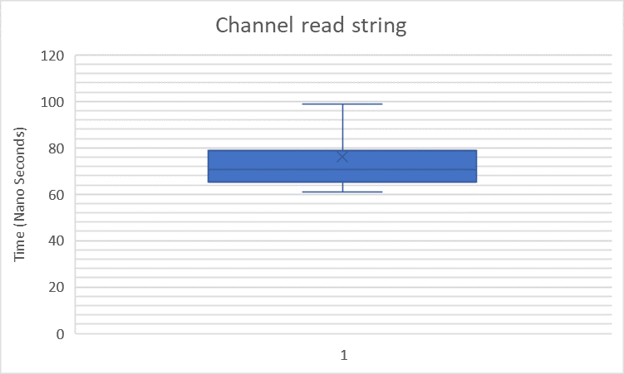
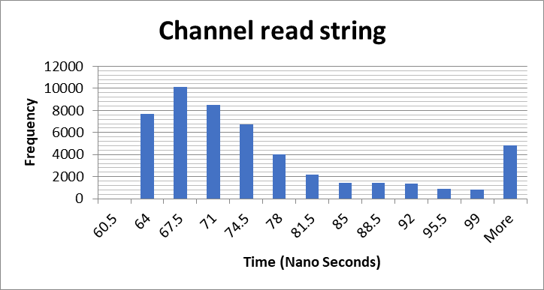
Channel reading string
50,000 timings of 50,000 executions of reading a string from a channel
Theoretical time per execution
Median Time: 70.56 Nanoseconds

Slide 27
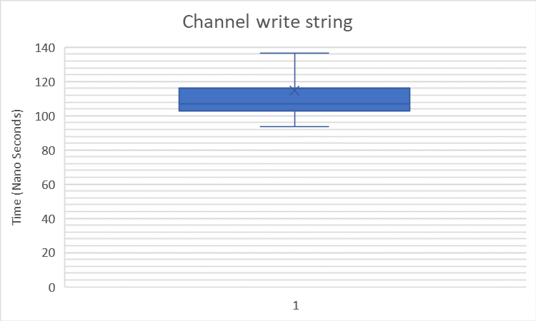
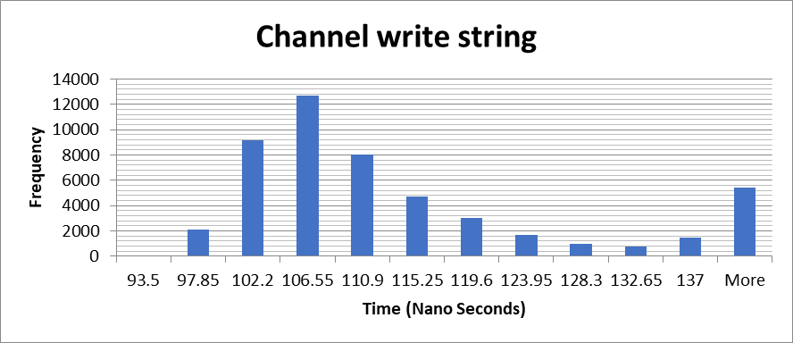
Channel writing string
50,000 timings of 50,000 executions of writing a string to a channel
Theoretical time per execution
Median Time: 106.98 Nanoseconds

Slide 28
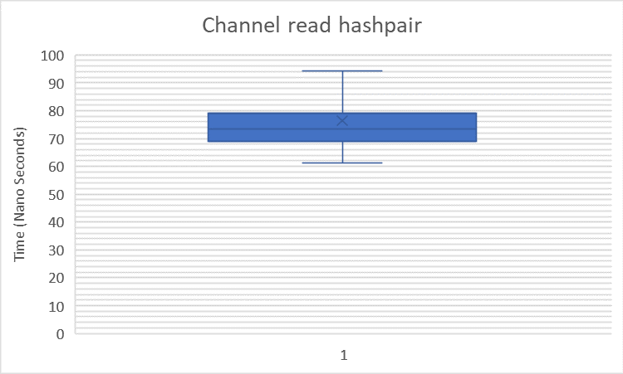
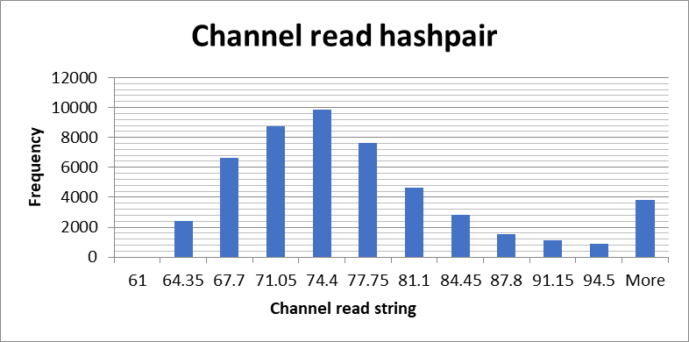
Channel reading hashpair
50,000 timings of 50,000 executions of reading a string and hash from a channel
Theoretical time per execution
Median Time: 73.56 Nanoseconds

Slide 29
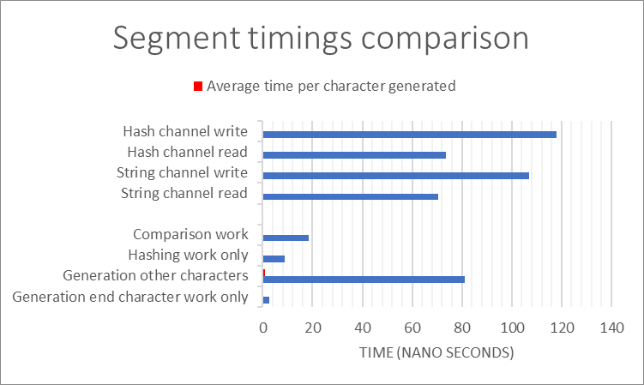
Comparison
Generation: Single character, string channel writing, 1/95th of root password updating
Hashing: Hash, string channel reading, hashpair channel writing
Comparison: Hash comparison, haspair channel reading

Slide 30
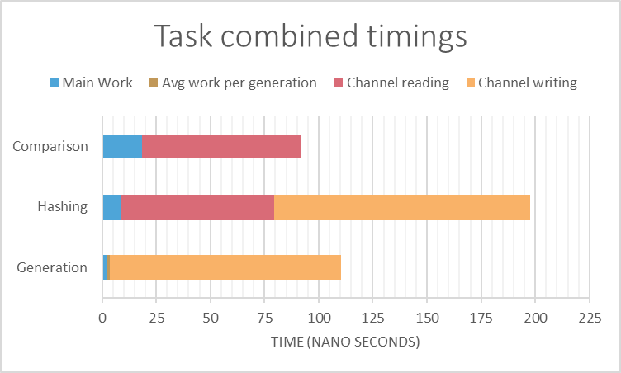
Total comparison
Generation: 110.5ns
Hashing: 197.5ns
Comparison: 92ns
Hashing approximately twice as slow as generation and comparison.
Therefore two threads for ever comparison and generation thread.

Slide 31
Control
Task | Time per guess per thread (Ns) | Threads | Time per guess all threads (Ns)
Password root increment | 0.8558 | 1 | 0.8558
Password last character increment | 220.056 | 1 | 220.056
Hashing | 395 | 1 | 395
Comparison | 184 | 1 | 184
Total (Theoretical) | 799.912 | 4 | 799.912

Slide 32
Optimisation
Task | Time per guess per thread (Ns) | Threads | Time per guess all threads (Ns)
Password root increment | 0.8558 | 1 | 0.8558
Password last character increment | 220.056 | 1 | 220.056
Hashing | 395 | 2 | 395
Comparison | 184 | 1 | 197.5
Total (Theoretical) | 799.912 | 5 | 602.412

Slide 33
Prediction
Control theoretical time per guess | Optimised theoretical time per guess
799.912 | 602.412
$(1 – \frac{602.412}{799.912} )=\text{24}\text{.}\text{69}\text{\%}$ Theoretical time improvement
$$Time to crack = ([Theoretical time per guess]∗({[number of characters in characterset]}^{[number of characters in password]}))/2$$
Number of letters in password | Control time predictions | Optimised time predictions
1 | 38.0μs | 28.6μs
2 | 3.61ms | 2.72ms
3 | 0.343s | 0.258s
4 | 32.6s | 24.5s
5 | 51.6min | 38.8min

Slide 34
Results
Number of letters in password | Control time actual | Optimised time actual
1 | 0.006827s | 0.006827
2 | 0.009858s | 0.009858
3 | 0.011002s | 0.011002
4 | 0.011778s | 0.011778
5

Slide 36
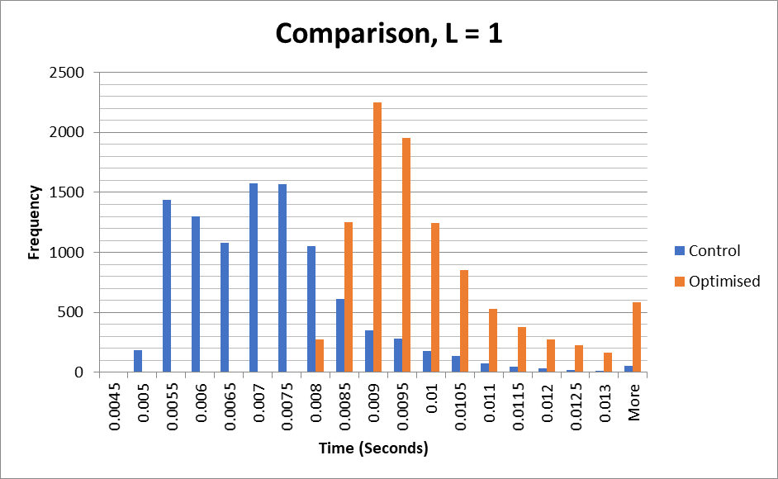
Results, number of letters = 1

Slide 37
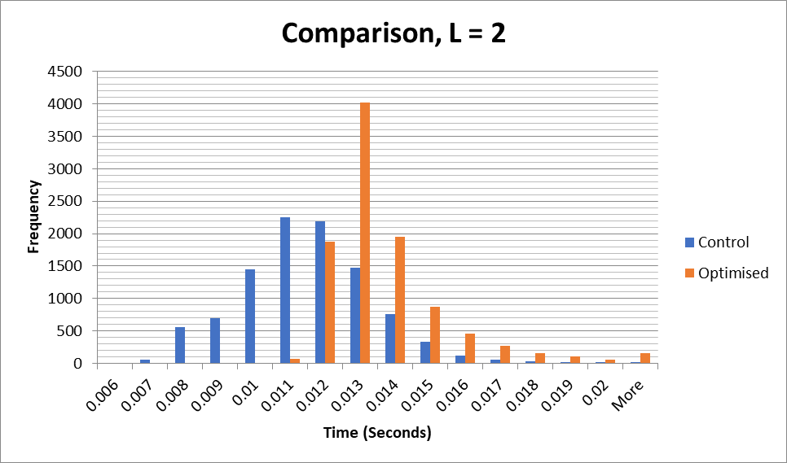
Results, number of letters = 2

Slide 38
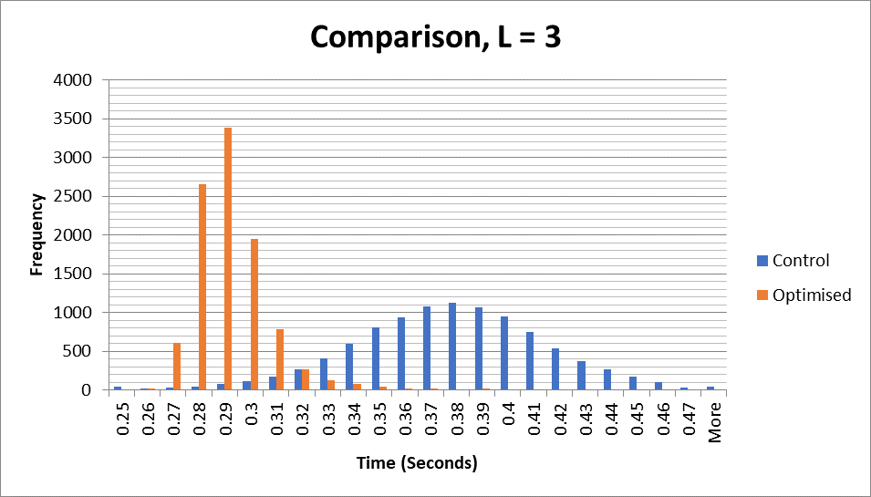
Results, number of letters = 3

Slide 39
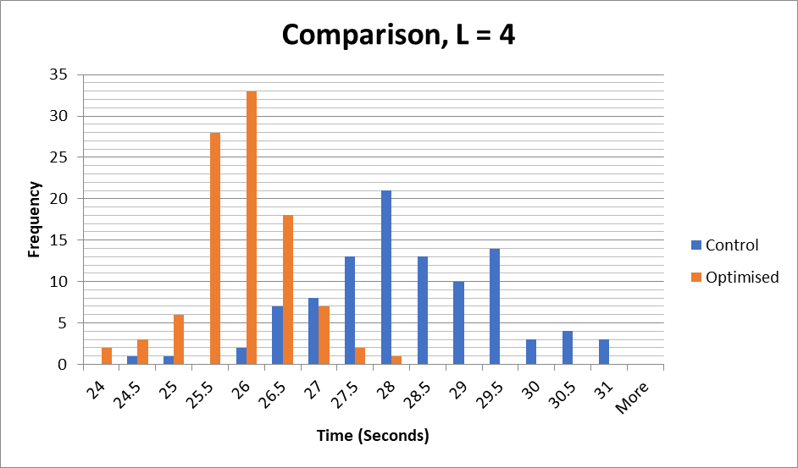
Results, number of letters = 4

Slide 40
Difference from prediction
Time pre crack | Predicted (seconds) | Actual (seconds) | Percentage error
Control: L =1 | 3.79958E-05 | 0.006827 | 17867.78%
L = 2 | 0.003609601 | 0.011002 | 204.80%
L = 3 | 0.342912095 | 0.373407 | 8.89%
L = 4 | 32.57664903 | 27.983454 | -14.10%
L = 5 | 3094.781657 | 3226.771973 | 4.26%
Optimised: L = 1 | 2.86146E-05 | 0.009286 | 32352.02%
L = 2 | 0.002718382 | 0.012724 | 368.07%
L = 3 | 0.258246314 | 0.284701 | 10.24%
L = 4 | 24.53339981 | 25.69767 | 4.75%
L = 5

Slide 41
Results
For low numbers of characters

