Slide 1

AI INTERNSHIP APPLICATION PROJECT
Finance Credit Follow-Up Email Agent
Agentic System for Accounts Receivable Automation Platform
Shardul Dhekane

Slide 2
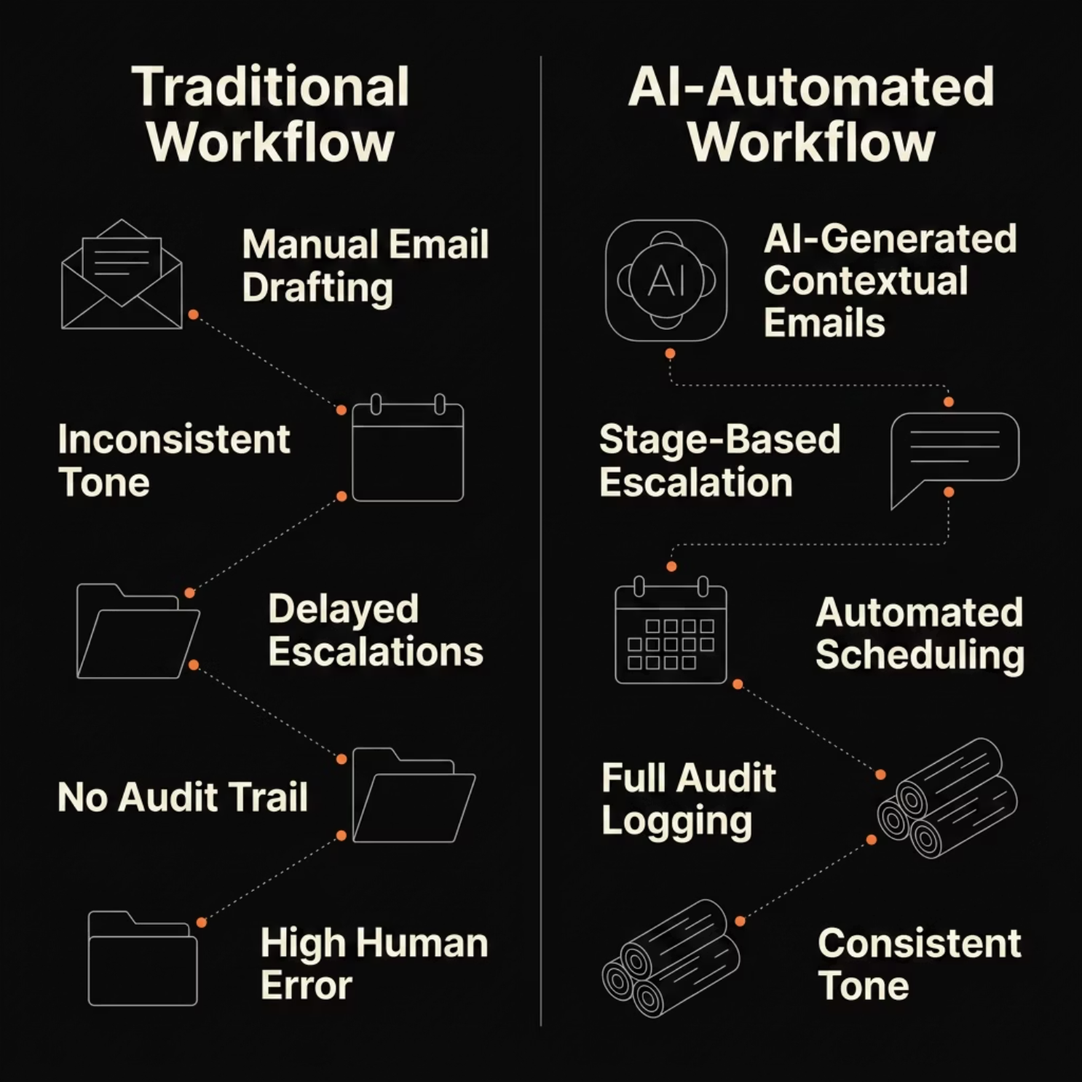
The Collections Problem
Traditional finance teams rely on manual, error prone processes for payment follow-ups: Causing delays, inconsistent messaging, and zero audit visibility.
Manual Follow-Ups
Inconsistent Tone
Hours spent drafting repetitive payment reminders
It can sound rude or a company might sound like “Vasooli”
Zero Audit Trail
Human Error
No persistence or tracking of communication history
Misaddressed emails, missed deadlines, duplicate sends

Slide 3





Proposed Solution
NVIDIA LLM + Delivery
Contextual email gen; SMTP delivery, scheduling, logging
AI Agent Layer
Prompt orchestration and JSON parsing
Streamlit UI
User input, invoice selection, approval gates
AI Email Generation
Scheduling Automation
Contextual, stage-aware messaging
Timed follow-ups with persistence
Human Approval
Dashboard Analytics
Review before live send
Real-time tracking & audit logs

Slide 4






Technology Stack
A modern, production-grade stack built for observability, reliability, and structured AI output.
Python
Streamlit
Core orchestration, prompt engineering, regex JSON extraction fallback
Interactive UI with invoice tables, scheduling controls, and analytics
SQLite
NVIDIA Llama 3.3 70B
Persistent audit logging, scheduling state, and invoice records
Structured JSON output via API with prompt-engineered finance tone
SMTP / Gmail
LangSmith + Pandas + Altair
Real email delivery with retry logic and dry-run sandbox mode
Full observability tracing, data manipulation, and interactive charts

Slide 5




AI Workflow & Prompt Engineering
Stage-Based Escalation
Prompt Engineering Highlights
The agent adapts tone and urgency across five escalation stages, ensuring professional, human-like communication that escalates appropriately when payments remain unresolved.
Structured JSON outputs — LLM returns parseable, validated email objects
Regex fallback extraction — Handles malformed LLM responses gracefully
Iterative prompt tuning — Refined through LangSmith trace analysis
Tone adaptation — Stage-aware language calibrated for finance context
Parsing reliability — Multi-layer validation ensures output consistency
Stage 1 — Friendly
Warm reminder, assumes good faith
Every prompt iteration is traced in LangSmith for full reproducibility and debugging.
Stage 2 — Firm
Clear deadline, professional tone
Stage 3 — Serious
Urgent language, escalation notice
Stage 4 — Human / Legal Review
Handoff to collections team

Slide 6




Dashboard & Platform Features
A unified Streamlit interface giving finance teams full visibility and control over every collection action.
Invoice Management
Filterable invoice table with client selection and selective send
Scheduling & Retry
Persistent scheduling with automatic retry logic for failed sends
Human Approval Mode
Dry-run sandbox lets reviewers approve before live delivery
Audit Trail Logs
Full persistence of every email, timestamp, and escalation decision

Slide 7
Results & Demo Highlights
The platform was validated end-to-end with real SMTP delivery, live database updates, and full LangSmith observability tracing.
100%
5
Email Delivery
Escalation Stages
Real SMTP sends with retry logic confirmed
Automated stage transitions with human review gate
0
24/7
Manual Drafting
Scheduling
Fully AI-generated, context-aware email content
Persistent follow-up scheduling with no manual intervention
LangSmith Tracing
Interactive Analytics
Audit Persistence
Full prompt and output observability
Altair charts with live invoice data
SQLite-backed immutable action logs

Slide 8
Future Scope & Conclusion
Roadmap
Shardul Dhekane · Bennett University
Portfolio: https://probablyspirit.dev
E-Mail: shardulmd@gmail.com
Resume | Github | Kaggle |
Thank You
01
Multi-Agent Workflows
Specialized agents for risk scoring, negotiation, and legal handoff
02
ERP / CRM Integration
Native connectors for SAP, Oracle, and HubSpot
03
WhatsApp & SMS Reminders
Multi-channel outreach beyond email
04
ML Payment Risk Scoring
Predictive models to prioritize collections
05
Docker + Cloud Deployment
Containerized, scalable production release

