Slide 1
The Ways People Learn and Fail to Learn

Slide 2
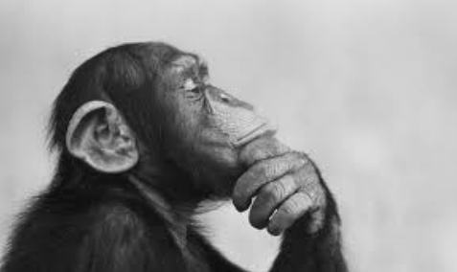
Questions:
Why couldn’t the coyote memorize the “song” although he tried so hard?
Why did the coyote misunderstand the true meaning of the “song”?

Slide 3

Don’t learn by simple repetitions
The Coyote tried to learn the “song” by singing it over and over again, but always forgot it at last due to some “accidents”.
Thinking about our own experience as examples:
E.g. memorizing words in contents; understanding the meaning of a poem before reciting it.

Slide 4
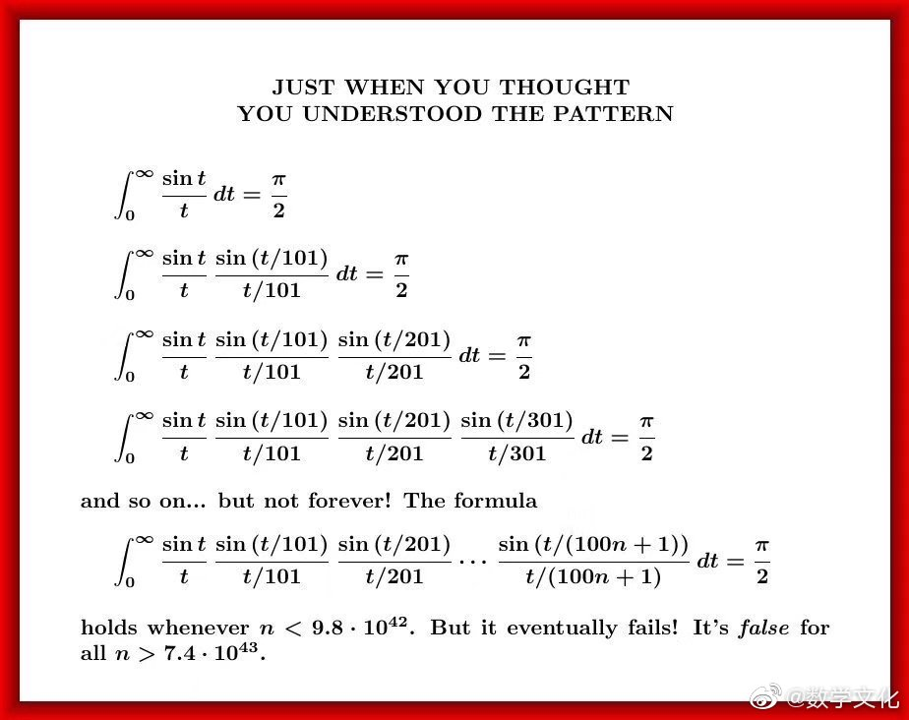
Try to get it right at one shoot
The coyote couldn’t remember the “song” partially because he got a wrong idea about it.
When learning, remember some wrong/biased information is terrible, for you need to pay double effort to get it correct afterward.
Starting memorizing only you make sure you understand it correctly.

Slide 5

Learn by active involvement
The coyote finally got the meaning of his so-called “song” by getting himself hurt.
If you have some previous experience on something, then it will be much easier to learn the related knowledge systematically.
If you don’t, then you should actively get involved. E.g., when learning physics, doing some experiments to verify the laws is extremely helpful.

