Slide 1


Project Title: Femme Secure
Subject: CE363 Project-III
Internal Guide: Dr. Premal Patel
Prepared by: 22DCE006-Probin Bhagchandani
22DCE017-Shivaansh Dave
22DCE040-Japan Kachhiya
D23DCE150-Vraj Shah

Slide 2

Introduction
Project Review:
Femme Secure is a disaster management app aimed at improving safety, communication, and preparedness during natural disasters.
Idea for the Project:
The idea came from the need to offer reliable tools for people in emergencies, particularly in areas with limited connectivity and resources.
Development Approach:
The app was developed with a user-centric approach, focusing on ease of use, accessibility, and reliability to meet the needs of individuals during disasters.

Slide 3
Problem Statement
The frequency and intensity of natural disasters are increasing, leading to significant risks for individuals and communities.
Lack of immediate access to critical information and support can result in confusion and delayed responses during emergencies.
Insufficient preparedness and knowledge about safety protocols contribute to tragic outcomes.
Key Challenges:
Difficulty obtaining real-time information during emergencies.
Limited communication channels leading to disorganized responses.
Inadequate access to resources and assistance for affected individuals.

Slide 4
Objectives
1)Enhance User Preparedness - Equip users with essential tools and information to improve disaster readiness through real-time alerts and educational resources.
2)Facilitate Real-Time Communication - Enable efficient communication during emergencies, ensuring users receive timely updates and can respond effectively.
3)Provide Accurate and Accessible Information - Deliver real-time weather updates, disaster alerts, and location tracking to empower users with critical information for informed decision-making.
4)Ensure User Safety and Support - Implement features that allow users to send SOS alerts and access emergency contacts quickly, enhancing personal safety during disasters.

Slide 5
Functional Requirements
1)Safety Tips and Checklist
The app provides comprehensive safety tips and a structured checklist, ensuring users are well-prepared with precautions and critical items during emergencies.
2)Real Time Map
The app provides an interactive map displaying nearby shelters, safe zones, and disaster-affected areas, with GPS tracking for the user's current location.
3)SOS and Emergency Feature
An SOS button must be available for users to send a distress signal and their location to pre-configured emergency contacts, along with an option for direct dialing emergency services.
4)Weather Updates
The app should provide real-time weather updates and AI-driven, allowing users to configure alert preferences for specific weather conditions or disasters.

Slide 6
Non-Functional Requirements
1)Usability
The app has an intuitive and user-friendly interface, ensuring easy navigation and accessibility for all users, especially during stressful situations.
2) Reliability
The app must function reliably and stably, with critical features like emergency contacts accessible 99.99% of the time.
3) Security
User data must be kept secure, with measures in place to protect sensitive information and ensure user privacy.
4) Performance
The app must load within shorter seconds under normal network conditions, with real-time updates and weather data refreshing efficiently to ensure a smooth user experience.

Slide 7
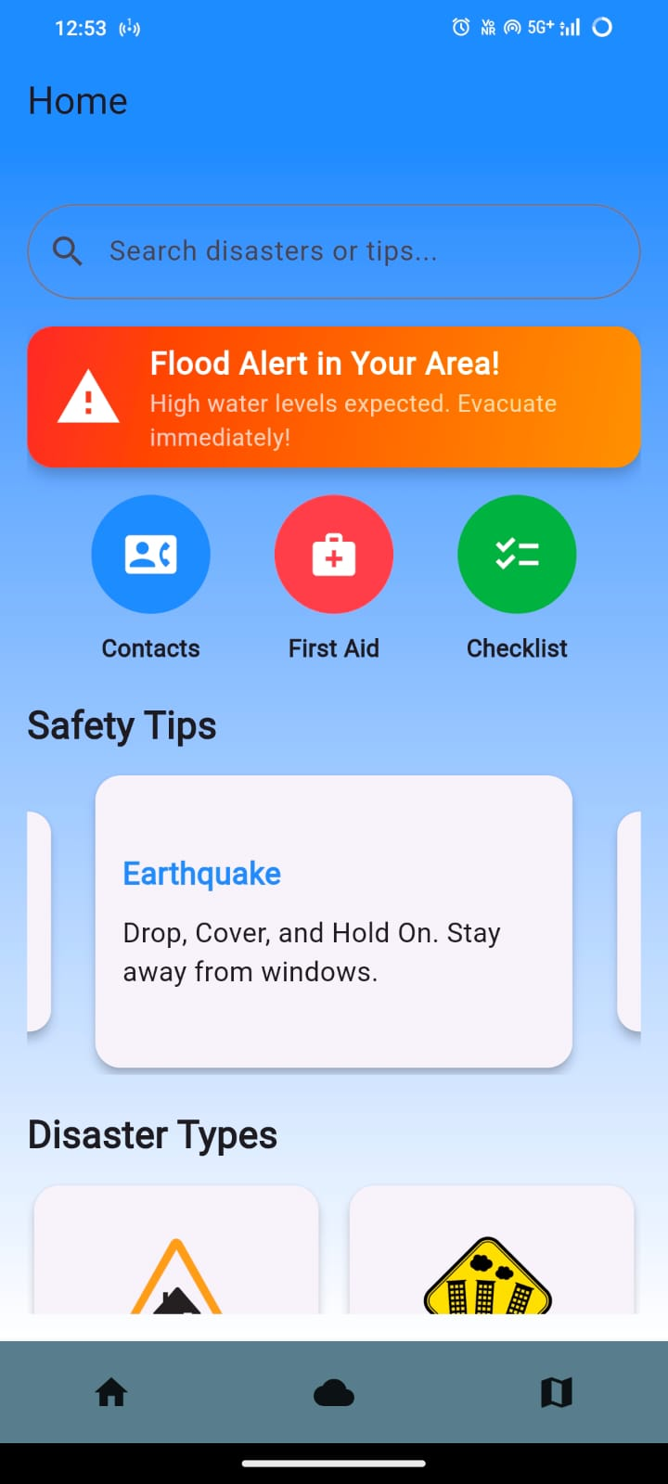
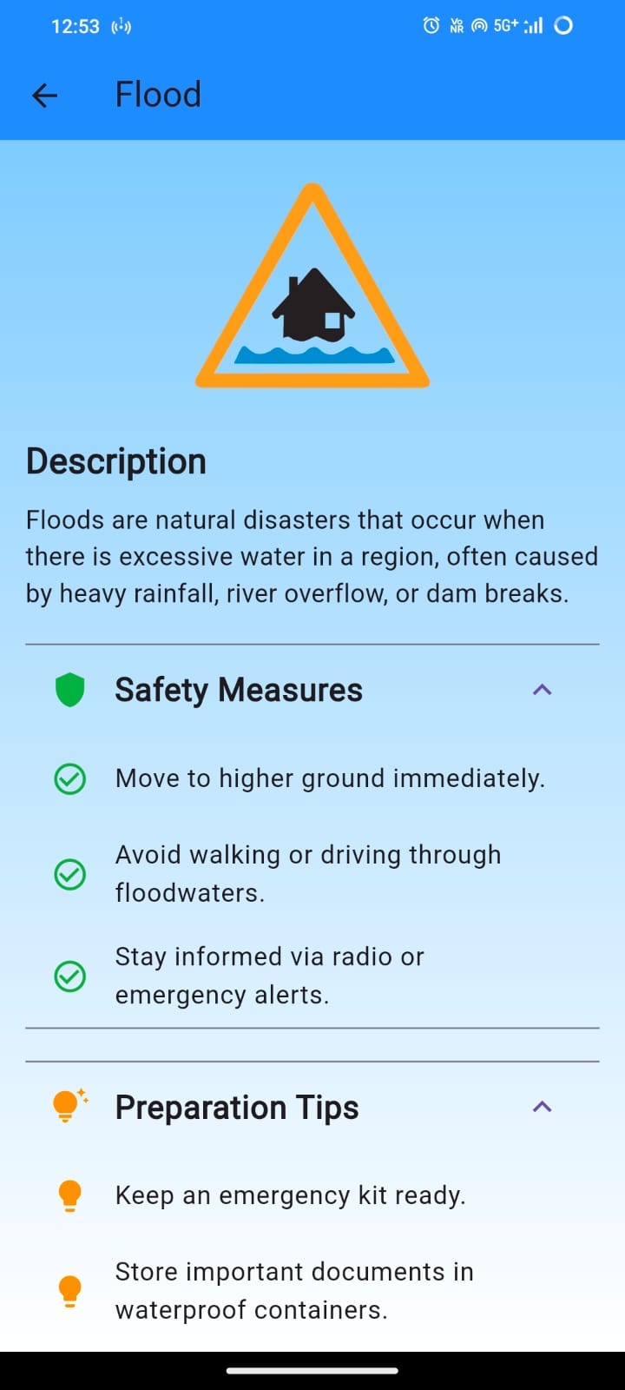
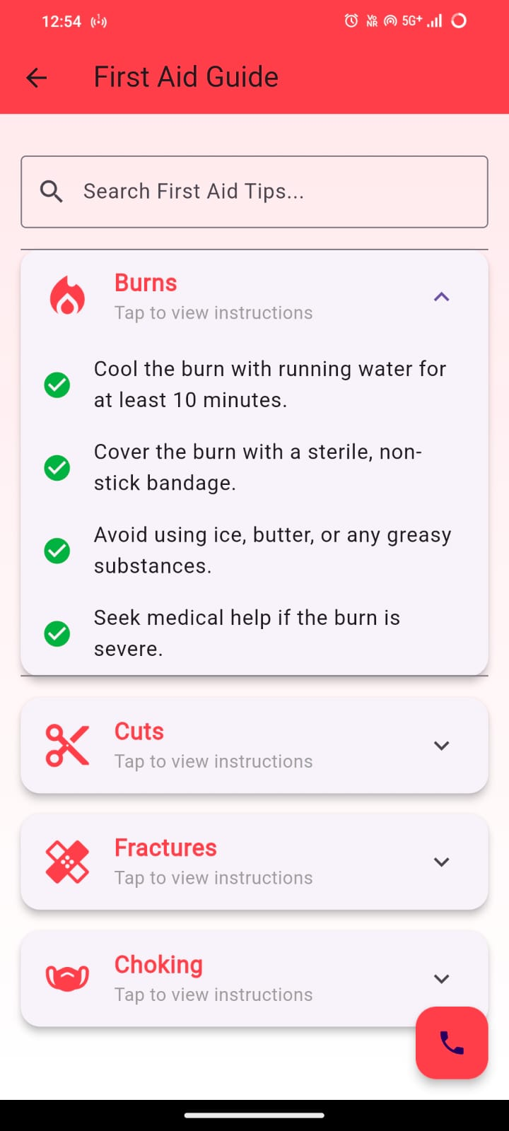
Project Results:

Slide 8
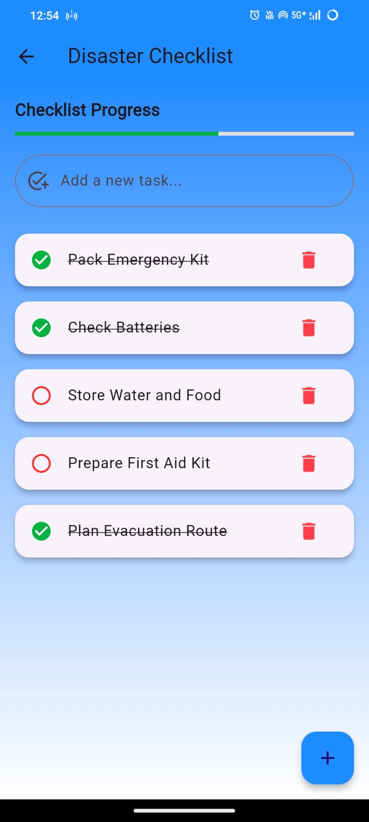
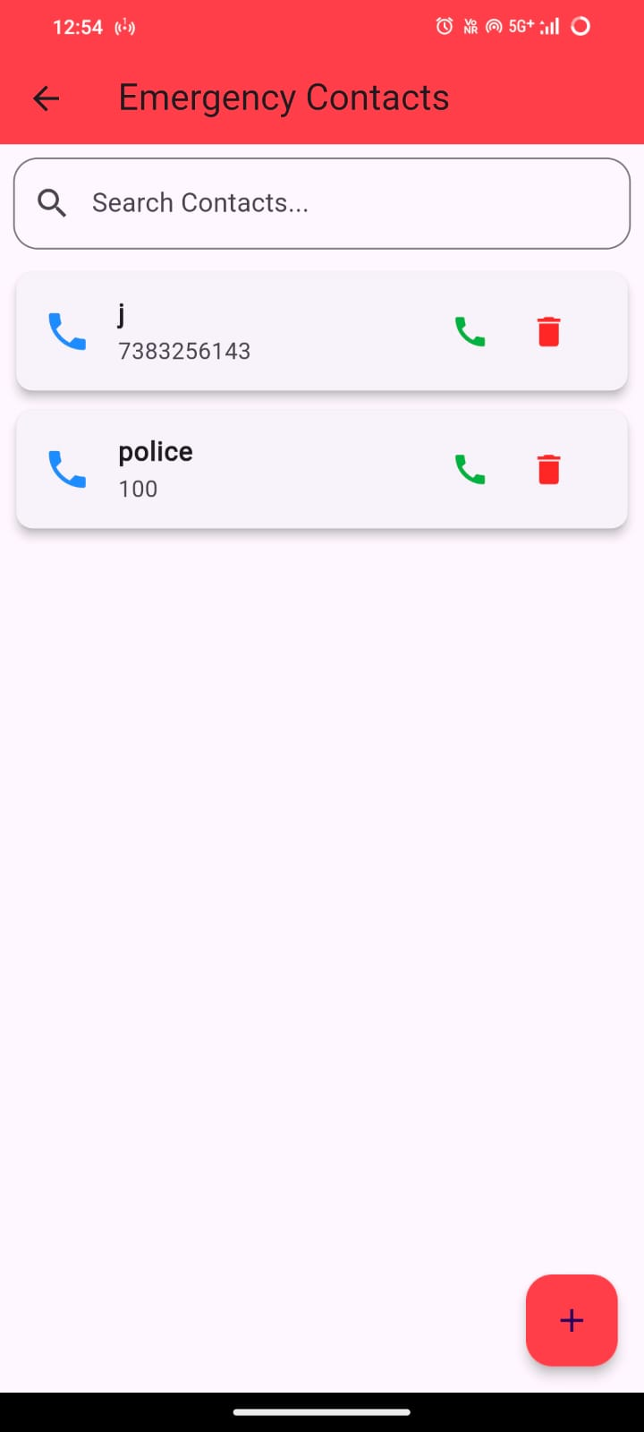
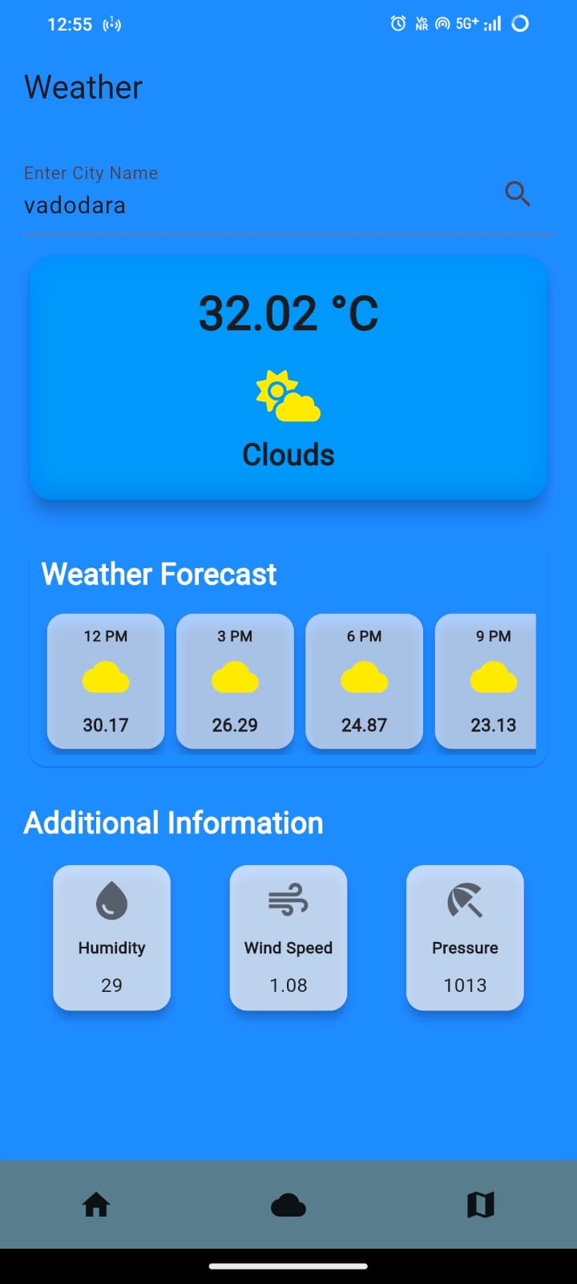
Project Results:

Slide 9
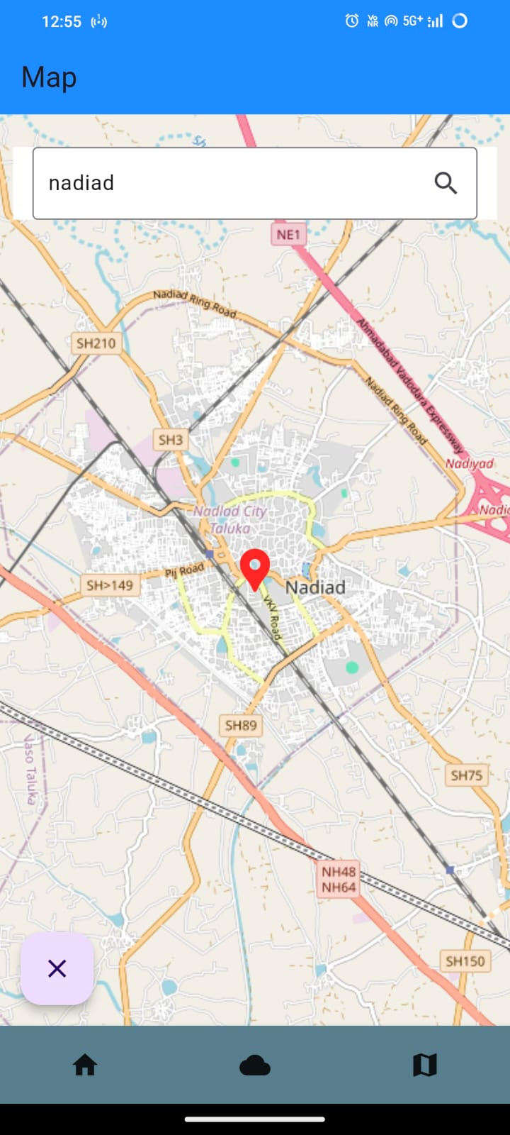
Project Results:

Slide 10
Future Enhancements
1)Multilingual Support – Broaden app accessibility by adding multiple languages, enabling more users to understand and use the app effectively.
2)Advanced AI Weather Predictions – Improve weather forecasting accuracy with enhanced machine learning models and additional data sources, such as local weather stations.
3)Integration with Local Alert Systems – Partner with government and local agencies to deliver real-time, location-based hazard alerts directly to users.
4)Wearable Device Compatibility – Enable use on smartwatches, offering SOS alerts and quick-access emergency features for faster responses.

Slide 11
Conclusion
Key Takeaways
The project provided valuable experience in developing a real-world application, emphasizing the importance of understanding user needs and solving complex problems effectively.
Outcomes
Through this project, we enhanced our app development and project management skills, while also recognizing the critical role of user-centered design and collaboration in creating successful solutions.
Learnings and Growth
Developing Femme Secure strengthened our technical and problem-solving skills, while also deepening our understanding of user-centric design and disaster management technology.

Slide 12
References:
https://www.youtube.com/watch?v=VPvVD8t02U8
https://www.youtube.com/playlist?list=PLr7P7lMIUTuukkflWTYrPgTwueG-BoUHN
https://www.youtube.com/playlist?list=PL9n0l8rSshSmNoWh4KQ28nJn8npfMtzcs
https://youtu.be/GFhKfMY0L2E?si=1xpHI8lc4l65h5T-
https://developers.google.com/maps/documentation/javascript/get-api-key

Slide 13


