Slide 1
EC 291: Exploratory Project – 2024 Electronic Components Recognition from Images using Computer Vision
Group members
Probuddho Basak (22095081)
Rohan Sharma 222095148)
Yash Sachan (22095127)
Supervisor
Dr. Shivam Verma
Department of Electronics Engineering, IIT (BHU) Varanasi, Varanasi -221005

Slide 2
The Problem Statement
The problem statement is centred around automating the identification and classification of electronic components from visual data, including images. The project aims to solve these issues by developing a computer vision system that can:
Recognize and classify a wide range of electronic components in real-time with high accuracy.
Operate effectively under different environmental conditions, such as variable lighting and backgrounds.
Handle the miniaturization trend in electronics, where components are becoming increasingly smaller and harder to distinguish.
Integrate seamlessly with existing manufacturing and inventory systems to provide a streamlined workflow.

Slide 3
Introduction
WHY THIS PROJECT?
Manual identification and sorting of components are time-consuming and prone to human error, leading to increased production costs and potential device malfunctions.
In the electronics industry, the accurate identification of components is critical for assembly, quality control, and inventory management. Additionally, the human eye is limited in its ability to consistently recognize and classify small or visually similar components, especially under varying lighting conditions and orientations.
The project “Electronic Components Recognition from Images using Computer Vision” provides automation in components identification and error detection in circuits. The project aims to reduce the reliance on manual labour, minimize errors, and speed up the production cycle.
This project involves three main features:
1. General Component Recognition
2. PCB Components Recognition
3. Fault Detection
ABOUT THE PROJECT

Slide 4
Applications
Expansion into Robotics: Robotics systems can benefit from improved computer vision capabilities, allowing for more precise and autonomous handling of electronic components during manufacturing and assembly processes.
Enhanced Quality Control: Defect or inconsistency detection can be further improved, improving the quality control measures in electronics manufacturing.
Educational Tools: The technology can be adapted into educational platforms, providing interactive learning experiences for students and enthusiasts in electronics by visually identifying and explaining components.
Portable and Mobile Applications: With the miniaturization of technology, computer vision systems could be implemented in portable devices, making component recognition accessible in fieldwork and small-scale operations.
Automated Inventory Management: The system can be integrated with inventory management software to keep track of components in warehouses, reducing manual inventory checks and errors.

Slide 5
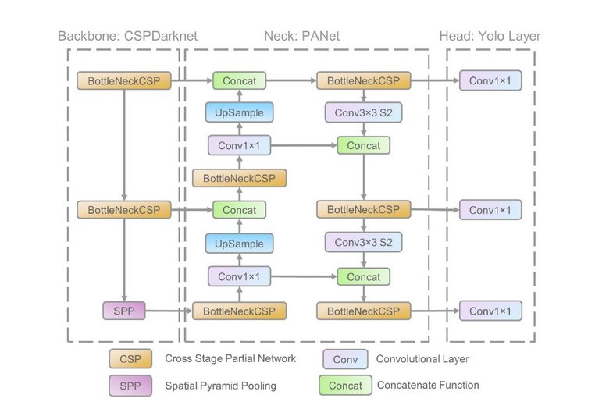
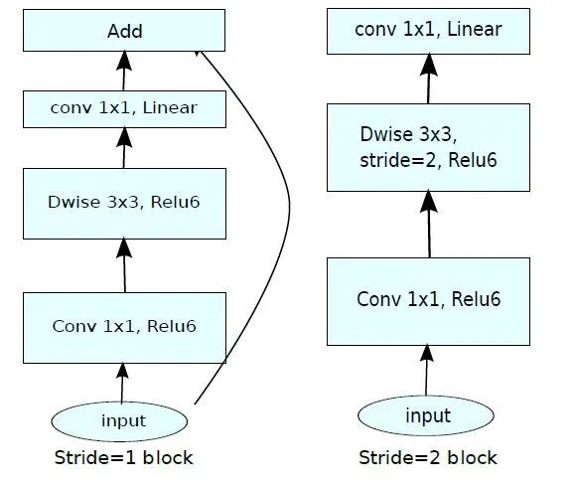
Models Used
For this project implementation, we have fine-tuned pre-trained models namely:
MobileNetv2(for general component recognition): MobileNetv2 is a convolutional neural network that is 53 layers deep. MobileNetv2 can be easily implemented using machine learning frameworks like TensorFlow and PyTorch. It also supports any input size greater than 32x32 pixels, with larger image sizes offering better performance.
YOLOv5: It is a DNN model used in image recognition. It consists of three parts: (1) Backbone: CSPDarknet, (2) Neck: PANet, and (3) Head: Yolo Layer. The data are first input to CSPDarknet for feature extraction, and then fed to PANet for feature fusion.

Slide 6
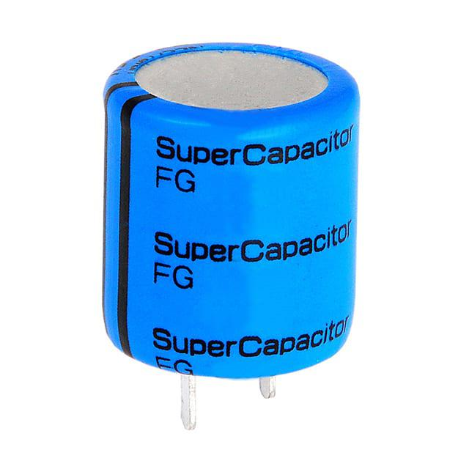
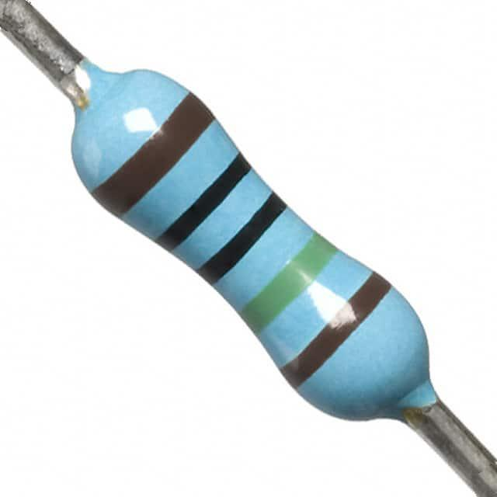
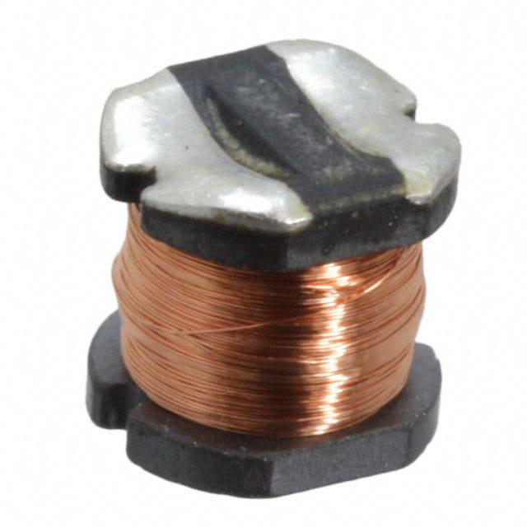
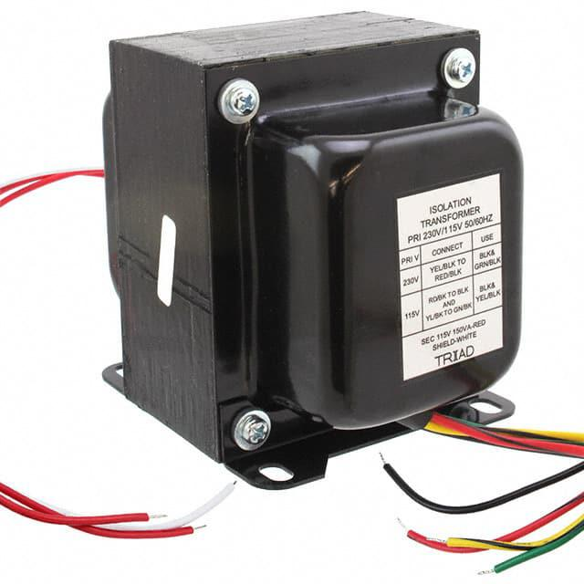
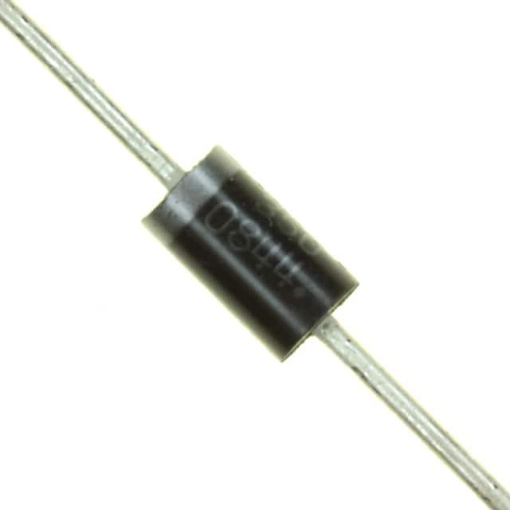
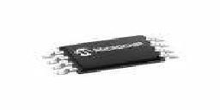
Dataset for General Component Analysis
The dataset contains 4038 photos of electronic components in 6 different categories: Capacitor, Diode, Resistor, Transformer, Inductor, and IC. Two resources were used to create the dataset. The Digi-Key website, which is the biggest seller of electronic components in the world, was crawled in order to extract photos of the mentioned categories. Also, a public dataset of electronic components hosted in Kaggle was used.
The dataset is maintained in a proper folder structure with images segregated into their component folder. It consists of images of various components type and from various orientation and background condition.
The Distribution of the images is as follows:
Capacitor: 535 images, Resistor: 470 images, Inductor: 265 images, Transformer: 747 images, IC: 1503 images, and Diode: 518 images

Slide 7
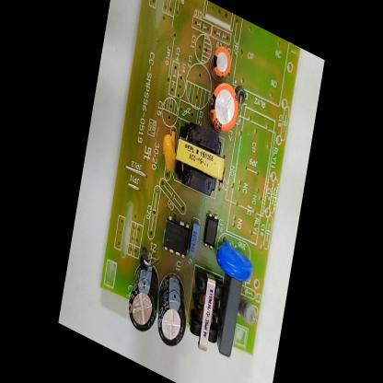
Dataset for PCB Components Analysis
This dataset consists of various PCB circuit design images taken on a white sheet background with components like MOSFETs, Resistors, Capacitors, Diodes, and Transformers.
It is maintained in a proper folder structure consisting of 1113 training set images, 200 validation images and 110 test images.
PCB circuit Train Image for training fed into the model as a 640x640 image.

Slide 8
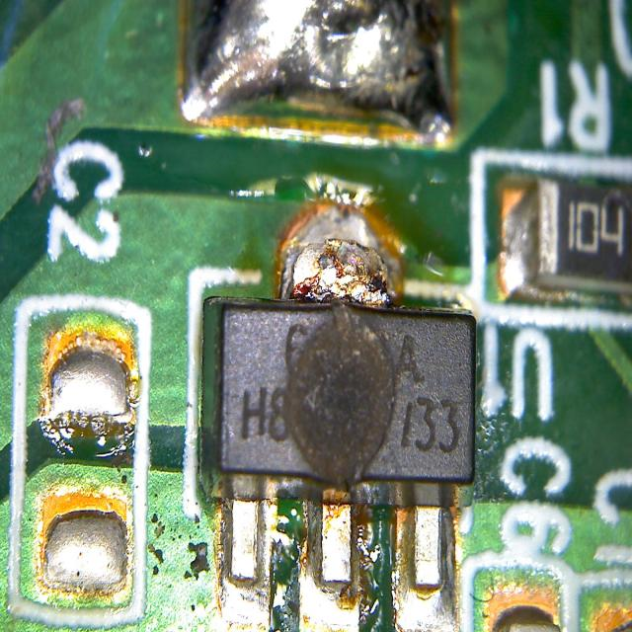
Dataset for Electronic Component Fault Detection Analysis
This dataset consists of various PCB circuit faults images collected from google and Roboflow datasets.
It is maintained in a proper folder structure consisting of 381 training images, and 54 validation images.
Faulty PCB Circuit Train Image
Image Label:
0 0.540625 0.63359375 0.27734375 0.54453125
where 0 is the class category(0 for fault detected and 1 for no fault detected)remaining four coordinates are for fault boundary box.

Slide 9
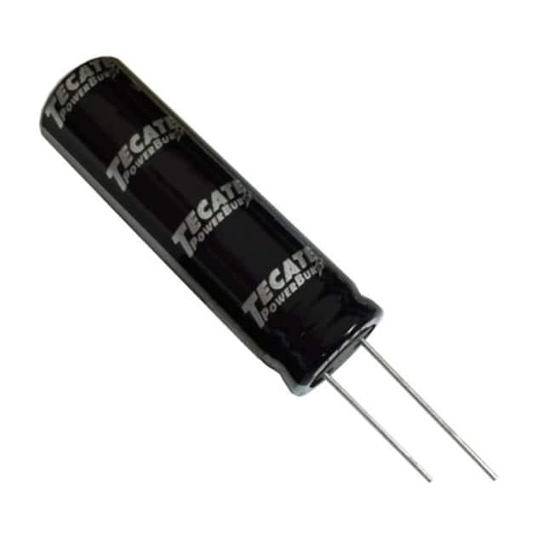
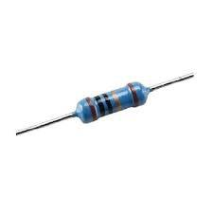
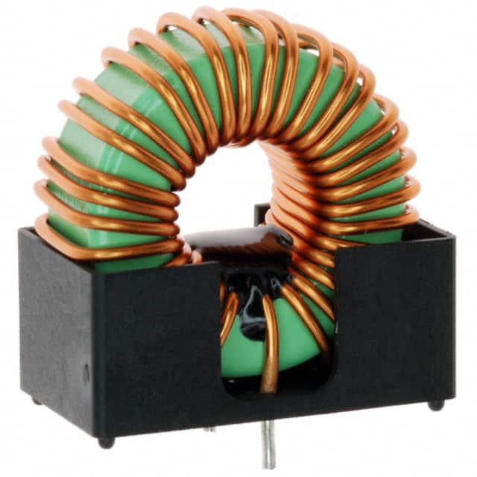



Results and Metrics for General Components Recognition
The model demonstrated a commendable accuracy of 77.8% in recognizing general electronic components within the dataset.

Slide 10
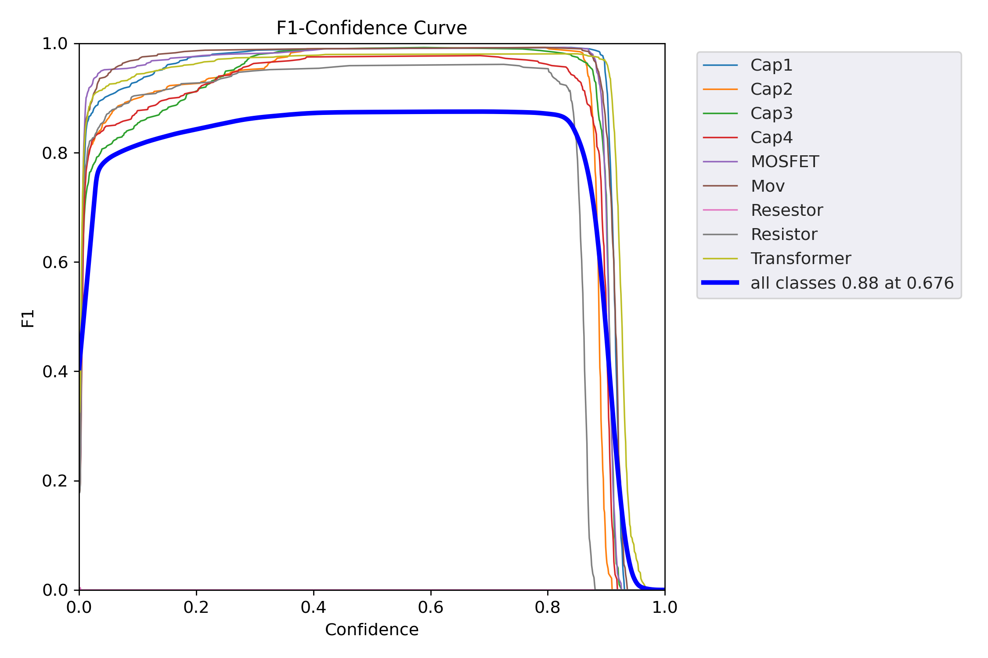
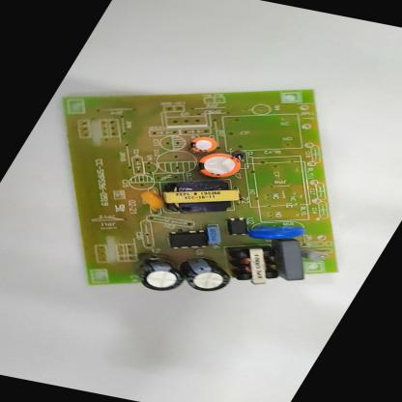
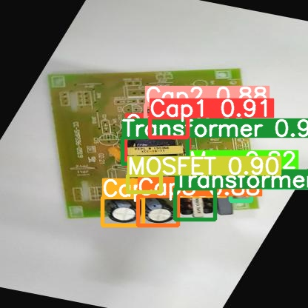
Results and Metrics for PCB Components Analysis
The model demonstrated a commendable precision of 59% in recognizing electronic components on PCB within the dataset.

Slide 11
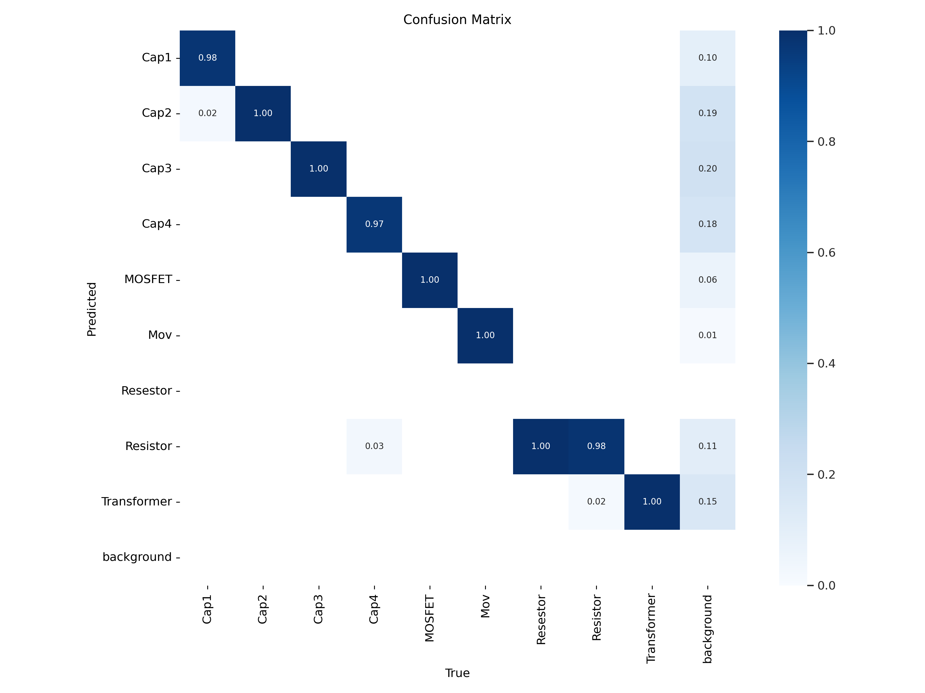
Results and Metrics for PCB Components Analysis
PCB Components Analysis

Slide 12
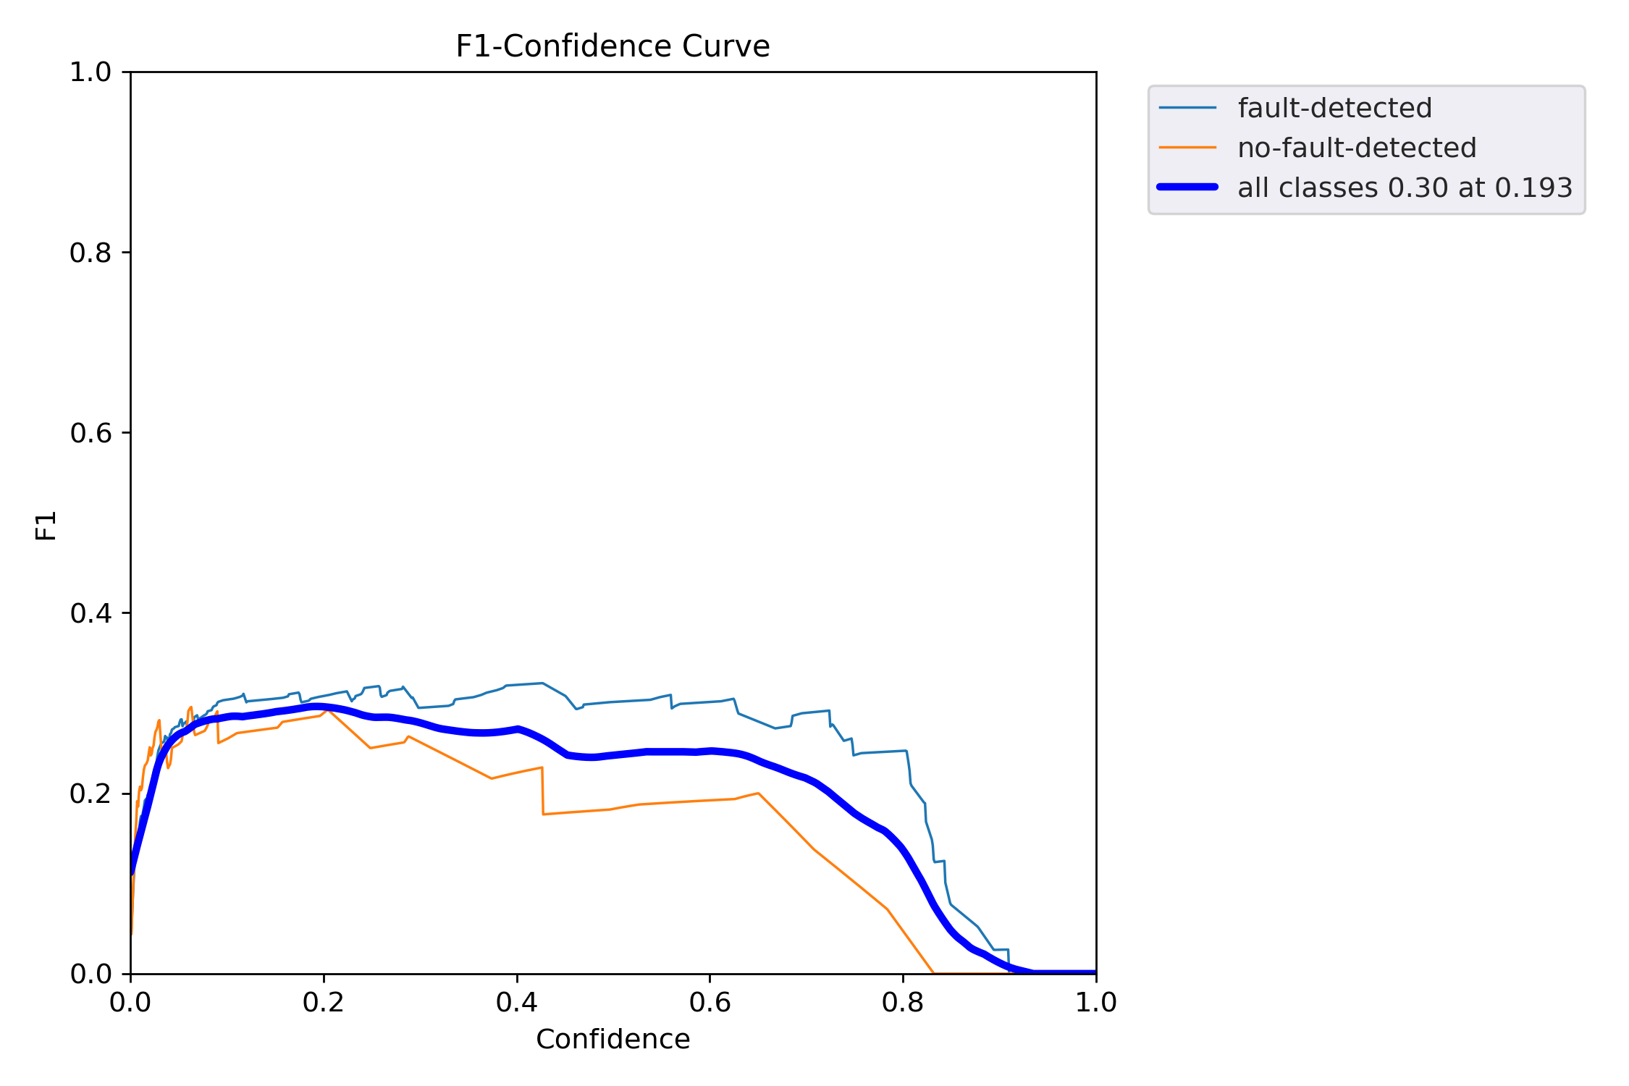
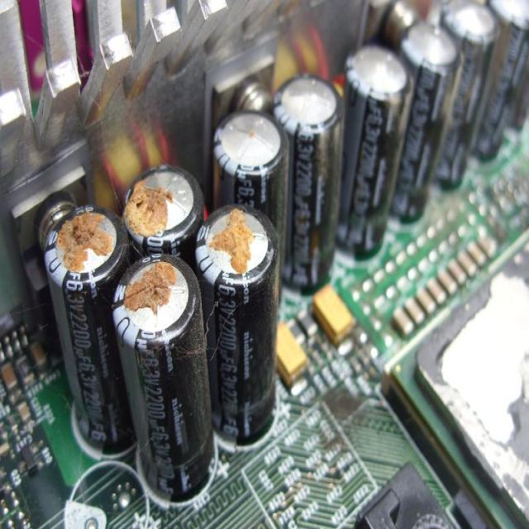
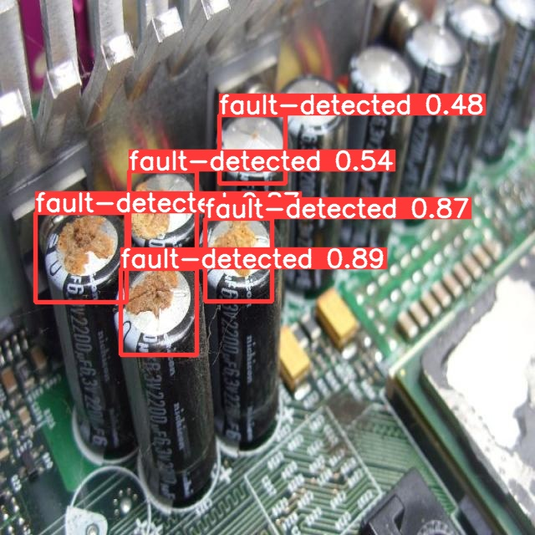
Results and Metrics for Electronic Component Fault Analysis
The Fault Detection model demonstrated with a great accuracy in identifying faults in electronic
components ensuring reliable performance in fault detection tasks.

Slide 13
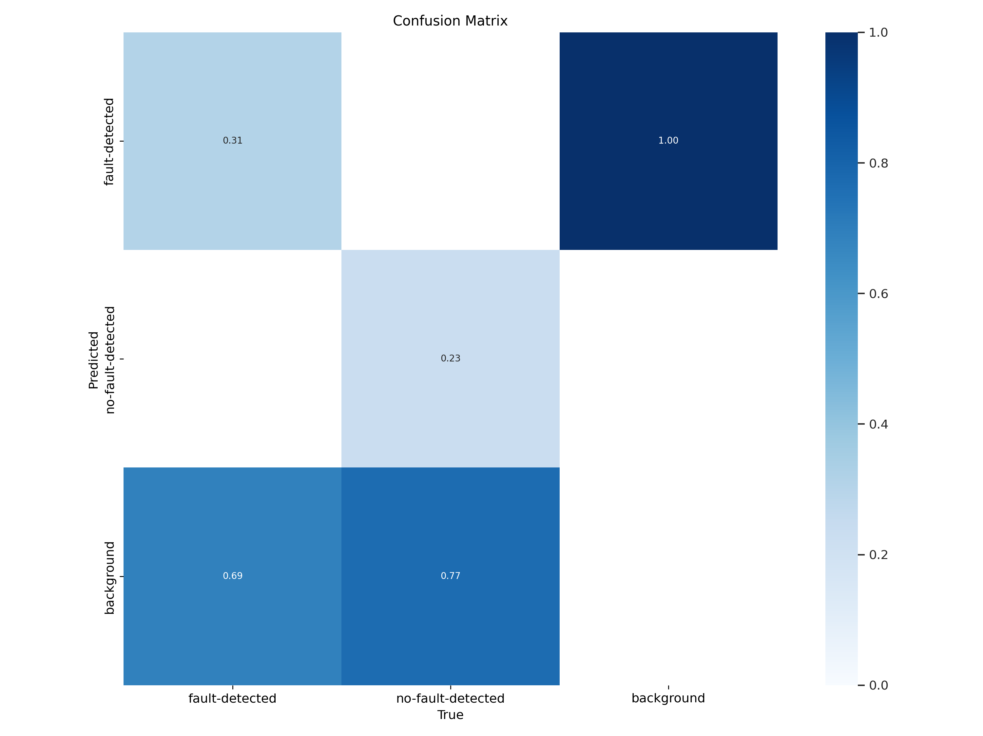
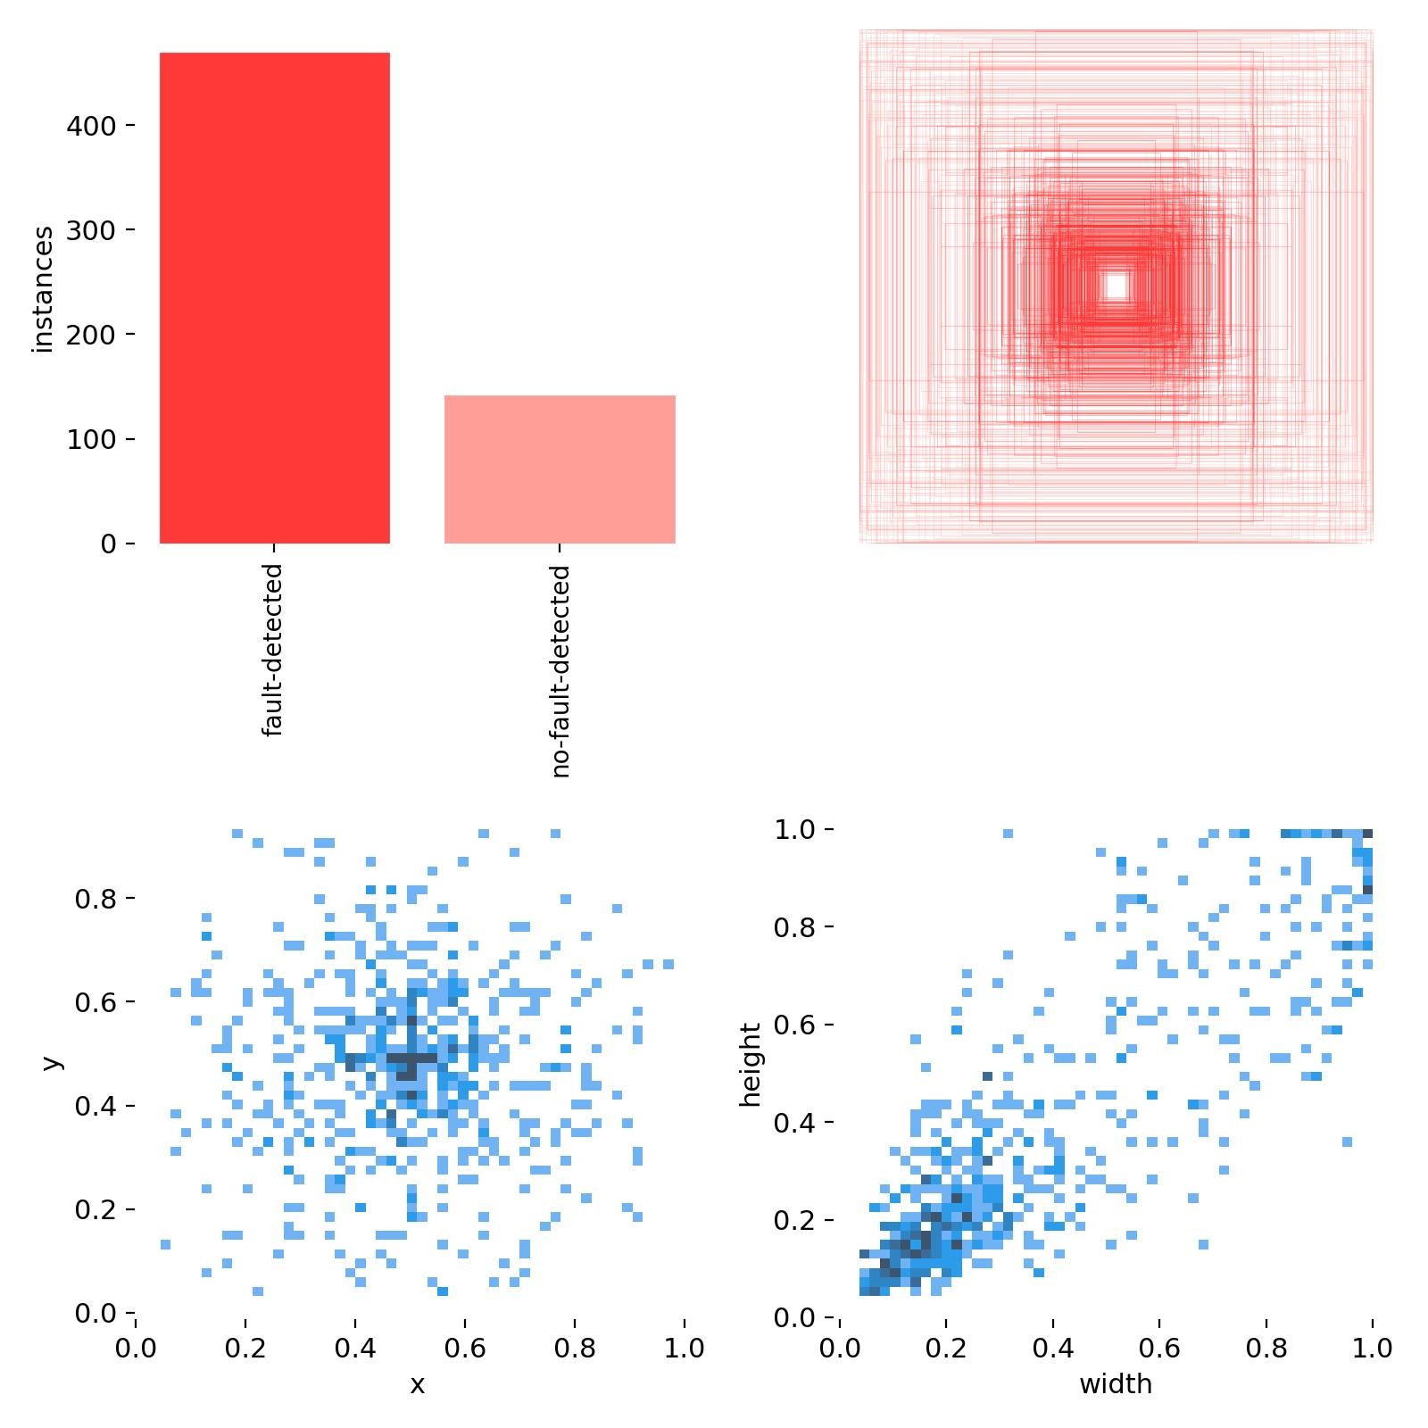
Results and Metrics for Electronic Component Fault Analysis
Fault Detection

Slide 14
Challenges
1. Variability in Component Appearance: Electronic components can vary greatly in terms of size, color, shape, and markings, making it difficult for algorithms to maintain high accuracy across all types.
2. Quality of Data: Collecting a large and diverse dataset of electronic component images is challenging. The dataset must include images from various angles and under different lighting conditions to train the model
Effectively.
3. Miniaturization of Components: As electronic components become smaller, detecting and identifying micro-sized features becomes increasingly challenging, requiring more sophisticated image processing techniques.
4. Complex Backgrounds: Components are often situated on complex circuit boards with intricate patterns, which can confuse recognition systems and lead to false positives or negatives.
5. Handling Defective Samples: In a production line, it is relatively easy to collect non-defective samples but difficult to collect defective samples, which are crucial for training the model to recognize faults.
6. Effective Computational Power: A powerful GPU is required to run complex models like YOLO and MobileNet for large number of epochs in short time.

Slide 15
The successful implementation of YOLO and MobileNet for component recognition validates computer vision's feasibility in the electronics industry for automated identification. This project confirms high accuracy and processing speed, rendering computer vision suitable for real-time applications in production. Its industrial applications span quality control, maintenance, repair, and custom PCB design, significantly enhancing precision and efficiency.
In conclusion, the project has laid a solid foundation for the advancement of computer vision in electronic component recognition, with the potential to transform current practices and drive innovation in the electronics industry.
Conclusion

Slide 16
References
https://universe.roboflow.com/annotation-2dedh/yolov8-fault-detection
https://www.google.com/
https://github.com/ultralytics/yolov5
https://www.tensorflow.org/api_docs/python/tf/keras/applications/MobileNetV2
Colab Notebook for PCB
Colab Notebook for Fault Analysis
Drive Link for General Components Recognition

