Slide 1
Taekwondo kicking Tracker
https://youtu.be/JOwEe8s5WO8

Slide 2
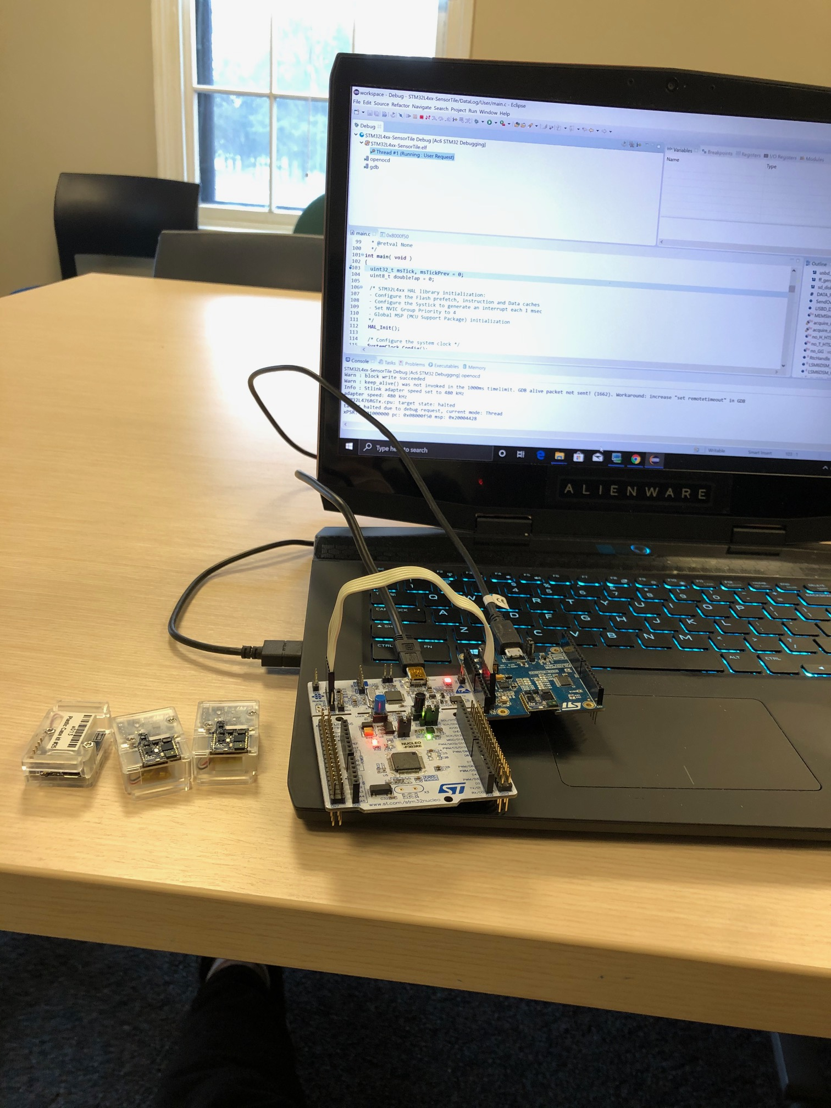
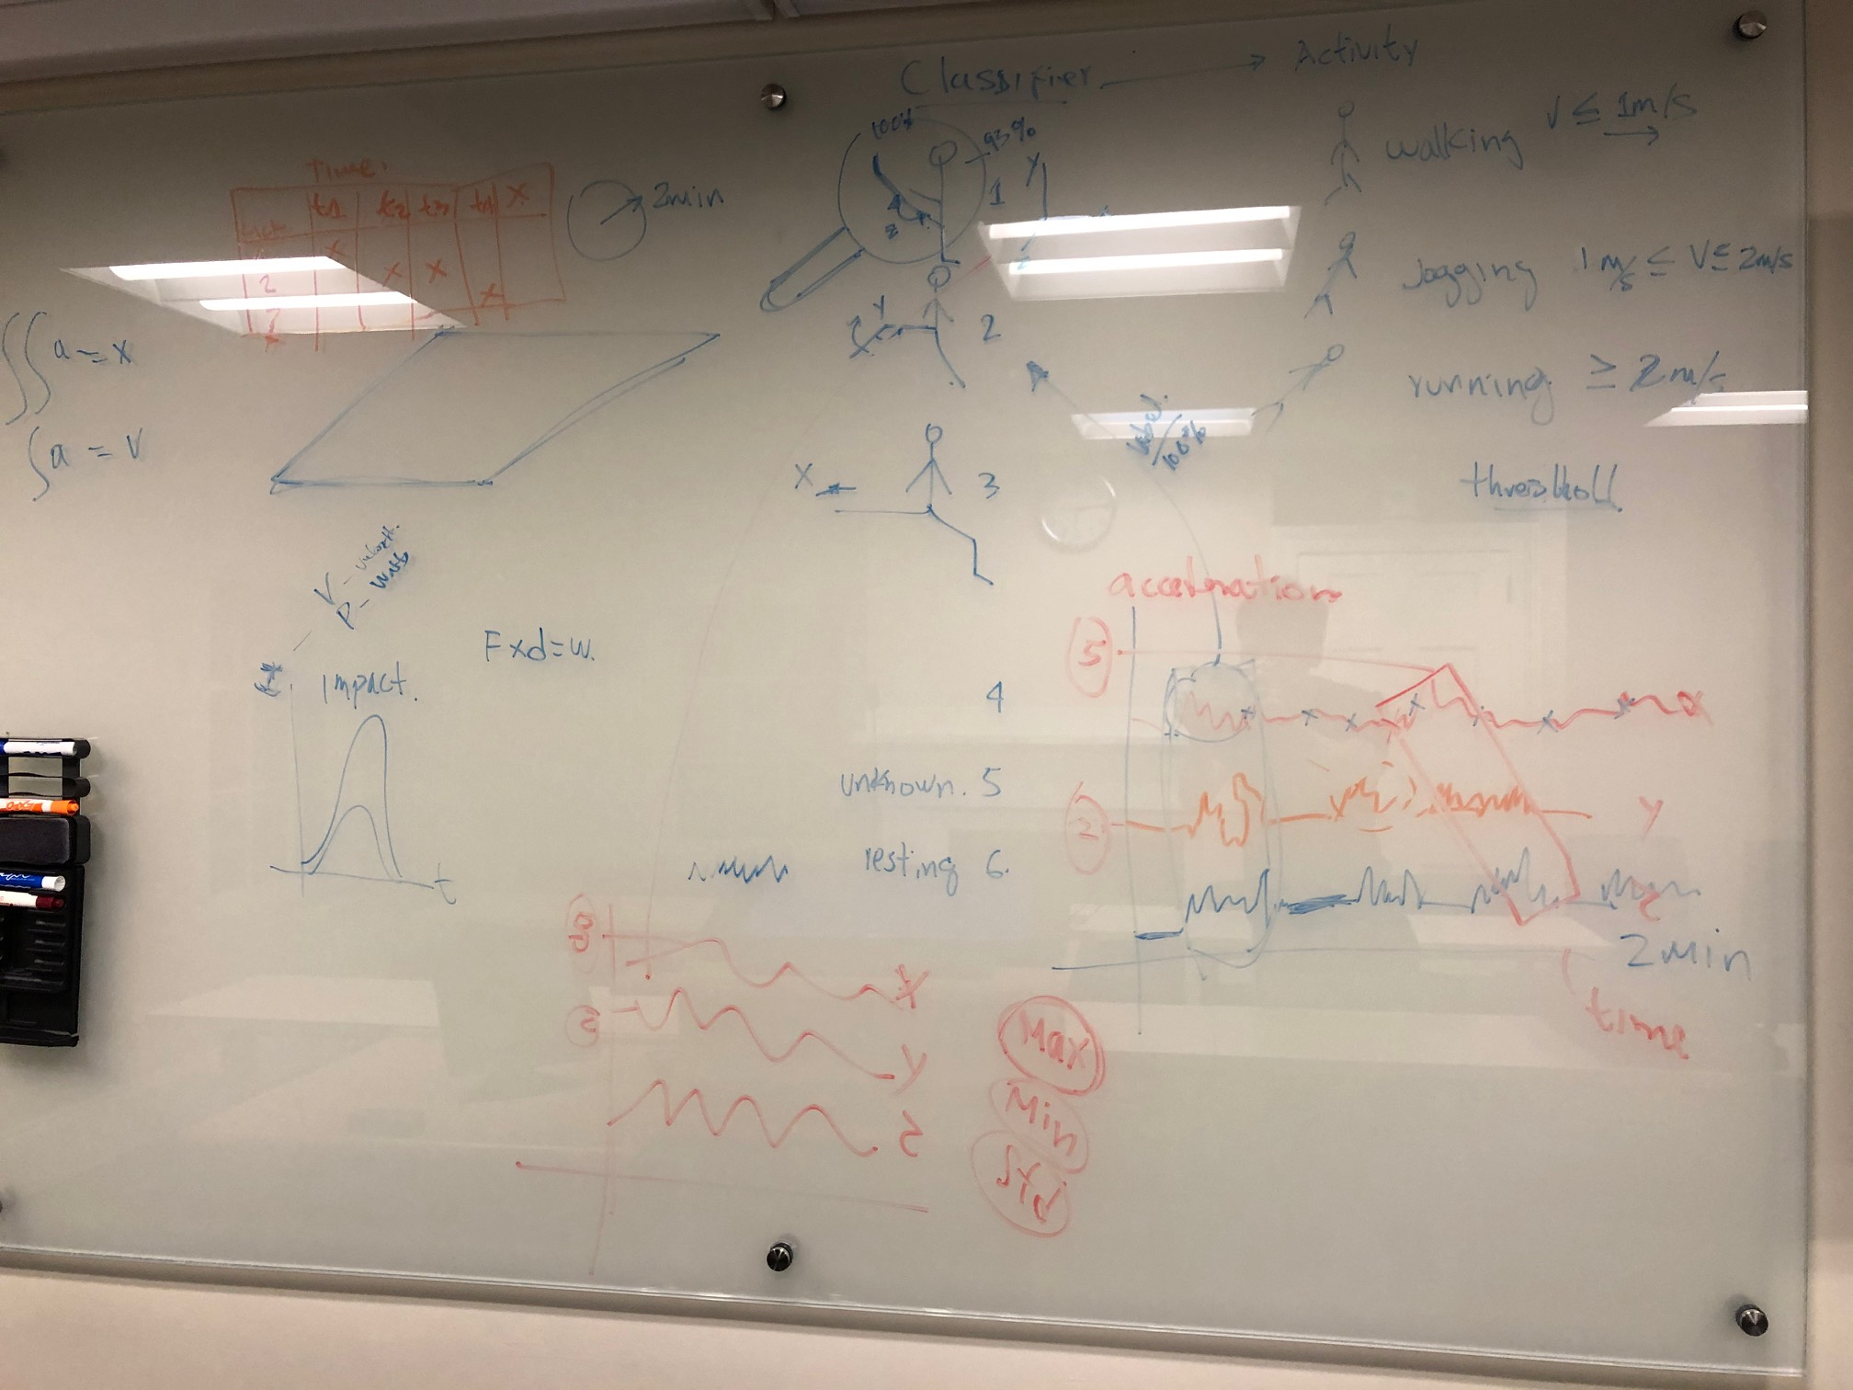
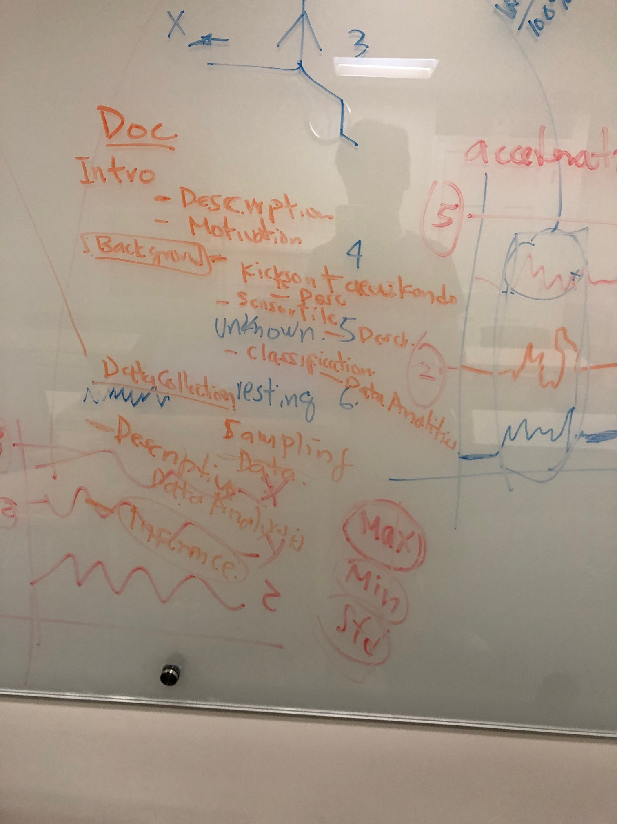

Slide 3


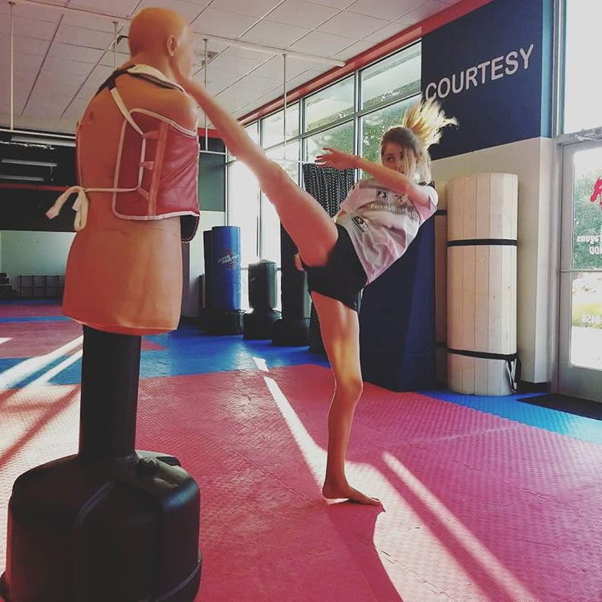

Data collection
Export

Slide 4
The basics of machine learning
Python libraries
Basic Machine Learning Algorithms
Supervised Learning
Linear Regression
Classification
Using logistic Regression
Using Support Vector Machines
Using K-Nearest Neighbors (KNN)
Unsupervised Learning
Clustering using K-means
1. Numpy
2. Pandas
3. Mathplotlib
4. Scikit-learn

Slide 5
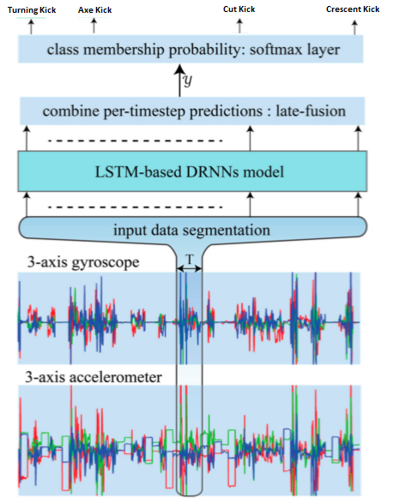

Slide 6
x_test,Y_test
Data
x_train, Y_train
x_train,
x_test,Y_test
Python
Output
Data
Program
model
clf.fit(points, result)
kick_pred = model.predict(x_test)
Y_train
Predicted kicks are labels
numbered 1,2,3,or 4
Use data and the output to derive your
program (known as the model
Compare Predicted kicks
with the corresponding Y_test
Accuracy

Slide 7
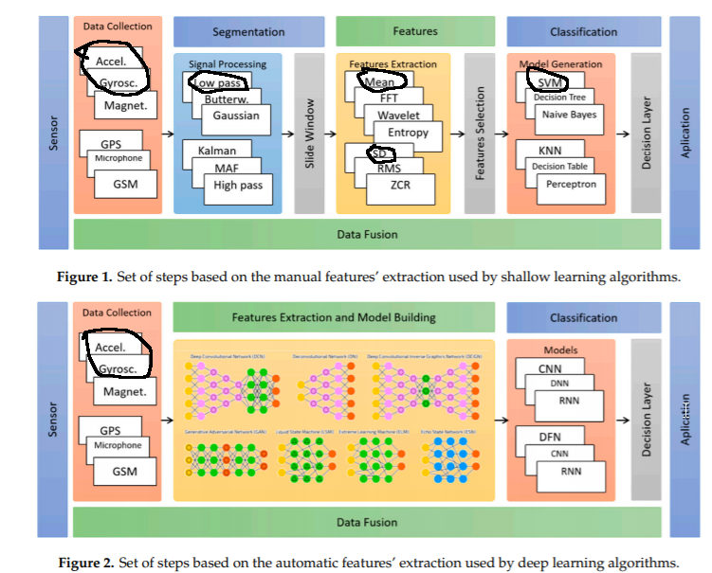

Slide 8
python jupyter notebook

