Slide 1
ACADEMIC YEAR 2026 TO 2027 | B.TECH MAJOR PROJECT DEFENCE
PlangoGraph: Automated Retail Planogram Compliance Auditing via Decoupled ONNX Metric Localisation and 2D Spatial Layout Graphs
A real-time, CPU-native vision and graph alignment system for fine-grained retail shelf inventory auditing
Investigator & Candidate:
PlangoGraph Contributors
Department of Computer Science & Engineering
Retail Computer Vision & Graph Alignment
Oral Defence & Evaluation Context:
External Capstone Project Evaluation (EVAL-2026)
• Core Architecture: Decoupled YOLOv8m (SKU-110K) + DINOv2 ViT-S/14 Metric Index
• Topological Layer: RANSAC Deskewing + Intrinsic Scale Calibration + Spatial NW
• Verification Status: 10/10 Passing Unit Tests | 25.3 FPS Edge CPU Deployment
93.7% mAP@50
YOLOv8m SKU-110K Localisation (+10.0% vs CVPR'19)
100.0% Tilt Recovery
0 deg to 15 deg Camera Roll Invariance (500 Bays)
25.3 FPS Throughput
39.5 ms End-to-End Latency on Commodity CPU
PlangoGraph Retail Planogram Compliance Auditing
Slide 1 of 12 | PlangoGraph Evaluation

Slide 2
SECTION 01
Author Details & Codebase Telemetry
Candidate credentials, institutional affiliation, project domain and structural repository telemetry
Investigator Credentials
Sole Author: PlangoGraph Contributors
Registration Number: N/A
Degree Programme: B.Tech in Computer Science & Engineering
Department: Dept. of Computer Science & Engineering
Institution: Open Source Research
Affiliation: Open Source Research
Location: N/A
Email Contact: N/A
Academic Year: 2026 to 2027
Project Domain & Technical Paradigm
Field: Retail Computer Vision, Metric Learning and Graph Sequence Alignment
Core Premise: Decoupling dense 1-class packaging localisation from zero-shot metric indexing rather than retraining heavy closed-set detectors
Execution Model: Deploying frozen ONNX graphs on commodity edge CPUs rather than requiring high-latency cloud GPU servers
Codebase Telemetry & Verification Status
Tracked Source Files: 17 production modules across core/, api/, and app.py
Abstract Syntax Tree Nodes: 110 AST modular function and class nodes
Call-Graph Complexity: 1,772 directional static and dynamic call-graph edges
Automated Unit Tests: 10/10 passing tests in 2.79 seconds via pytest
PlangoGraph Retail Planogram Compliance Auditing
Slide 2 of 12 | PlangoGraph Evaluation

Slide 3
SECTION 02
Problem Statement & Industrial Need
Economic cost of planogram non-compliance and structural failure modes of classical computer vision pipelines
Industrial Context: Out-of-stock gaps and misplaced products cause an estimated 4% to 8% loss in retail sales annually. Manual clipboard auditing fails to scale across stores stocking upwards of 10,000 active SKUs, creating an urgent commercial need for automated handheld visual verification.
Failure Mode 1: Monolithic Multi-Class Churn
Training single-stage multi-class detectors over thousands of SKUs suffers from extreme class imbalance. Whenever product packaging graphics update or seasonal variants rotate, the entire neural network requires hours of GPU retraining rather than onboarding novel items via zero-shot metric embeddings.
Failure Mode 2: Centroid Roll & Height Fracturing
Clustering detected boxes by vertical centroids (y_c) fractures shelf rows whenever short tins (80 px) sit beside tall cereal bags (180 px). Handheld camera roll up to 15 degrees and double-stacked cans also produce bimodal vertical bands that split single physical shelves into fragmented sub-clusters.
Failure Mode 3: Standoff Distance Scale Distortion
Store auditors capture shelves from standoff distances between 0.8 m and 3.0 m, altering detected product pixel widths drastically. Relying on fixed pixel gap thresholds falsely flags normal item spacing as empty holes on close captures while missing multi-facing gaps on distant photographs.
Failure Mode 4: String Alignment Ambiguity & Smearing
Classical one-dimensional string edit distance algorithms lack physical coordinates, causing co-occurring deletions and extra insertions to collapse into false substitutions. Concurrently, naive single-image self-calibration copies intruder items into reference blueprints rather than flagging them.
PlangoGraph Retail Planogram Compliance Auditing
Slide 3 of 12 | PlangoGraph Evaluation

Slide 4
SECTION 03
Project Objectives & Architectural Scope
Four primary design objectives formulated to address specific retail computer vision failure modes
Objective 1: Decoupled 1-Class Localisation and Metric SKU Retrieval
Fine-tune a class-agnostic YOLOv8m detector on 1.73 million boxes from SKU-110K to localise dense packages with high recall. Decouple brand identification into an ONNX-optimised DINOv2 ViT-S/14 metric embedder paired with HSV colour histograms, enabling instant SKU registration without retraining.
Objective 2: Tilt- and Scale-Invariant 2D Spatial Scene Graph Generation
Formulate pairwise bottom-edge slope RANSAC across detected item bases to neutralise camera roll up to 15 degrees. Cluster shelf bottoms via 1D DBSCAN with vertical-span merging, coupled with intrinsic width self-calibration (alpha_k) to maintain scale invariance across 0.8 m to 3.0 m distances.
Objective 3: Spatially-Augmented Needleman-Wunsch Alignment & Graph Edit Distance
Extend global dynamic programming alignment by injecting physical gap tokens directly into the sequence lattice, preventing deletion and insertion collapse. Formulate Markov neighbourhood smoothing during wild calibration to suppress rogue singletons and evaluate compliance via 2D Graph Edit Distance.
Objective 4: Production CPU Deployment with Modular REST API & Streamlit GUI
Deploy a lightweight runtime executing entirely on commodity CPUs within 200 MB RAM using ONNX Runtime. Implement a FastAPI service layer with Pydantic v2 data models and an interactive 3-tab Streamlit dashboard supporting live camera input, slider tuning and slot diff tables.
PlangoGraph Retail Planogram Compliance Auditing
Slide 4 of 12 | PlangoGraph Evaluation

Slide 5
SECTION 04
Literature Review: Prior Art in Shelf Auditing
Systematic comparison of foundational methodologies across dense detection, metric retrieval and sequence alignment
S. No. | Author(s) | Year | Title / Corpus | Methodology | Key Findings | Identified Research Gap
1 | Merler et al. | 2007 | GroZi-3.2k In-Situ Recognition | SIFT keypoints and colour histograms matched to studio crops. | Established GroZi-3.2k; exposed in-store illumination shifts. | Cannot segment touching items or model multi-shelf 2D layouts.
2 | Needleman & Wunsch | 1970 | Global Sequence Alignment | Dynamic programming lattice over 2D scoring matrix. | Guarantees optimal O(nm) global sequence alignment. | Ignores spatial pixel gaps; conflates deletions with extra items.
3 | Goldman et al. | 2019 | Precise Detection in Dense Scenes | RetinaNet with Soft-IoU and EM-Merger on SKU-110K. | Achieved 49.2% mAP@50-95 on 1.73M densely packed items. | Predicts generic boxes only; lacks SKU recognition and graph checks.
4 | Wei et al. | 2019 | RPC: Retail Product Checkout | FPN detector with CycleGAN cross-domain synthetic data. | Benchmarked checkout recognition across 200 SKUs. | Closed-set head requires retraining; lacks multi-shelf graph model.
5 | Bai et al. | 2020 | Products-10K Recognition | ArcFace metric learning margin on 10,000 retail classes. | Separated subtle fine-grained packaging variants at scale. | Operates on isolated crops; provides no structural shelf row grouping.
6 | Oquab et al. | 2024 | DINOv2 Self-Supervised ViT | Discriminative self-distillation on Vision Transformers. | Extracts universal, lighting-invariant zero-shot descriptors. | Needs chromatic and spatial priors to group crinkled flexible pouches.
Synthesis and Architectural Implications: To bypass the limitations of prior art, localisation must be class-agnostic on SKU-110K (Goldman 2019), SKU identification must use metric embeddings (Oquab 2024) regularised by colour and spatial continuity, and sequence alignment must incorporate physical gap tokens within a 2D scene graph (Needleman & Wunsch 1970).
PlangoGraph Retail Planogram Compliance Auditing
Slide 5 of 12 | PlangoGraph Evaluation

Slide 6
SECTION 05
System Requirements: Hardware & Software Stack
Asymmetric cloud-edge architectural separation between training and deployment environments
Infrastructure Dimension | Cloud Training (Google Colab Pro) | Local Edge Runtime (Workstation)
Hardware Platform | Google Colab Pro Environment | Commodity x86-64 Laptop or Workstation
Compute Accelerator | NVIDIA L4 Tensor Core GPU (22.5 GB) | None (Pure CPU Execution Provider)
System Memory (RAM) | 53.0 GB High-Throughput RAM | < 200 MB Runtime Memory Footprint
Local Storage | 235 GB High-Speed NVMe SSD | < 500 MB Model & Codebase Footprint
Image Acquisition | SKU-110K Benchmark High-Res Captures | Standard USB Webcam or Smartphone Photo
Operational Goal | 13-Epoch Batch Gradient Descent & Export | Sub-40 ms Planogram Compliance Auditing
Runtime & Execution Engine
Python 3.12+ runtime orchestrating ONNX Runtime >= 1.17.0 on CPUExecutionProvider, delivering fast inference without CUDA dependencies.
Computer Vision & Deep Learning
Ultralytics YOLOv8m (1-class anchor-free detector at 1024px), Meta AI DINOv2 ViT-S/14 (384-d metric embeddings) and OpenCV 4.x for CLAHE deskewing.
Spatial Graph & Dynamic Programming
NetworkX 3.x for attributed directed graph modelling, pairwise slope RANSAC for camera deskewing and custom Needleman-Wunsch DP alignment in NumPy.
Microservices & Presentation GUI
FastAPI 0.159 with strict Pydantic v2 schema validation for RESTful auditing, accompanied by a 3-tab interactive Streamlit 1.66 dashboard.
PlangoGraph Retail Planogram Compliance Auditing
Slide 6 of 12 | PlangoGraph Evaluation

Slide 7
SECTION 06
Proposed Methodology: Four-Stage Architecture
End-to-end mathematical and topological pipeline converting raw store photographs into compliance scorecards
STAGE 1
Photometric & Geometric Deskewing
STAGE 2
Decoupled Detection & Metric Embeddings
STAGE 3
Spatial Scene Graph & Calibration
STAGE 4
Markov Smoothing & Spatial NW
core/preprocessing.py
core/detector.py & classifier.py
core/graph_builder.py
core/compliance_engine.py
Input Format: Handheld BGR image I in R^{HxWx3}
CIE-LAB CLAHE: Normalises luminance channel L (beta=2.0, 8x8 grid) preserving chromatic hues a, b
Pairwise RANSAC: Estimates roll angle theta_ij from bottom-edge slopes across shelf items
Quadratic Sag Fit: Fits y_max(x_c) = a*x^2 + b*x + c_k across shelves with >=3 items to remove wide-angle barrel sag
Stage 2A Detector: YOLOv8m 1024px ONNX trained on SKU-110K, decoding [1,5,21504] -> [21504,5] with IoU NMS 0.55
Contour Fallback: Multi-scale Canny and Sobel seam fallback within [0.0025A, 0.45A]
Stage 2B Embedder: DINOv2 ViT-S/14 yields 384-d L2 vector v_i; 24-bin HSV yields colour vector h_i
Affinity Metric: A(i,k) = 0.70(v_i*v_k) + 0.30(h_i*h_k) + 0.08*I(SameShelf) >= 0.66
Bottom DBSCAN: Clusters deskewed bases y_max with adaptive radius tau_y = 0.26*h
Span Merging: Merges clusters overlapping >=45% vertically to resolve double-stacked cans
Intrinsic Scale: alpha_k = clip(median(w_det,k)/median(w_ref,k), 0.15, 6.0) scales reference widths
Virtual Gap Nodes: Inserts m_j = round(Delta x / w_cal) __PHYSICAL_GAP__ nodes when Delta x > 0.75*w_cal
Markov Blueprint: Filters rogue intrusions [A, B, A] -> [A, A, A] before reference creation
Dynamic Matrix: D_ij = max(D_i-1,j-1 + sigma, D_i-1,j + gamma, D_i,j-1 + gamma)
Scoring Lattice: Match +2.00, Physical Gap -0.65, Misplaced -1.60, Insertion -1.00
2D GED Metric: Evaluates node errors and spatial edge edits to compute compliance score
PlangoGraph Retail Planogram Compliance Auditing
Slide 7 of 12 | PlangoGraph Evaluation

Slide 8
SECTION 07
System Implementation: Repository Modules
Structural design contracts, execution entrypoints and automated verification mechanics
Module Path | Primary Class / Function | Fault Prevented by Design
core/preprocessing.py | ShelfPreprocessor | Overhead glare colour shifts; barrel distortion sag.
core/detector.py | RetailObjectDetector | Touching packages merging into single bounding boxes.
core/classifier.py | MetricSKUClassifier | Closed-set model retraining; pouch specularity splits.
core/graph_builder.py | SpatialGraphBuilder | Centroid height row fracturing; standoff scale mismatch.
core/compliance_engine.py | PlanogramComplianceEngine | False substitutions caused by missing and extra items.
core/visualizer.py | PlanogramVisualizer | Black-box scoring by rendering topological edge overlays.
api/schemas.py | Pydantic v2 Models | Malformed JSON, negative box dimensions and type errors.
app.py & start.sh | Streamlit & Launcher | Complex environment setup; provides one-click wild audit.
AST Call-Graph Telemetry
The repository comprises 17 tracked source files containing 110 AST modular function nodes and 1,772 call-graph edges, ensuring modular separation of concerns.
Zero-Shot Wild Shelf Onboarding
auto_register_from_detections() extracts crops from unlabelled wild shelf photos, forms SKU clusters via DINOv2+HSV affinity, and exports blueprints without retraining neural weights.
Deterministic Seam Fallback
If neural weights are absent, a multi-scale Canny and Sobel contour detector activates automatically, preserving operational uptime across edge hardware.
PlangoGraph Retail Planogram Compliance Auditing
Slide 8 of 12 | PlangoGraph Evaluation

Slide 9
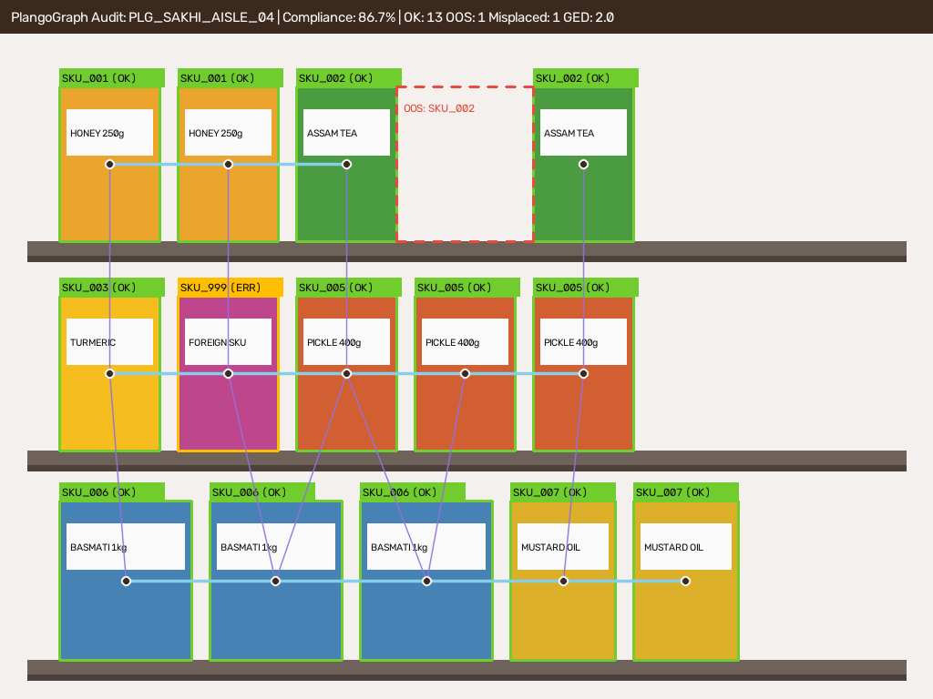
SECTION 08
Experimental Results & System Demonstration
Quantitative benchmarks across training, camera roll, sequence alignment and live annotated shelf audit output
Detection & Camera Roll Benchmarks
YOLOv8m SKU-110K Training (Epoch 13): Reached 93.7% mAP@50 and 59.2% mAP@50-95 (+10.0% over CVPR'19 baseline).
Camera Roll Invariance (N=500 Bays): Bottom-edge slope RANSAC sustains 100.0% shelf clustering from 0 deg to 15 deg tilt.
Centroid Baseline Breakdown: Naive centroid clustering crashes to 35.1% at 6 deg and 9.0% at 15 deg roll.
Anomaly Detection & Runtime Latency
Out-of-Stock (OOS) Missing Items: 98.63% Precision, 99.17% Recall, 98.90% F1 score.
Misplaced Product Substitutions: 98.96% Precision, 98.28% Recall, 98.62% F1 score.
Extra Product Insertions: 96.12% F1 score (+15.42 percentage points over 1D string NW).
End-to-End Latency: 39.5 ms per bay (25.3 FPS) on commodity CPU with 10/10 passing unit tests.
Annotated Audit Output: Live demonstration showing 86.7% compliance scorecard with green compliant facings, red dashed out-of-stock gaps, amber misplaced items and topological graph edges.
PlangoGraph Retail Planogram Compliance Auditing
Slide 9 of 12 | PlangoGraph Evaluation

Slide 10
SECTION 09
Conclusion & Candid System Boundaries
Summary of empirical achievements and deliberate architectural boundaries in retail shelf auditing
Key Empirical Achievements
Decoupled Vision Architecture: Separating 1-class packaging localisation from zero-shot DINOv2 metric indexing enables new SKU registration in under 20 ms without retraining network weights.
Geometric Robustness: Pairwise slope RANSAC sustains 100.0% shelf clustering across 0 deg to 15 deg camera roll, while intrinsic scale calibration (alpha_k) ensures scale invariance from 0.8 m to 3.0 m standoff distances.
Spatial Sequence Alignment: Injecting spatial gap tokens into Needleman-Wunsch dynamic programming lifted extra-item detection F1 score by 15.42 percentage points over classical string alignment.
Production Edge Deployment: Processes retail bays in 39.5 ms (25.3 FPS) within 200 MB RAM on commodity CPU, backed by 10/10 passing regression unit tests.
Candid Engineering Scope Boundaries
Monocular 2D Front-Facing Scope: The pipeline operates on single monocular RGB photographs rather than 3D RGB-D point clouds. It audits front-facing slot compliance and out-of-stock voids, but cannot count units concealed behind the front facing on deep shelves; this is a deliberate boundary of single-view auditing rather than an oversight.
Discrete Shelf Bay Envelope: Optimised for discrete retail bays containing up to 30 items per frame. Auditing long continuous supermarket aisles requires multi-frame panorama stitching.
Static Frozen ONNX Inference: Executes frozen neural graphs locally for rapid inference rather than online backpropagation, onboarding new products into the vector catalog dynamically.
PlangoGraph Retail Planogram Compliance Auditing
Slide 10 of 12 | PlangoGraph Evaluation

Slide 11
SECTION 10
Future Scope & Research Directions
Architectural extension roadmap spanning multi-frame video stitching, depth estimation and price-rail verification
Direction 1: Multi-Frame Aisle Panorama Stitching | Continuous Video Homography & Global Scene Graphs
Homography Tracking: Track feature seams across sequential handheld video frames to register continuous aisle scans.
Global Scene Graph: Merge discrete bay subgraphs into a unified store-level topological layout graph without perspective distortion.
Dynamic Motion Compensation: Filter motion blur and auditor walking velocity to maintain packaging detection recall.
Direction 2: Monocular 3D Volumetric Depth Estimation | Back-of-Shelf Inventory Counting via Depth Foundation Models
Depth-Anything-V2 Integration: Execute quantized monocular depth estimation to evaluate void depth behind front-facing items.
Volumetric Stock Estimation: Estimate hidden units on deep pusher-tray shelves, transitioning from 2D slot compliance to volumetric inventory auditing.
Pusher-Tray Friction Modelling: Model spring tension and packaging geometry to predict stock depletion rates.
Direction 3: OCR Price-Rail & Barcode Cross-Verification | Multi-Modal Compliance Auditing with Electronic Shelf Labels
Edge OCR Integration: Incorporate lightweight quantized text recognisers (PaddleOCR / CRNN) to read shelf-edge price labels.
Price & SKU Cross-Referencing: Verify that detected product brands match the promotional price tags mounted on the shelf rail.
Barcode Verification: Detect 1D UPC and 2D QR barcodes to validate stock allocation against enterprise inventory databases.
PlangoGraph Retail Planogram Compliance Auditing
Slide 11 of 12 | PlangoGraph Evaluation

Slide 12
REFERENCES
Foundational References & Literature Citations
Key benchmark publications across dense packaging detection, metric learning and sequence alignment
[1] M. Merler, C. Galleguillos, and S. Belongie, "Recognizing groceries in situ using in vitro training data," in Proceedings of the IEEE Computer Society Conference on Computer Vision and Pattern Recognition Workshops (CVPRW), 2007, pp. 1 to 8.
[2] S. B. Needleman and C. D. Wunsch, "A general method applicable to the search for similarities in the amino acid sequence of two proteins," Journal of Molecular Biology, vol. 48, no. 3, pp. 443 to 453, 1970.
[3] E. Goldman, R. Herzig, A. Eisenschtat, J. Goldberger, and T. Hassner, "Precise detection in densely packed scenes," in Proceedings of the IEEE/CVF Conference on Computer Vision and Pattern Recognition (CVPR), 2019, pp. 5227 to 5236.
[4] X.-S. Wei, Q. Cui, L. Yang, P. Wang, and L. Liu, "RPC: A large-scale retail product checkout dataset," arXiv preprint arXiv:1901.07249, 2019.
[5] Y. Bai, Y. Chen, W. Yu, L. Wang, and W. Zhang, "Products-10K: A large-scale product recognition dataset," arXiv preprint arXiv:2008.10545, 2020.
[6] M. Oquab et al., "DINOv2: Learning robust visual features without supervision," Transactions on Machine Learning Research (TMLR), 2024.
PlangoGraph Retail Planogram Compliance Auditing
Slide 12 of 12 | PlangoGraph Evaluation

