Slide 1
Seatsurfer:
An AI-Driven Architecture for Hybrid Workplace Booking and Smart Office Management
Radu-Matei Prodan
Babeș-Bolyai University
Faculty of Mathematics and Computer Science
Studia Universitatis Babeș-Bolyai Informatica - 2025 Conference
Notes:
Good [morning/afternoon], my name is Radu-Matei Prodan and I’m presenting my research project, SeatSurfer: An AI-Driven Architecture for Hybrid Workplace Booking and Smart Office Management.
This work focuses on how we can optimize office seat usage in the context of hybrid work using intelligent systems.

Slide 2
Motivation & problem
Shift to hybrid work models
Static desk models are inefficient
Need for flexible, intelligent booking
Notes:
The COVID-19 pandemic triggered a shift in work habits. Companies now operate in hybrid modes, with employees alternating between home and on-site work.
But fixed seating plans no longer work in this flexible environment — they waste space on low-attendance days and cause overcrowding on peak ones.
Organizations need adaptive tools that allow dynamic seat allocation and user autonomy, while minimizing administrative effort.

Slide 3
Objectives of seat surfer
Real-time seat booking & visualization
AI-powered seat recommendation
Modular, multi-tenant backend
Notes:
SeatSurfer was developed to address these challenges with three primary goals:
First, enable intuitive and real-time booking through a responsive frontend.
Second, leverage AI to suggest seats tailored to user preferences and behavior.
And third, provide a scalable backend that supports multi-tenancy, role-based access, and easy extension.

Slide 4
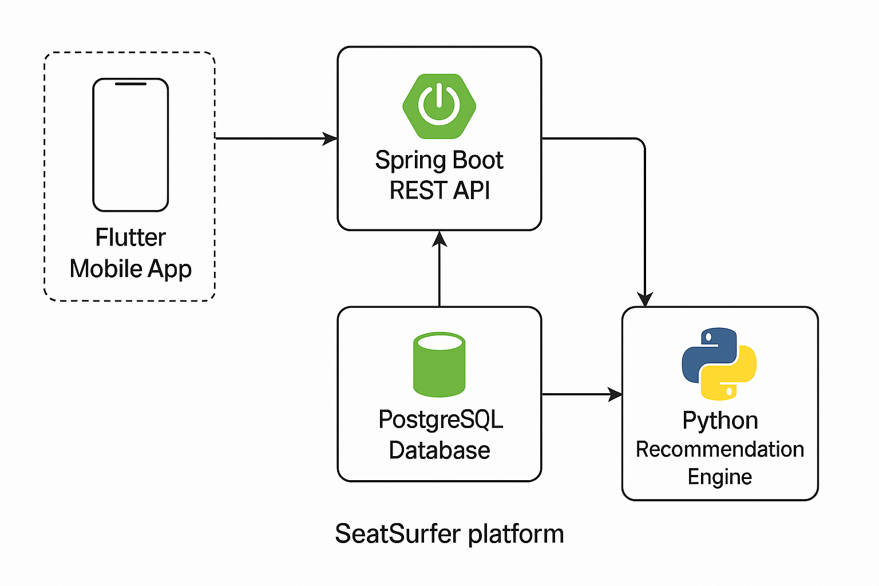
System architecture
Diagram: platform layers
Modular components overview
Notes:
SeatSurfer follows a modular full-stack architecture.
The frontend, built in Flutter, offers a cross-platform interface.
The backend uses Spring Boot and PostgreSQL for secure, transactional operations.
AI recommendations are handled by a Python-based microservice.
This decoupling ensures scalability and allows each layer to evolve independently.
(Point to diagram while speaking.)

Slide 5
Booking workflow
Flowchart: Input → Backend → AI → Ranked Seats → Frontend
Stateless and asynchronous pipeline
Notes:
Here’s how a booking request works.
A user selects the date and floor. The backend queries the AI engine, which ranks available seats based on historical data, seat metadata, and spatial context.
The result is a list of top recommendations, shown in real time.
The system is stateless, fast, and supports asynchronous calls — crucial for large-scale usage.

Slide 6
Ai Engine
Input features: history, spatial zones, time patterns
Collaborative filtering + heuristics
Recommender performance
Notes:
The AI model combines collaborative filtering with spatial heuristics.
It learns from previous user behavior, time patterns, and layout preferences.
This hybrid logic allows it to personalize suggestions while ensuring even seat distribution.
The microservice returns results in under 50 milliseconds, enabling seamless UX.

Slide 7
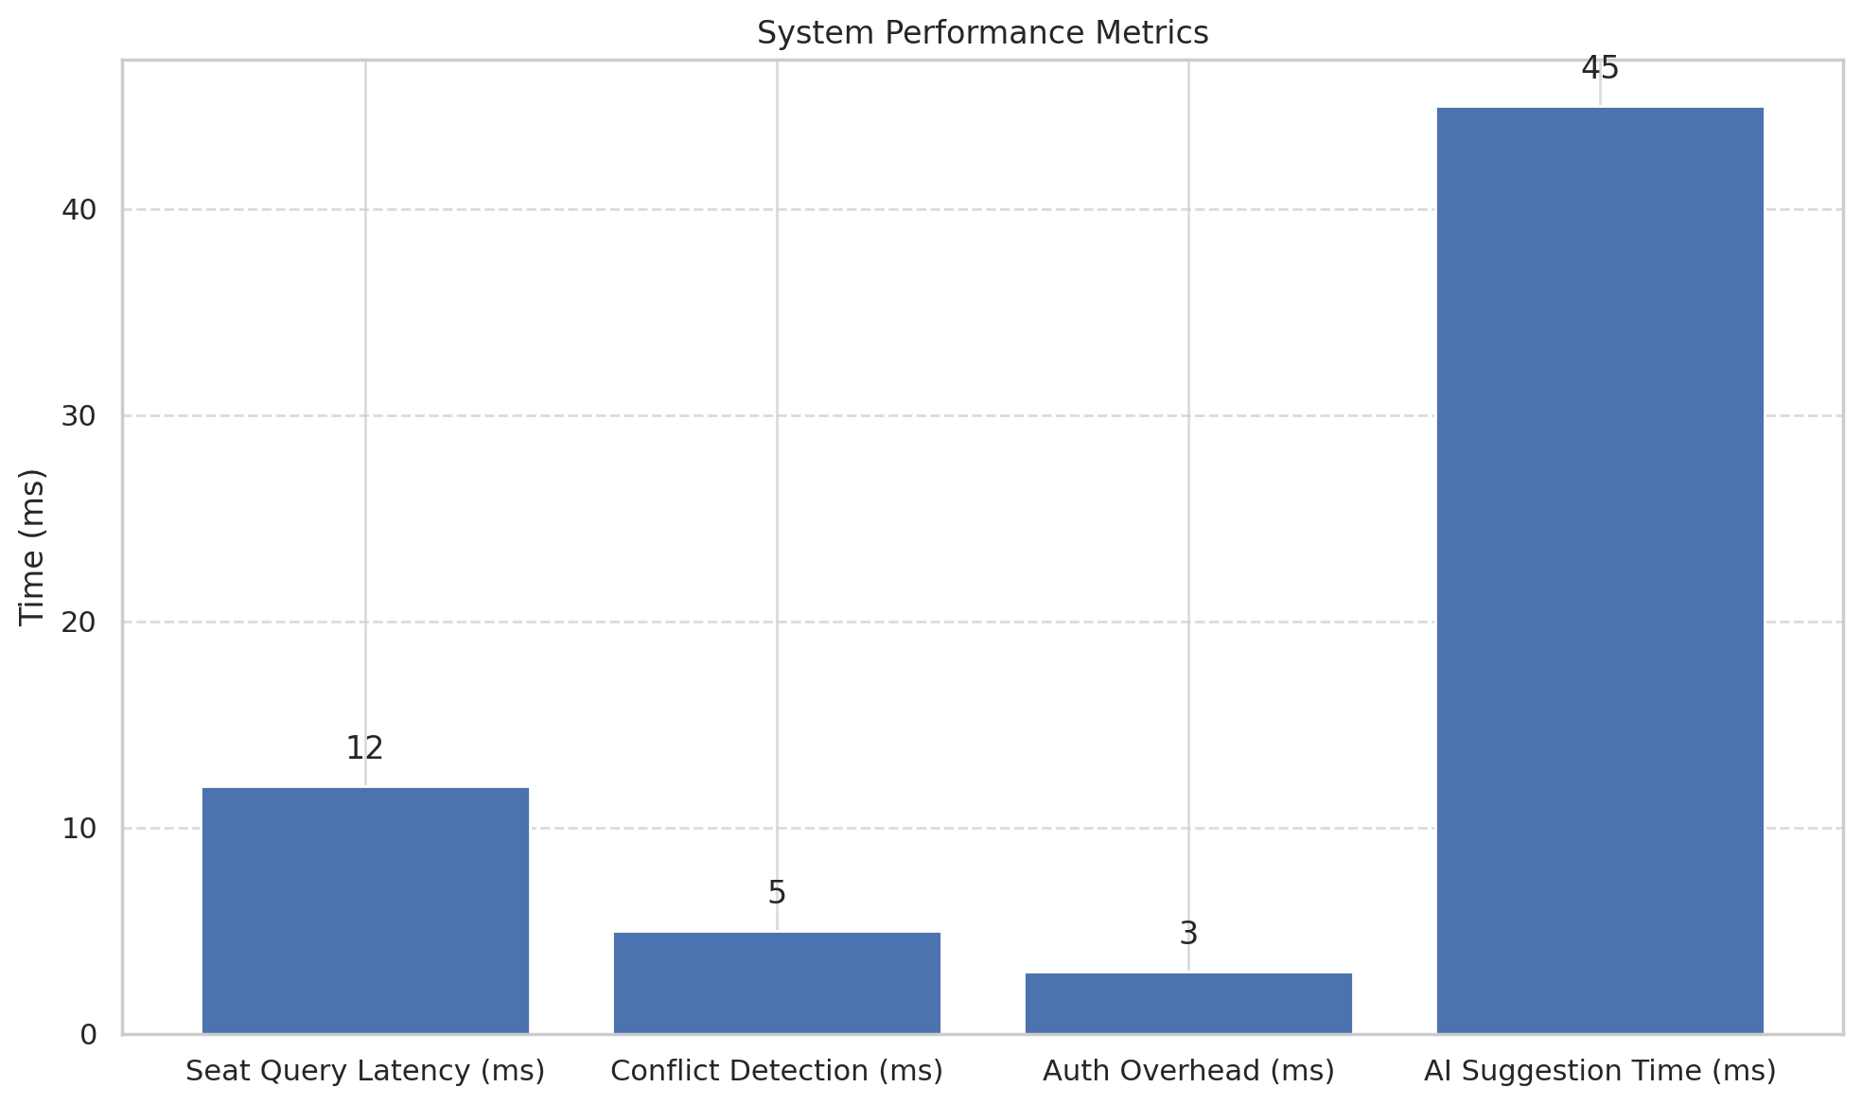
Performance evaluation
Chart: API latency, booking speed
200+ seats/floor, under 15 ms queries
Scalable and secure
Notes:
We evaluated the backend using simulated multi-user environments.
Seat availability queries for 200+ seats returned in under 15 milliseconds.
Booking conflicts were resolved instantly, and security overhead was negligible.
The system architecture scales well, especially since the AI engine runs as a separate microservice.

Slide 8
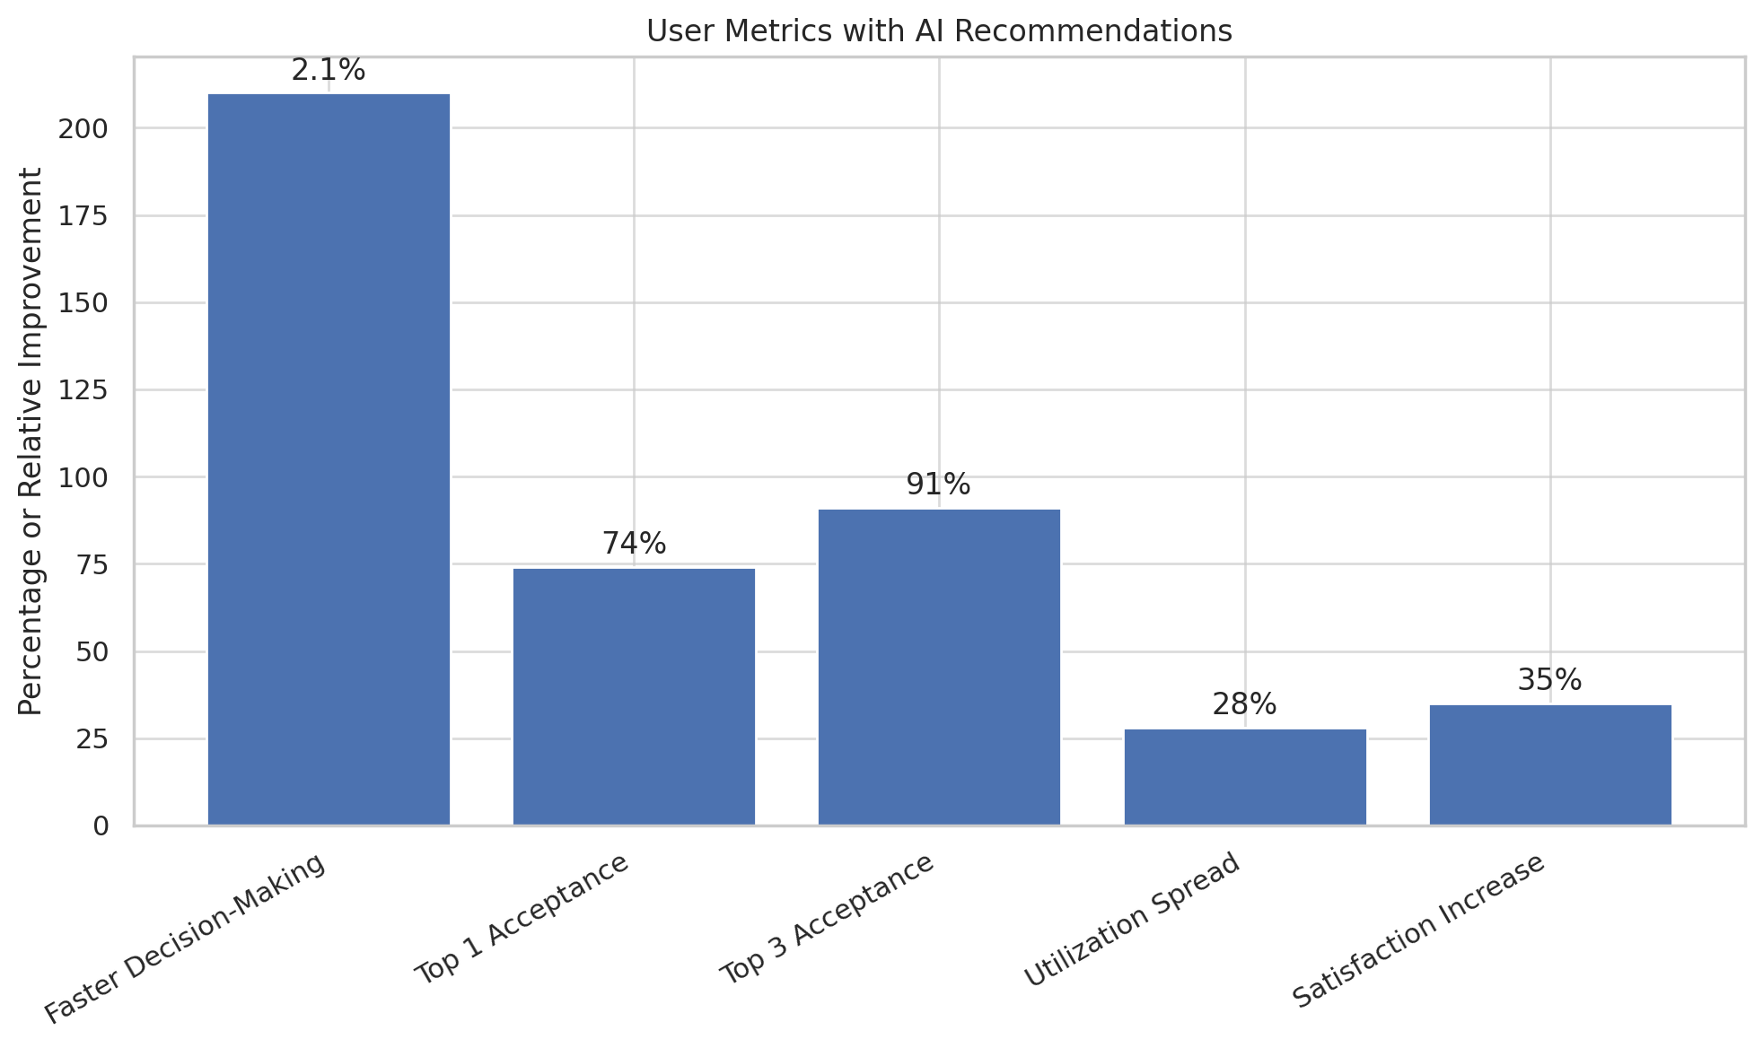
User metrics from simulation
Chart: Faster booking (2.1x), 74% acceptance rate
Reduced booking clusters by 28%
Higher satisfaction (Likert)
Notes:
We ran a 30-day simulation with 60 virtual users.
AI-assisted sessions had 2.1x faster booking times.
74% of users accepted the top suggestion.
Booking clusters — where everyone books the same few seats — dropped by 28%.
Satisfaction ratings improved significantly thanks to reduced decision fatigue.

Slide 9
Related work & innovation
Most platforms lack real-time AI
SeatSurfer bridges UX + data optimization
Novel architecture and integration
Notes:
Compared to existing tools, SeatSurfer stands out in two ways.
First, it integrates AI directly into the booking workflow. Most systems offer rule-based filtering at best.
Second, it focuses on both user experience and backend scalability — something that’s rare in academic and commercial solutions alike.

Slide 10
Conclusion & Future work
SeatSurfer improves space usage and satisfaction
Real-time, modular, AI-enhanced
Future work: real deployment, IoT, reinforcement learning
Notes:
SeatSurfer demonstrates how AI and modular architecture can transform hybrid workplace booking.
It improves efficiency, personalization, and system-wide balance.
In the future, we aim to deploy it in live environments, integrate IoT occupancy sensors, and use reinforcement learning for proactive seat allocation.
Thank you — I’m happy to take any questions.

