Slide 1
SeatSurfer:
A Database-Centric Seat Management System
Prodan Radu-Matei
Supervisor: Lect. PhD Emilia Loredana Pop
Babeș-Bolyai University - Faculty of Mathematics and Computer Science
2025
Notes:
Good [morning/afternoon],
My name is Prodan Radu-Matei, and today I’m excited to present the results of my Bachelor’s thesis:
“SeatSurfer: A Database-Centric Seat Management System” — a project developed under the supervision of Lecturer PhD Emilia-Loredana Pop.
The project addresses a growing need in today’s hybrid work environments: intelligent and flexible seat management. It was also selected for presentation at the SCSS Student Symposium, where I showcased its AI-driven capabilities and simulation-based results.

Slide 2

Motivation and Problem Statement
The rise of hybrid work models
Problems with fixed seating: inefficiency, crowding, poor user experience
Need for intelligent, real-time, personalized booking systems
Notes:
The pandemic accelerated a shift towards hybrid work models, where employees alternate between remote and in-office presence. While flexible, this model introduced serious logistical challenges for managing office space efficiently.
Fixed desk assignments no longer make sense, and traditional solutions often lead to either underutilized areas or overcrowding during peak days. Most existing tools are expensive, lack adaptability, or fail to personalize the experience.
There’s a clear need for a smarter, data-driven system that adapts to real usage patterns, user preferences, and can scale across different organizations.

Slide 3
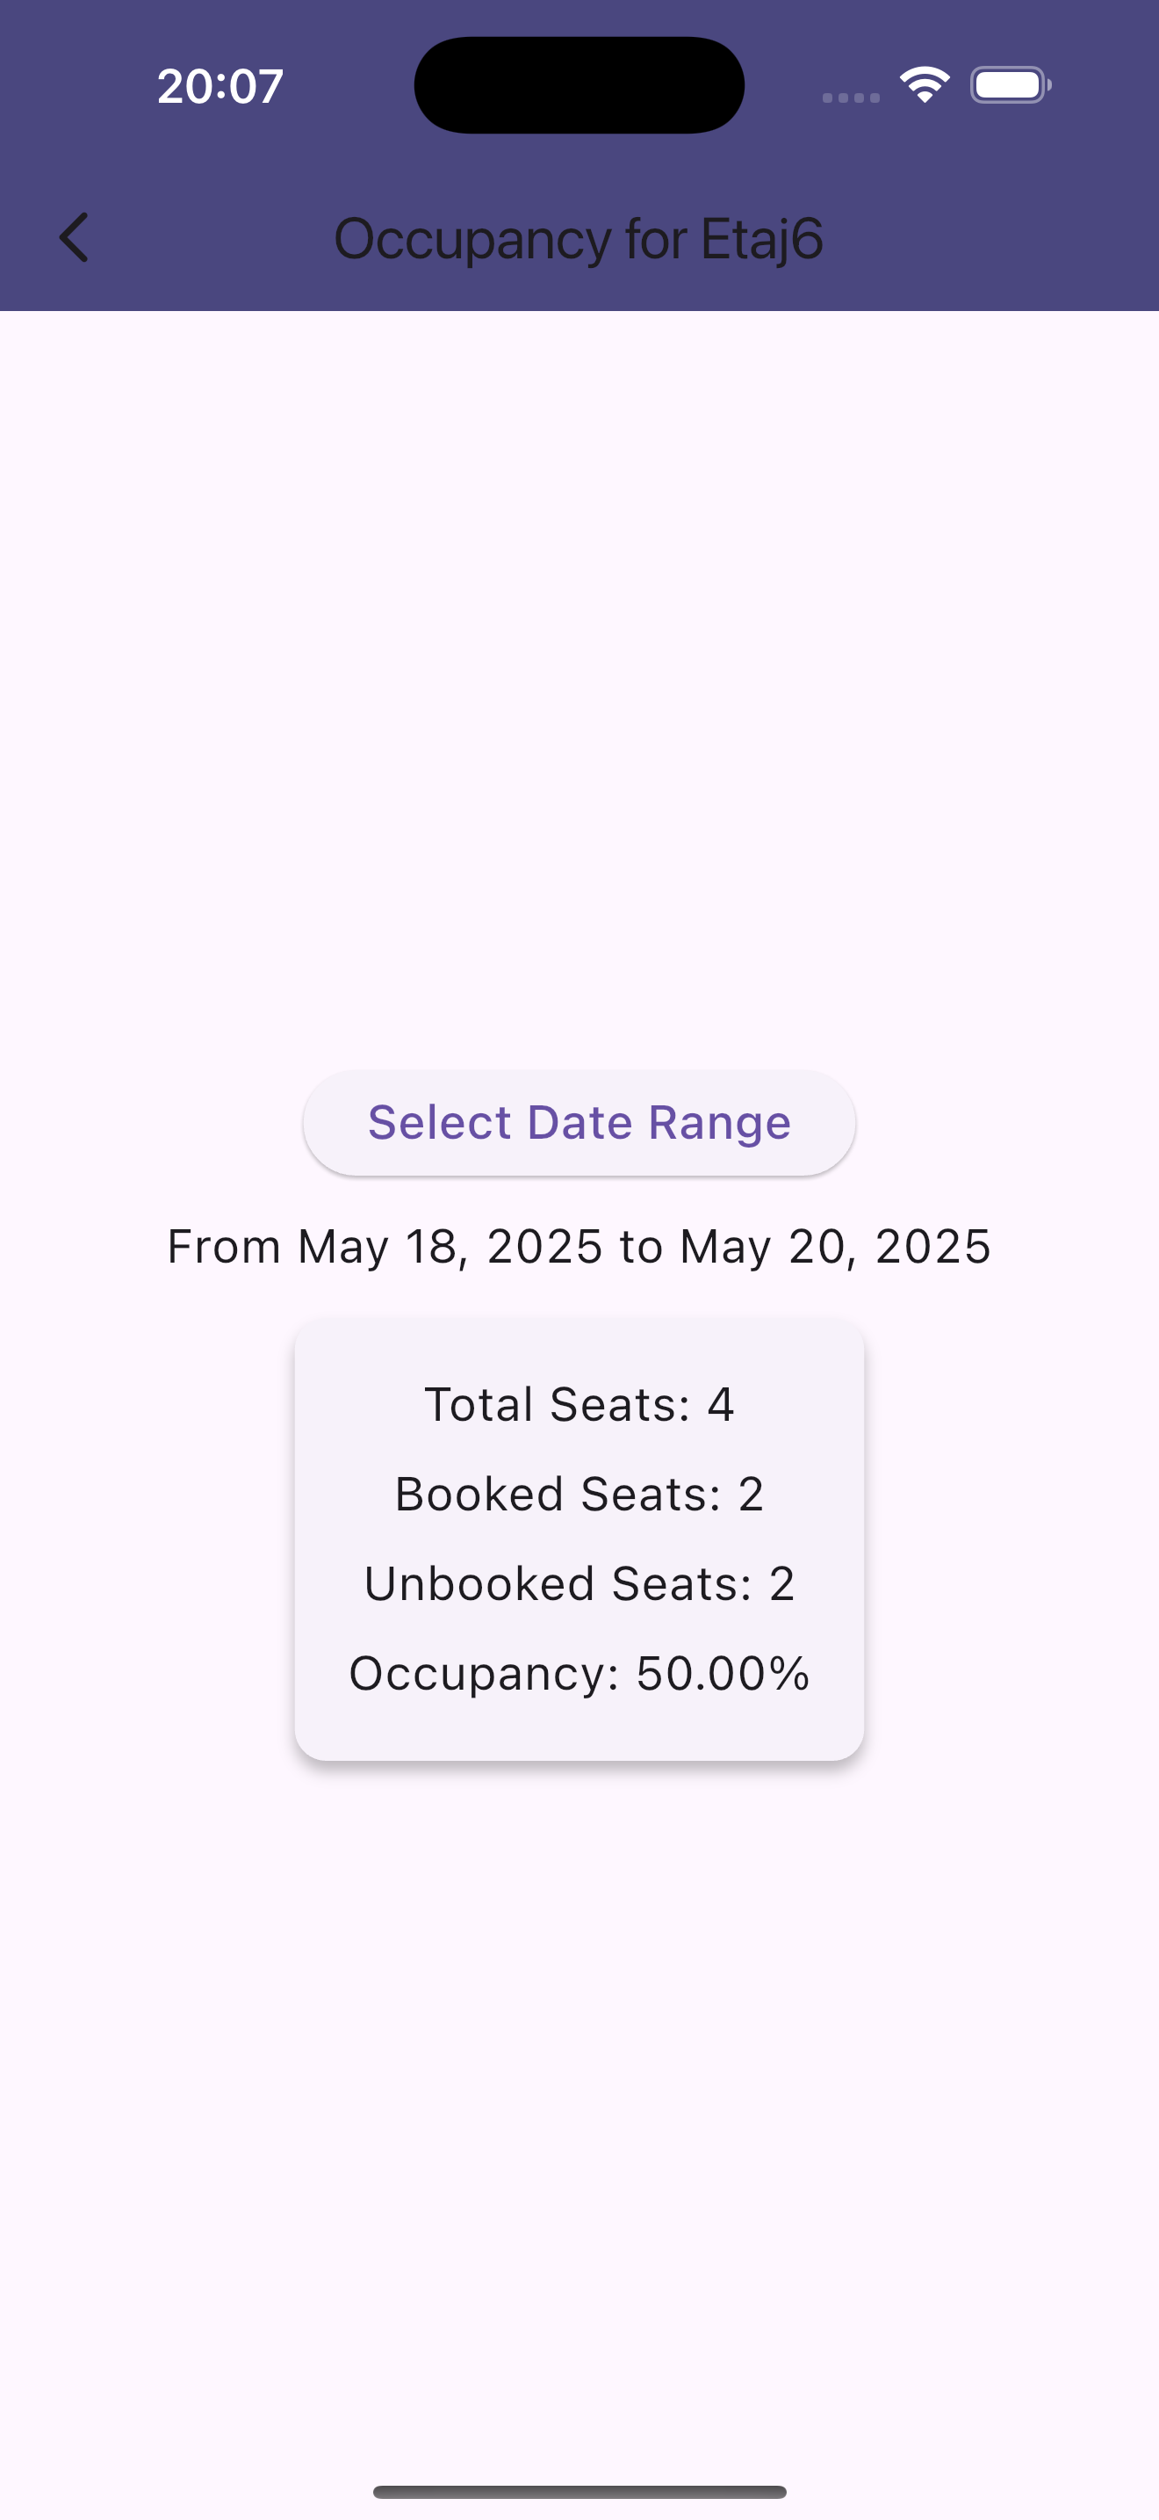
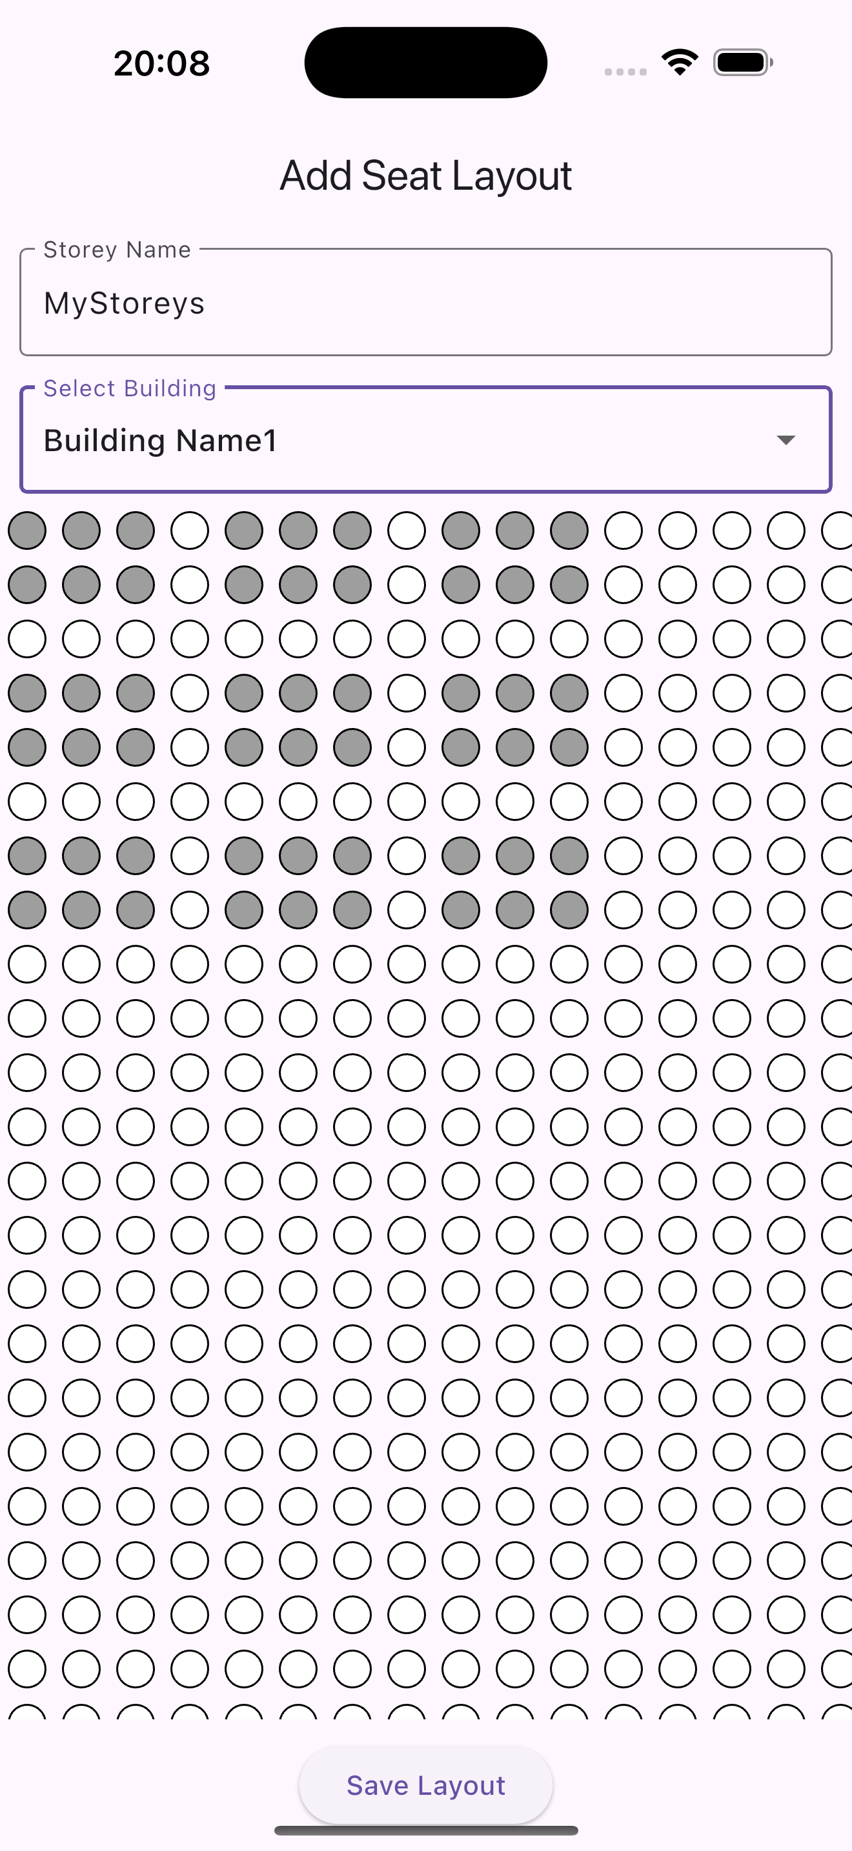
Objectives of the Project
Real-time seat booking and visualization
AI-powered personalized seat suggestions
Scalable multi-tenant backend for organizations
Notes:
The main goal of my thesis was to build a full-stack, production-ready seat management system. I set out to implement three key capabilities:
• A real-time booking and visualization interface, built using Flutter
• An AI-driven seat recommendation engine, based on historical behavior and preferences
• A multi-tenant backend, built with Spring Boot and PostgreSQL, designed for scalability and organizational separation
These features together aim to improve not just technical performance, but also the quality of user experience in modern hybrid offices.

Slide 4



Related Work & Existing Solutions
Tool | AI Integration | Customization | Cost
 | ❌ | ❌ | 100$/month (15 users)
 | ✅ | Limited | 2.5$ user/month
 | ✅ | ✅ | 0.5$ user/month
Temporal prediction of seat usage
Deep learning for desk recommendations
Survey on collaborative filtering
Notes:
There’s growing academic interest in applying AI to workspace optimization.
• Nguyen et al. developed a model that predicts seat availability using historical trends
• Vasudevan and Iyer applied deep learning to recommend desk locations in open-plan offices
• Commercial tools like Skedda and Robin offer booking services, but often lack integration flexibility, AI personalization, or cost-efficiency
To benchmark SeatSurfer, I conducted a comparative study across academic papers and tools, which I also presented at the SCSS Student Conference.
What sets SeatSurfer apart is its open, customizable architecture, and the fact that AI is embedded directly in the booking flow, not just bolted on.

Slide 5
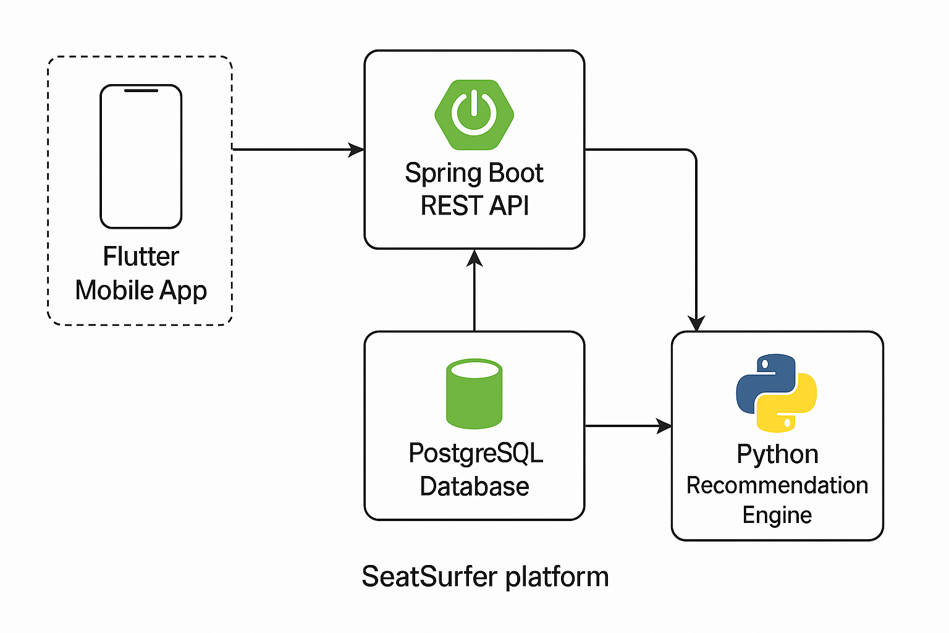
System Architecture
Notes:
SeatSurfer is built using a modular, microservice-based architecture:
• The Flutter frontend ensures a responsive experience across mobile and desktop devices
• The Spring Boot backend handles bookings, authentication, and multi-tenant support
• The Python AI microservice is responsible for generating ranked seat suggestions
Each module is independently deployable, which ensures scalability, maintainability, and ease of extension.

Slide 6
Booking and Recommendation Flow
Notes:
The system follows a clean, asynchronous pipeline:
1. A user requests a suggestion
2. The backend forwards the request to the AI microservice
3. The model uses collaborative filtering and spatial logic to rank available seats
4. The top suggestions are returned and displayed on the interface, with visual highlights
This design minimizes latency and allows the system to scale horizontally as user demand grows.

Slide 7
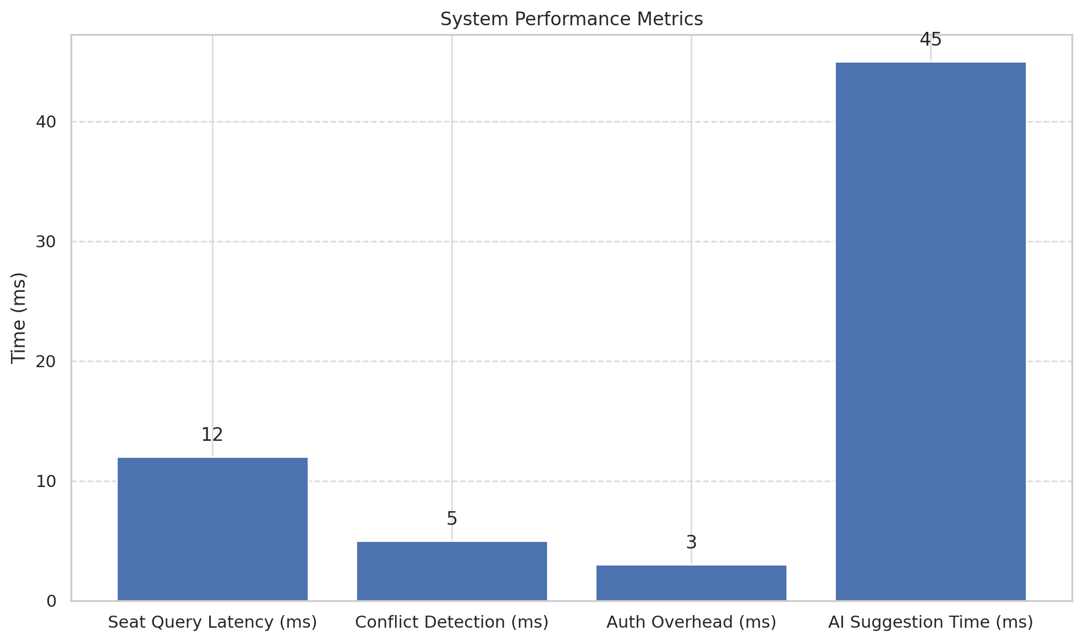
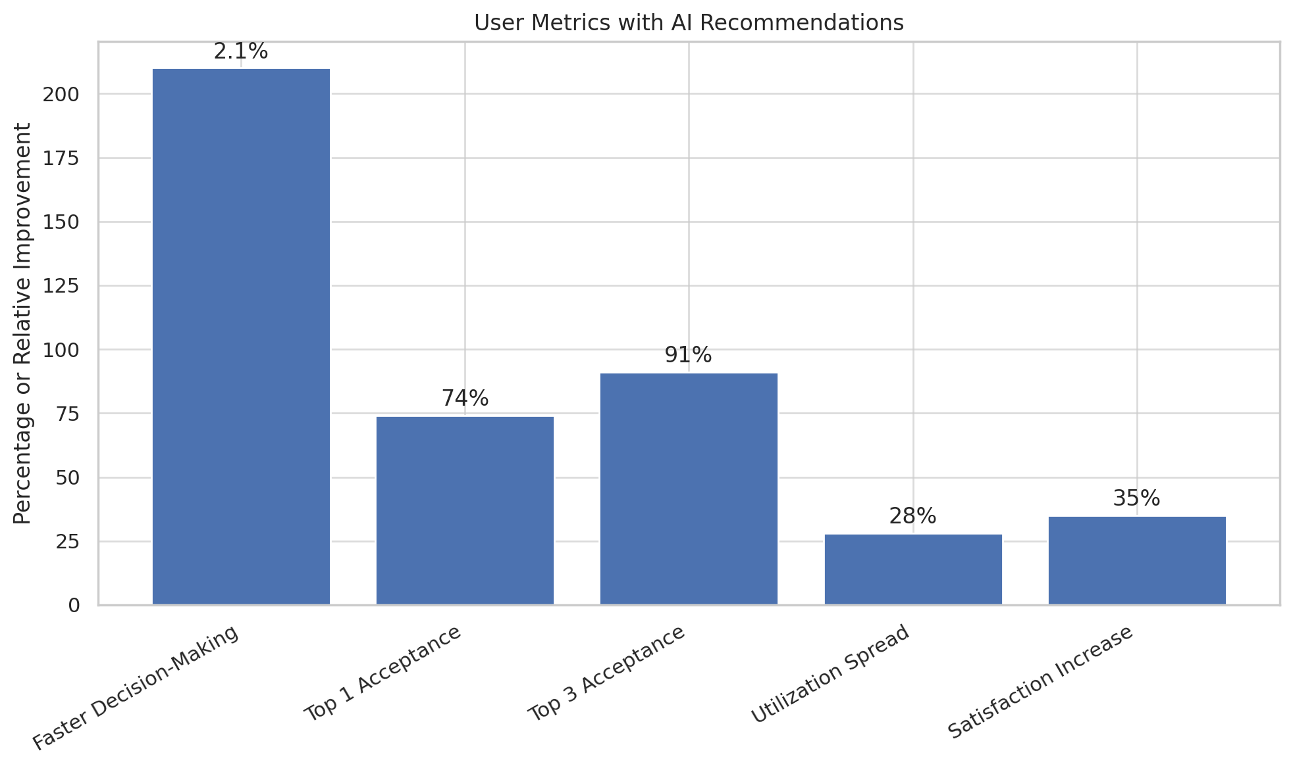
Performance and AI Benefits
Collaborative filtering + spatial heuristics
Input features: booking history, preferences, spatial metadata
Stateless, scalable Python microservice
Notes:
To validate the AI engine, I simulated booking behavior for 200 users over a 30-day period. The simulation covered varying preferences, departments, and floors.
Key results:
• Users booked seats 2.1× faster with AI suggestions
• 91% selected one of the top 3 recommended options
• Seat clustering dropped by 28%, leading to more balanced space utilization
• User satisfaction—measured via Likert-scale feedback—improved significantly
These outcomes show that integrating AI into the booking flow improves not just performance, but also the human experience.

Slide 8
Technical Challenges and Solutions
ADMIN
- id
- username
- email
- password
- buildingIDs
USER
- id
- username
- email
- password
- bookingIDs
BUILDING
- id
- name
- storeyIDs
STOREY
- id
- name
- buildingID
- start_date
- end_date
- seatIDs
BOOKING
- id
- userID
- seatID
- date
SEAT
- id
- seat_row
- seat_column
- storeyID
- details
Notes:
The AI component considers:
• User history — including frequent locations and past preferences
• Temporal factors — such as day-of-week or time-of-day trends
• Spatial features — including desk location, proximity to exits, or clustering patterns
On the backend, the PostgreSQL database is normalized to 3NF, with tables for:
Users, Bookings, Seats, Floor layouts and buildings
Security is handled via JWT-based role access and tenant scoping, ensuring full separation between organizations.

Slide 9
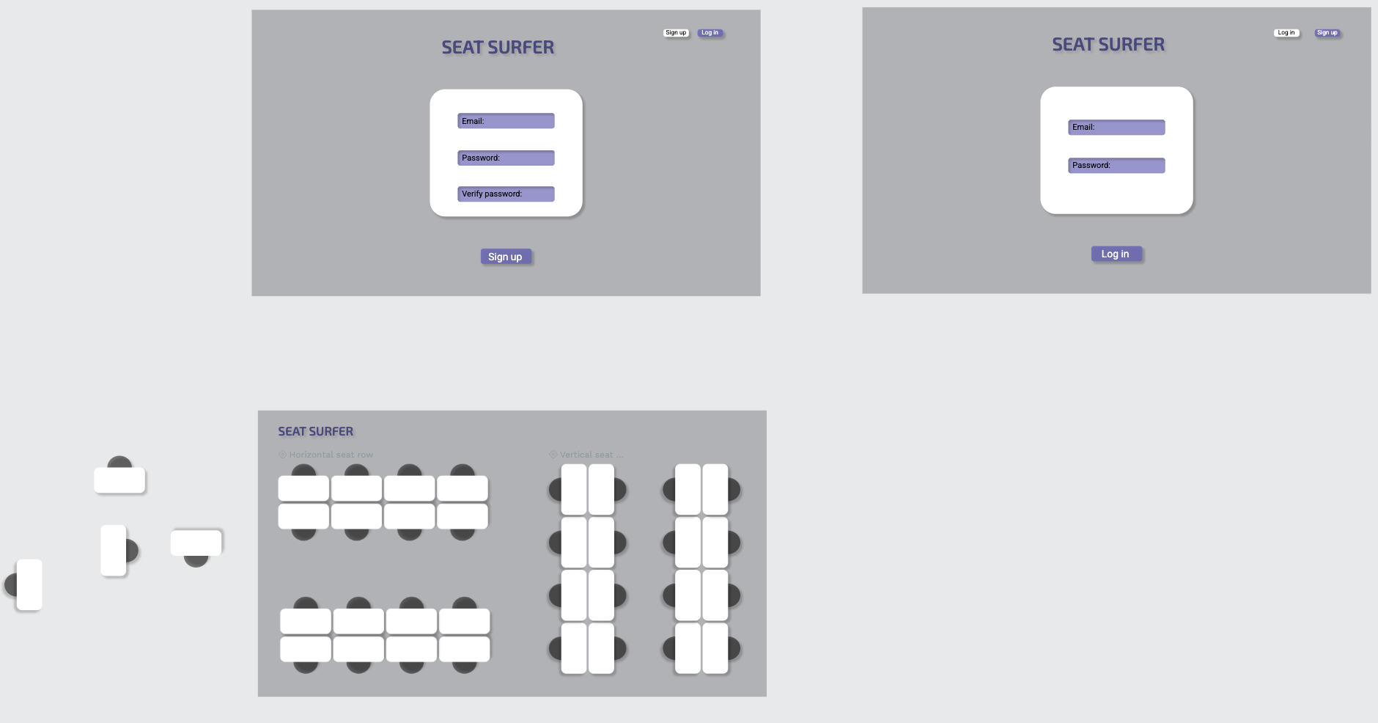
Development Methodology
Agile methodology
UI prototypes
Testing
Notes:
The application was built entirely from scratch using an Agile development process. Key steps included:
• Weekly sprints with reviews
• Wireframing and UI prototyping in Penpot
• Test-driven development using unit and integration tests
• Continuous simulation using mock data
No pre-built frameworks were used for booking or recommendation logic. This allowed me to control every layer and focus on deep understanding and scalability.

Slide 10
Conclusion and Future Work
Benefits: Efficiency, user satisfaction, scalable and intelligent system
Future improvements: IoT integration, team-aware recommendations, reinforcement learning
Notes:
In summary, SeatSurfer offers a practical and innovative solution to a real-world problem. It combines:
A robust backend, A clean user interface, And a working, production-ready AI assistant
My contributions include:
Designing a scalable, secure, and multi-tenant system
Implementing an AI recommendation engine from scratch
Running simulations and evaluations based on realistic hybrid office scenarios
For future work, I plan to extend the system with: IoT sensor integration for real-time occupancy, Reinforcement learning for dynamic seat policies
And team-aware seat clustering, which helps teammates book close to each other

Slide 11
Thank You / Q&A
Notes:
Thank you for your attention.
I look forward to your questions!

