Slide 1
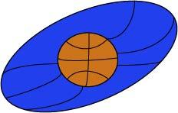
Basketball Vision
Team 3 - Kendall Weihe, Jared Becker,
Thomas Underwood, Matt Resch,
and Byron Giles

Slide 2

Introduction
Client:
Mr. Williams & North Oldham High School
NOHS’ first partnership with UKY
How the project came about
Delegating some responsibilities to high school students

Slide 3
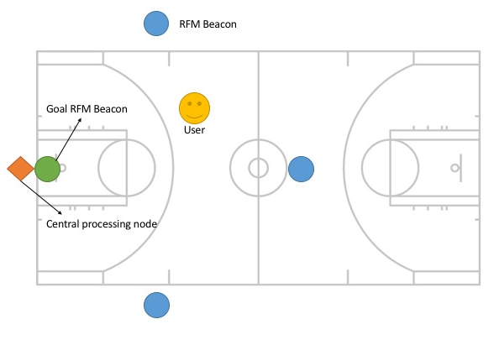
Embedded Systems
Position
Where am I?
Distance
How far am I from the basket?
Shot Detection
Did I make a basket?

Slide 4
Positioning
User’s microcontroller emits signal
Anchor nodes receive signal and compute distance
Send to central node
Central node computes (x,y)
Sends to smartphone

Slide 5
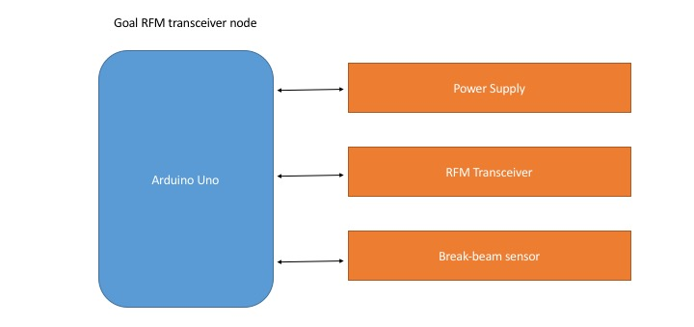
Shot Detection
An IR sensor at the rim detects if a shot is made

Slide 6
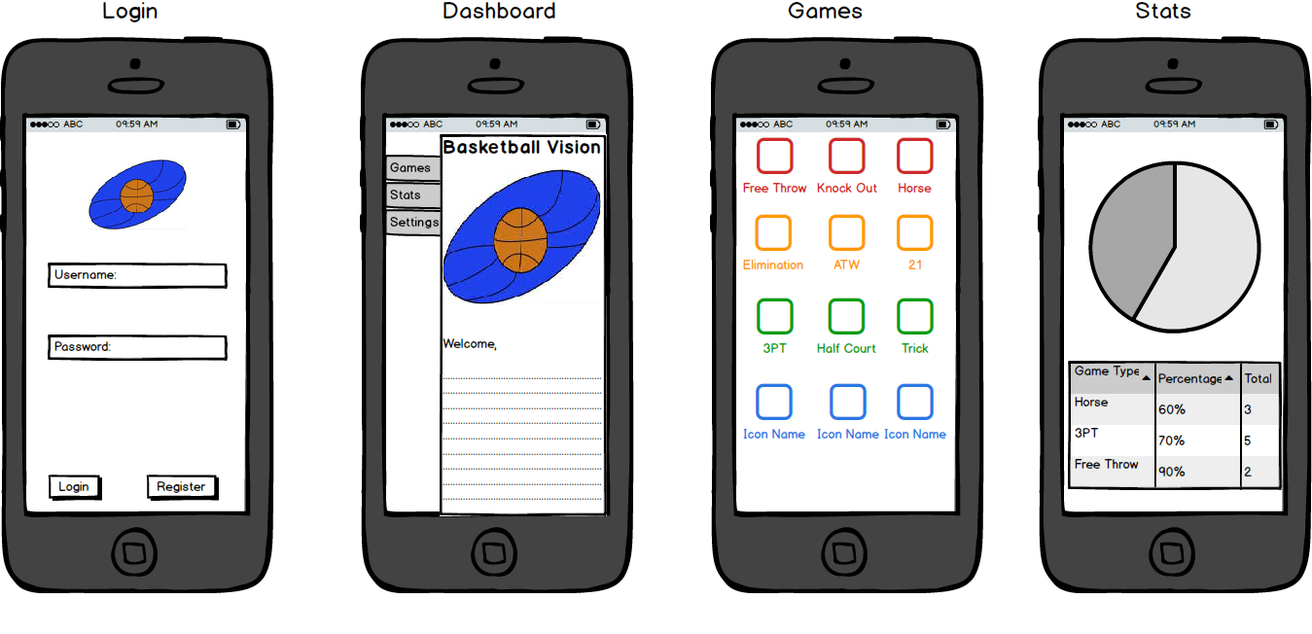
Milestones
User authentication
Encryption
Statistics
Games
HORSE

Slide 7

Cloud Integration
Google Cloud Platform (GCP)
Firebase
Cloud service provider (GCP)
Backend
Asynchronous database
Live updates
Notifications
Messaging

Slide 8
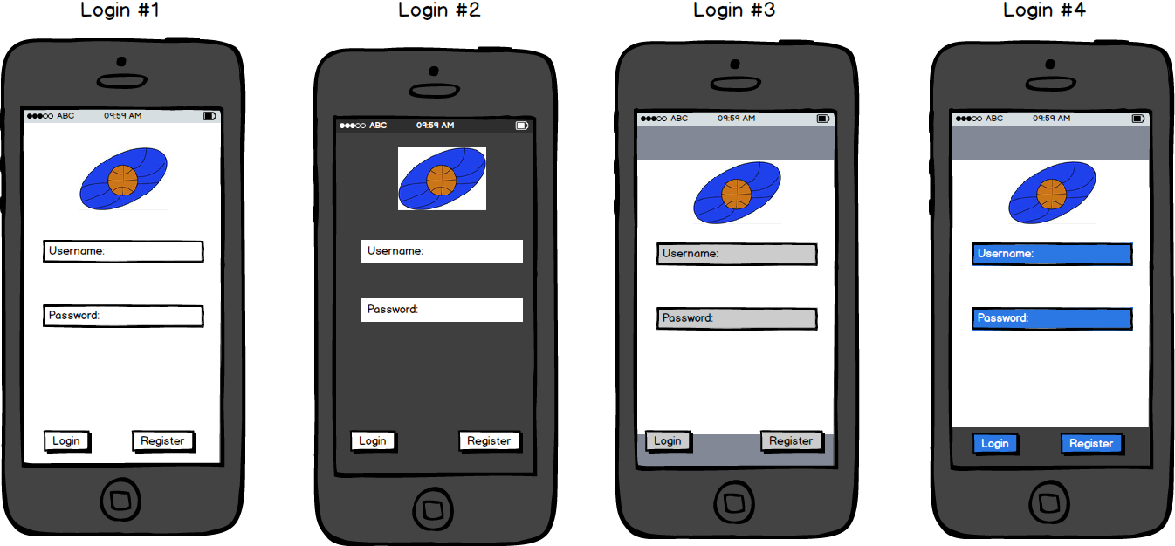
User Authentication
Login via…
Google
Facebook
Twitter
Encrypted login

Slide 9
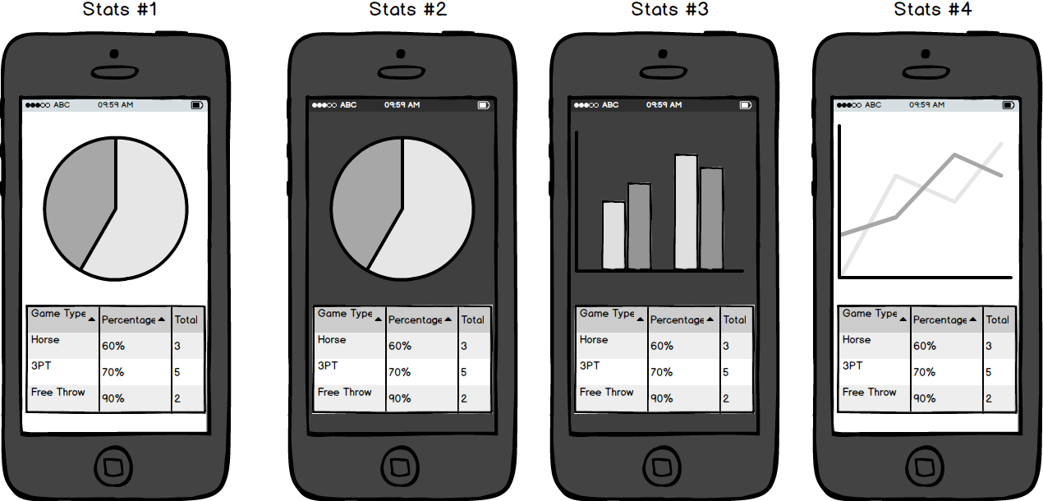
Statistics
Store statistics for current session and entire history
Store:
Shooting percentage
Number of 3-pointers
Number of 2-pointers
Total number of points

Slide 10
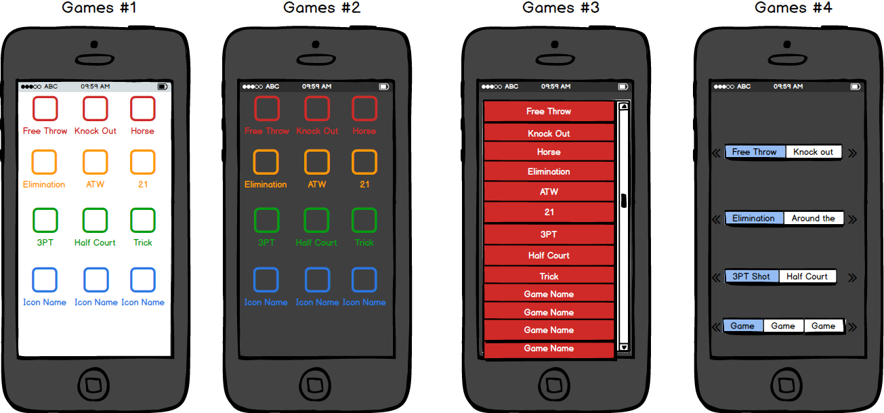
Games
HORSE
Do you know how to play HORSE?
Location
Current score

Slide 11
Closing Statements
Partnership with NOHS
Hardware system to collect info:
Position
Distance to goal
Shot made?
Mobile application:
Inform the user via audio
Store user statistics
Play games
Awesome opportunity for something that isn’t on the market
Future developments?

