Slide 1
Prodigo
Incessant Integration for Inspiring Education

Slide 2
“Hello World” I am Prodigo
Prodigo is a platform which not just fill the common communication and administration gaps but also collects and analyzes data. It saves an enormous amount of time and human effort. It is fast and effective with utmost accuracy. This will establish a smooth flow of administration with it’s user-friendly Interface. This will boost the performance of the Institution/Organization and it’s progress a notch higher.

Slide 3

Will excuses and explanations repair the damage done?
“ Nobody told me about that”
“ I was uninformed”
“ I forgot”
“I did not receive”
“I don’t Know”
These are the some of the common words for which we pay a price.

Slide 4

We are here to bridge these gaps of information.
Prodigo plays the role of your personal assistant and will establish a smooth flow of administration.
There are reminders which brief you the tasks for the day.
A schedule that notifies you deadlines, upcoming events, and lots more.
The transfer of assignments and Documents directly to the concerned administrator are just one click away.
No more mediators.

Slide 5
Ever struggled for collection and organization of Data?
This is one of the major problem faced in any institution or organization.
Let’s tackle it, Once the participants are registered on this platform the collection of data is just one click away.
Every time you need data just push a notification on to your Client's screen.
Most interesting part is that the data collected can be effortlessly analyzed and displayed Static visual aids.
This will enable you to comprehend the most complex data and work on the areas of improvement.

Slide 6
Visual Stastics
An illustration of students attended for online classes vs the months.

Slide 7



Is it complex to use?
Well, not more than an 6th standard math problem.
The lucid User friendly interface will give the users a smooth experience without any complications.
Never the less technical team is always there for your rescue in case you need them.

Slide 8
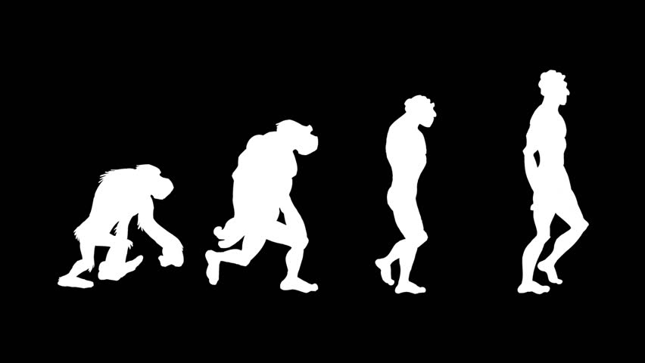

So what are you waiting for?
It’s time to update from the old methods of administration to new technology for better communication and development.

Slide 9
Thank You

