Slide 1
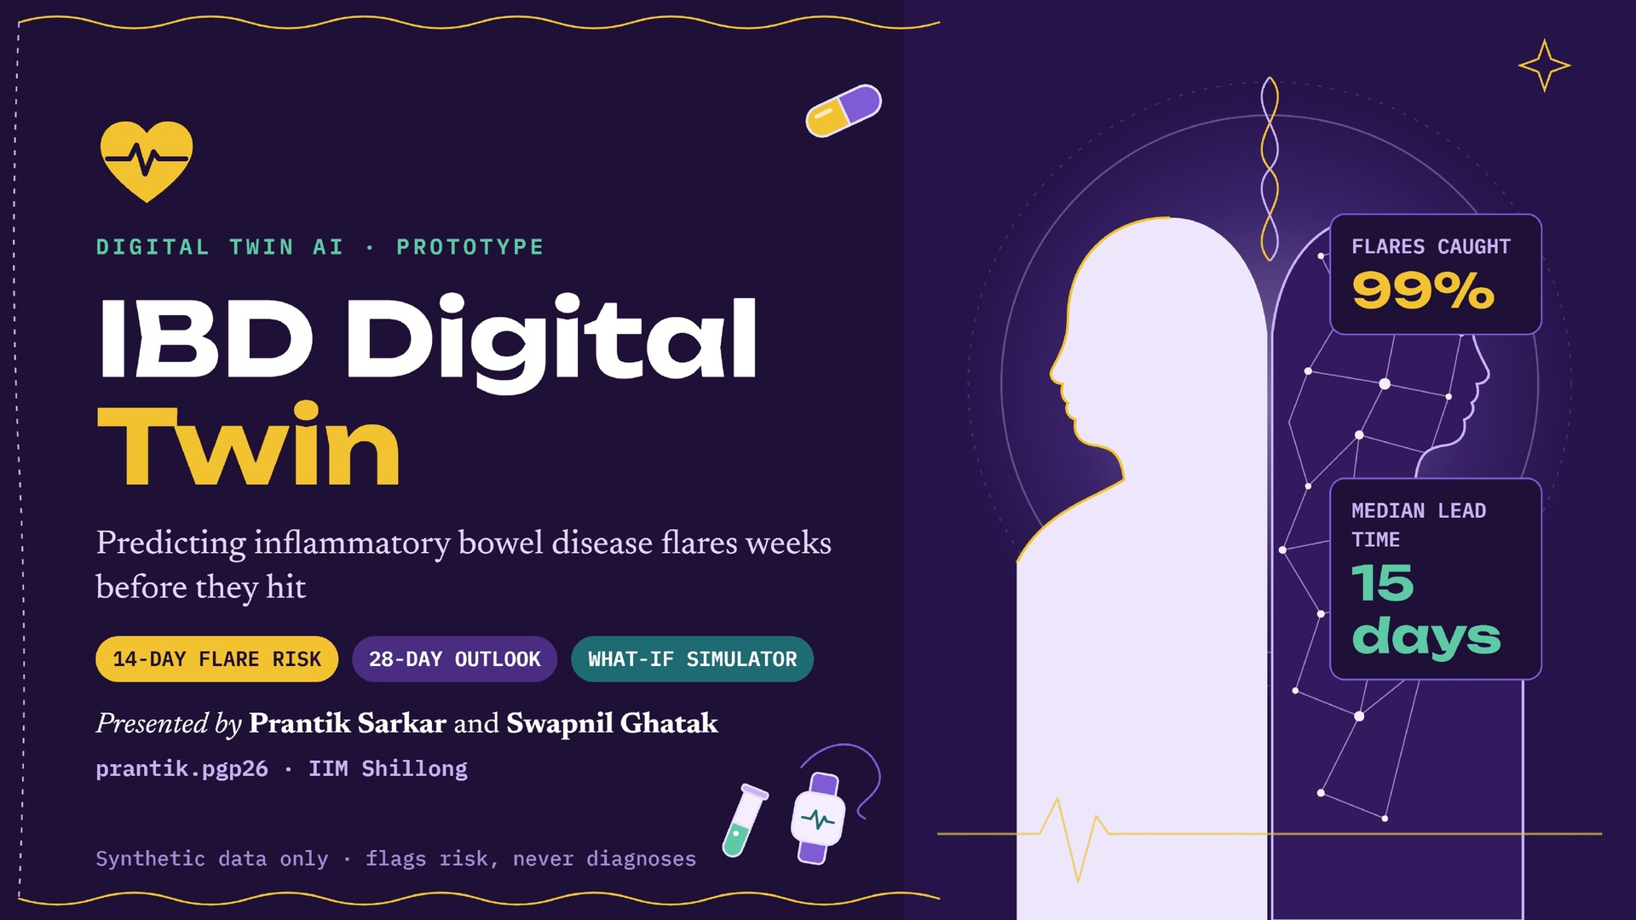
Notes:
Introduce the team. One line: a blood-pressure cuff for gut inflammation. Happiest Health Digital Twin challenge, Phase 1 submission.

Slide 2
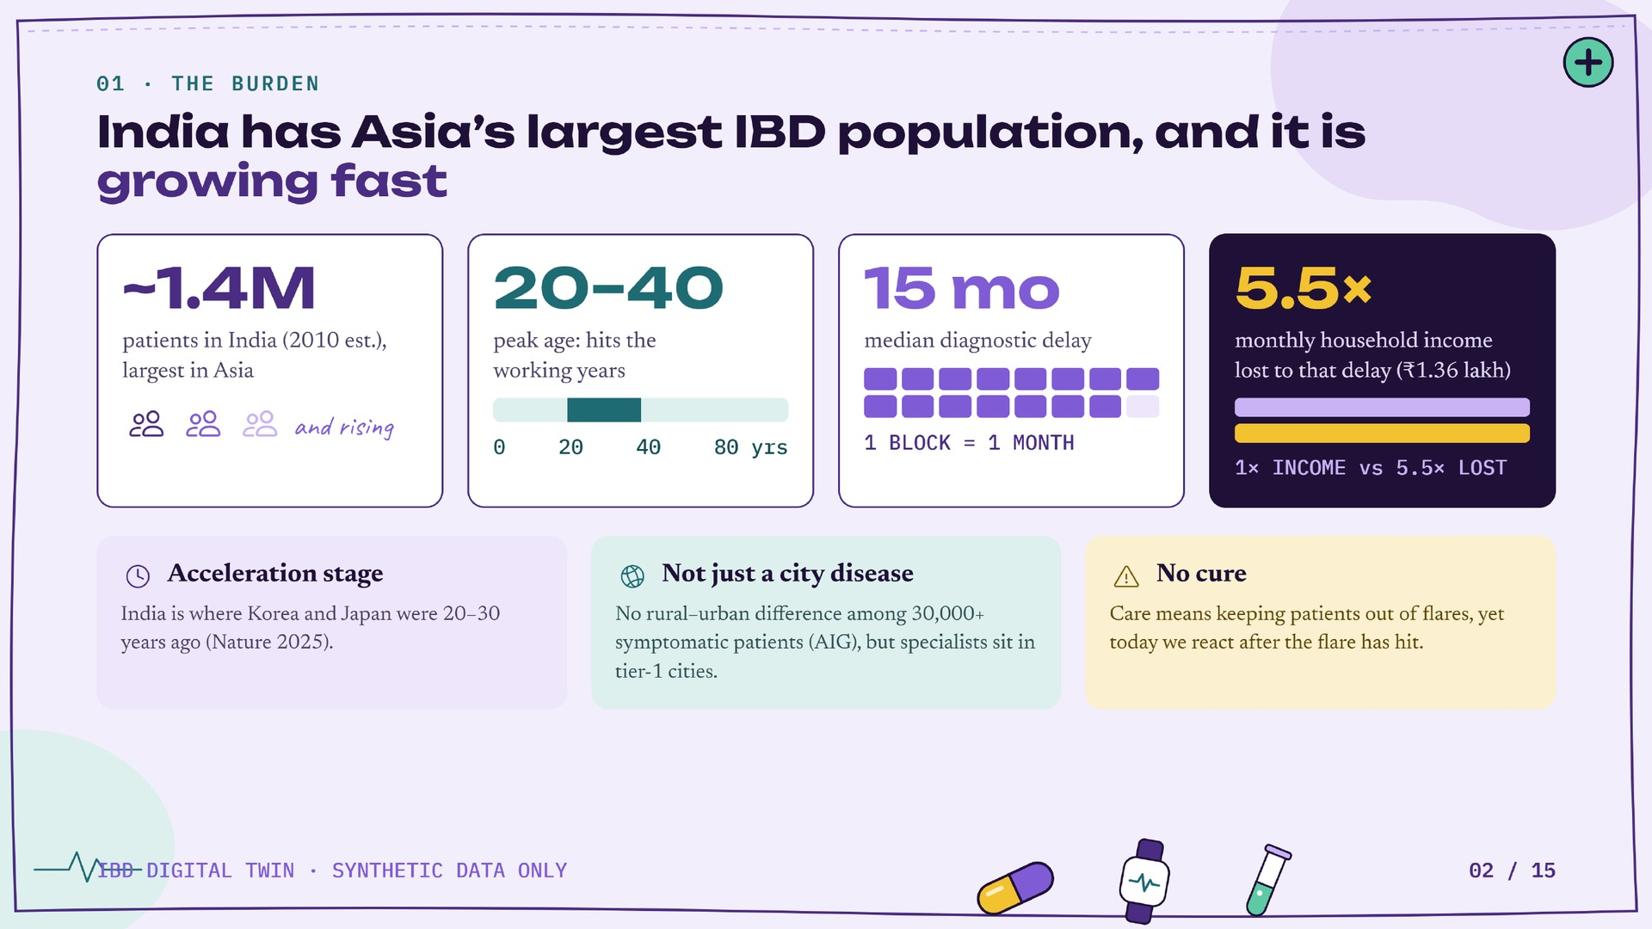
Notes:
3 minutes. Answer 'is IBD prevalent?' with growth and severity, not headcount. Sources: Kedia & Ahuja Pivot to Asia; Indian J Gastroenterol diagnostic delay study; Hracs/Kaplan Nature 2025; Banerjee et al. Lancet Reg Health SEA 2023.

Slide 3
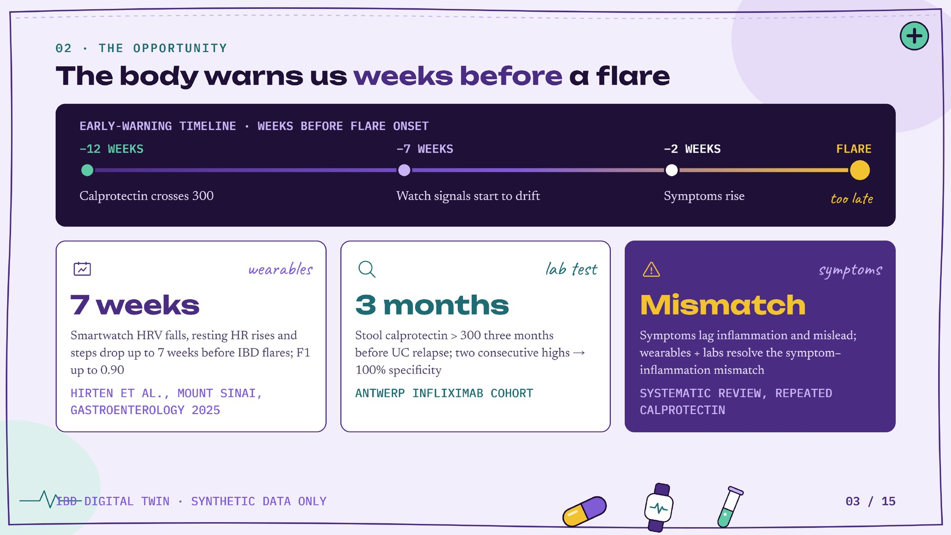
Notes:
2 minutes. The evidence base. Emphasise this is research-proven but not productised: no IBD digital twin exists.

Slide 4
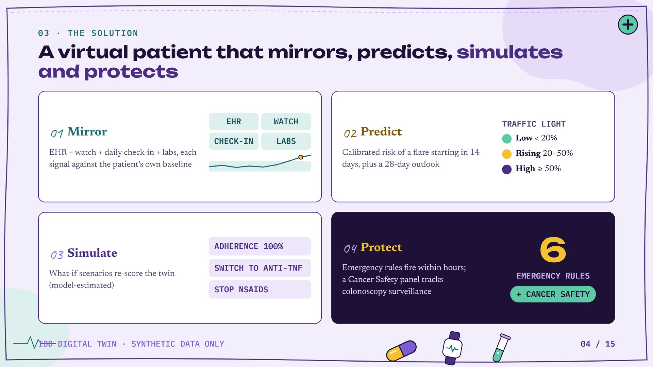
Notes:
2 minutes. Twin concept. The simulate step is what makes this a twin rather than a classifier.

Slide 5
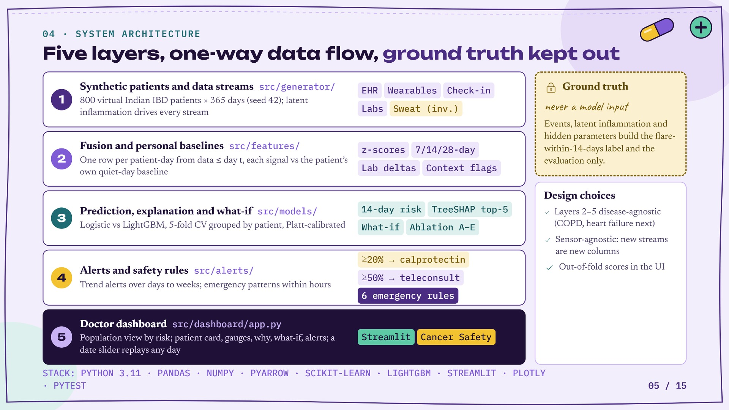
Notes:
3 minutes. Walk the five layers top to bottom. Stress: ground truth is labels-only; lab reason/setting dropped; only prescriptions and logged colds/infections read from events. Disease-agnostic layers 2-5; sensor-agnostic.

Slide 6
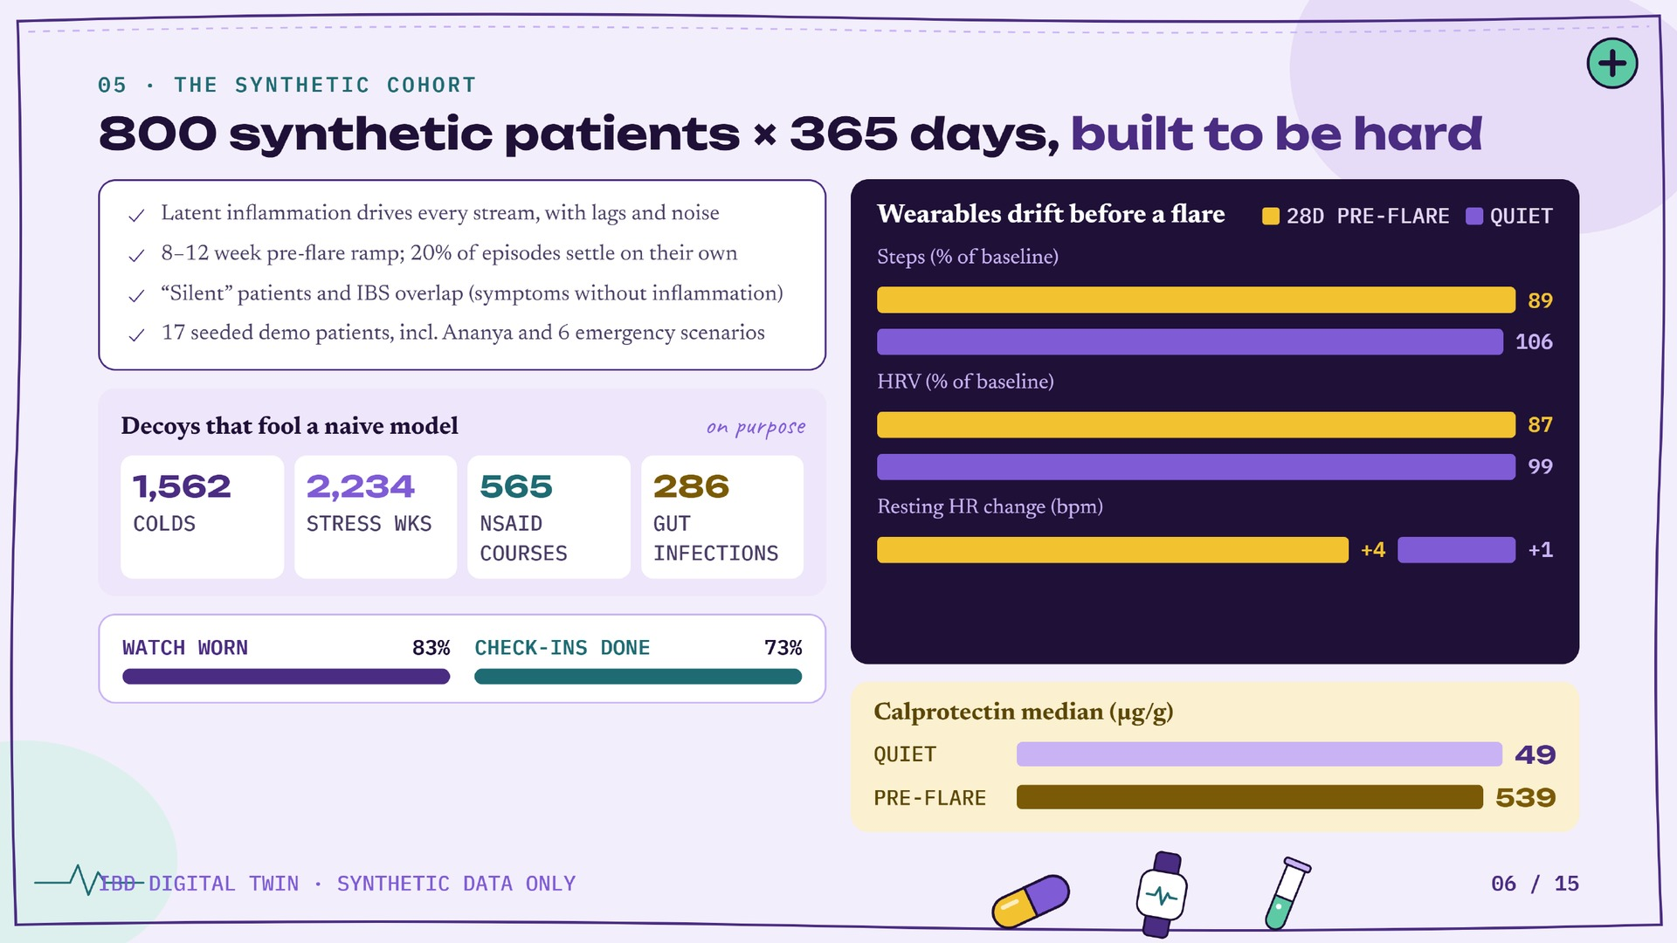
Notes:
3 minutes. Synthea has no IBD module, so we built a seeded generator. Drift sizes are design assumptions informed by the literature, not measurements.

Slide 7
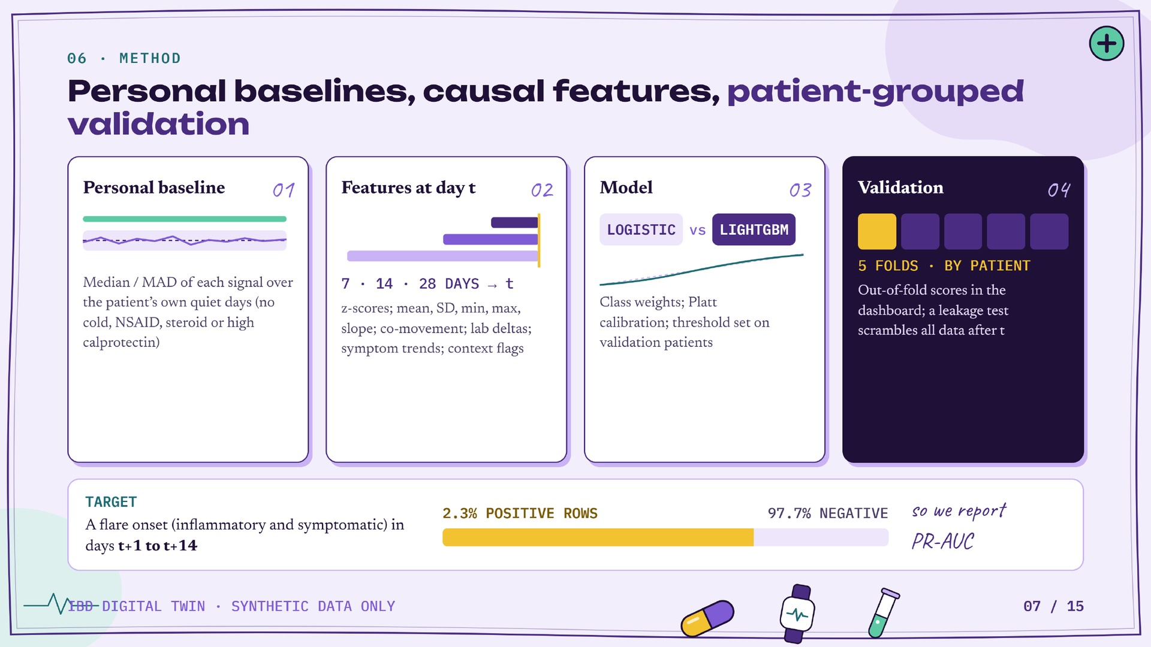
Notes:
Explain no-leakage: features at t use data up to t only; there is a pytest that proves it. Guard: PR-AUC above 0.95 is treated as a bug.

Slide 8
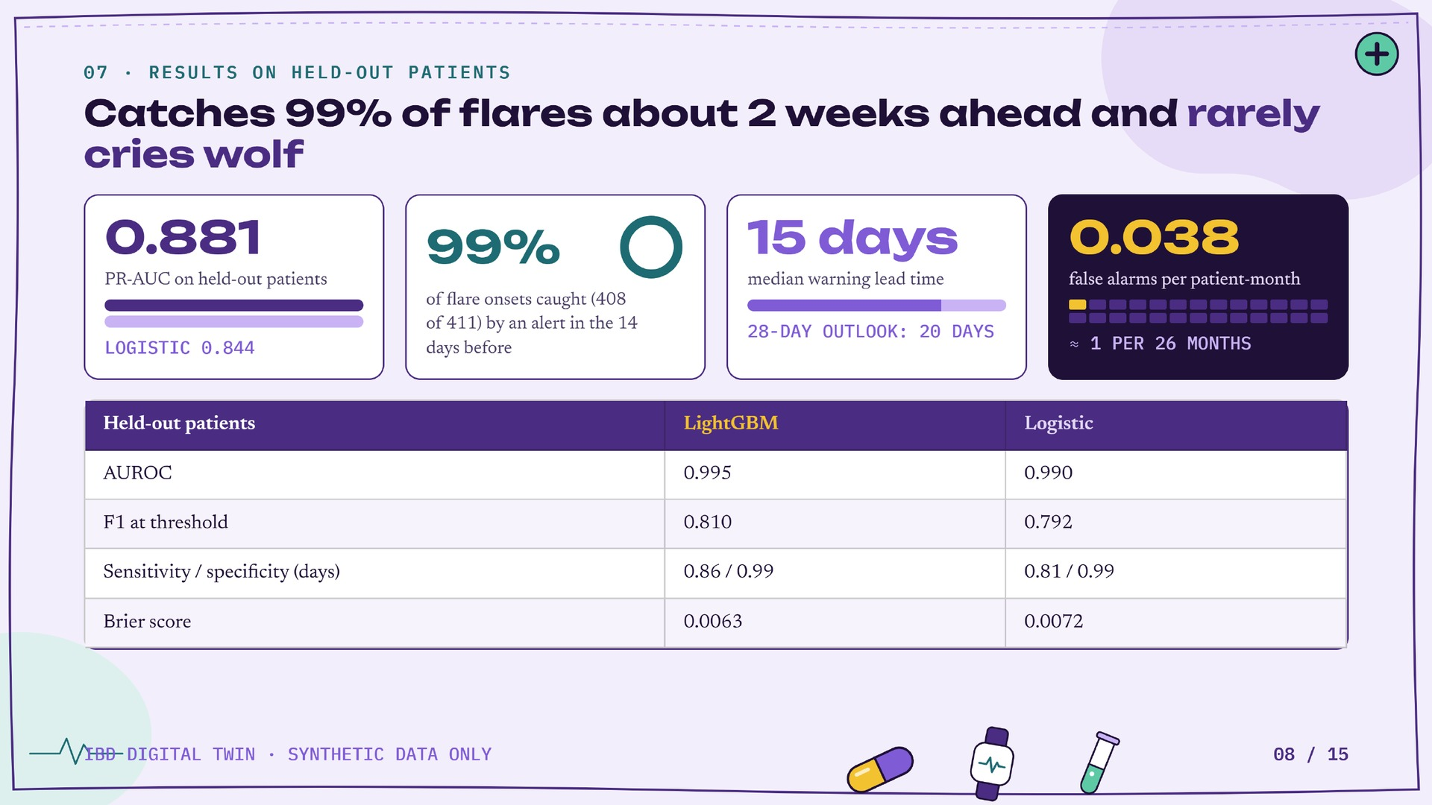
Notes:
3 minutes. 5-fold patient-grouped CV. Lead time is from the start of the alert episode to onset. Synthetic data: strong metrics show the pipeline works, not clinical accuracy.

Slide 9
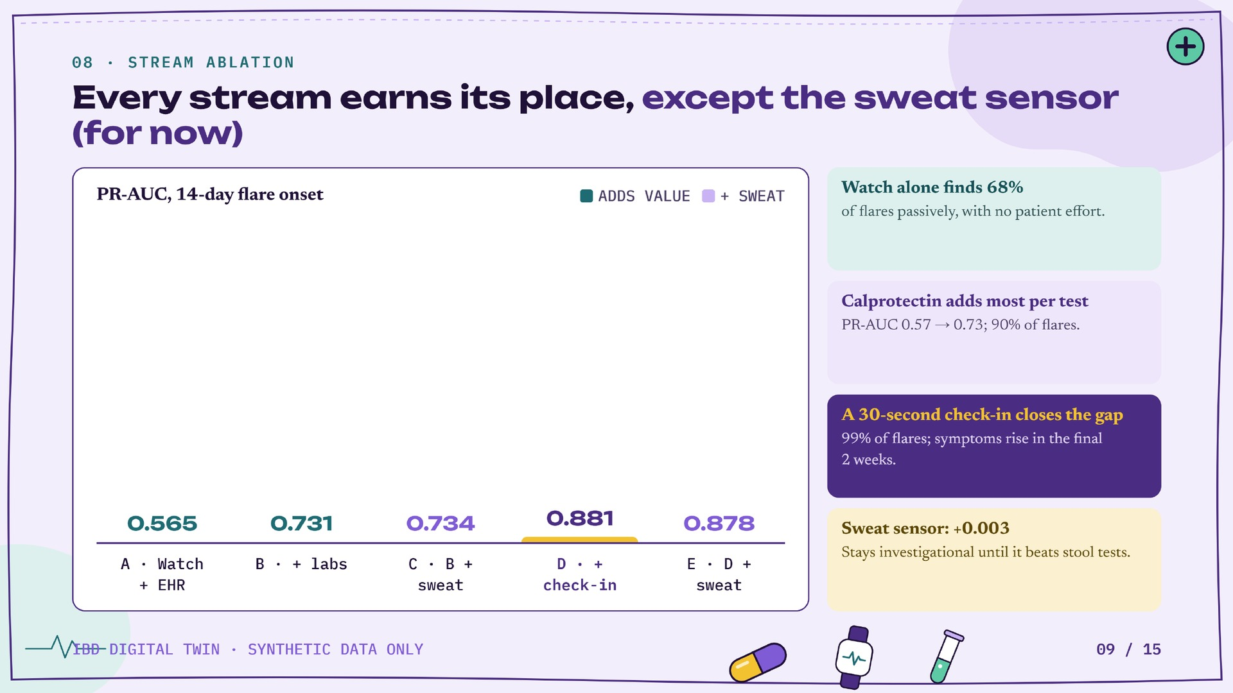
Notes:
The ablation quantifies the value of each stream: A wearables+EHR, B +labs, C +sweat, D +symptoms (main), E D+sweat.

Slide 10
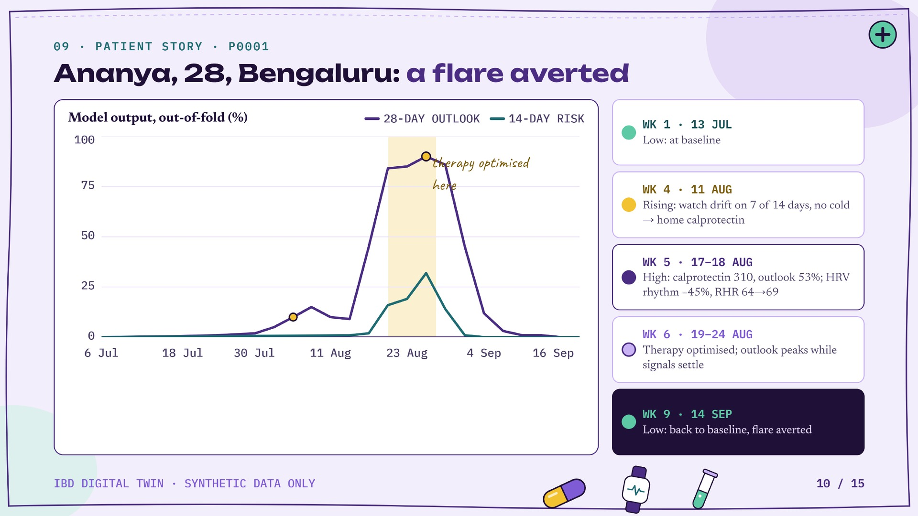
Notes:
4 minutes live demo: use the Ananya replay buttons in the sidebar. Then open P0002 on its emergency day (acute severe colitis) and P0013 for the Cancer Safety panel. Every number shown is model output, not scripted.

Slide 11
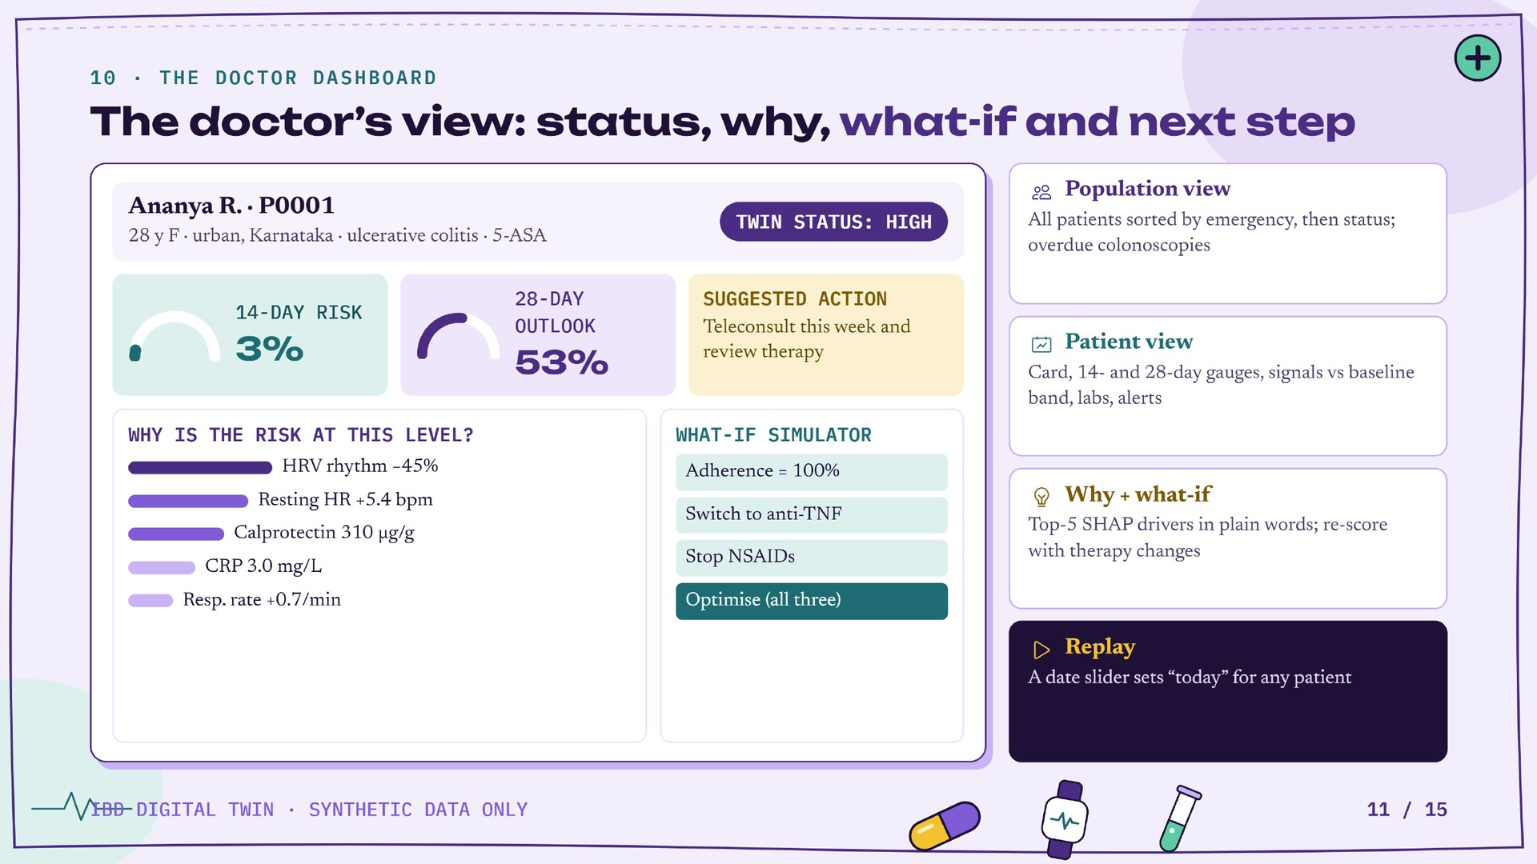
Notes:
Run locally with one command: make dashboard. Streamlit + Plotly.

Slide 12
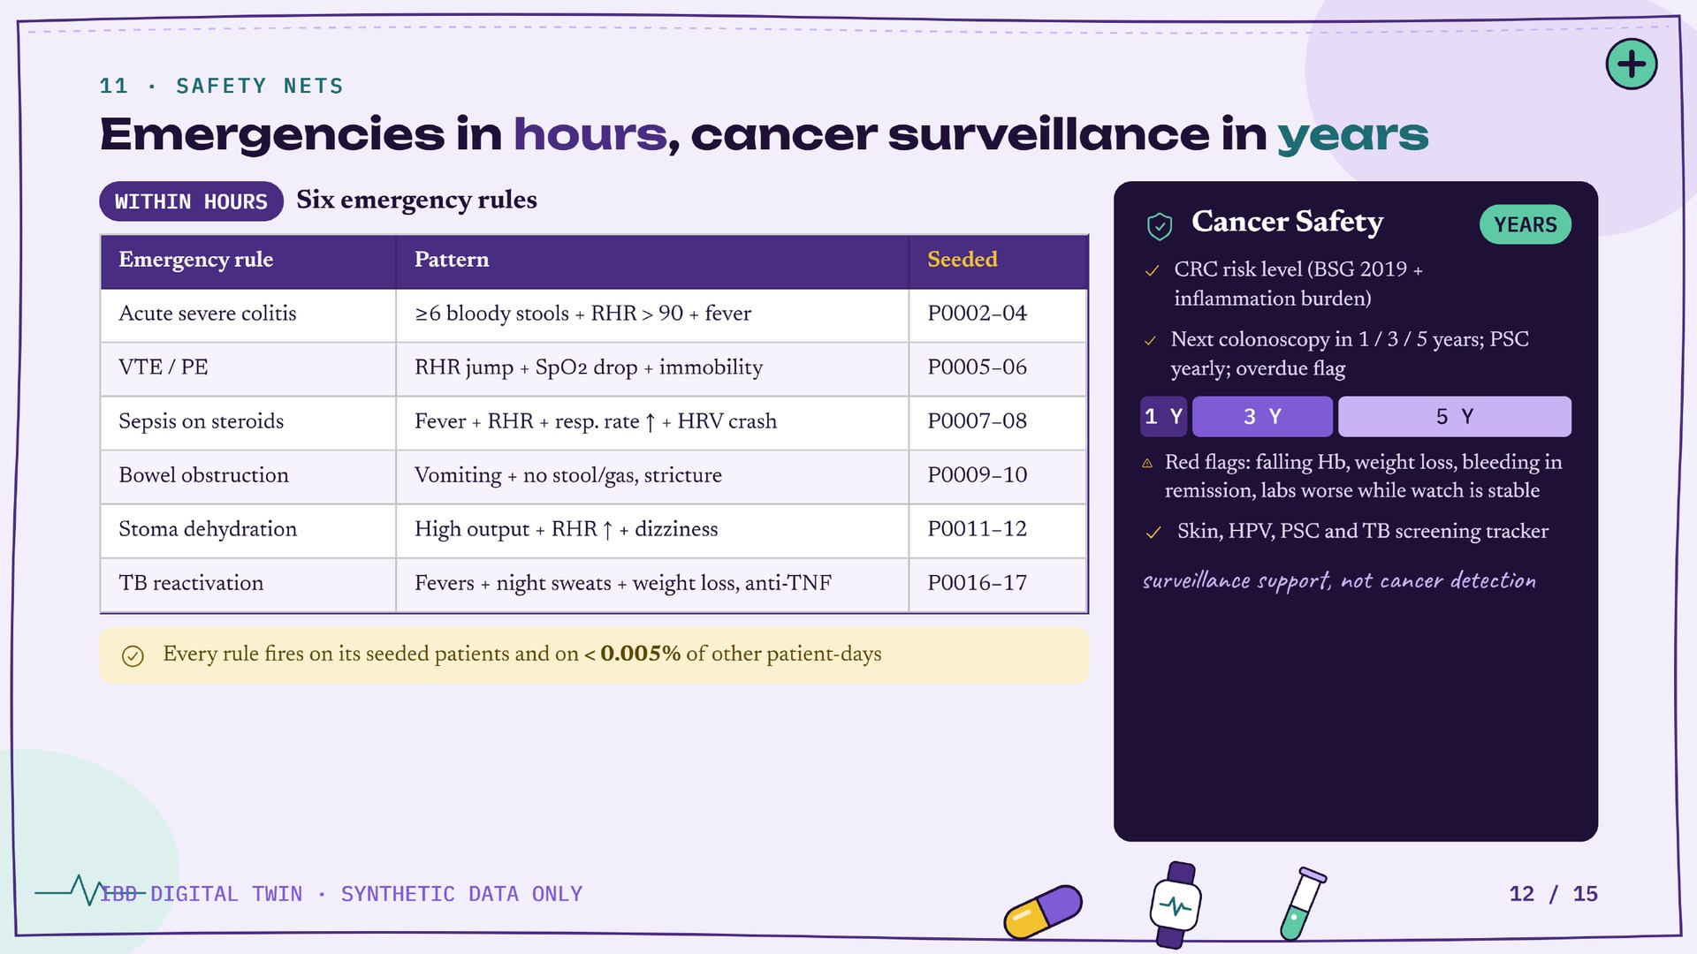
Notes:
Show P0007 on 8 Apr 2026 (sepsis) and P0013 Cancer Safety. Stage I CRC ~90% 5-year survival vs stage IV ~13-15%.

Slide 13
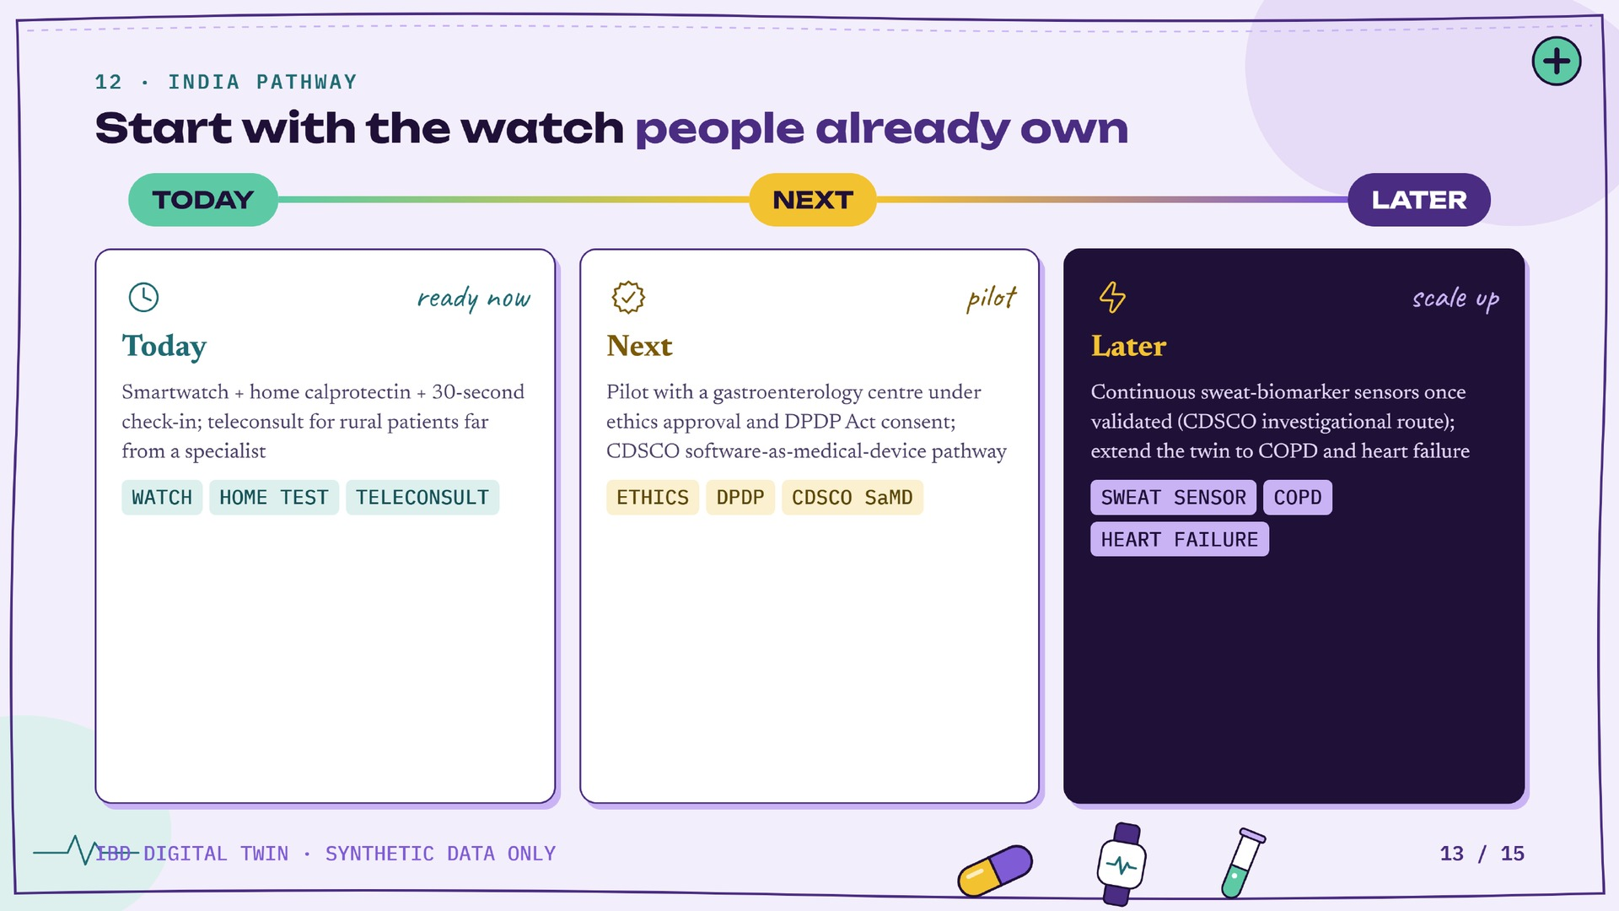
Notes:
1 minute. Layers 2-5 are disease-agnostic; the sensor slot is sensor-agnostic.

Slide 14
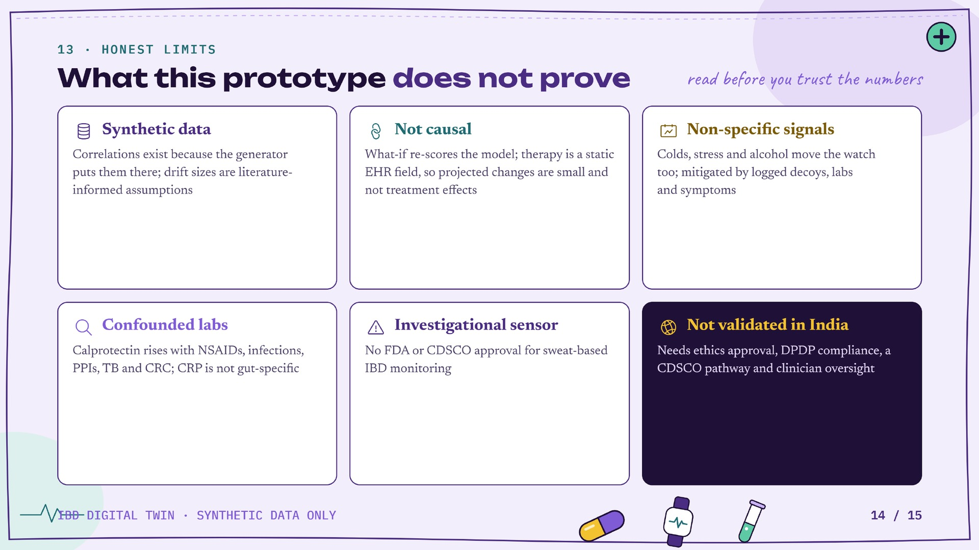
Notes:
1 minute. Flags risk, never diagnoses.

Slide 15
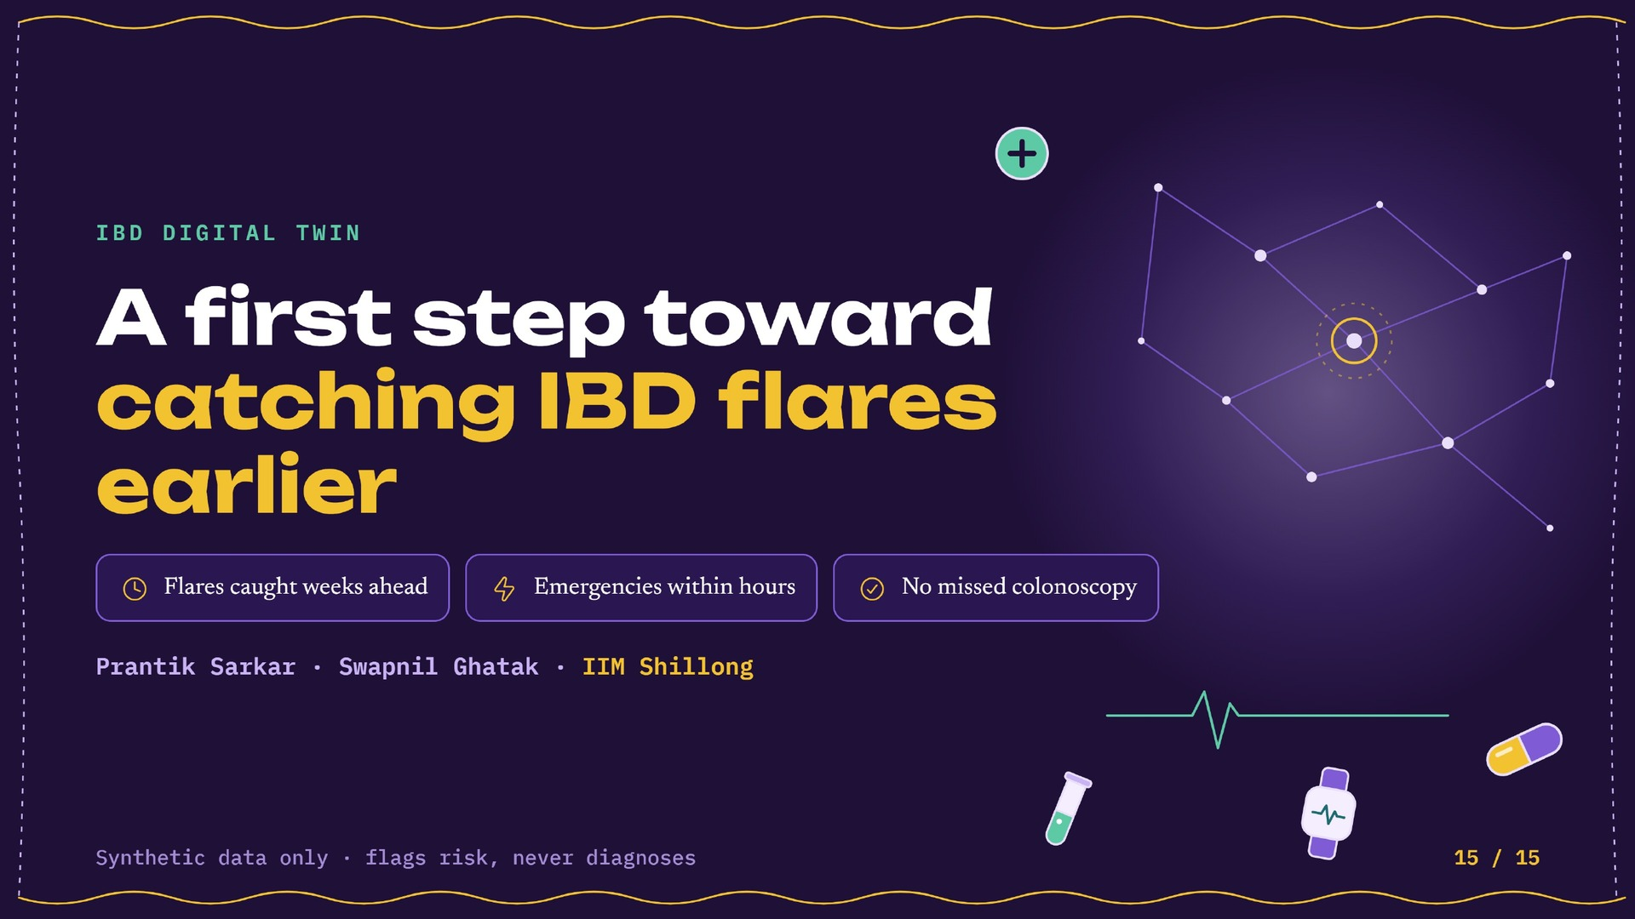
Notes:
Close with the one-liner. Thank the jury.

