Slide 1
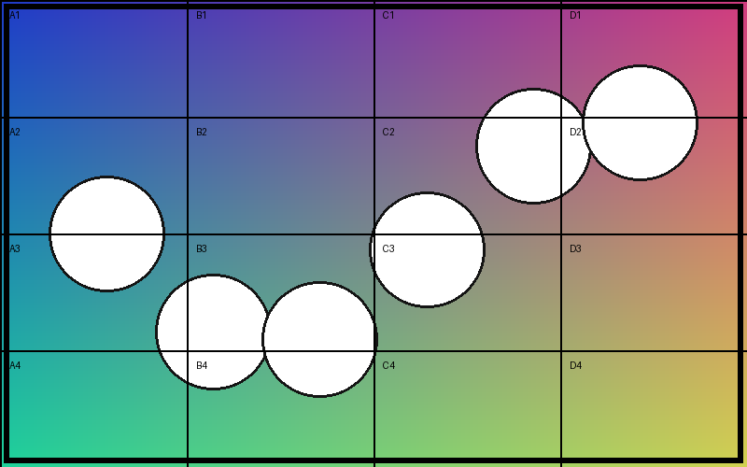

Picture at native aspect, and stretched

Slide 2

Cropped pictures
Left: columns B–C. Middle: rows 3–4. Right (JPEG): columns C–D, rows 2–3.

Slide 3
Text over a full-bleed picture

