Slide 1

Cyber Adventures
By Pritesh Mehta and Poojan Shah

Slide 2


Social Cause
In this age of increasing digital exposure, it is pertinent that children be educated about a safe and secure stay in the online world – they should have a basic understanding of cyber-security.
Our game aims to provide this education in an interactive and gamified manner to increase reach and accessibility.

Slide 3
Aim of the Game
Target audience is adolescent and pre-adolescent age group - where children generally get their first taste of an independent online existence.
A simple platform to provide insights about various concepts like password security, internet ethics, and anti-virus software.
We hope to not only provide awareness, but actual and tangible outcomes so that the audience becomes capable of starting to be wary about online scams, cyber-bullying, information leakage, etc.

Slide 4
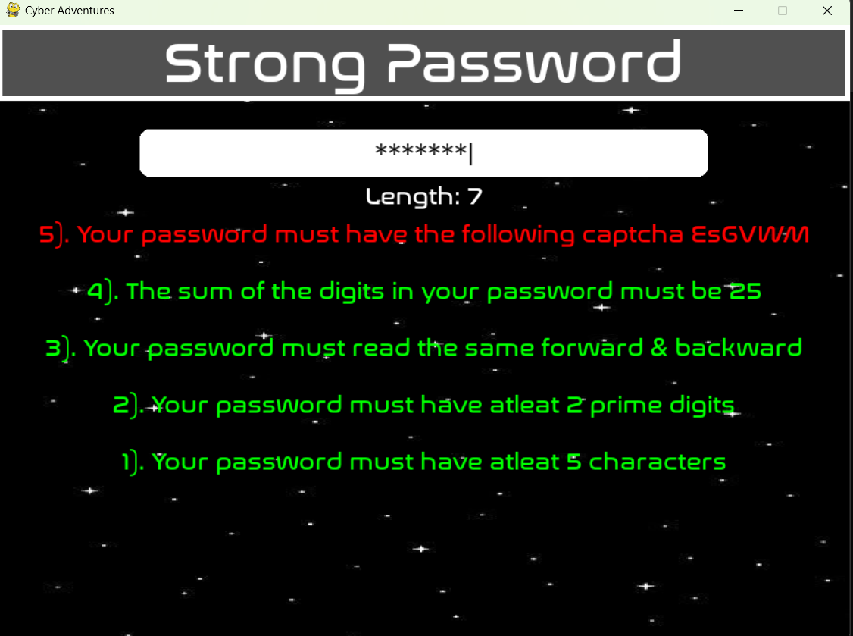
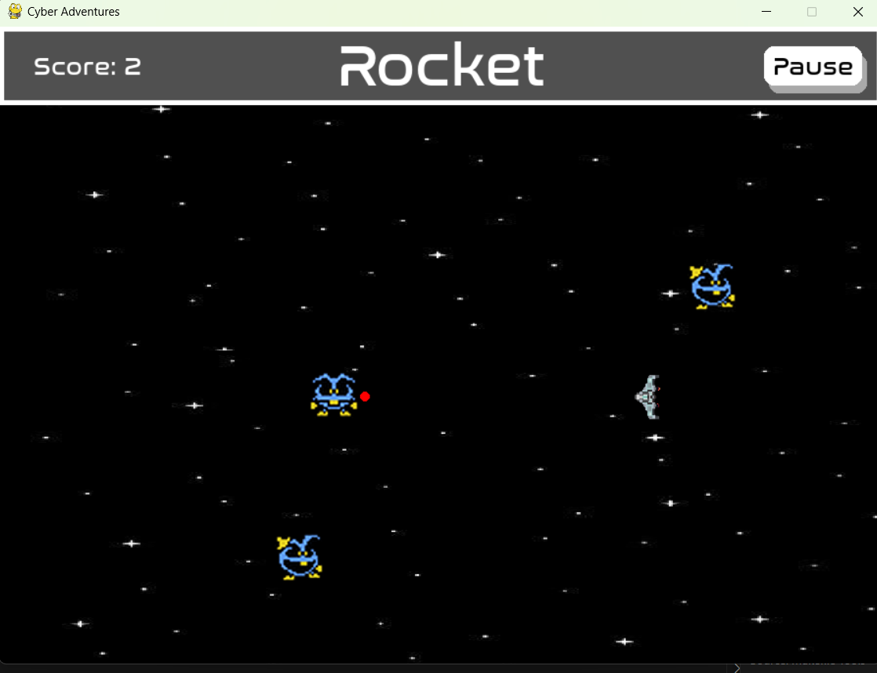
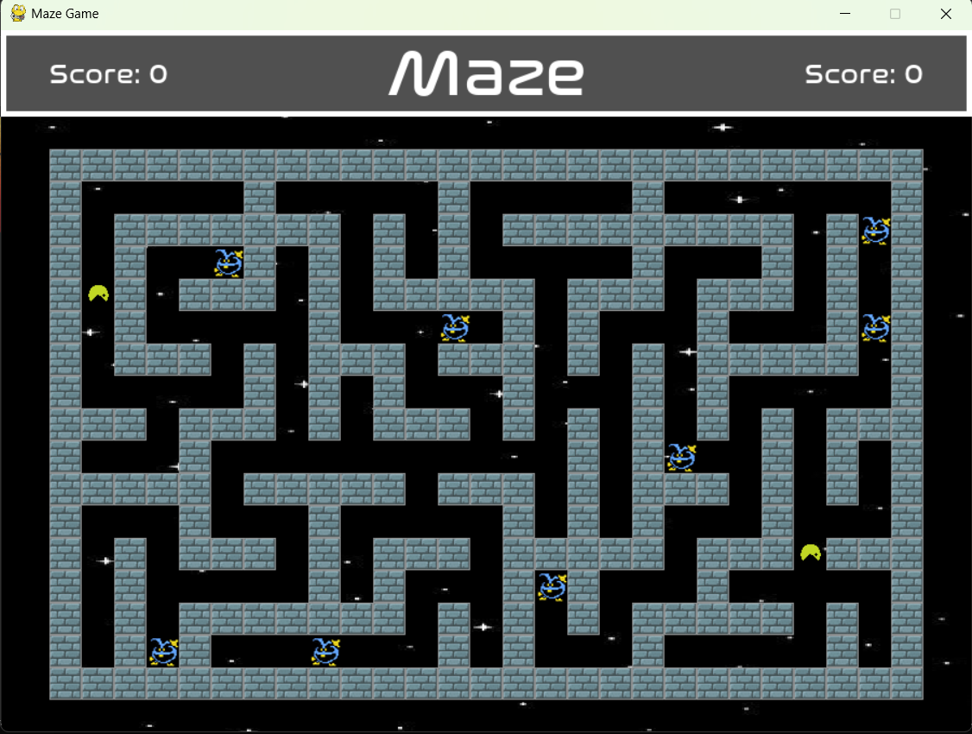
Mini Games
Password Game: A puzzle-like game to create strong passwords while maintaining constraints. The hard mode features more mathematical puzzles and invisible passwords.
Rocket Game: A fun arcade game to prevent viruses from crossing over your computer.
Maze Game: An arcade game to catch viruses and learn about security.

Slide 5
Game Mode
Story Mode: This is a guided educative experience with gameplay.
Arcade Mode: This allows the audience to play the above games independently. They can choose difficulty levels and play as single players or in multiplayer mode.

Slide 6
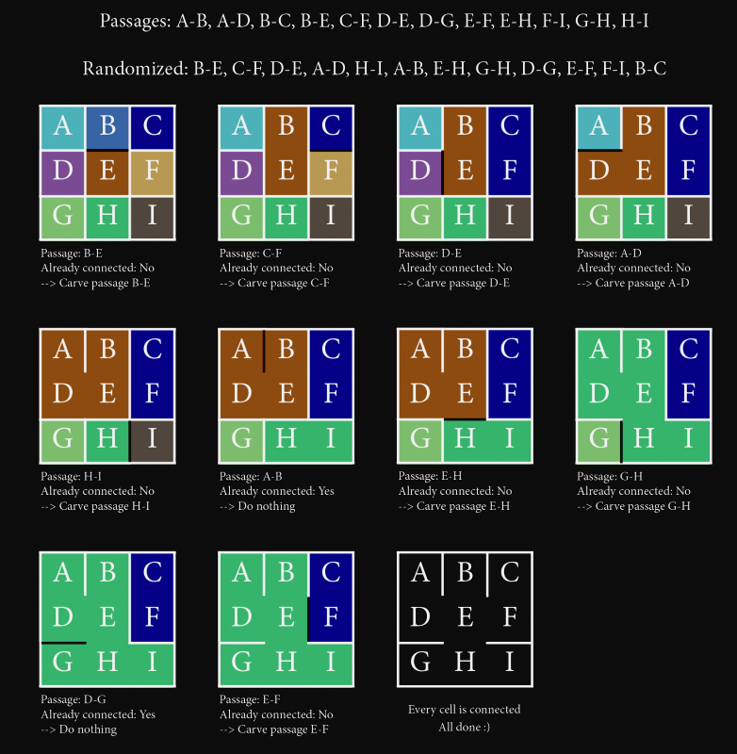
Data Structures & Algorithms
Being CS students, one of the main goals of this project is to apply interesting DSA concepts while designing the gameplay mechanics.
We used the Disjoint Set Union Find (with rank and path compression) to implement a randomized version of Kruskal's Algorithm to generate a new level every time.
This algorithm is guaranteed to generate a "good level" in the sense that it produces a spanning tree without any cycles, so between any two points, there is exactly one unique path - this increases the difficulty as well as the enjoyment!
Not only this, but we have also provided a mesmerizing visualization of the algorithm in action while generating the maze level.

Slide 7

Data Structures & Algorithms
Intelligent Enemies
Another interesting domain is to make intelligent game enemies. Another aspect that makes games fun to play is randomness in generation (which we also leveraged in the preceding slide).
Rocket Game
The enemies are generated randomly from all four directions. We allow 4-directional motion for the player. The probability of an enemy being generated is indirectly proportional to the square of the total number of enemies present on the screen - this allows for a good balance and hence, a good player experience.
Maze Game
The enemies are generated at random, and at each timestamp move randomly. If the player is too close to the enemy, then the enemy tries to move away from the player. In the course of the game, the enemies also randomly teleport to different locations in the maze to increase the difficulty.

Slide 8

Design Decisions
UI Philosophy:
We chose to keep our UI simple, intuitive, and responsive to provide a smooth experience.
Navigation:
The player has the opportunity to return to the main menu using the escape key at any time they want. Moreover, they have the ability to pause and resume their game as and when they please.
Sound Effects:
We provide sound effects of button clicks, game completion, attacks, game over, etc., for aesthetic reasons. We used pygame's inbuilt music channels to deal with many sounds playing at once.

Slide 9

Coding Practices
Use of base.py:
We maintain frequently used classes like buttons, navbars, scroll texts, etc., in base.py.
Modular Approach:
We use a different file for each portion of the game to implement better testing and debugging without affecting the rest of the code.
Implementation of FSM logic:
We use main.py to implement a FSM-like logic to control the flow of the game. This allowed us to easily debug the complete workflow of the project.
Best Coding Practices:
We have followed recommended practices of variable naming, modular programming, and clean logic to build a robust application.
Organized File Structure:
We maintain different folders for images, sound effects, etc.

Slide 10

EVALUATION PARAMETERS
Developer Practices
Social Cause:
A useful cause related to tech
Use of DSA Knowledge
Interesting Game Mechanics
Smooth Navigation Experience
Inclusion of:
Game levels
Multiplayer options
Story and Arcade Mode for Education and Fun

Slide 11

THANK YOU

