Slide 1
Binary Search Trees
Presented by Prof. Goble
Dickinson College Spring 2024

Slide 2
Binary Tree Review
A binary tree is a structure that consists of a root node which can have up to two children
Each subsequent node can have at most two children
We’ve focused on a Max Heap
The key of every node is larger than the key of it’s children

Slide 3
Binary Tree Review
A binary tree is a structure that consists of a root node which can have up to two children
Each subsequent node can have at most two children
We’ve focused on a Max Heap
The key of every node is larger than the key of it’s children
Is there an ordering to this structure?

Slide 4
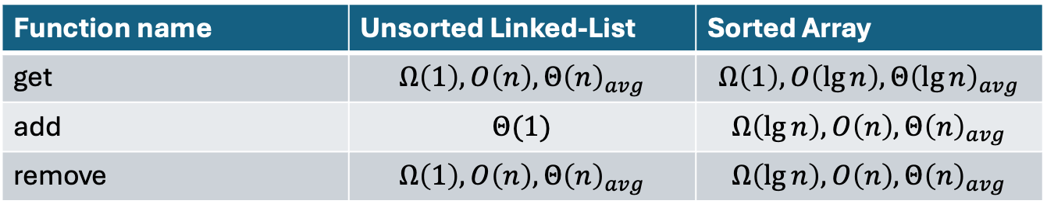
Binary Trees
Overall, we can consider binary trees to be unordered
As long as it maintains the property of the heap, the exact ordering of the children does not matter
What is the overall cost for different functions?
Function name | Unsorted Linked-List | Sorted Array
get | $$Ω\left(1\right), O\left(n\right), Θ{\left(n\right)}_{avg}$$ | $$Ω\left(1\right), O\left(\lg{n}\right), Θ{\left(\lg{n}\right)}_{avg}$$
add | $$Θ(1)$$ | $$Ω\left(\lg{n}\right), O\left(n\right), Θ{\left(n\right)}_{avg}$$
remove | $$Ω\left(1\right),O\left(n\right), Θ{\left(n\right)}_{avg}$$ | $$Ω\left(\lg{n}\right), O\left(n\right), Θ{\left(n\right)}_{avg}$$

Slide 5

get
$Ω\left(1\right):$ Happens rarely
When the value we are looking for is the root node
$O\left(n\right) or Ο(\lg{n)}$: When we have to search through all the nodes

Slide 6
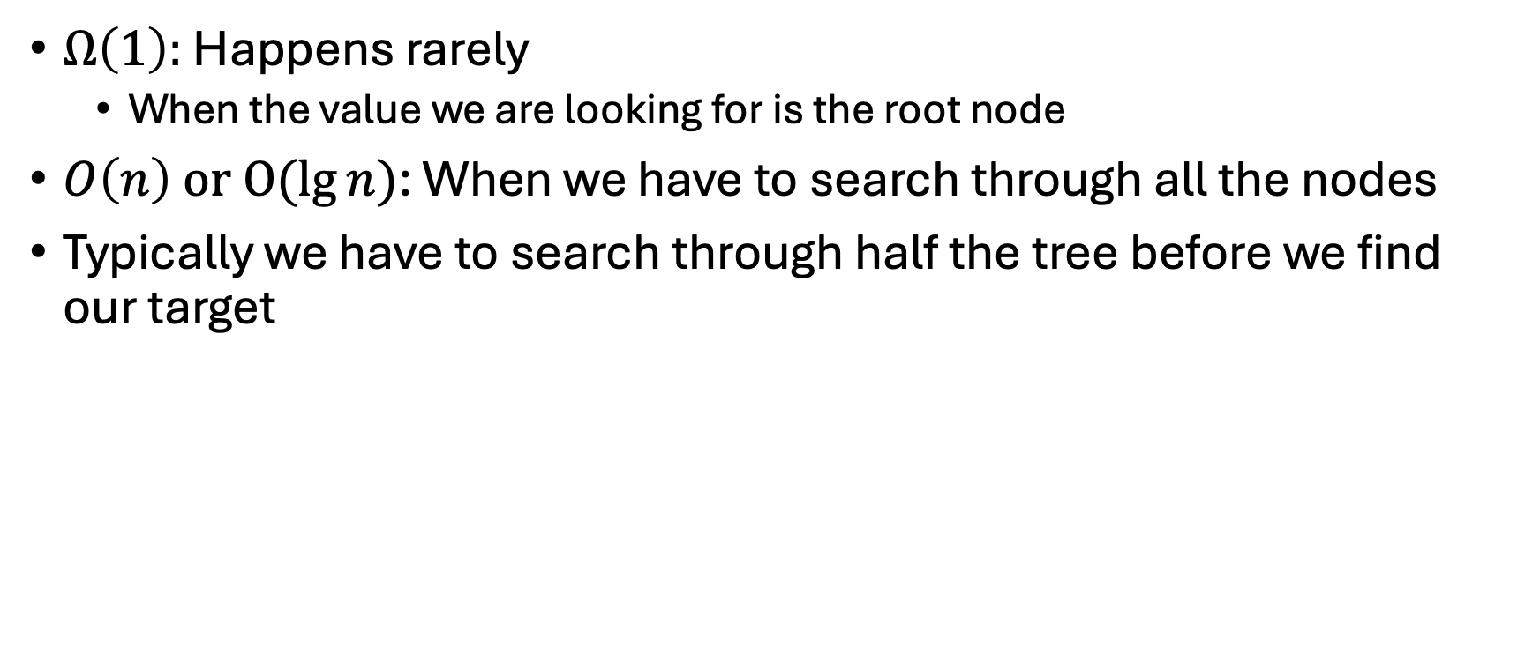
get
$Ω\left(1\right):$ Happens rarely
When the value we are looking for is the root node
$O\left(n\right) or Ο(\lg{n)}$: When we have to search through all the nodes
Typically we have to search through half the tree before we find our target

Slide 7
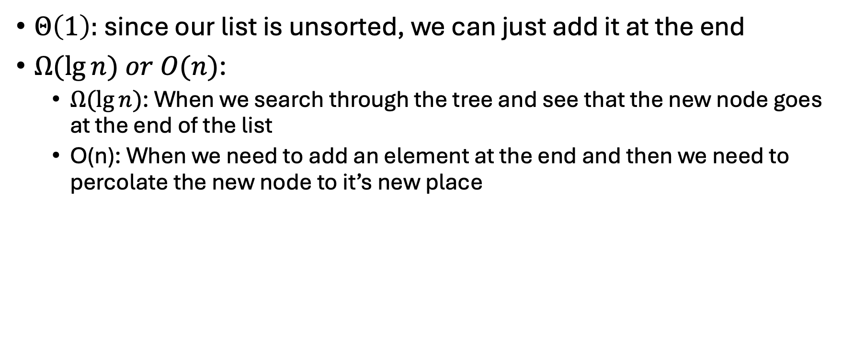
add
$Θ\left(1\right):$ since our list is unsorted, we can just add it at the end
$Ω(\lg{n) or O(n)}$:
$Ω(\lg{n)}$: When we search through the tree and see that the new node goes at the end of the list
O(n): When we need to add an element at the end and then we need to percolate the new node to it’s new place

Slide 8
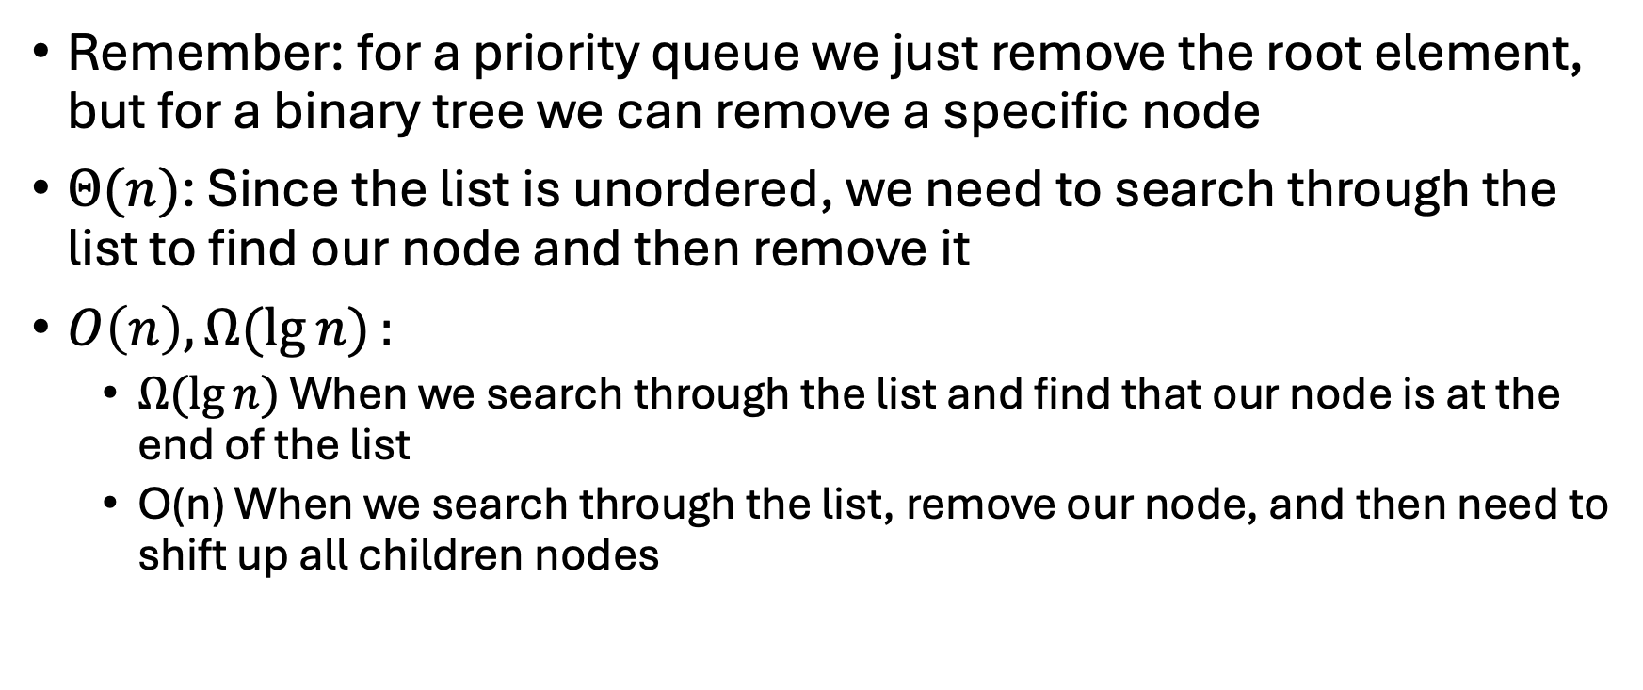
remove
Remember: for a priority queue we just remove the root element, but for a binary tree we can remove a specific node
$Θ(n)$: Since the list is unordered, we need to search through the list to find our node and then remove it
$O\left(n\right), Ω(\lg{n)}:$
$Ω(\lg{n)}$ When we search through the list and find that our node is at the end of the list
O(n) When we search through the list, remove our node, and then need to shift up all children nodes

Slide 9
What does this mean?
Using a sorted list: We can search quickly but insert a node slowly
Using an unsorted list: We can insert quickly but search slowly

Slide 10
What does this mean?
Using a sorted list: We can search quickly but insert a node slowly
Using an unsorted list: We can insert quickly but search slowly
As is we cannot search quickly and insert quickly
If we add a constraint to the binary search tree, then we can remedy this

Slide 11
Binary Search Tree

Slide 12
Binary Search Tree
All nodes in every left subtree have a key less than the key at the root
All nodes in every right subtree have a key greater than or equal to the key at the root
9
4
17
3
6
22
5
7
20

