Slide 1

Generics and Linear Structures
Presented by Prof. Goble
Dickinson College Spring 2024

Slide 2
Linear Structures

Slide 3
Linear Structures
In COMP132 you were introduced to three types of linear structures
List
Stack
Queue

Slide 4
List ADT
A list is an ordered collection of object
With each implementation there are six basic operations
size
get
set
add
remove
insert

Slide 5
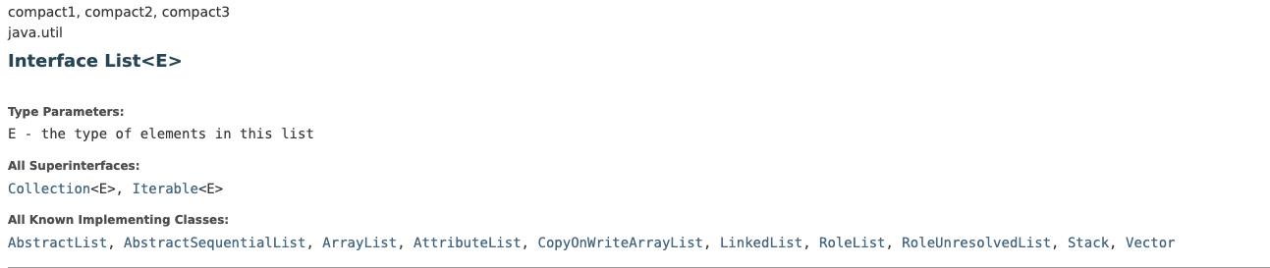
List Implementation

Slide 6
Stack ADT
A stack models a pile of objects
Operates in a Last In First Out Model - LIFO
With each implementation there are four basic operations
pop
peek
size
push

Slide 7
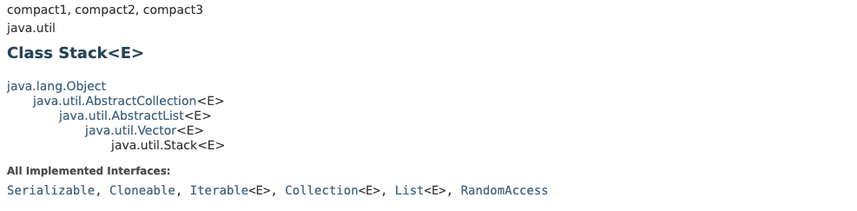
Stack Implementation

Slide 8
Queue ADT
A queue models a line of object
Operates in a First In First Out Model - FIFO
With each implementation there are four basic operations
remove
peek
size
add

Slide 9
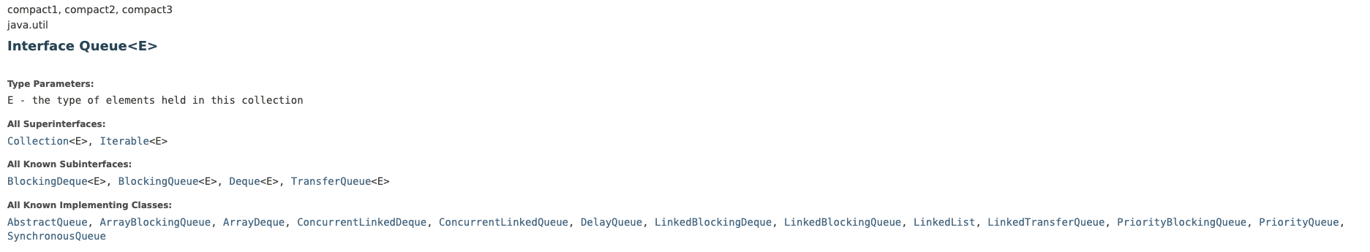
Queue ADT

Slide 10
Linear Structure Implementation
As we’ve seen, we are able to implement linear structures in a number of different ways
Specifically there are two we can focus on
Arrays
Linked List

Slide 11
Backing Store
Backing Store refers to the way the data behind the ADT implementation is stored
Array, linked list, etc.
The different implementations should have the same functionality but different performance

Slide 12
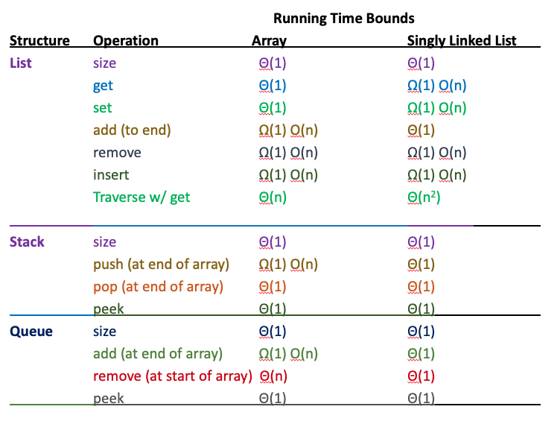
Linear ADT Operations

