Slide 1

Generics and Linear Structures
Presented by Prof. Goble
Dickinson College Spring 2024

Slide 2
Review
Abstract Data Type (ADT)
A theoretical understanding of how we want to organize and work with our data
The interface of the ADT is defined in terms of a type and a set of operations
The ADT does not specify how the data type is implemented
Data Structure
The actual implementation of an ADT
In OOP, this is a class with member functions and member data

Slide 3
Linear Structures

Slide 4
Linear Structures
In COMP132 you were introduced to three types of linear structures
List
Stack
Queue

Slide 5
List ADT
A list is an ordered collection of object
With each implementation there are six basic operations

Slide 6
List ADT
A list is an ordered collection of object
With each implementation there are six basic operations
size
get
set
add
remove
insert

Slide 7
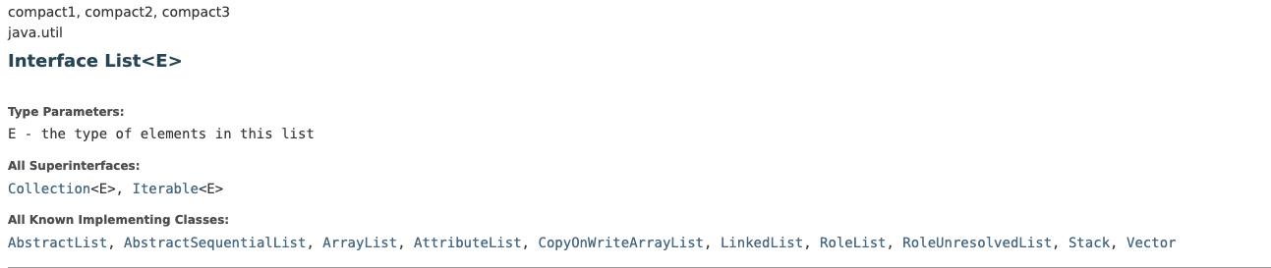
List Implementation

Slide 8
Stack ADT
A stack models a pile of objects
Operates in a Last In First Out Model - LIFO
With each implementation there are four basic operations

Slide 9
Stack ADT
A stack models a pile of objects
Operates in a Last In First Out Model - LIFO
With each implementation there are four basic operations
pop
peek
size
push

Slide 10
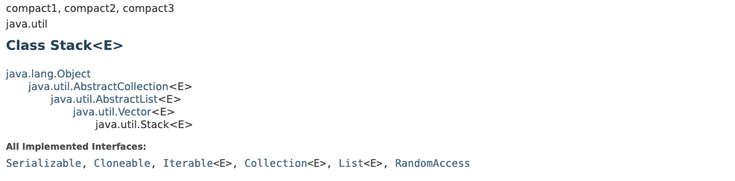
Stack Implementation

Slide 11
Queue ADT
A queue models a line of object
Operates in a First In First Out Model - FIFO
With each implementation there are four basic operations

Slide 12
Queue ADT
A queue models a line of object
Operates in a First In First Out Model - FIFO
With each implementation there are four basic operations
remove
peek
size
add

Slide 13
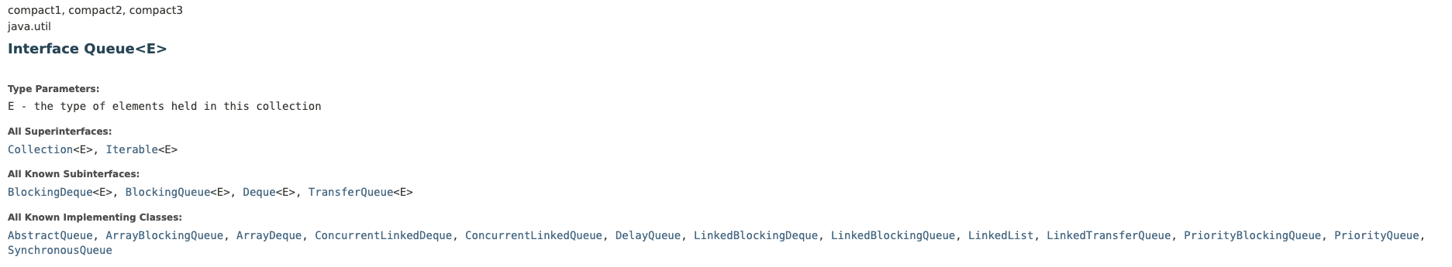
Queue ADT

Slide 14
Linear Structure Implementation
As we’ve seen, we are able to implement linear structures in a number of different ways
Specifically there are two we can focus on

Slide 15
Linear Structure Implementation
As we’ve seen, we are able to implement linear structures in a number of different ways
Specifically there are two we can focus on
Arrays

Slide 16
Linear Structure Implementation
As we’ve seen, we are able to implement linear structures in a number of different ways
Specifically there are two we can focus on
Arrays
Linked List

Slide 17
Backing Store
Backing Store refers to the way the data behind the ADT implementation is stored
Array, linked list, etc.
The different implementations should have the same functionality but different performance

Slide 18
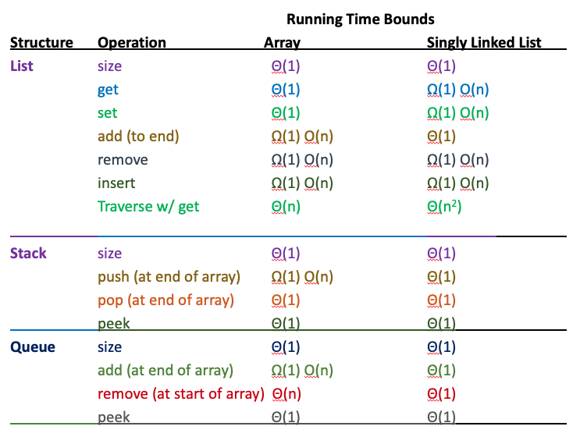
Linear ADT Operations

Slide 19

List size()
Array Backing: $Θ\left(1\right)$
SLL Backing: $Θ(1)$

Slide 20
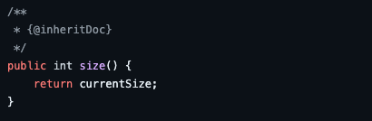
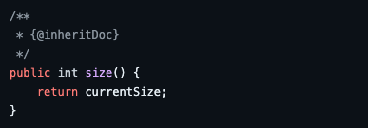
List size()
Array Backing
SLL Backing

Slide 21

List get()
Array Backing: $Θ(1)$
SLL Backing: $Ω\left(1\right) O(n)$

Slide 22
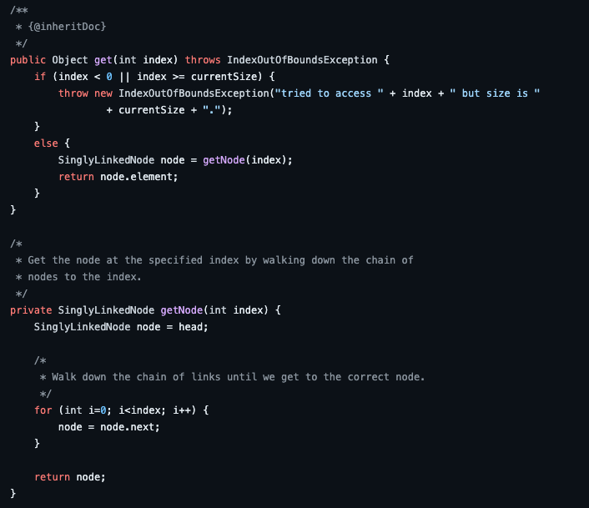
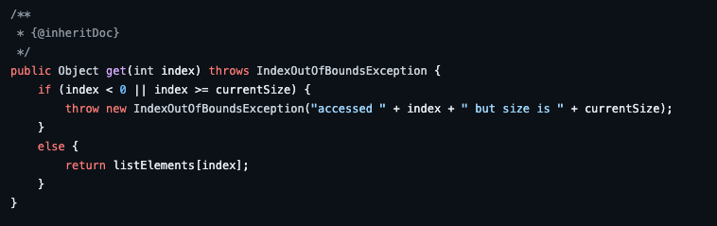
List get()
Array backing
SLL Backing

Slide 23

List add()
Array Backing: $Ω\left(1\right) O(n)$
SLL Backing: $Θ(1)$

Slide 24
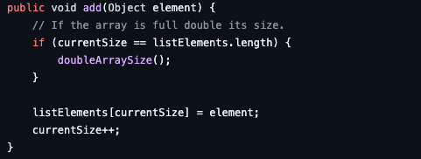
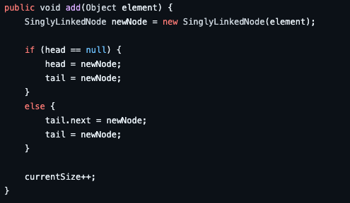
List add()
Array Backing
SLL Backing

