Slide 1


Generics and Linear Structures
Presented by Prof. Goble
Dickinson College Spring 2024

Slide 2
Generics vs. the Object Superclass

Slide 3
The Object Superclass

Slide 4
Objects
The Object class sits at the top of the class hierarchy tree
We can implement ADTs by using the Object type in order to reuse methods for a number of different data types

Slide 5
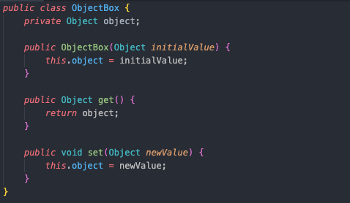

Slide 6
Objects
The Object class sits at the top of the class hierarchy tree
We can implement ADTs by using the Object type in order to reuse methods for a number of different data types
A caveat to using the Object superclass is the compiler is not able to resolve if a specific data type implements all the necessary methods of our ADT
One way to fix this is to type cast our class whenever we make method calls

Slide 7
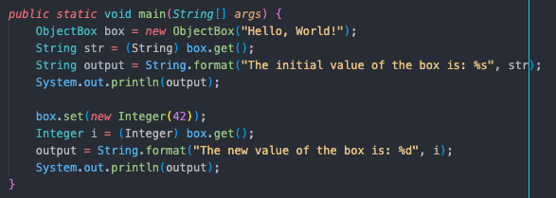

Slide 8
COMP132VsJavaAPI

Slide 9
Generics

Slide 10
Generics
Generics enable types to be parameters when we are defining classes
Type parameters allow us to reuse the same code with different input types
At compile time, generics have stronger type checks

Slide 11
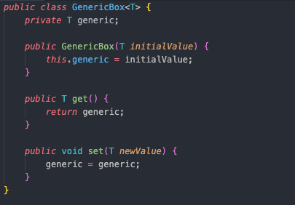

Slide 12
Generics
Generics enable types to be parameters when we are defining classes
Type parameters allow us to reuse the same code with different input types
At compile time, generics have stronger type checks
Since we’ve parameterized the type, we do not need to perform type checks
However, now the instance of that object is locked into the initial type

Slide 13
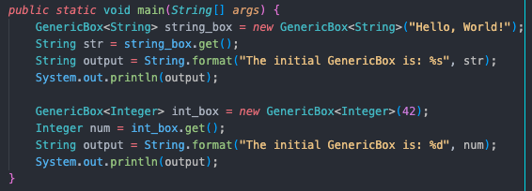

Slide 14
Type Parameter Naming Conventions
By convention, type parameter names are single uppercase letters
The most commonly used type parameter names are:
E := Element
K := Key
N := Number
T := Type
S, U, V for the 2nd , 3rd, 4th, types

Slide 15
Implementations

Slide 16
COMP132List vs MyList
COMP132ArrayList, COMP132SinglyLinkedList, MyArrayList, MyDoublyLinkedList

Slide 17
SLL vs DLL

Slide 18
Singly Linked List
Issues when using a SLL
Impossible to move backwards on a SLL
When we want to remove the last element we face added difficulty

Slide 19
Doubly Linked List
We can modify a SLL so now we can move backwards on our list
Make the tradeoff in space/time complexity
We consume a bit more space, but it’ll make our programming easier

