Slide 1

Iteration
Presented by Prof. Goble
Dickinson College Spring 2024

Slide 2
DLL insert

Slide 3
Why Use an Iterator?

Slide 4
Iterator
Iteration across data structures is a very common operation
Aren’t for loops easier?

Slide 5
Iterator
Iteration across data structures is a very common operation
Aren’t for loops easier?
If we want to traverse a data structure with a for loop we will have different performance based on the backing store

Slide 6
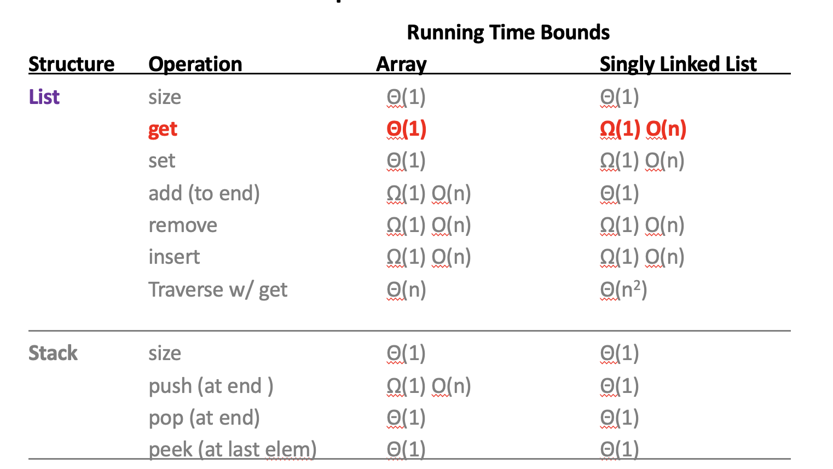

Slide 7
Iterator
Iteration across data structures is a very common operation
Aren’t for loops easier?
If we want to traverse a data structure with a for loop we will have different performance based on the backing store
If we can use an iterator, then we can efficiently iterate across our data structures regardless of the backing store

Slide 8
What is an iterator?
An iterator is an object that keeps track of the current location in a List

Slide 9
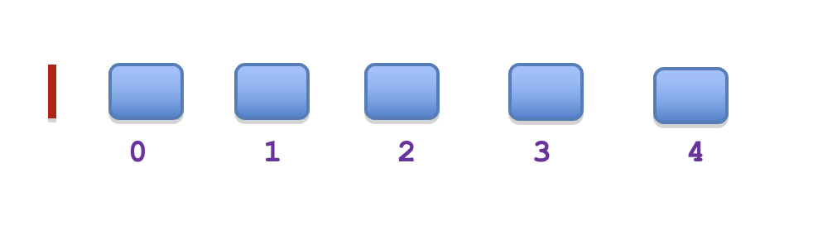
What is an iterator?
An iterator is an object that keeps track of the current location in a List

Slide 10
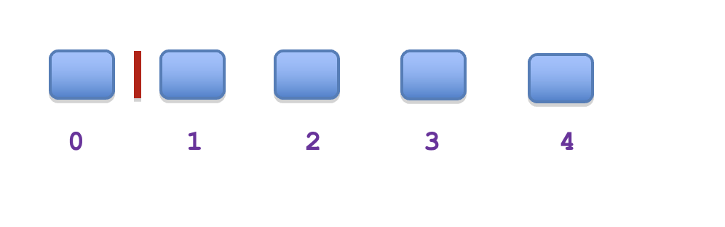
What is an iterator?
An iterator is an object that keeps track of the current location in a List

Slide 11
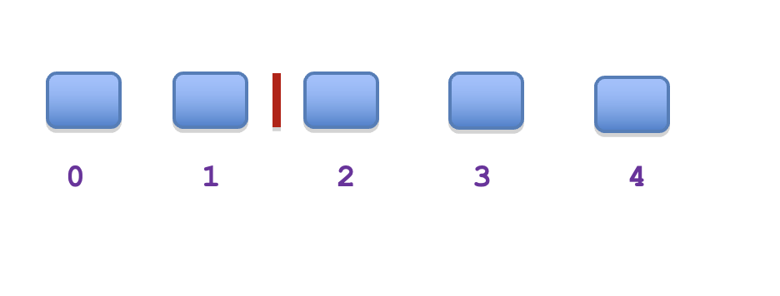
What is an iterator?
An iterator is an object that keeps track of the current location in a List

Slide 12
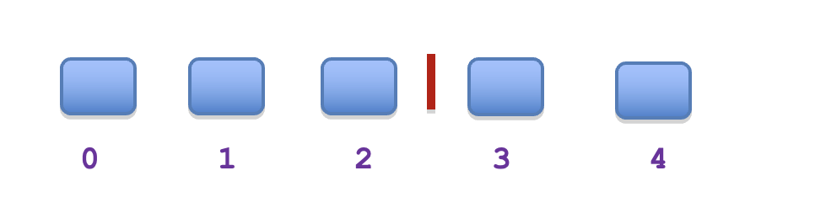
What is an iterator?
An iterator is an object that keeps track of the current location in a List

Slide 13
What is an iterator?
An iterator is an object that keeps track of the current location in a List
Performance difference with get and iterator
IteratorUseExamples.traverseListWithGet
IteratorUseExamples.traverseListWithIterator

Slide 14
What is an iterator?
An iterator is an object that keeps track of the current location in a List
Performance difference with get and iterator
Performance of traversal using get depends on the list implementation
Performance of traversal using an iterator is efficient regardless of the data structure implementation

Slide 15
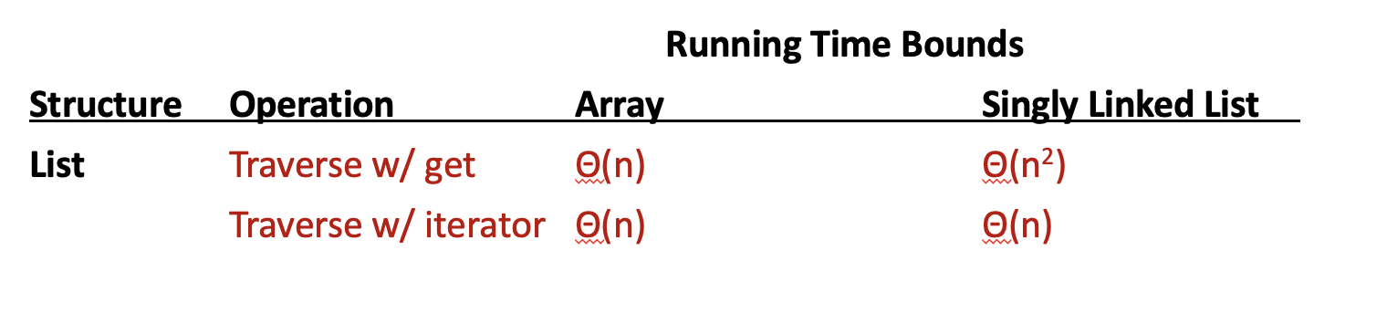

Slide 16
Why does this matter?
If we are doing a lot of inserting/removing from both the start and end of a list
Iterators can help keep track of where we are
Better to use a Linked List than an Array List
If we need to traverse the full list
Such as finding the index of a given element
Iterators are more efficient than using a for loop

Slide 17
Why does this matter?
Remember: often we want to keep our code generalized
Regardless of the backing store, iterators allow us to be more efficient

Slide 18
Reusable Algorithms
The same code operates on multiple types of objects
Is efficient regardless of the object type
GenericMethods.linearSearchList
GenericMethods.callLinearSearchList

Slide 19
Reusable Algorithms
The same code operates on multiple types of objects
Is efficient regardless of the object type
GenericMethods.linearSearchList
GenericMethods.callLinearSearchList
Here we can see that we will encounter a problem
The initial linearSearchList is only implemented for String
This means we would have to rewrite it for different types

