Slide 1
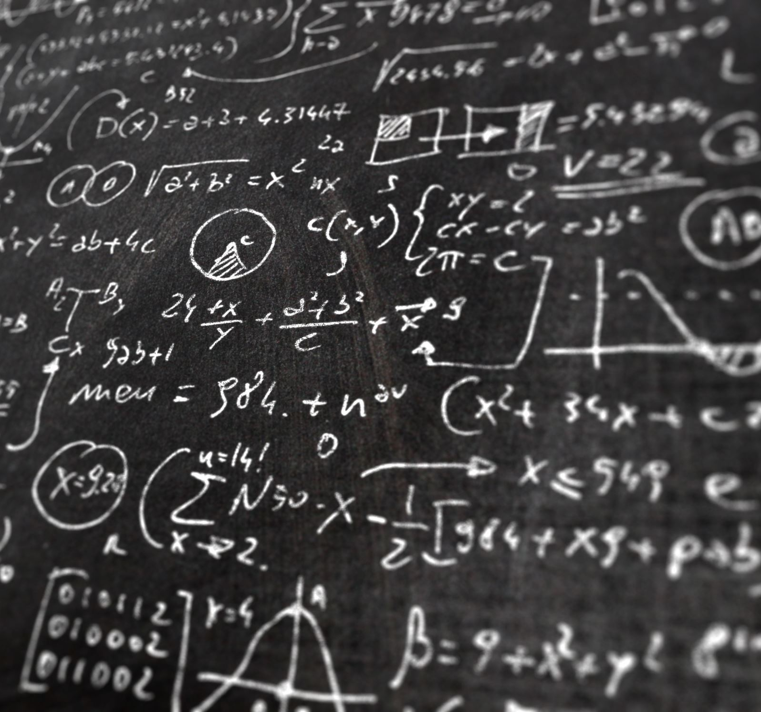
Algorithm Analysis
Presented by Prof. Goble
Dickinson College Spring 2024

Slide 2
Review

Slide 3
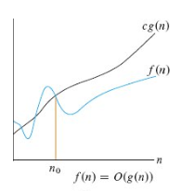

Big-O
Given an algorithm, which inputs would result in the worst performance?
What is the minimum possible input size, n₀, which would lead to our function having an upper bound for constant $c$
Ex. Given a sorting algorithm, which inputs would lead to the worst run time?

Slide 4
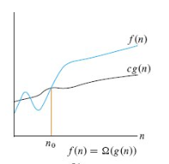


Big-$Ω$
Given an algorithm, which inputs would result in the best performance?
What is the minimum possible input size, n₀, which would lead to our function having an lower bound for constant $c$
Ex. Given a sorting algorithm, which inputs would lead to the best run time?

Slide 5
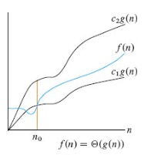

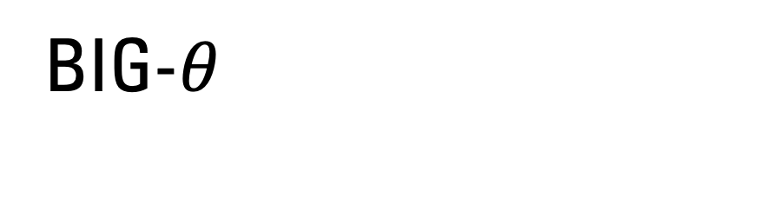
Big-$θ$
Given an algorithm, which inputs would result in an average case performance?
What is the minimum possible input size, n₀, which would lead to our function existing between some function $g(n)$ when multiplied by some constants c₁ and c₂
Ex. Given a sorting algorithm, which inputs would lead to the average case run time?

Slide 6
bounds vs case scenario
We often use asymptotic notation and different case scenarios to understand the performance of an algorithm
The different case scenarios give us concrete examples for how our algorithm will perform with different inputs
The upper and lower bounds describe our understanding of the growth rate for a specific cost measure

Slide 7
Analyzing Loops

Slide 8
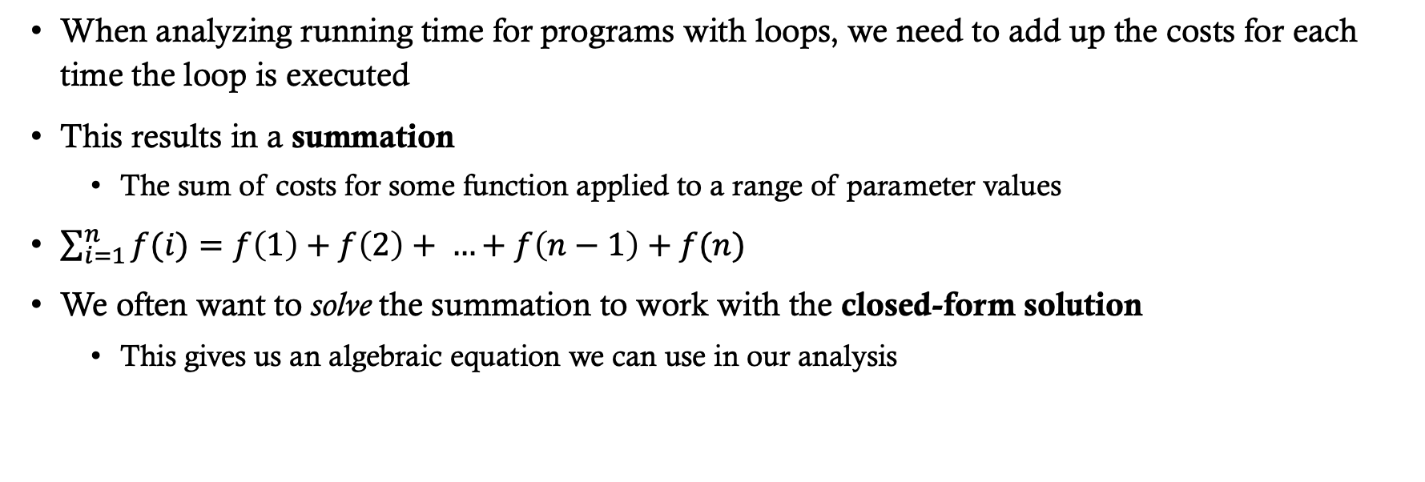
Analyzing Loops
When analyzing running time for programs with loops, we need to add up the costs for each time the loop is executed
This results in a summation
The sum of costs for some function applied to a range of parameter values
$\sum_{i=1}^{n}{f(i)}=f\left(1\right)+f\left(2\right)+ …+f\left(n−1\right)+f(n)$
We often want to solve the summation to work with the closed-form solution
This gives us an algebraic equation we can use in our analysis

Slide 9
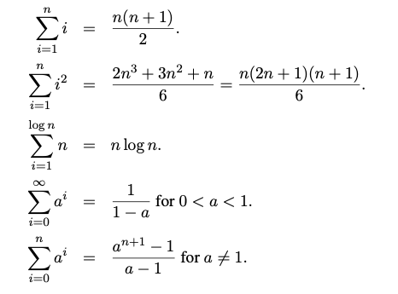
Common summations and their closed-form solutions

Slide 10

Recurrence Relations
A recurrence relation defines a function by means of an expression that includes one or more (smaller) instances of itself
A classic example is the factorial function: $n!=\left(n −1\right)! ∙n$ for $n>1$ and $1!=0!=1$
Recurrence relations are often used to model the cost of recursive functions

Slide 11
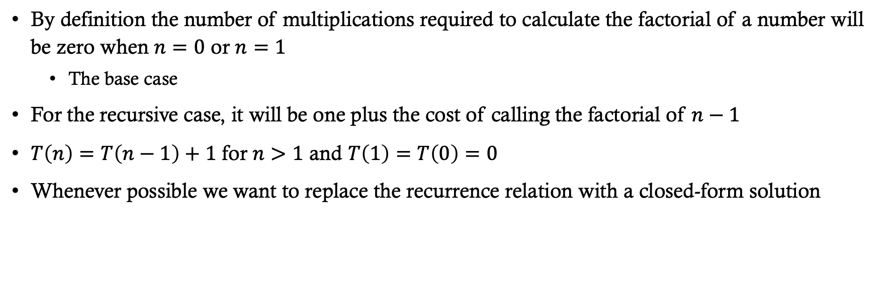
Factorial example
By definition the number of multiplications required to calculate the factorial of a number will be zero when $n=0$ or $n=1$
The base case
For the recursive case, it will be one plus the cost of calling the factorial of $n−1$
$T\left(n\right)=T\left(n−1\right)+1$ for $n>1$ and $T\left(1\right)=T\left(0\right)=0$
Whenever possible we want to replace the recurrence relation with a closed-form solution

