Slide 1

Algorithm Analysis Examples
Presented by Prof. Goble
Dickinson College 2024

Slide 2
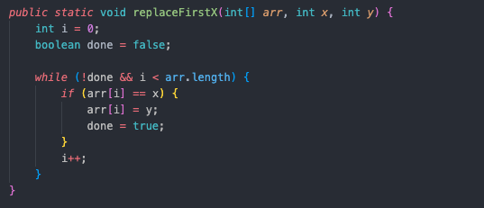
OpCountExamples.replaceFirstX

Slide 3
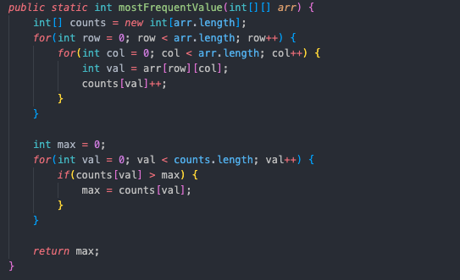
OpCountExample.mostFrequentValue

Slide 4
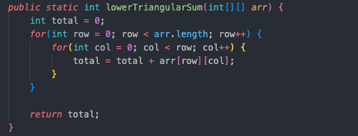
OpCountExample.lowerTriangularSum

Slide 5
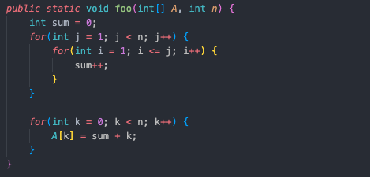
What is Big-O of the following code snippet?

Slide 6
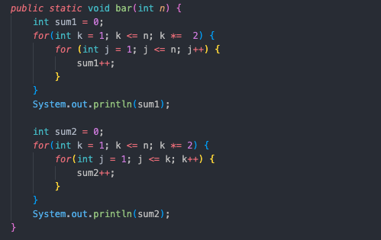
What is Big-O of the following code snippet?

