Slide 1

Binary Tree ADT
Presented by Prof. Goble
Dickinson College Spring 2024

Slide 2
Binary Tree ADT

Slide 3
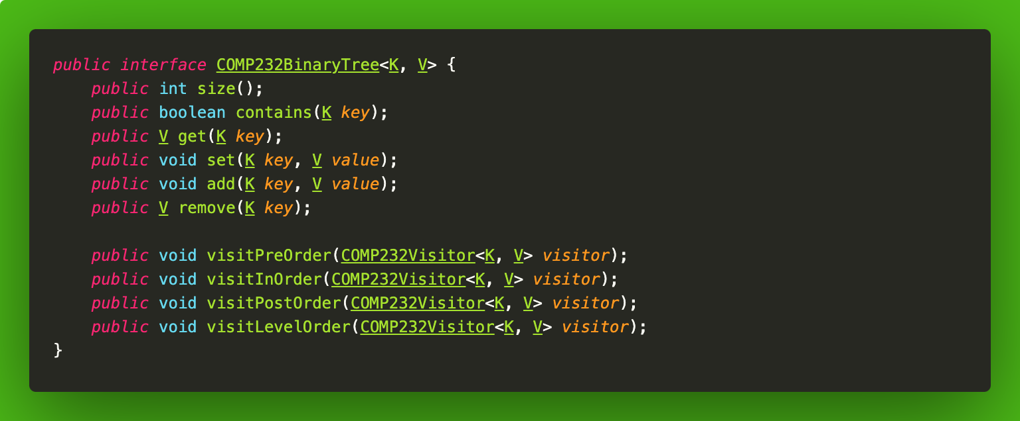
Binary Tree ADT

Slide 4
Visitor
Whenever we are working with trees, we need a way to visit each node
The visitor ADT will act like an iterator, but in an automated fashion
Each of the visit methods will need a visitor object

Slide 5
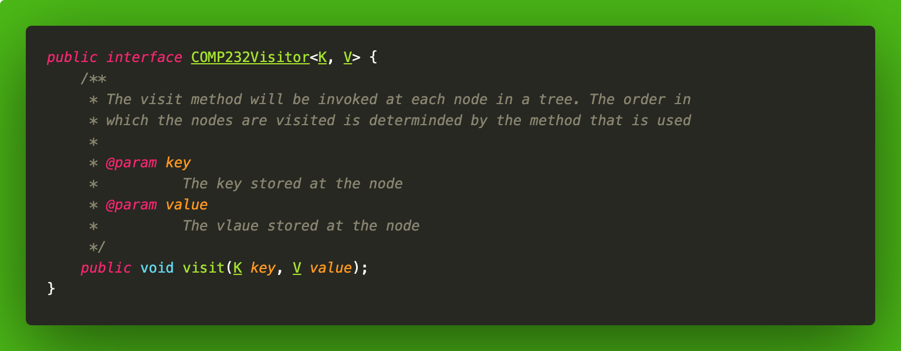
Visitor ADT

Slide 6
Visitor
We can implement a different operation depending on what we want to do whenever we visit a node
Important things to keep in mind:
While we are visiting a node we cannot modify the structure
We are able to modify the content of each <key, value> pair (if the object allows us to)

Slide 7
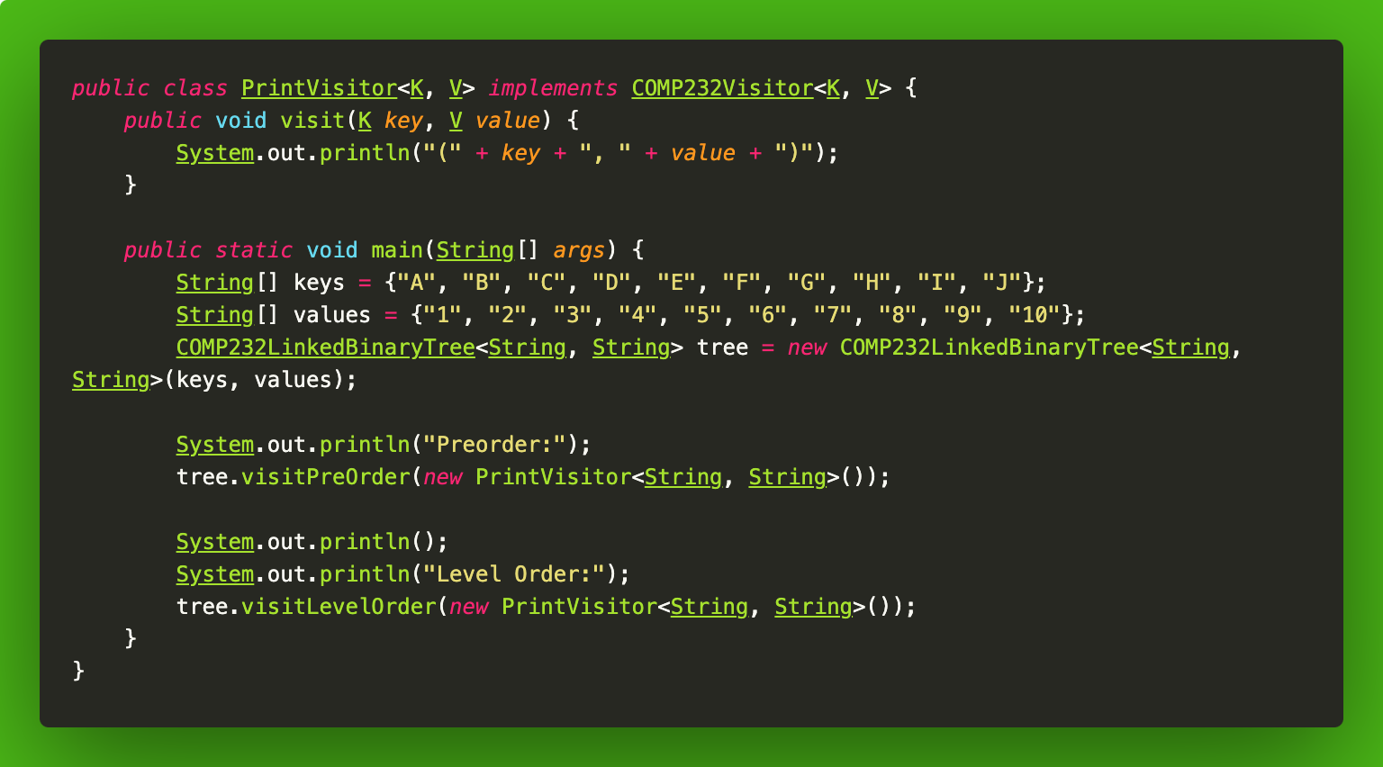
PrintVisitor

Slide 8
Binary Tree Implementation

Slide 9
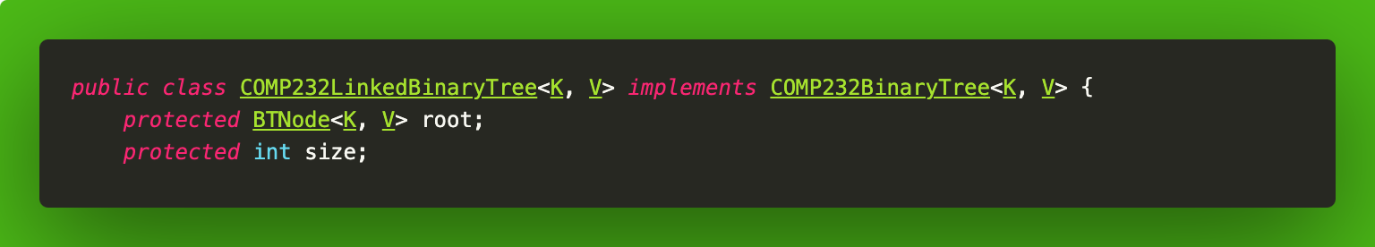
Binary Tree Implementation
Similar to lists, stacks, and queues, we can use either an array or linked list as the backing store for binary trees
We will be focusing on the linked list implementation

Slide 10
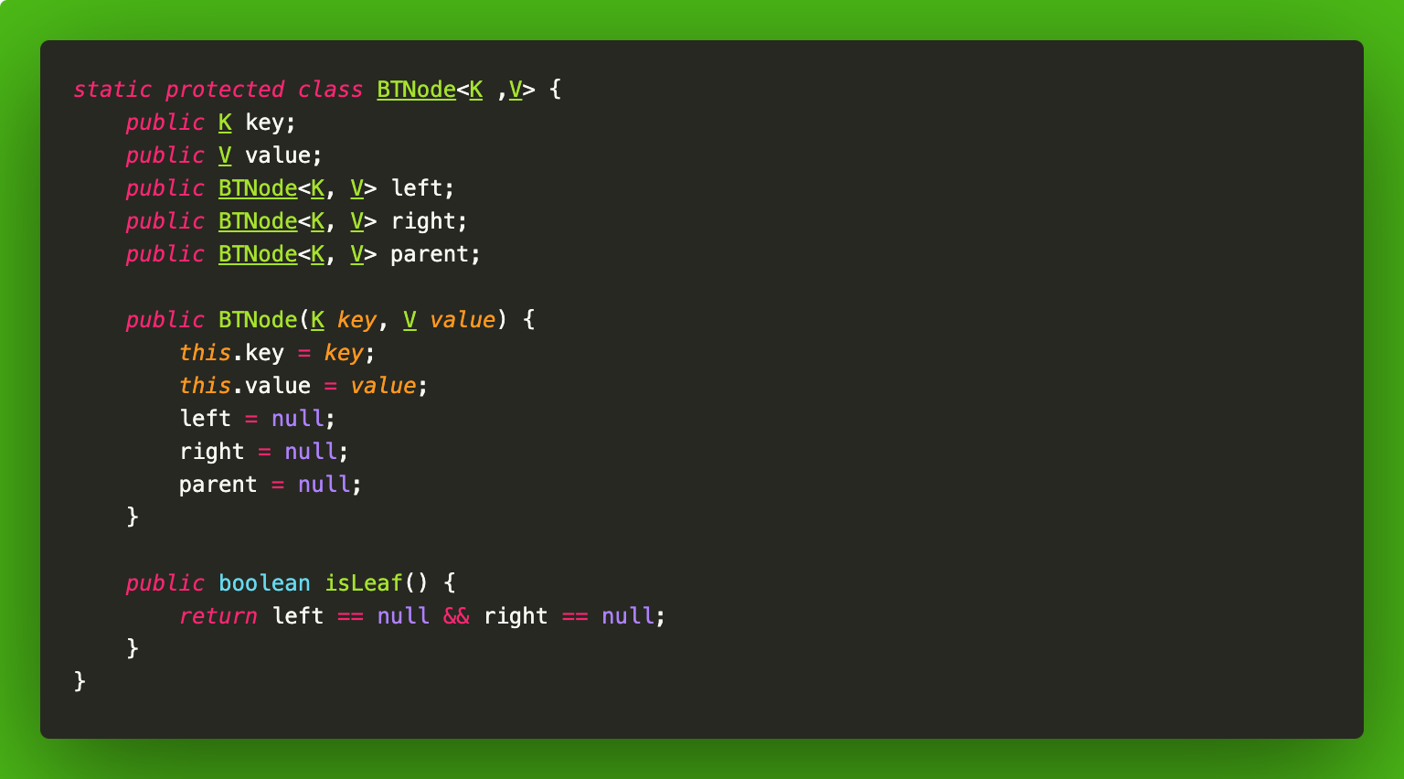
BTNode Implementation

