Slide 1

Binary Trees
Presented by Prof. Goble
Dickinson College Spring 2024

Slide 2
Trees

Slide 3
Tree Definition
A tree is a non-linear data structure which organizes data in a hierarchical structure

Slide 4
Tree Definition
A tree is a non-linear data structure which organizes data in a hierarchical structure
A binary tree is a tree which has
- Nodes that have 0, 1, or 2 child nodes
- Children that are distinguishable
- Left and Right child Nodes
Binary trees have a recursive structure
- For any node in the tree, its left and right children are the root of a smaller binary tree (also called a subtree)

Slide 5
Binary Tree Examples

Slide 6
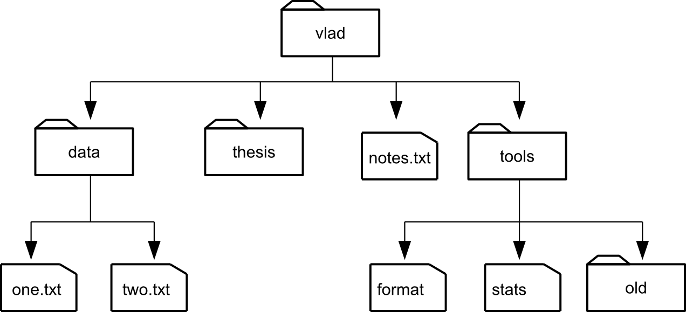
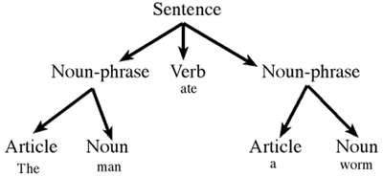
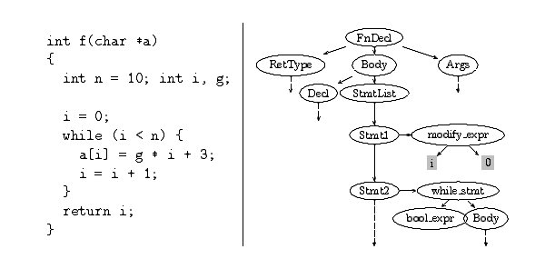
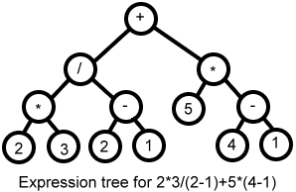
Some Common Tree Structures

Slide 7
Tree Terminology
The root node: The first node in the tree
An edge is a connecting link between two nodes
A parent node: is any node in a tree which has a child/children
- A node which is a predecessor of any other node is also referred to as a parent node
A child node: any node which is a descendant of any other node
A path is a sequence of nodes and edges between two nodes

Slide 8
Tree Terminology Cont.
Sibling Nodes: Any nodes which has the same parent as other nodes
Leaf Nodes: In any tree, the node which does not have any children are referred to as leaves
An Internal Node: Any node which has at least one child
- Every non-leaf node is an internal node

Slide 9
Degree/Arity/Order
The degree/arity/order of a tree refers to the maximum number of children each node can have
Nodes of a k–ary tree can each have at most k children
The height of a node refers to the total number of edges from leaf to that node
The depth of a node refers to the total number of edges from the root to that node

