Slide 1

Algorithm Analysis Examples
Presented by Prof. Goble
Dickinson College 2024

Slide 2

Prove or disprove this claim
Suppose we have the function $T\left(n\right)=2n^{2}+5n+8$
Is $T(n)$ in $O(n)$?
Can we find a constant $c$ and $n_{0}$ that would create a linear upper bound?
What if I pick a really large $c$ value?

Slide 3

Prove or disprove this claim
Suppose we have the function $T\left(n\right)=2n^{2}+5n+8$
Is $T(n)$ in $O(n)$?
Can we find a constant $c$ and $n_{0}$ that would create a linear upper bound?
What if I pick a really large $c$ value?
Can we claim $T(n)$ is in ${O(n}^{3})$and $T(n)$ is in $Ω(1)$?

Slide 4
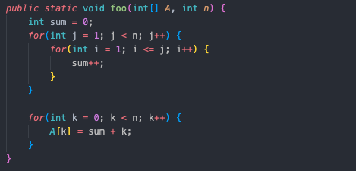
What is Big-O of the following code snippet?

Slide 5
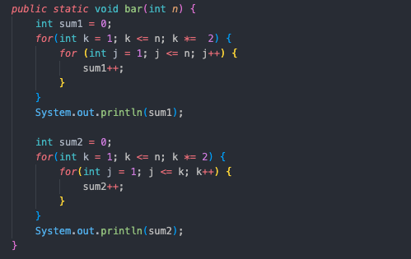
What is Big-O of the following code snippet?

Slide 6
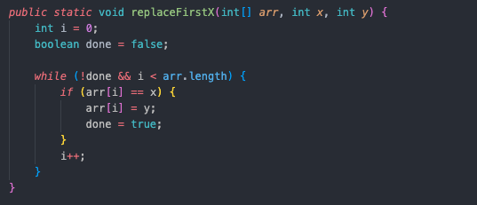
OpCountExamples.replaceFirstX

Slide 7
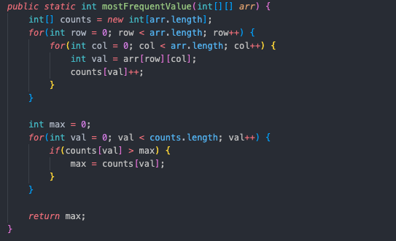
OpCountExample.mostFrequentValue

Slide 8
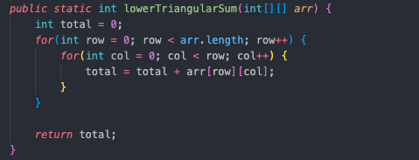
OpCountExample.lowerTriangularSum

