Slide 1

Algorithm Analysis
Presented by Prof. Goble
Dickinson College Spring 2024

Slide 2
Algorithm Analysis
When we talk about analyzing algorithms we are trying to estimate and set a bound around the run time and space requirement
Given a variety of inputs, can we determine the overall growth rate that the run-time takes?

Slide 3
How can we compare algorithms?

Slide 4
Comparing Algorithms
What is the best way to compare two algorithms against each other?
Empirical Method: Code up the algorithm in a given programming language and run the program with lots of different inputs of different sizes and see how long it takes.
Are there weaknesses in this?
Analytical Method: Carefully examine the algorithm or program and determine how the program would perform for different input sizes
This approach allows us to visualize a graph for the overall performance of the algorithm
The analytical method will be the focus of our studies

Slide 5
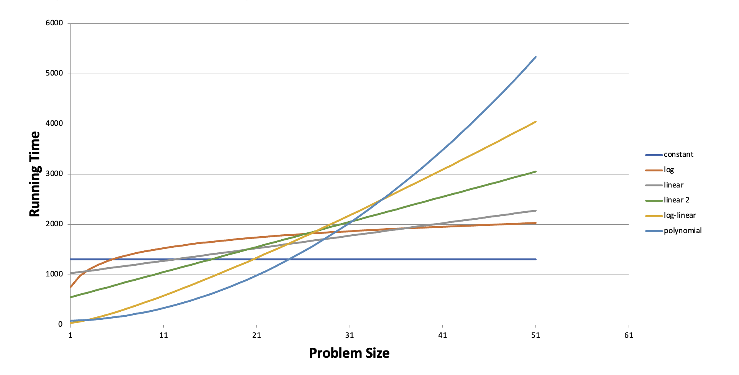

Slide 6
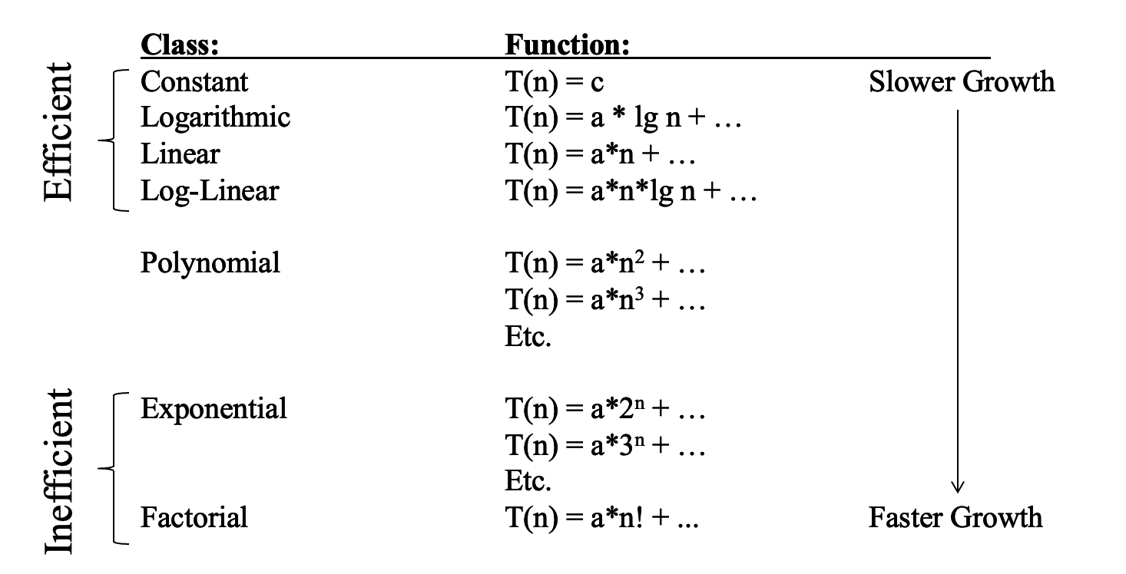

Slide 7
Analytical Analysis
Focused on two aspects: size and number of basic operations
Both can be rather vague terms
Size: Is often considered as the number of inputs that our algorithm is trying to process
Basic Operations: Refers to any operations whose time to complete does not depend on the particular value of its operands
Examples:
Assigning a value to a variable
Looking up the value of a particular element in an array
Comparing two values
Incrementing/Decrementing a value
Basic arithmetic operations

Slide 8
Basic Operations
Since a basic operation cannot depend on the size of the value
Summing two value together?
Yes, this is a basic operation
Summing the contents of an array containing n elements?
No, this is not a basic operation since its time of completion is dependent on the value of n

Slide 9
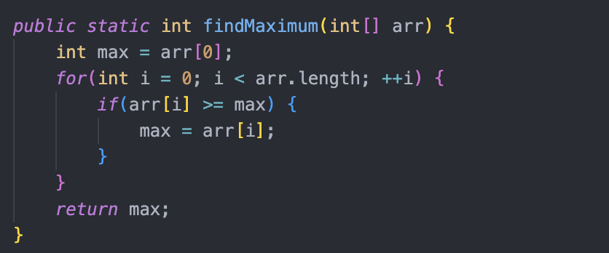
What are the basic operations here?

Slide 10
Example Analysis

Slide 11
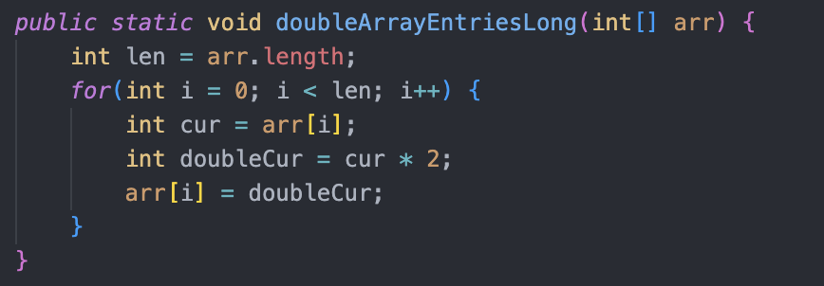
Example 2

Slide 12
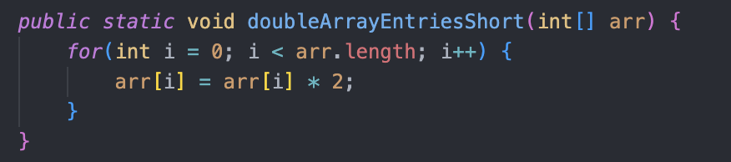
Example 3

