Slide 1
Coding Contest Prep

Slide 2
Announcements
Contest next Saturday
Location Derrick 231
Schedule:
9am – 9:45: Welcome and breakfast
9:45 – 10:00 : Explain rules, hand out sample problem
10:00 – 10:30 : Sample problem
10:30 – 3:30 Contest
3:30 – 4:00 Break and Social time
4:00 – 5:00 Awards and photos
Checking on lunch, snacks, drinks

Slide 3
Agenda
Plan for next Saturday
Cheat Sheets – YOU MUST HAVE THEM
Two pages double sided per person! Make a team set / do not duplicate
I am collecting cheat sheets and am putting them on github Prof-Greg/contest
I will continue to look for cheat sheats
In particular make sure you can enter the data entry portion without thinking about it!!!!
Key problem tactics
Complete Search

Slide 4
Cheat Sheats
Cheat Sheet 2014

Slide 5
Tactics
Pick a primary input coder
Look at all problems and read them before hitting any keys
Pick easiest problem, primary gets basic I/O code hammered in. Others go through problem carefully for assumptions, edge cases, algorithm, problem size,
Figure out data structures, initial sizes of these structures
Work out problem on paper – block diagrams, pseudo code, make sure you all understand what is proposed.
Code it, work out test cases – this can be done at same time
Submit
Have an exit strategy!! Know when to move on You have enough time to not just hit keys,
Think, talk about it , then SHUT UP AND CODE☺

Slide 6
Complete Search

Slide 7
Complete Search
Loops
UVA 725
Many Loops
UVA 441
Loops + Pruning UVA 11565
Permutations
UVA 11742
Subsets
UVA 12455
Recursive
Simple Backtracking
UVA 750 – Eight Queens

Slide 8
Fire Up – Practice Tactics
Lets work through loops and then talk about permutations, subsets, and backtracking.

Slide 9
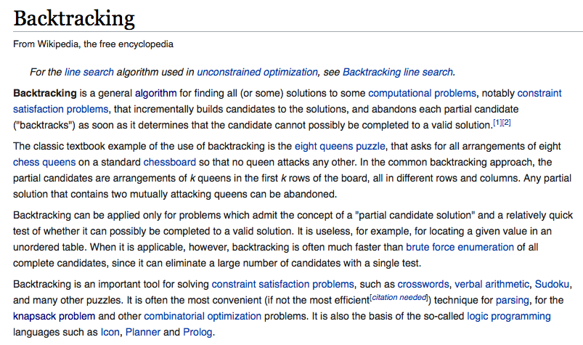
Backtracking

Slide 10
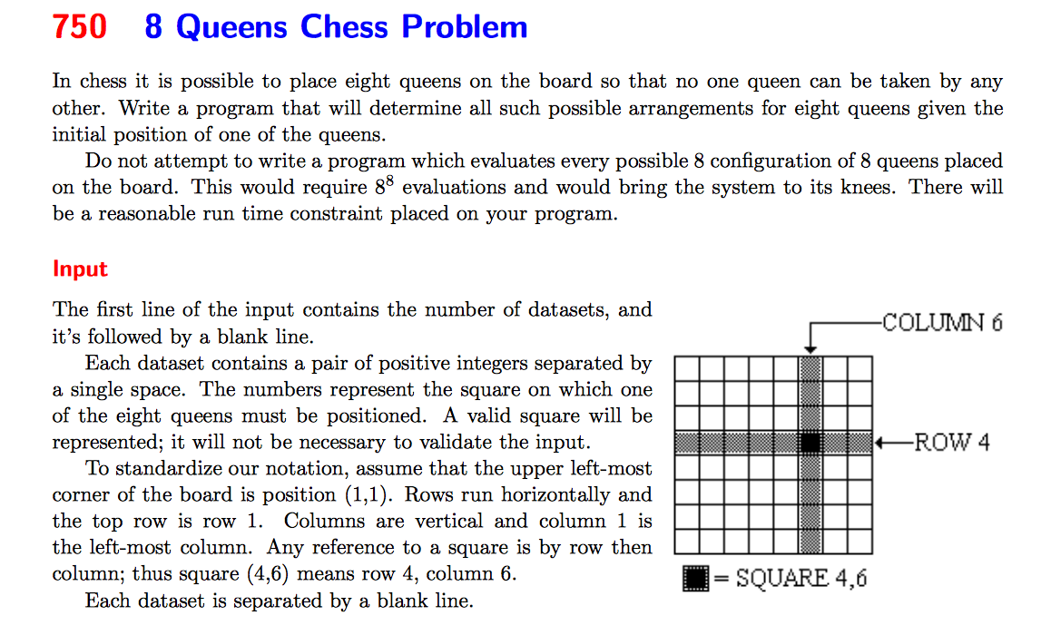
8 Queens

Slide 11
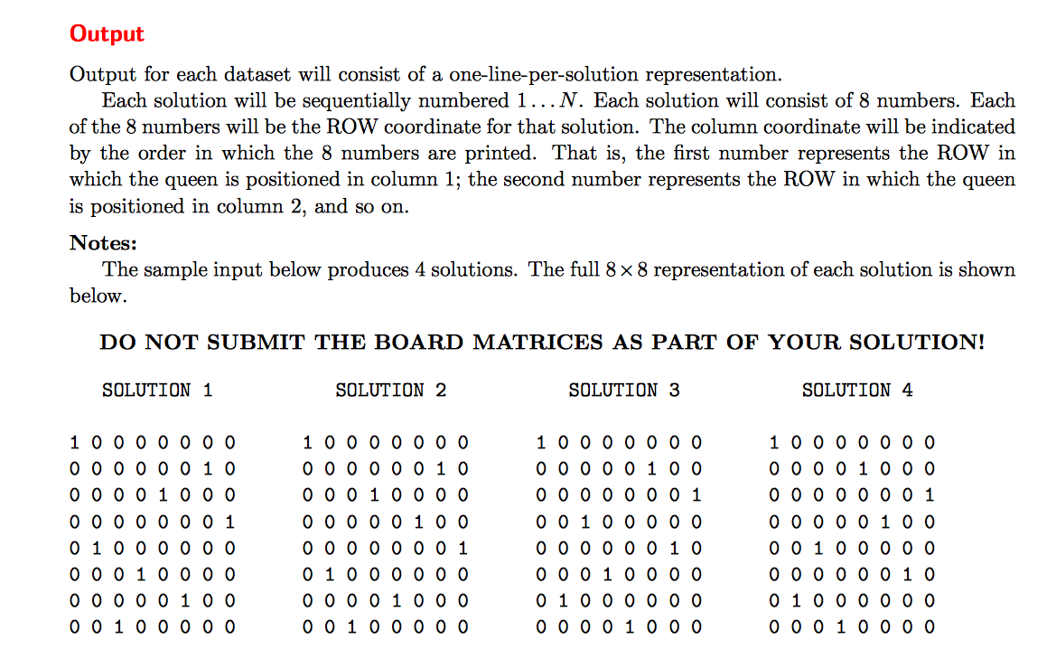
8 Queens

Slide 12
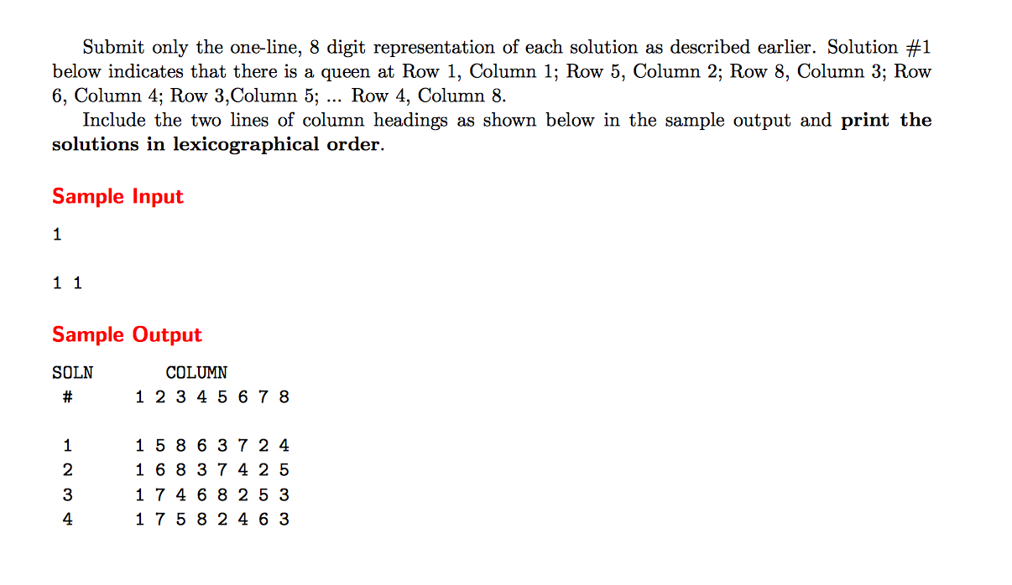
8 Queens

Slide 13
8 Queens

Slide 14
Strategy

