Slide 1
Future Value with Compound Interest
Liberal Arts Mathematics

Slide 2
Overview
Compound Interest Formula
Examples

Slide 3
Compound Interest Formula
Future Value with Compound Interest

Slide 4
Compound Interest
Compound Interest: interest is added to the principal at regular intervals.
Notes:
Interest is calculated on the updated principal each time.
The time between adding interest to principal is called a compounding period

Slide 5
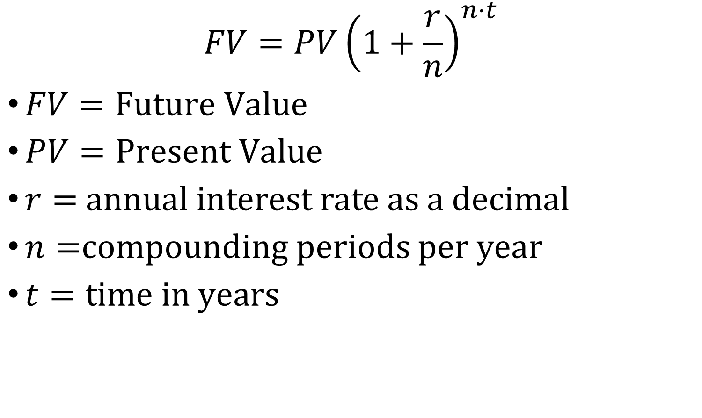
Future Value Formula with Compound Interest
$$FV=PV{\left(1+\frac{r}{n}\right)}^{n⋅t}$$
$FV=Future Value$
$PV=Present Value$
$r=$ annual interest rate as a decimal
$n=$compounding periods per year
$t=time in years$

Slide 6
Example
Future Value with Compound Interest

Slide 7
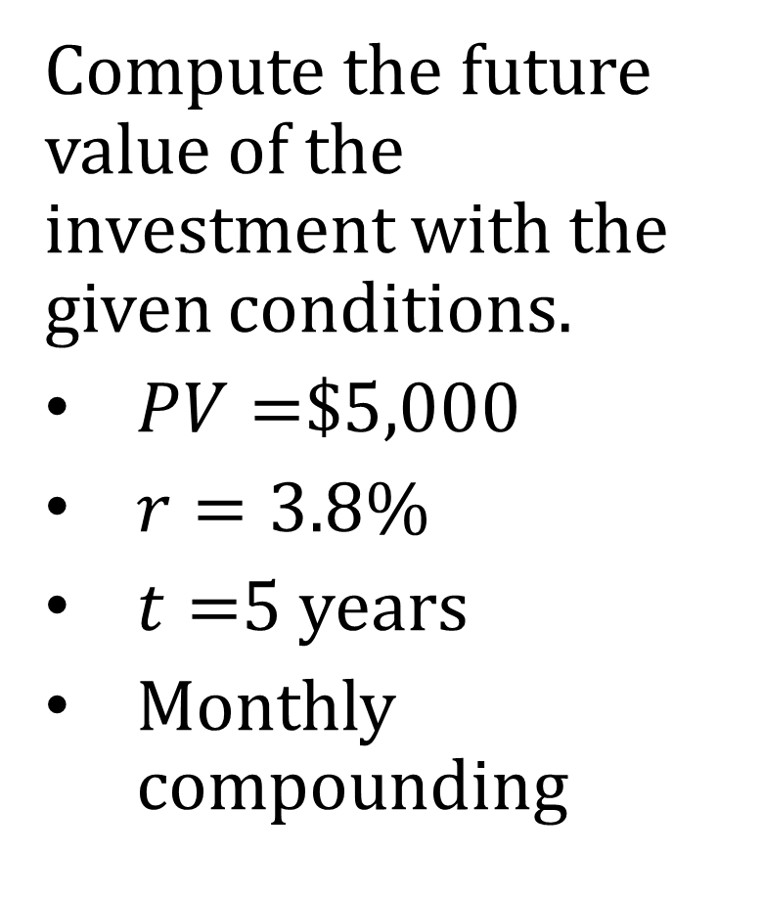
Example 1
Compute the future value of the investment with the given conditions.
$PV=$$5,000
$r=3.8\%$
$t=$5 years
Monthly compounding

Slide 8
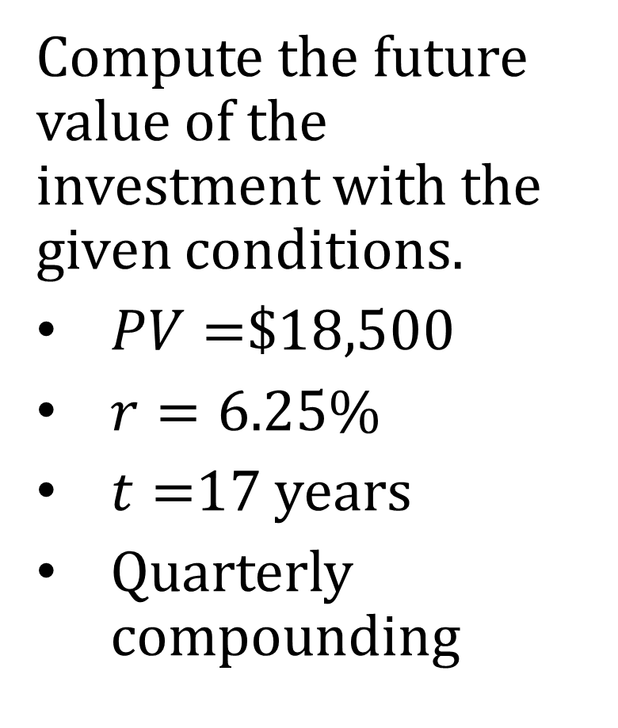
Example 2
Compute the future value of the investment with the given conditions.
$PV=$$18,500
$r=6.25\%$
$t=$17 years
Quarterly compounding

