Slide 1
Solving Logarithmic and Exponential Equations: Quick Start
Success in College Math

Slide 2
Overview
Inverse Properties of Logarithms and Exponential Functions
Solving Exponential Equations
Solving Logarithmic Equations

Slide 3
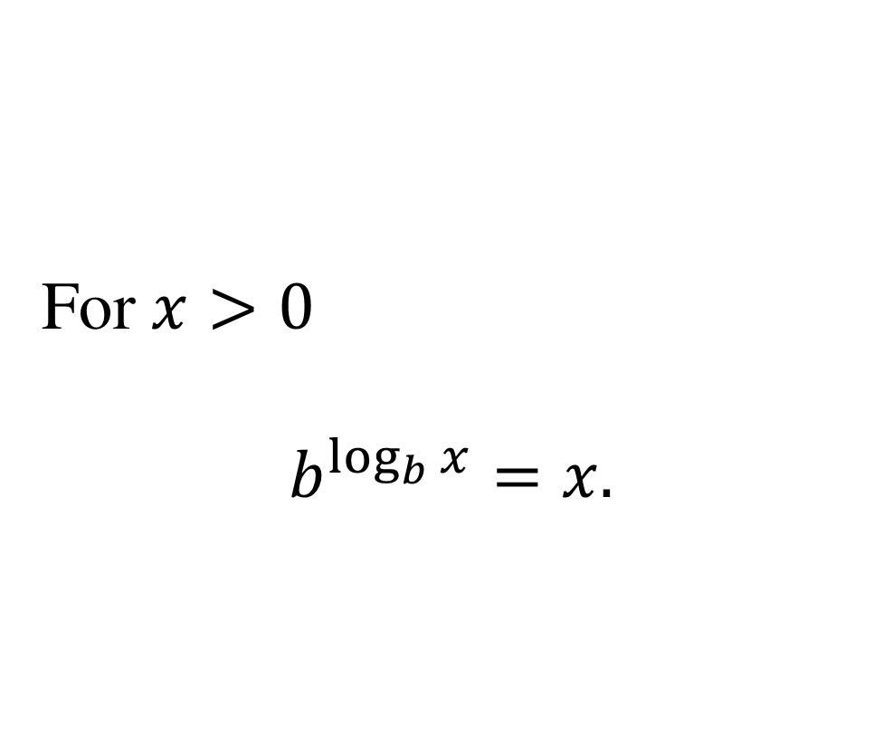
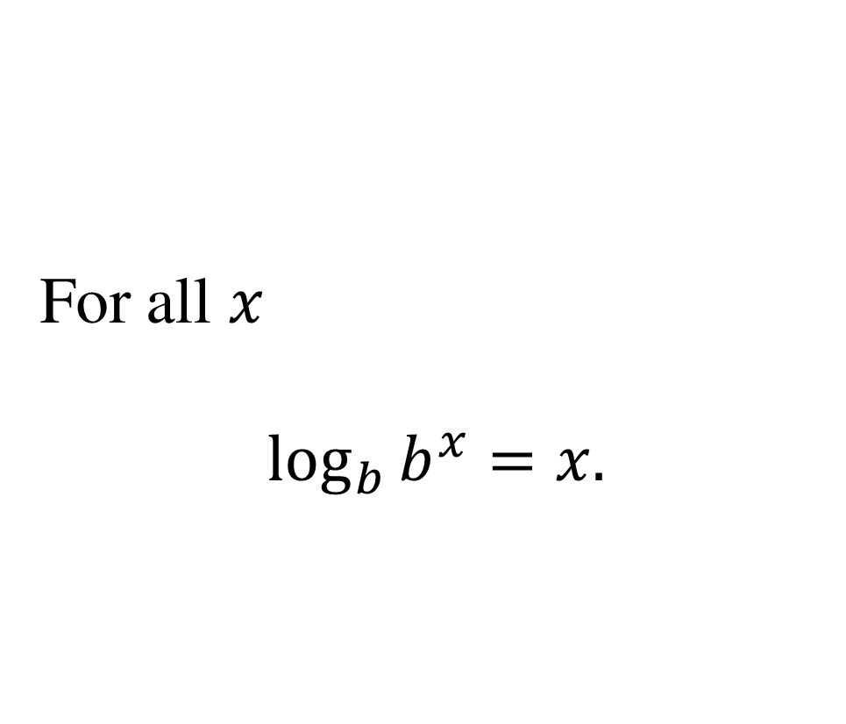
Inverse Properties of Logarithms and Exponential Functions
For all $x$ $$\log_{b}{b^{x}}=x.$$
For $x>0$ $$b^{\log_{b}{x}}=x.$$

Slide 4
How To – Solve Exponential Equations
To solve an equation containing an exponential expression:
Isolate the exponential expression.
Take the logarithm of both sides. Use the same base for the logarithm as the exponential expression.
Cancel the logarithm and exponential expression using the Inverse Property.
Solve the resulting equation.

Slide 5

Example 1
Solve the equation. Round your answer to three decimal places where appropriate.
$$4⋅9^{2x}=14$$

Slide 6
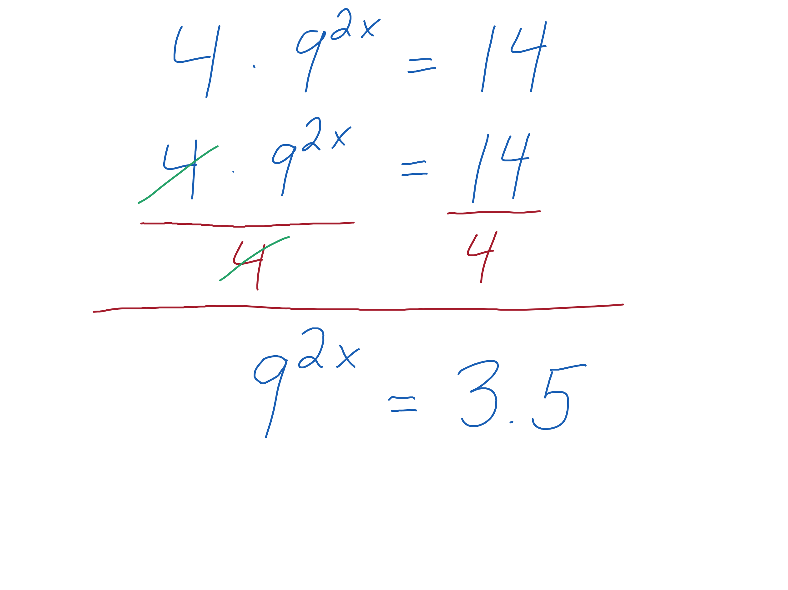
Example 1a
Solve for the exponential expression.

Slide 7
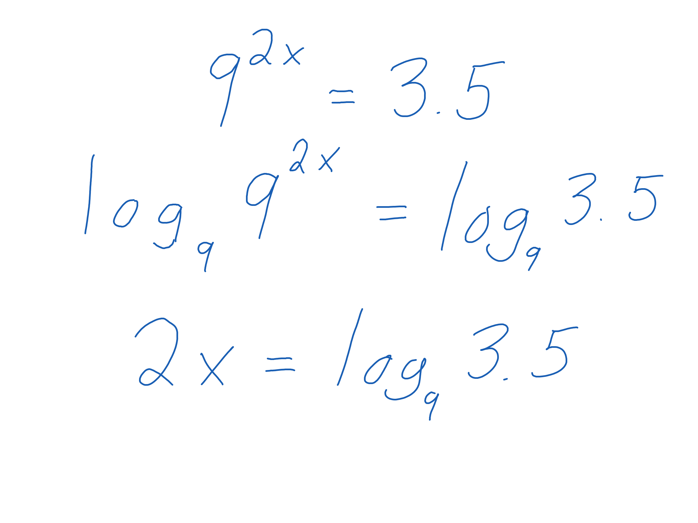
Example 1b
Take the logarithm base 9 of both sides.
Cancel the logarithm and exponent.

Slide 8
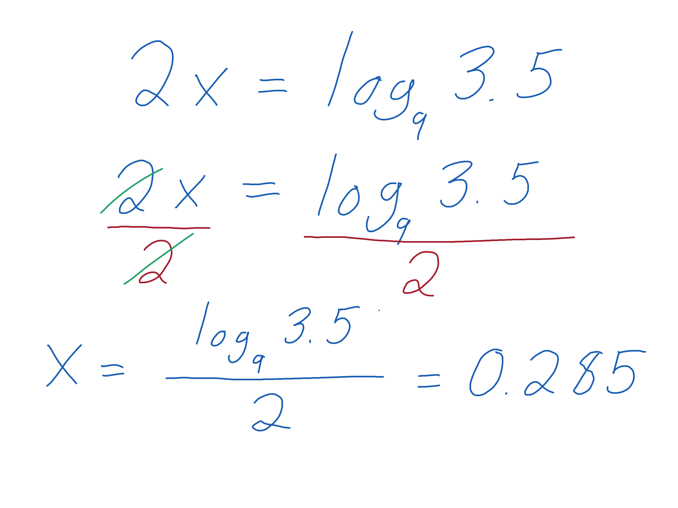

Example 1c
Solve for $x$.
Round your answer to three decimal places.

Slide 9
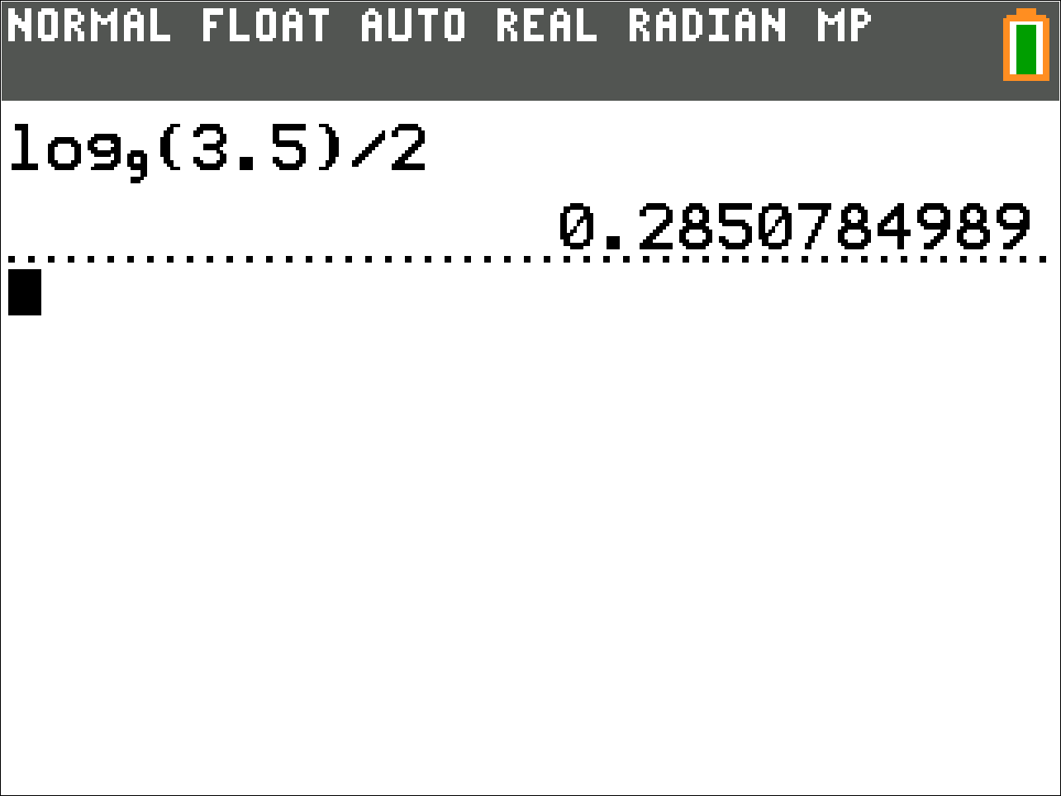
Example 1d
Here are the calculator steps to calculate the answer.

Slide 10

Example 2
Solve the equation. Round your answer to three decimal places where appropriate.
$${10}^{2x−18}+12=−3$$

Slide 11
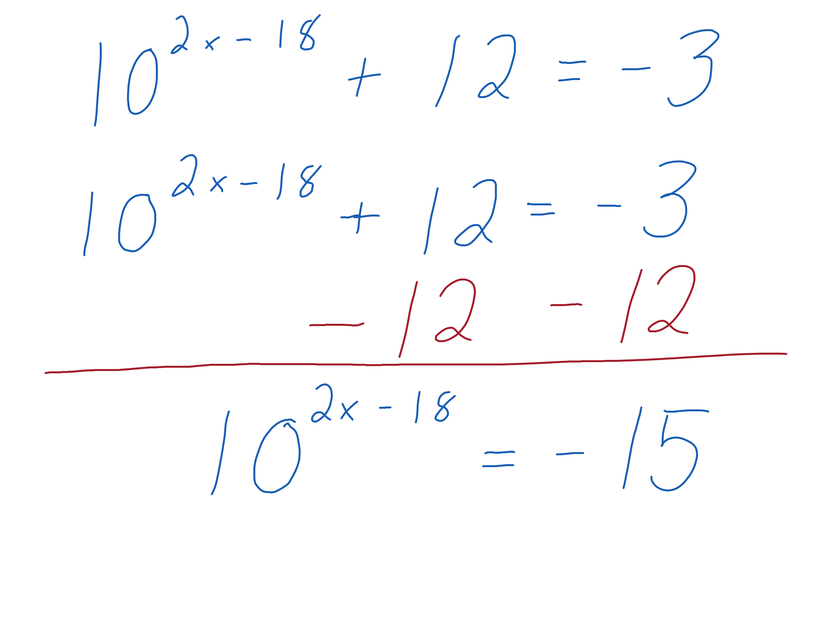
Example 2a
Solve for the exponential expression.

Slide 12
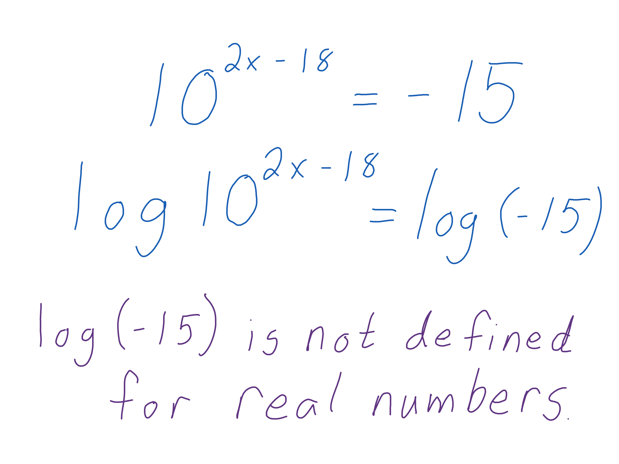
Example 2b
Take the common logarithm of both sides.
The common logarithm isn’t defined for -15, so the equation does not have (real number) solutions.

Slide 13
How To – Solve Logarithmic Equations
To solve an equation containing a logarithm:
Isolate the logarithm.
Use both sides as an exponent in an exponential expression. Use the same base for the exponential expression as the logarithm.
Cancel the exponential expression and logarithm using the Inverse Property.
Solve the resulting equation.

Slide 14

Example 3
Solve the equation. Round your answer to three decimal places where appropriate.
$$2⋅\log\left(6x\right)+16=14$$

Slide 15
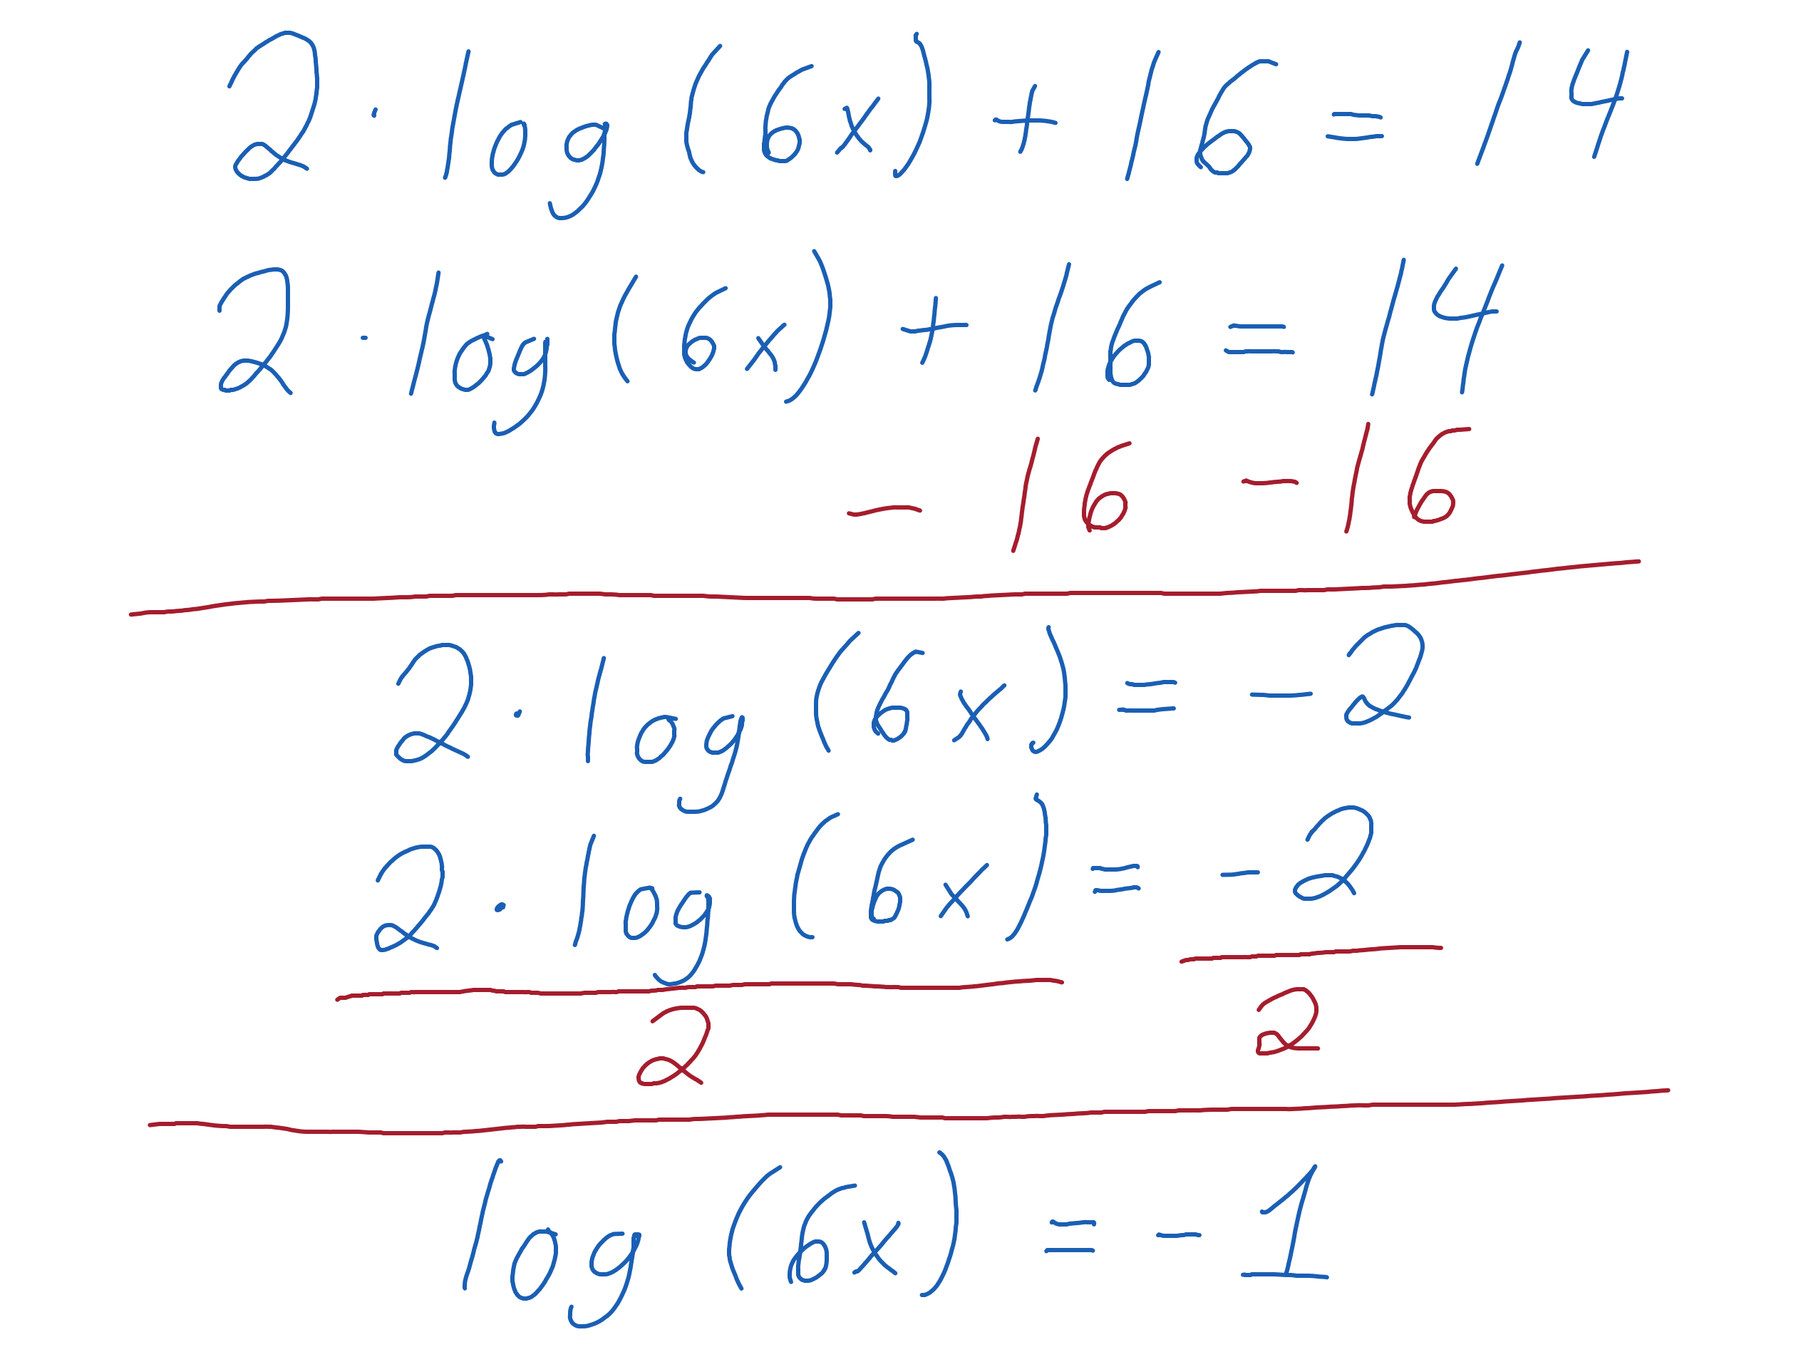
Example 3a
Solve for the logarithm.

Slide 16
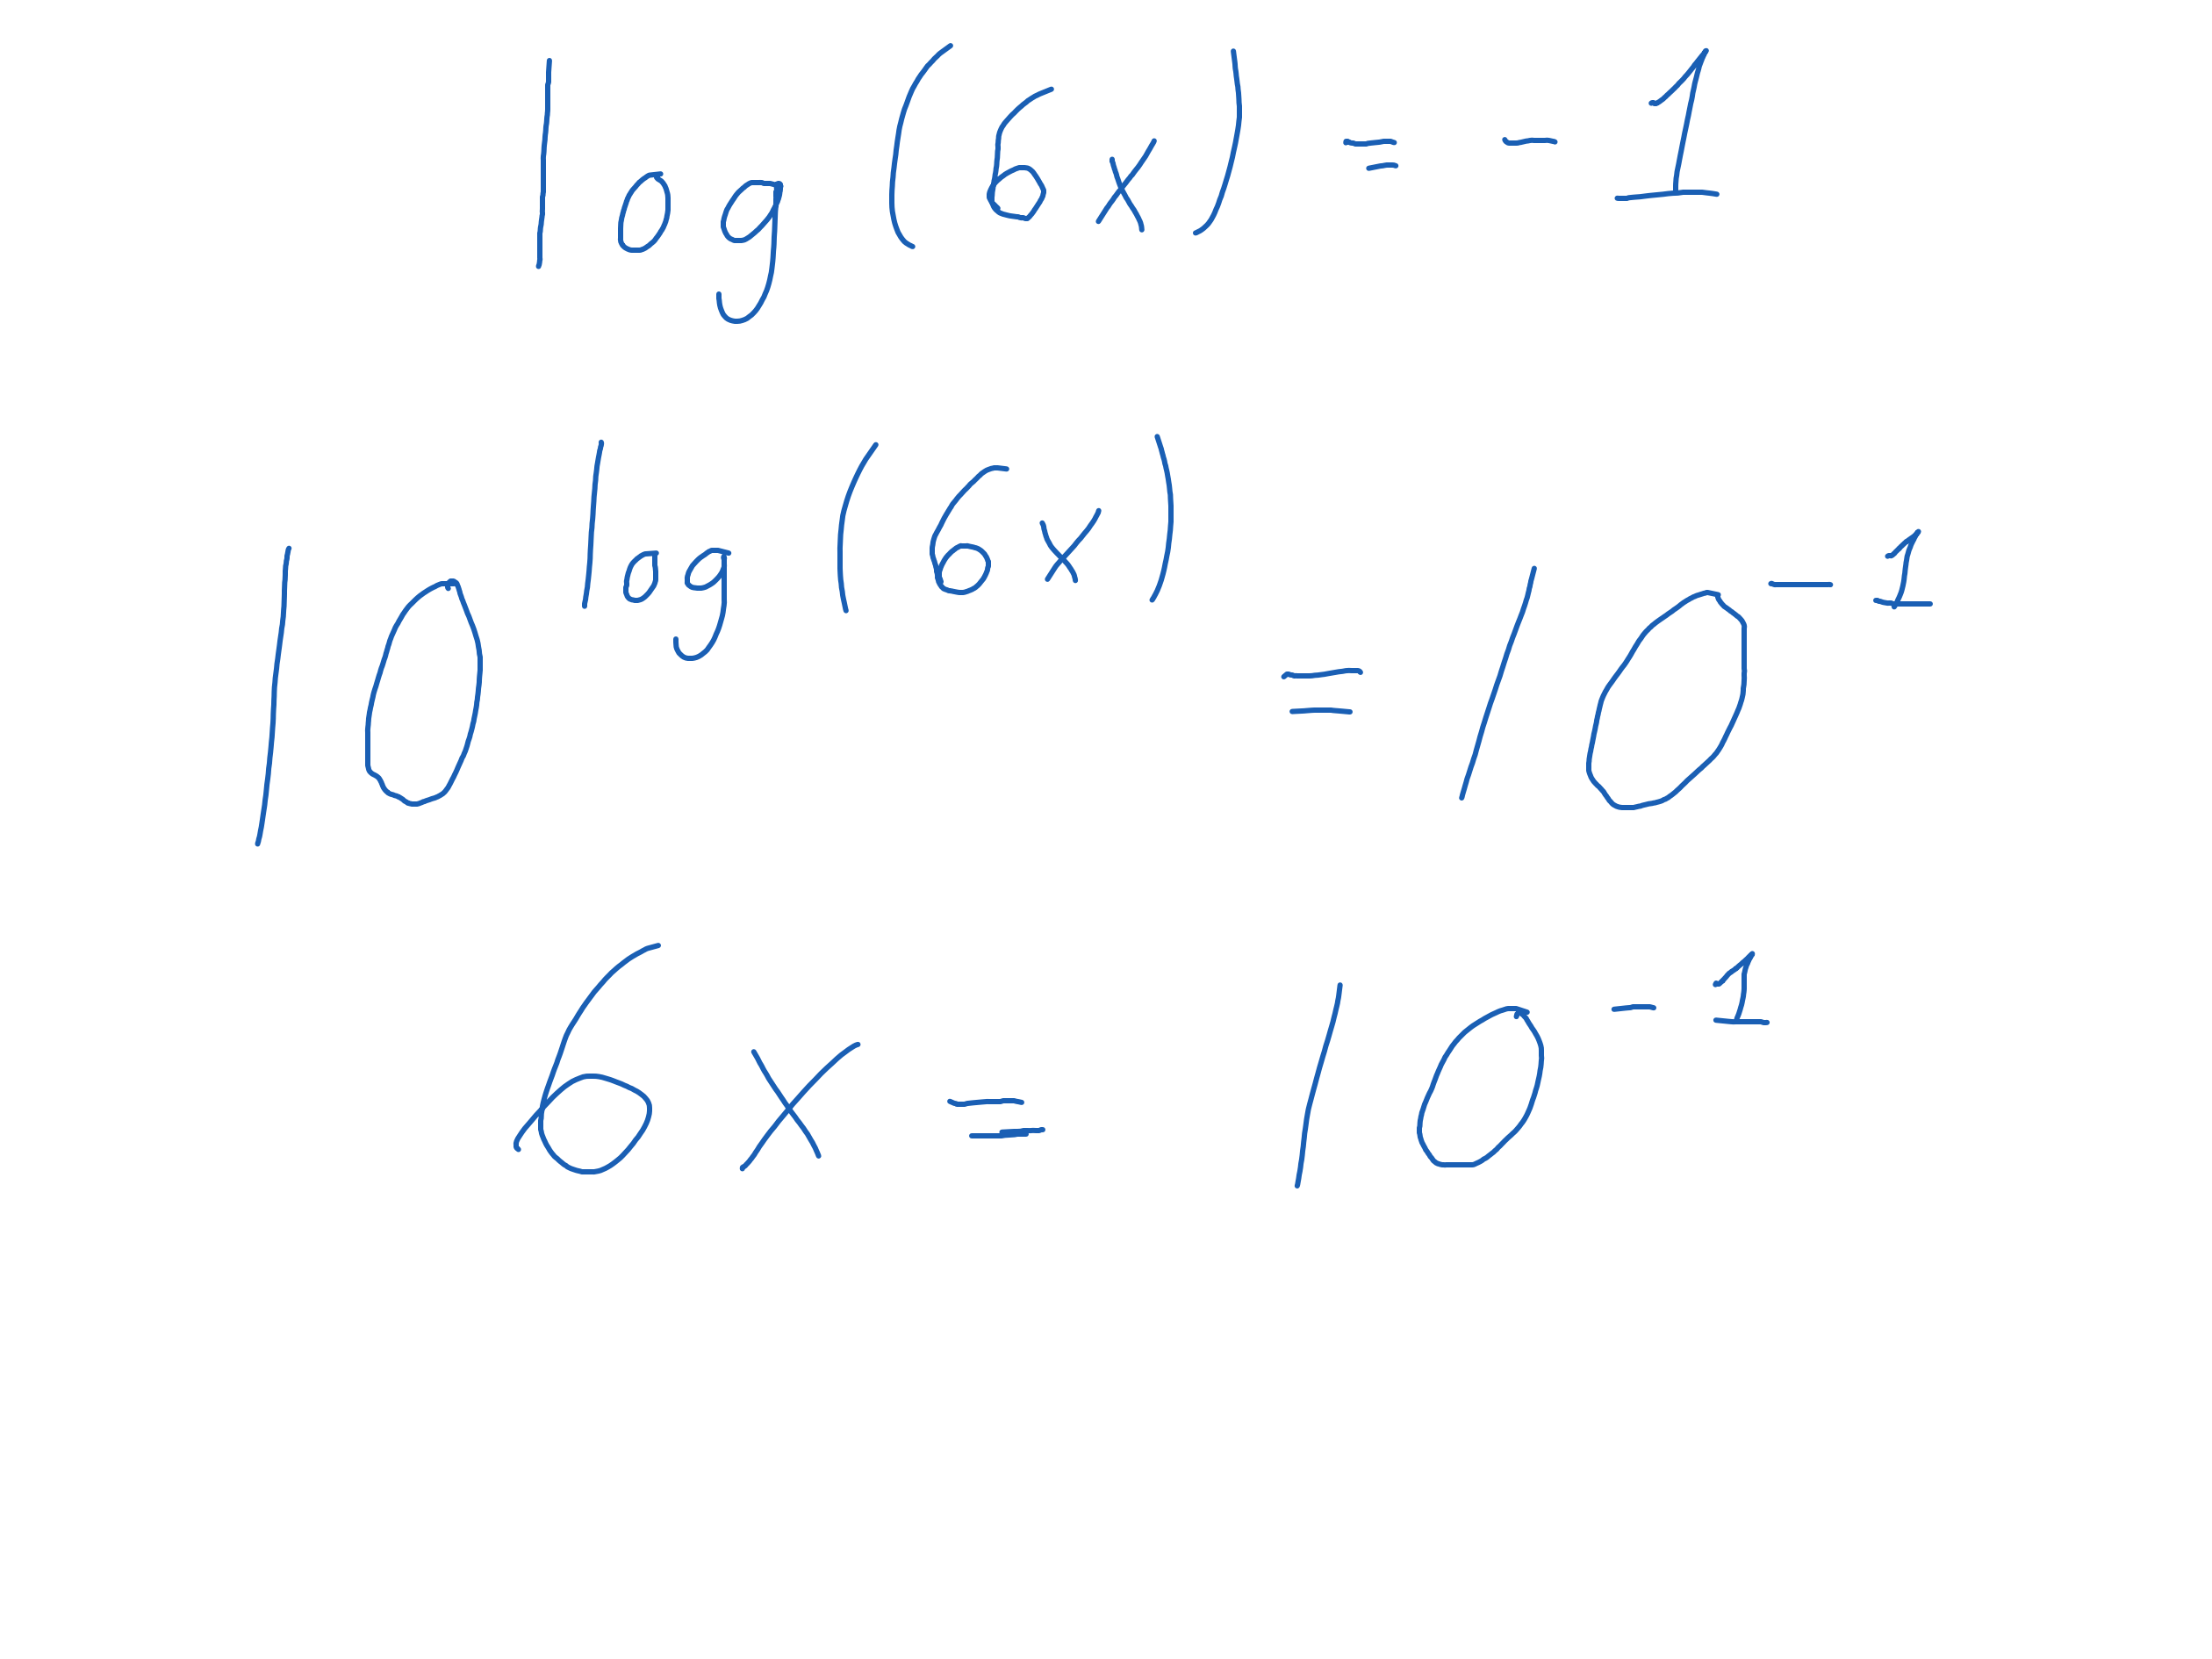
Example 3b
Use both sides as an exponent with base 10.
Cancel the exponent and logarithm.
The negative exponent is defined, so there are solutions.

Slide 17
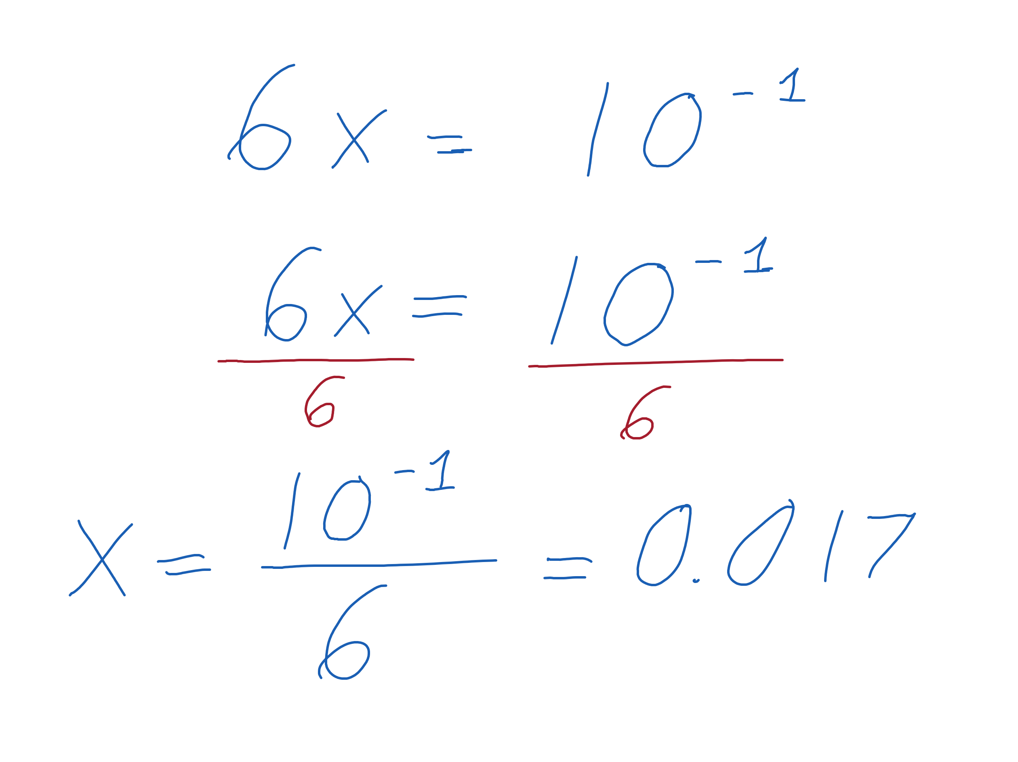
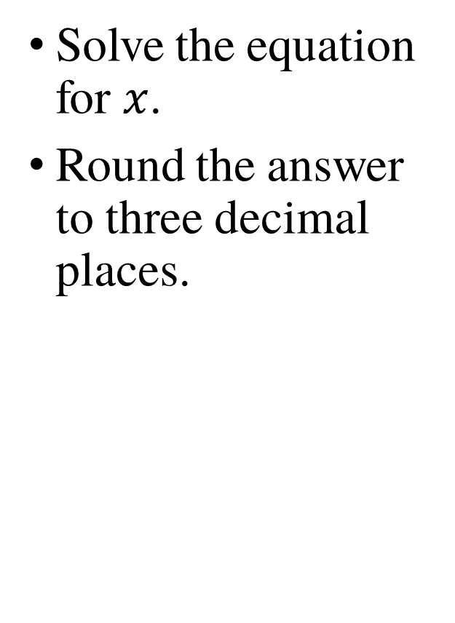
Example 3c
Solve the equation for $x$.
Round the answer to three decimal places.

Slide 18
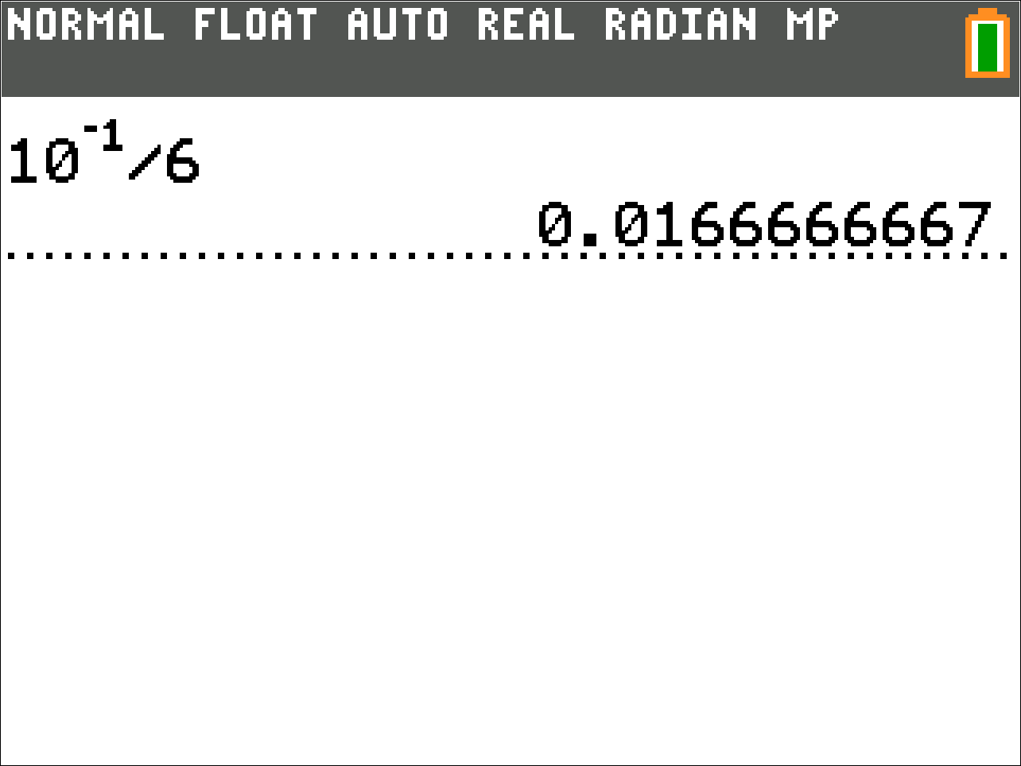
Example 3d
Here are the calculator steps to calculate the answer.

Slide 19

Example 4
Solve the equation. Round your answer to three decimal places where appropriate.
$$\log_{8}\left(3x−18\right)=3$$

Slide 20
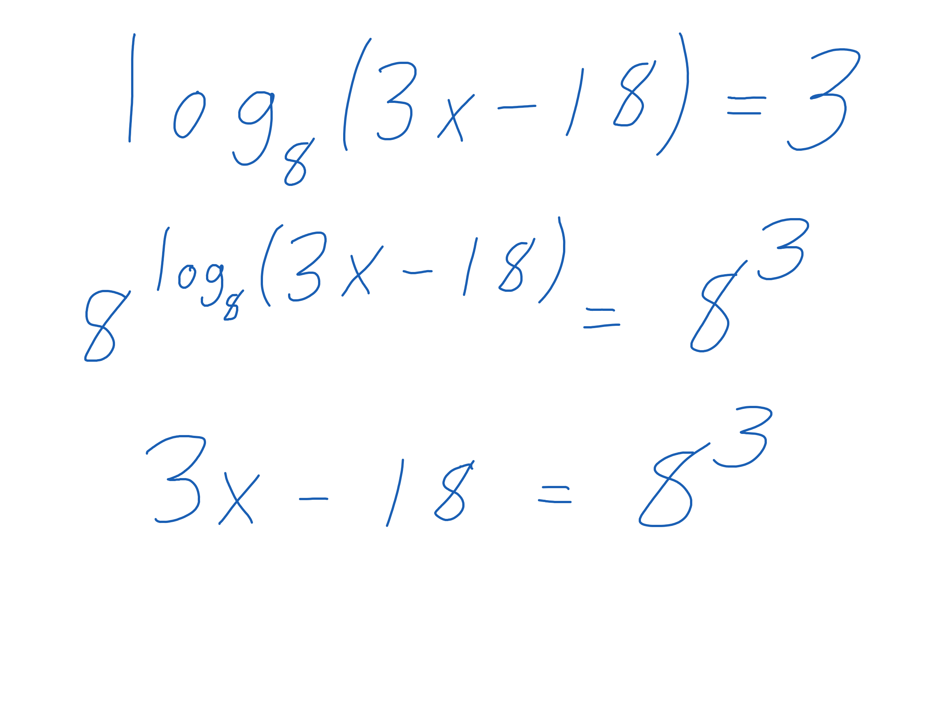
Example 4a
Use both sides of the equation as an exponent with base 8.
Cancel the exponent and logarithm

Slide 21
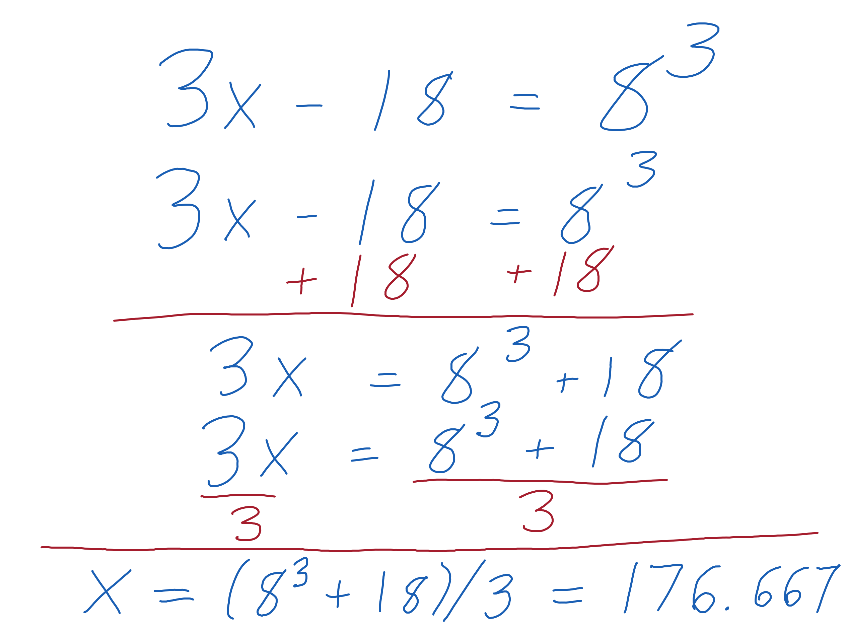
Example 4b
Use both sides of the equation as an exponent with base 8.
Cancel the exponent and logarithm

Slide 22
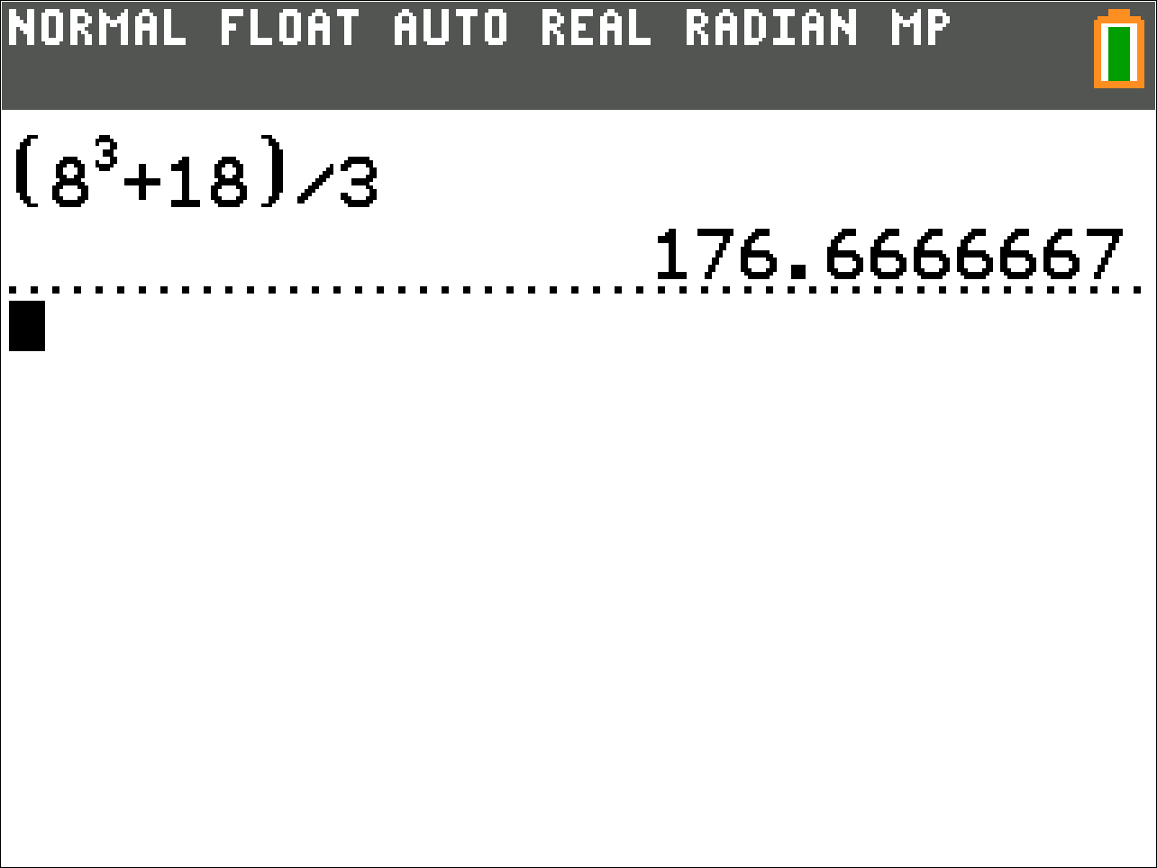
Example 4c
Here are the calculator steps to calculate the answer.

