Slide 1
Contingency Tables
Statistics

Slide 2
Overview
Definition of Contingency Tables
Examples

Slide 3
Definition of Contingency Tables
Contingency Tables

Slide 4
Definition
Contingency Table: Shows data distributed between two or more measured variables
Useful for calculating conditional probabilities
 | Speeding violation in the last year | No speeding violation in the last year | Total
Uses cell phone while driving | 25 | 280 | 305
Does not use cell phone while driving | 45 | 405 | 450
Total | 70 | 685 | 755

Slide 5
Examples
Contingency Tables

Slide 6
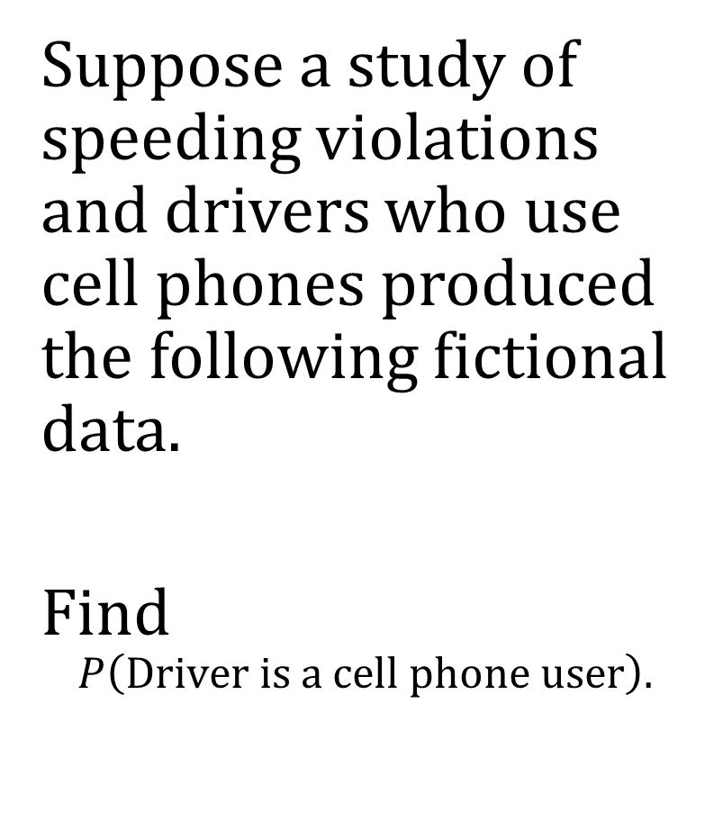
Example 1
 | Speeding violation in the last year | No speeding violation in the last year | Total
Uses cell phone while driving | 25 | 280 | 305
Does not use cell phone while driving | 45 | 405 | 450
Total | 70 | 685 | 755
Suppose a study of speeding violations and drivers who use cell phones produced the following fictional data.
Find $$P\left(\text{Driver} \text{is} \text{a} \text{cell} \text{phone} \text{user}\right).$$

Slide 7
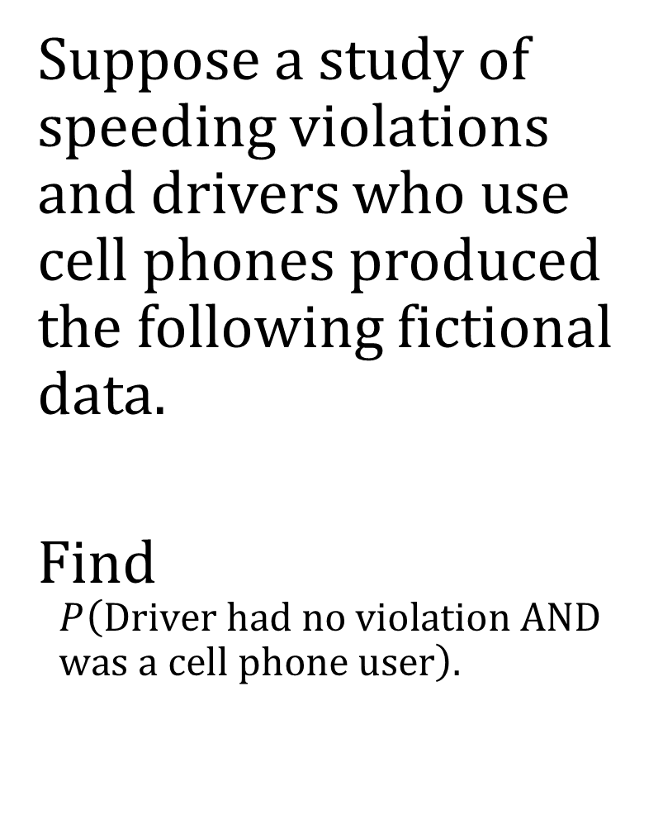
Example 2
 | Speeding violation in the last year | No speeding violation in the last year | Total
Uses cell phone while driving | 25 | 280 | 305
Does not use cell phone while driving | 45 | 405 | 450
Total | 70 | 685 | 755
Suppose a study of speeding violations and drivers who use cell phones produced the following fictional data.
Find $$P\left(\text{Driver} \text{had} \text{no} \text{violation} \text{AND} \text{was} \text{a} \text{cell} \text{phone} \text{user}\right).$$

Slide 8
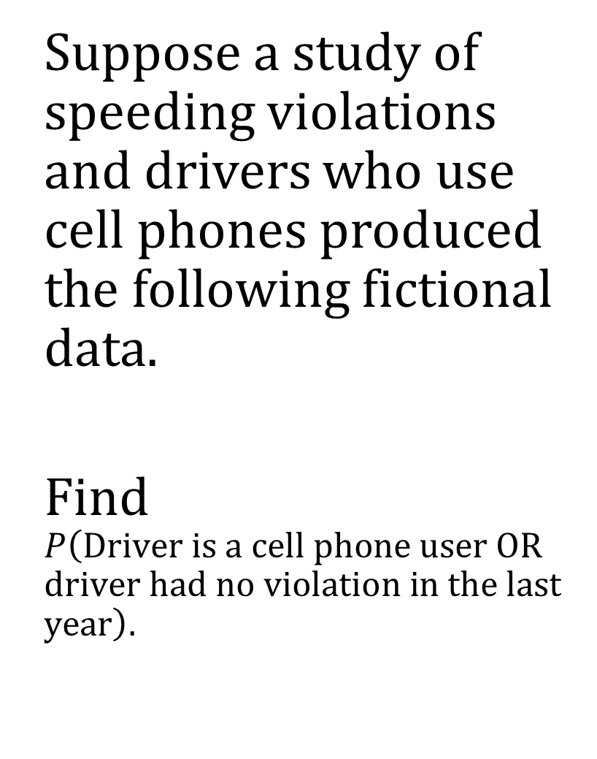
Example 3
 | Speeding violation in the last year | No speeding violation in the last year | Total
Uses cell phone while driving | 25 | 280 | 305
Does not use cell phone while driving | 45 | 405 | 450
Total | 70 | 685 | 755
Suppose a study of speeding violations and drivers who use cell phones produced the following fictional data.
Find $$P\left(\text{Driver} \text{is} \text{a} \text{cell} \text{phone} \text{user} \text{OR} \text{driver} \text{had} \text{no} \text{violation} \text{in} \text{the} \text{last} \text{year}\right).$$

Slide 9
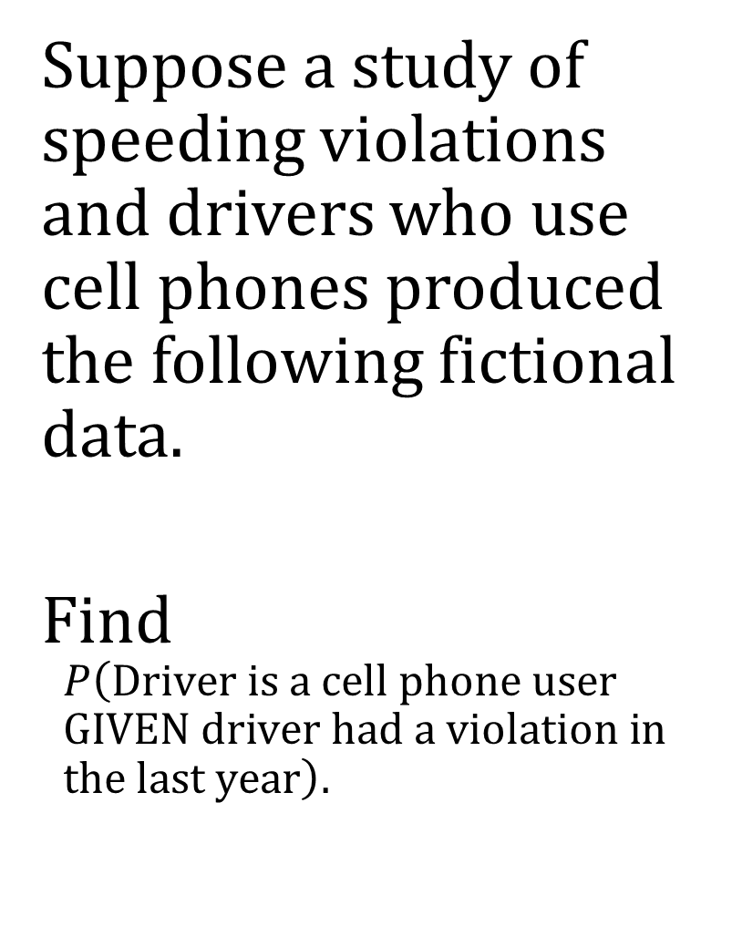
Example 4
 | Speeding violation in the last year | No speeding violation in the last year | Total
Uses cell phone while driving | 25 | 280 | 305
Does not use cell phone while driving | 45 | 405 | 450
Total | 70 | 685 | 755
Suppose a study of speeding violations and drivers who use cell phones produced the following fictional data.
Find $$P\left(\text{Driver} \text{is} \text{a} \text{cell} \text{phone} \text{user} \text{GIVEN} \text{driver} \text{had} \text{a} \text{violation} \text{in} \text{the} \text{last} \text{year}\right).$$

Slide 10
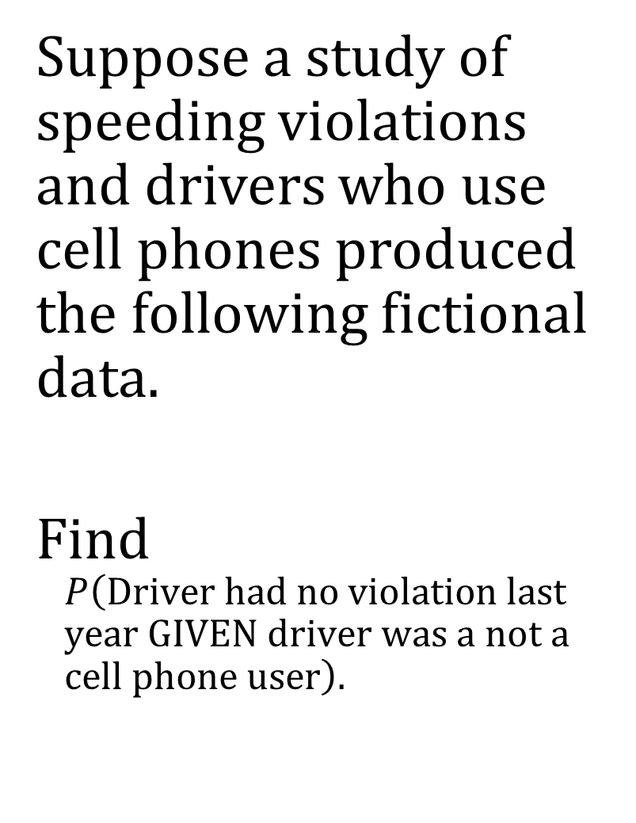
Example 5
 | Speeding violation in the last year | No speeding violation in the last year | Total
Uses cell phone while driving | 25 | 280 | 305
Does not use cell phone while driving | 45 | 405 | 450
Total | 70 | 685 | 755
Suppose a study of speeding violations and drivers who use cell phones produced the following fictional data.
Find $$P\left(\text{Driver} \text{had} \text{no} \text{violation} \text{last} \text{year} \text{GIVEN} \text{driver} \text{was} \text{a} \text{not} \text{a} \text{cell} \text{phone} \text{user}\right).$$

