Slide 1
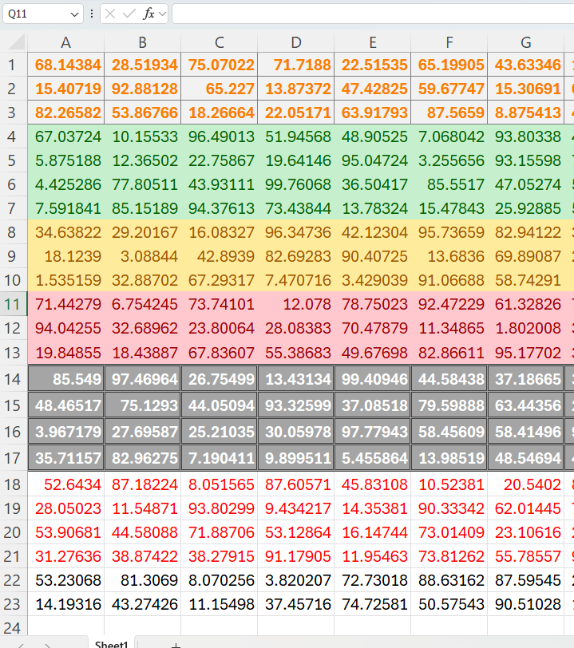
Counting the Size of a Dataset in Excel
Statistics

