Slide 1
Agentic RAG and LLMs for Holistic Observability
Onyinye S. Uche & Tianxiang Lu
MOC / Declare 2025
and Strategic Optimization in Fintech
Presenter: Prof. Dr T. Lu
Online Presentation,
Évora, Portugal,
September 24 - 26

Slide 2
Agenda for this topic
Problem -> Research Questions |  | 1 |  | p3-5, 15:05
Related Work & Limitations |  | 2 |  | p6, 15:10
Methodology (Framework & Analysis) |  | 3 |  | P7-11, 15:12
Recommendations |  | 4 |  | P12-13, 15:20
Conclusion |  | 5 |  | P14-16, 15:25

Slide 3
Onyinye S. Uche & Tianxiang Lu
Problem
Observability is vital in fintech,
but current approaches neglect business context.

Slide 4




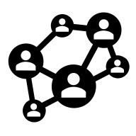

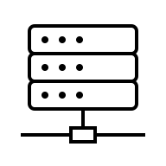

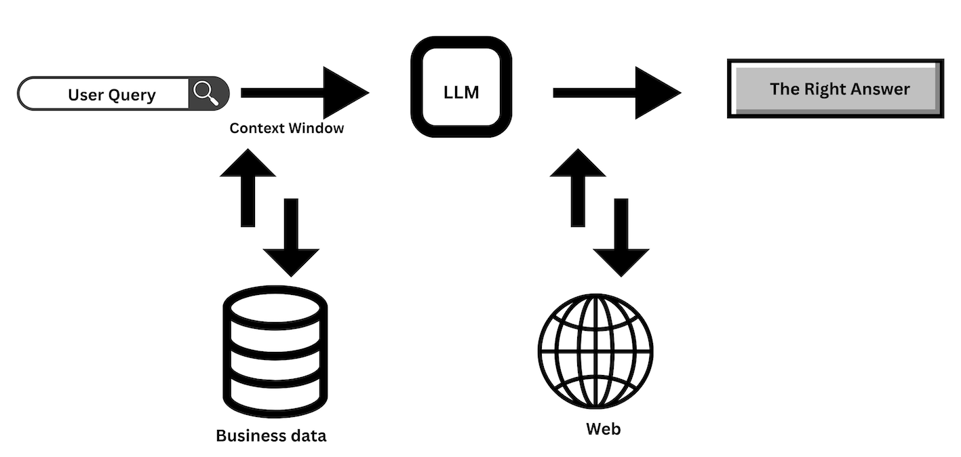
Unreliable Fintech Operations Hurt Business
Technical Observability
Business Impact / Context
Traditional observability rarely bridges
technical telemetry and business insights
Logs
Traces
Metrics
Events
Revenue / transaction impact
Customer experiences
Fraud detection
Regulatory compliance
Notes:
Unreliable Fintech Operations is bad for business.
Observability can provide critical insight into the systems that power fintech operations to prevent disruptions.
These insights are typically inferred from system outputs
Telemetry data – Logs, traces, Metrics, Events
Beyond technical insights, understanding how IT systems impact critical business outcomes is also critical
Traditional observability do not provide cross-functional insights.

Slide 5
Onyinye S. Uche & Tianxiang Lu
Research Questions
How can LLMs + RAG enable holistic observability?
What are enablers/barriers to adoption?

Slide 6
Related Work & Limitations
Domain | Contribution | Key References
Industry Platforms | AI/LLM-powered telemetry analysis; business playbooks linking observability to action | Siegfried et al., 2024; Livens, 2024; ElasticRAG, 2024; Elastic Playbook, 2025
Academic AI for Observability | LLM-based anomaly detection, intelligent log processing; surveys of distributed systems | Zhang et al., 2024; Ji & Luo, 2025; Usman et al., 2022; Fernando, 2023; Niedermaier et al., 2019; Souza, 2024
LLMs for Knowledge & Governance | Enterprise knowledge retrieval; strategic insight generation; governance-aware AI | Joshi, 2023; Pisoni, 2024; Prabhune & Berndt, 2024; Mayer et al., 2025; Ridzuan et al., 2024
Emerging AI Techniques | Agentic RAG for troubleshooting; GenAI for strategic decision support | Khanda, 2024; ElasticRAG, 2024; IBM, 2025; ElasticGenAI, 2025; Xu, 2024; Kumar et al., 2025
Prior work is mostly technical; our framework emphasizes strategic, organization-wide observability

Slide 7





Methodology
Iterative
Design-driven Approach
Case Study
Lagos FinTech firm
Semi-structured interviews (5 leads)
Thematic Analysis
SWOT
Source

Slide 8
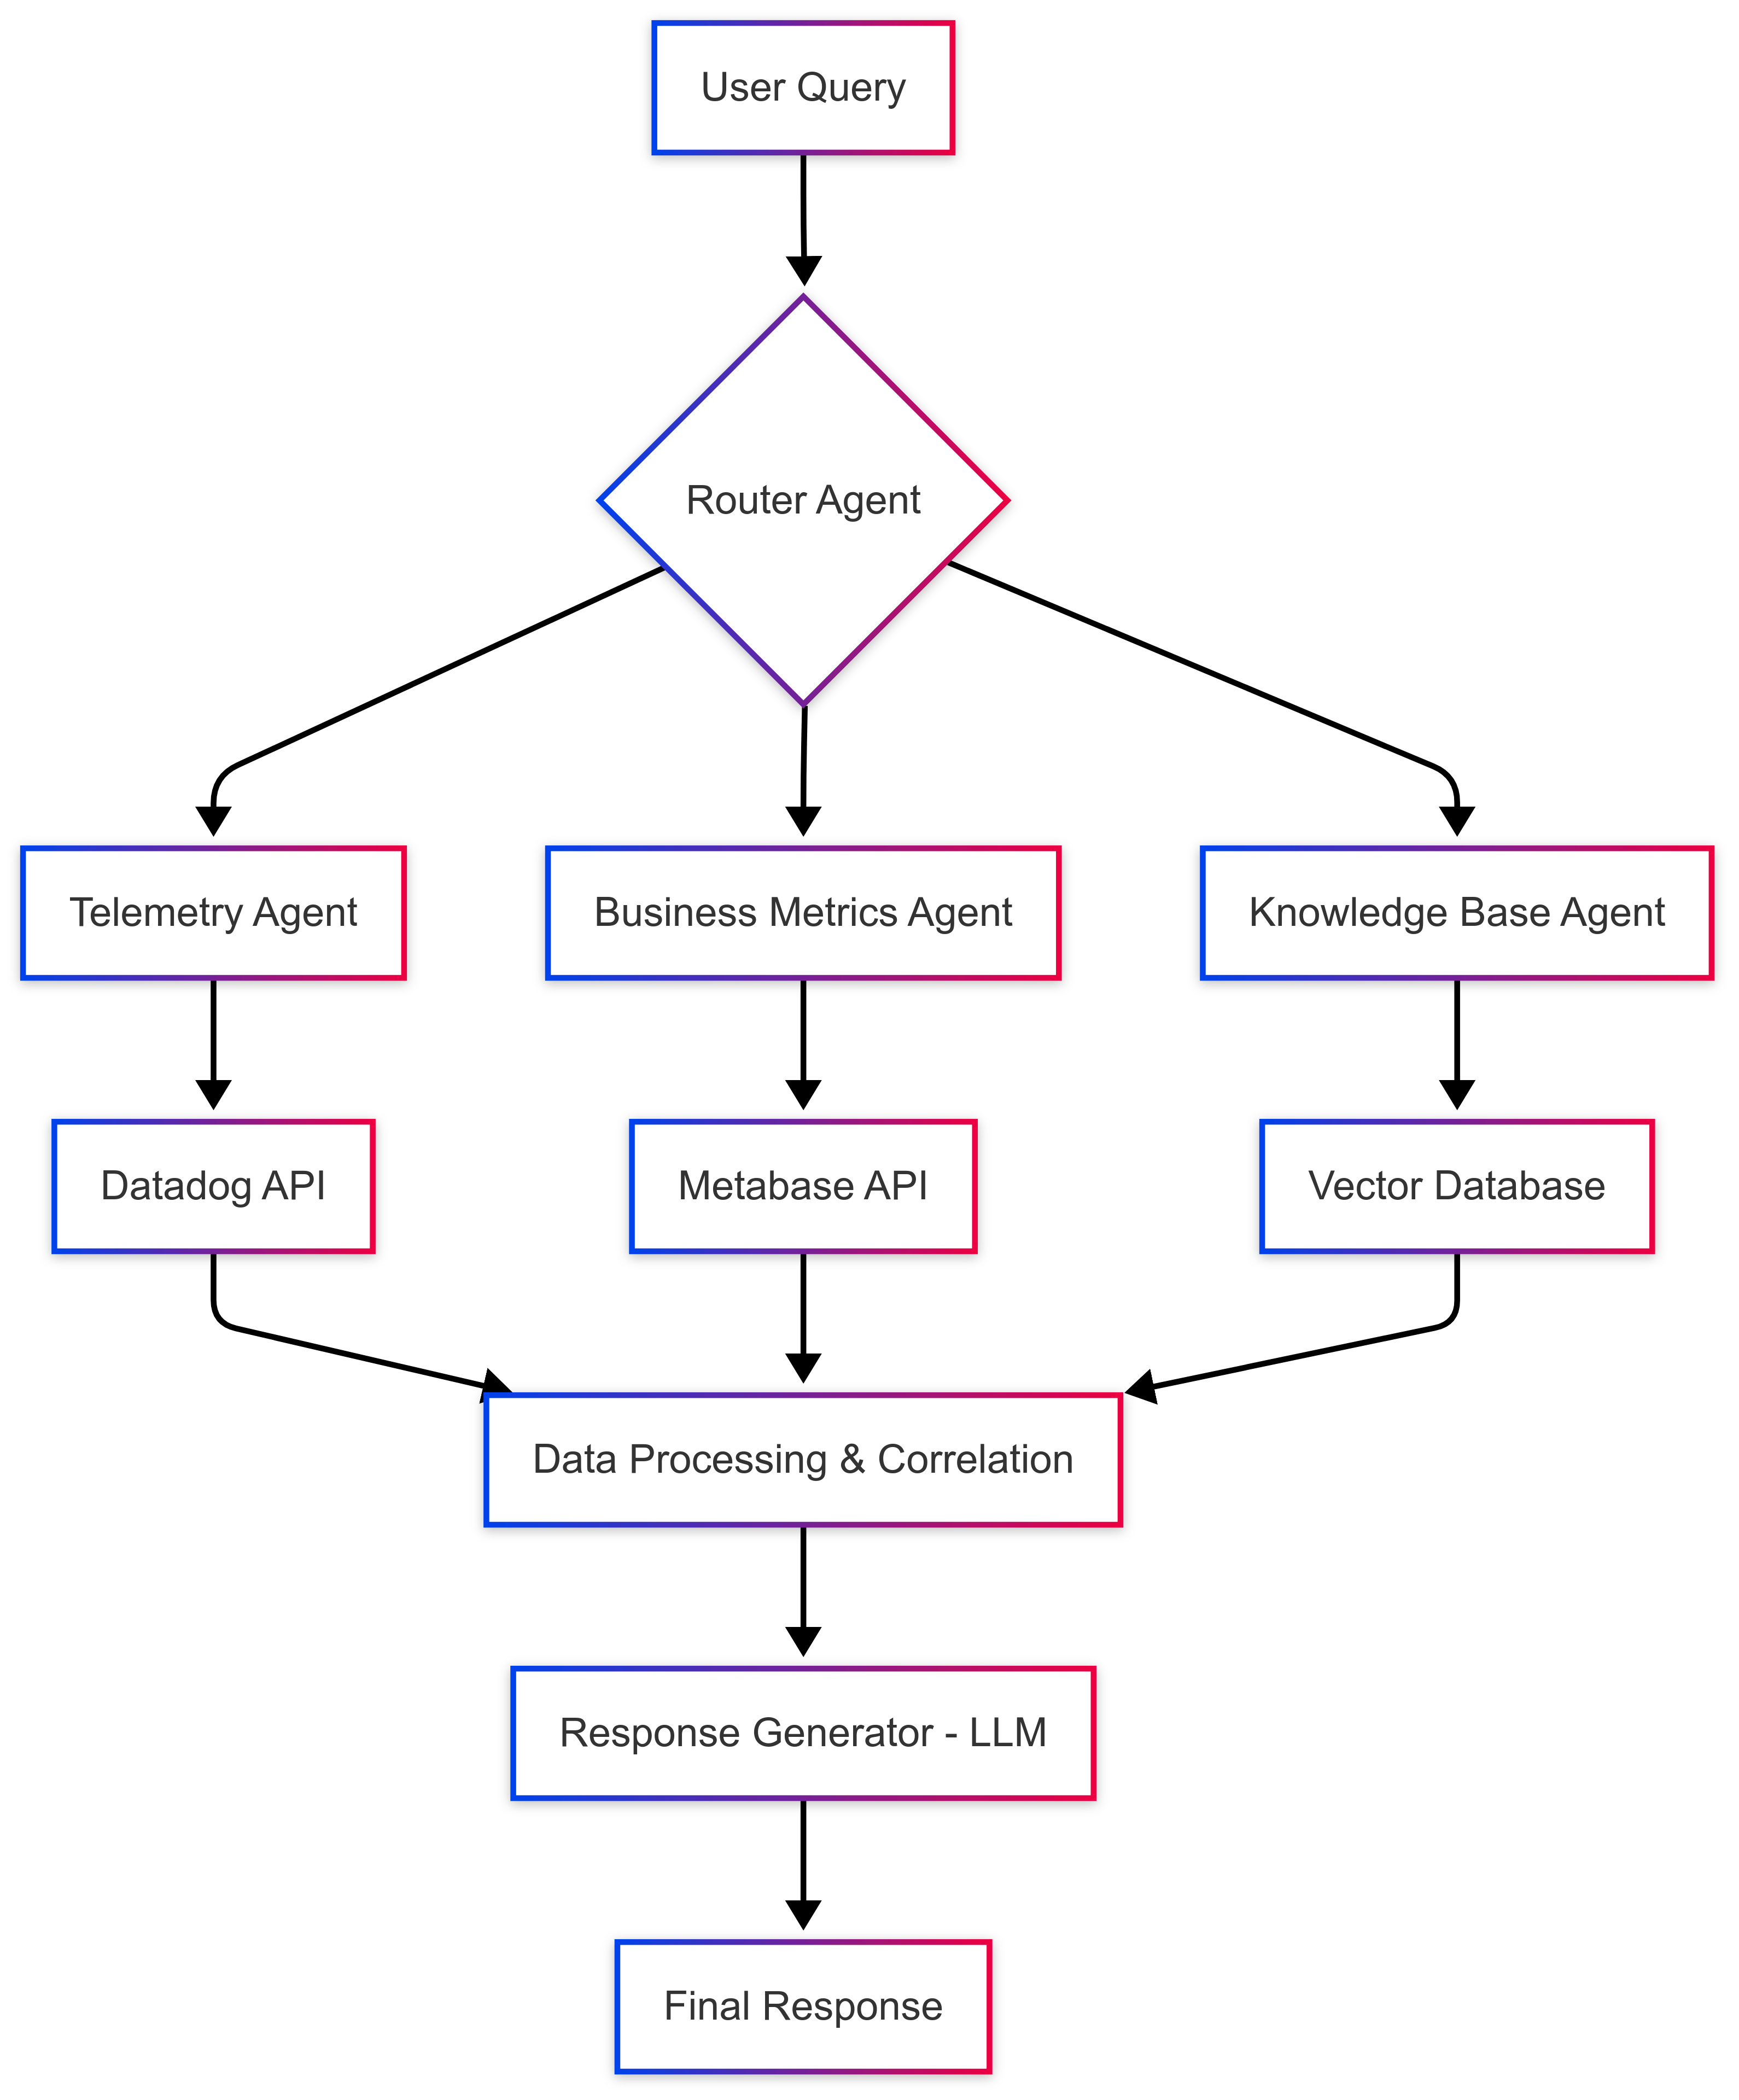
Proposed LLM-Powered Observability (LPO) Framework – The Initial Design
LLMs
→ democratize data
RAG
→ unify fragmented data → ground LLM outputs
AI Agents
→ autonomous, context-aware reasoning
Fig. 1. Proposed Agentic RAG Architecture for LLM-powered Observability

Slide 9



Onyinye S. Uche & Tianxiang Lu
Key Themes
Data silos as barrier
Technical feasibility confirmed
Organizational readiness/culture as key constraint
Compliance/ethical concerns?
Notes:
We went into the case study research trying to investigate how the conceptual LPO solution can be integrated and adopted to drive strategic resilience in fintech operations using FinTech Company as the unit of analysis Primary Data: Collected via semi-structured interviews at Paystack
Sampling: Leads of 5 Engineering Units (Platforms, Observability, Data, Infrastructure & Security, DevRel)
Three themes emerged after the thematic analysis:

Slide 10
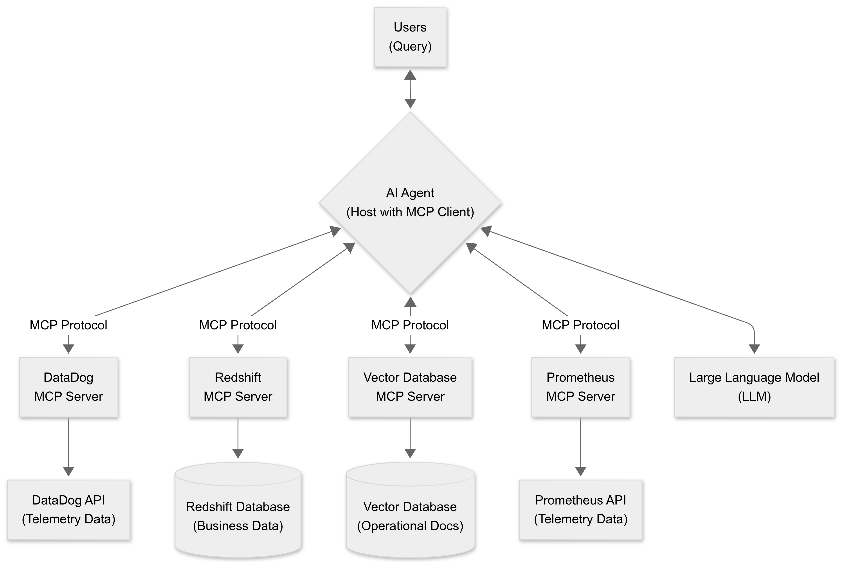
Refined Framework
“How did API errors affect merchant pay-ins?”
Model Context Protocol (MCP)
– Anthropic
Open Standard
Tool Integration
Context Sharing
Memory Management
Agentic Workflows
Cross-Platform
Secure & Governed
Fig. 2. Model Context Protocol (MCP) based final proposed Architecture of LPO System.
Notes:
Final Proposed Architecture of the LPO System. This refined agentic design
adopts the Model Context Protocol (MCP) as the orchestration layer, enabling the
central AI Agent to query disparate data sources through standardised MCP clients. An open standard introduced by Anthropic in November 2024 to unify AI-agent interactions with external tools and data sources. It enables real-time contextual memory and tool invocation via a structured JSON-RPC 2.0 interface, adopted by major platforms including OpenAI, Google DeepMind, and Microsoft. MCP facilitates seamless integration with services like GitHub, Slack, Google Drive, and Canva, and supports agentic AI workflows by allowing agents to remember, share, and reuse information across tools. Open-source SDKs are available in Python, TypeScript, Java, and other languages, with governance and security frameworks to mitigate risks like tool poisoning and unauthorized access. Anthropic. (2024, November 25). Introducing the Model Context Protocol. Retrieved from https://www.anthropic.com/news/model-context-protocol
Model Context Protocol. (2025, June 18). Specification. Retrieved from https://modelcontextprotocol.io/specification/2025-06-18
Wikipedia contributors. (2025, September 24). Model Context Protocol. In Wikipedia, The Free Encyclopedia. Retrieved from https://en.wikipedia.org/wiki/Model_Context_Protocol
Tom's Guide. (2025, July 24). Claude can now connect to Google Drive, Canva, Slack and more—here’s how to try it. Retrieved from https://www.tomsguide.com/ai/claude-can-now-connect-to-google-drive-canva-slack-and-more-heres-how-to-try-it
Reuters. (2025, September 24). Microsoft brings Anthropic AI models to 365 Copilot, diversifies beyond OpenAI. Retrieved from https://www.reuters.com/business/microsoft-brings-anthropic-ai-models-365-copilot-diversifies-beyond-openai-2025-09-24/

Slide 11
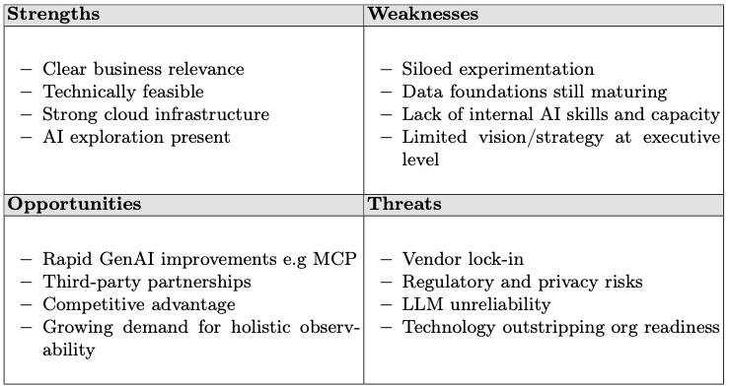
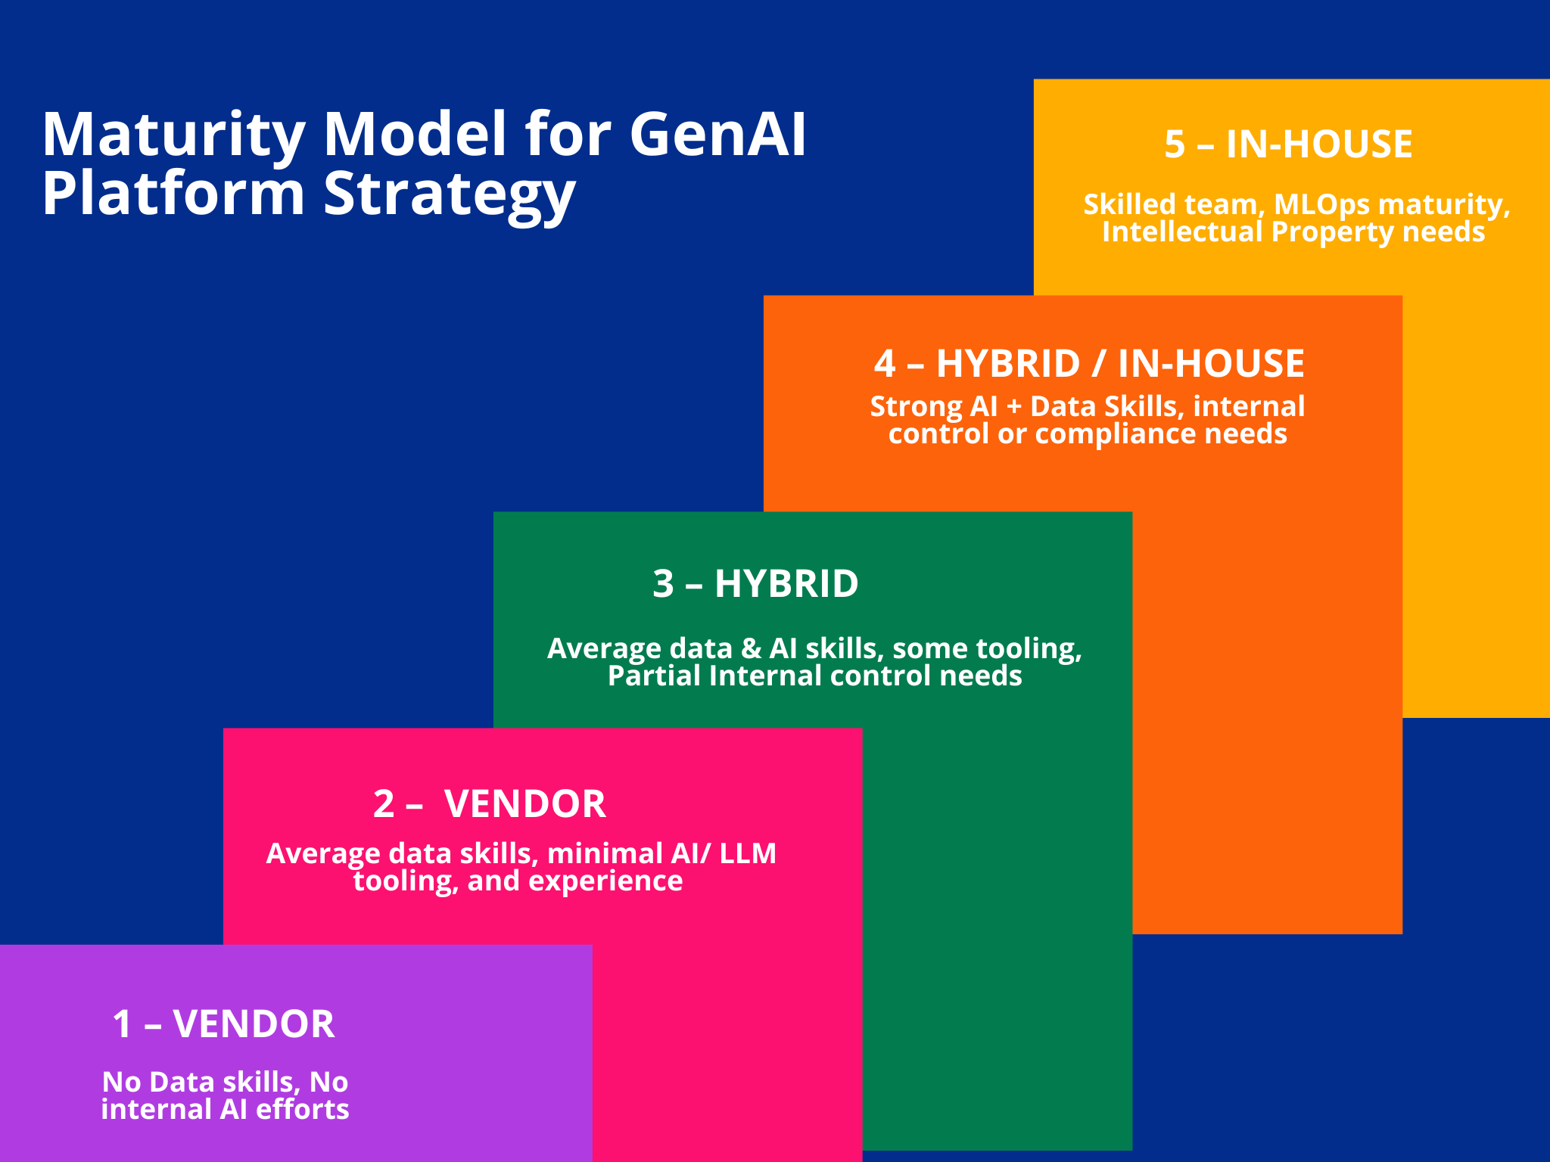
SWOT Analysis
Fig. 3. Maturity Model for GenAI Platform Strategy – case company lies between 2 and 3
Notes:
A SWOT analysis was performed to identify factors that can affect the successful
implementation of the LPO solution in the case company based on the empirical
analysis and thematic insights from the interviews. The result of this analysis is
summarized in the table. Internal (Strengths and Weakness)
External → MM for GenAI with a rating between 2 and 3,
the case company has the opportunity to rely on third-party cloud vendors to compensate for the lack of skills and internal capacity.

Slide 12
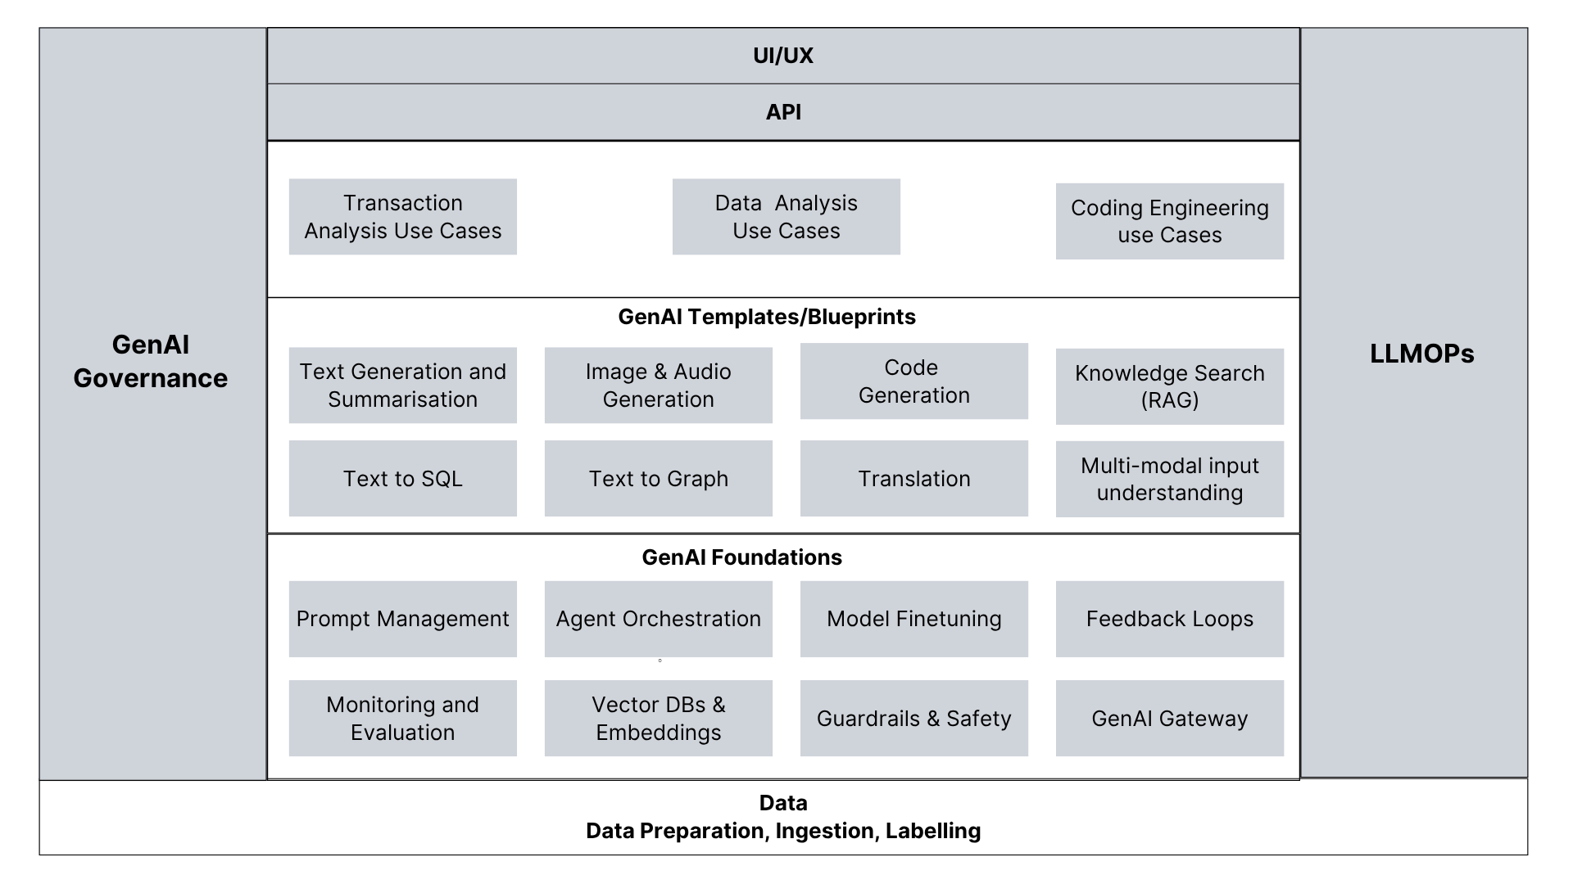
Recommendation: Platform-Centric AI Strategy
Fig. 4. Sample GenAI Platform Architecture
Notes:
Final Proposed Architecture of the LPO System. This refined agentic design
adopts the Model Context Protocol (MCP) as the orchestration layer, enabling the
central AI Agent to query disparate data sources through standardised MCP clients. An open standard introduced by Anthropic in November 2024 to unify AI-agent interactions with external tools and data sources. It enables real-time contextual memory and tool invocation via a structured JSON-RPC 2.0 interface, adopted by major platforms including OpenAI, Google DeepMind, and Microsoft. MCP facilitates seamless integration with services like GitHub, Slack, Google Drive, and Canva, and supports agentic AI workflows by allowing agents to remember, share, and reuse information across tools. Open-source SDKs are available in Python, TypeScript, Java, and other languages, with governance and security frameworks to mitigate risks like tool poisoning and unauthorized access. Anthropic. (2024, November 25). Introducing the Model Context Protocol. Retrieved from https://www.anthropic.com/news/model-context-protocol
Model Context Protocol. (2025, June 18). Specification. Retrieved from https://modelcontextprotocol.io/specification/2025-06-18
Wikipedia contributors. (2025, September 24). Model Context Protocol. In Wikipedia, The Free Encyclopedia. Retrieved from https://en.wikipedia.org/wiki/Model_Context_Protocol
Tom's Guide. (2025, July 24). Claude can now connect to Google Drive, Canva, Slack and more—here’s how to try it. Retrieved from https://www.tomsguide.com/ai/claude-can-now-connect-to-google-drive-canva-slack-and-more-heres-how-to-try-it
Reuters. (2025, September 24). Microsoft brings Anthropic AI models to 365 Copilot, diversifies beyond OpenAI. Retrieved from https://www.reuters.com/business/microsoft-brings-anthropic-ai-models-365-copilot-diversifies-beyond-openai-2025-09-24/

Slide 13
Recommendation: CRISP-ML (Q)
Business Data Understanding
Data Engineering
Evaluation
Deployment
Monitoring & Maintenance
Modelling
Fig. 2. Model Context Protocol (MCP) based final proposed Architecture of LPO System.
Notes:
Final Proposed Architecture of the LPO System. This refined agentic design
adopts the Model Context Protocol (MCP) as the orchestration layer, enabling the
central AI Agent to query disparate data sources through standardised MCP clients. An open standard introduced by Anthropic in November 2024 to unify AI-agent interactions with external tools and data sources. It enables real-time contextual memory and tool invocation via a structured JSON-RPC 2.0 interface, adopted by major platforms including OpenAI, Google DeepMind, and Microsoft. MCP facilitates seamless integration with services like GitHub, Slack, Google Drive, and Canva, and supports agentic AI workflows by allowing agents to remember, share, and reuse information across tools. Open-source SDKs are available in Python, TypeScript, Java, and other languages, with governance and security frameworks to mitigate risks like tool poisoning and unauthorized access. Anthropic. (2024, November 25). Introducing the Model Context Protocol. Retrieved from https://www.anthropic.com/news/model-context-protocol
Model Context Protocol. (2025, June 18). Specification. Retrieved from https://modelcontextprotocol.io/specification/2025-06-18
Wikipedia contributors. (2025, September 24). Model Context Protocol. In Wikipedia, The Free Encyclopedia. Retrieved from https://en.wikipedia.org/wiki/Model_Context_Protocol
Tom's Guide. (2025, July 24). Claude can now connect to Google Drive, Canva, Slack and more—here’s how to try it. Retrieved from https://www.tomsguide.com/ai/claude-can-now-connect-to-google-drive-canva-slack-and-more-heres-how-to-try-it
Reuters. (2025, September 24). Microsoft brings Anthropic AI models to 365 Copilot, diversifies beyond OpenAI. Retrieved from https://www.reuters.com/business/microsoft-brings-anthropic-ai-models-365-copilot-diversifies-beyond-openai-2025-09-24/

Slide 14

Critical Reflection & Next Steps
Bridging Silos: LPO links operational telemetry and business metrics—going beyond what Prometheus/Grafana or BI tools alone can offer.
Actionable Insights for All: LLM + RAG enables natural-language queries, helping non-technical stakeholders leverage multi-source insights.
Complementary, Not Replacement: Traditional BI remains effective for well-scoped technical metrics—simplicity and reliability matter.
Study Constraints: Single org, expert feedback, and rapid tech change limit generalizability.
Future Directions: Multi-case studies, quantitative benchmarks, collaborative design, and ROI/compliance assessments.
Evolving Field: Continuous reassessment needed as AI and observability landscapes advance.

Slide 15

Onyinye S. Uche & Tianxiang Lu
Conclusion
LPO = bridging technical + business observability
Feasible…… but organisational readiness + governance are critical
Notes:
We went into the case study research trying to investigate how the conceptual LPO solution can be integrated and adopted to drive strategic resilience in fintech operations using FinTech Company as the unit of analysis Primary Data: Collected via semi-structured interviews at Paystack
Sampling: Leads of 5 Engineering Units (Platforms, Observability, Data, Infrastructure & Security, DevRel)
Three themes emerged after the thematic analysis:

Slide 16
References
Byrne, P., Bangera, M., Siegfried, G., et al. (2024). Gartner Magic Quadrant for Observability Platforms. Gartner.
Elastic. (2024). Agentic RAG with LangChain & Elasticsearch. Elasticsearch Labs.
Elastic. (2025). Banking and Payments Playbook. https://www.elastic.co/pdf/elastic-banking-and-payments-playbook.pdf (Accessed: 2025-07-31)
Elastic. (2025). What is Generative AI? 15 GenAI use cases for the enterprise. https://www.elastic.co/what-is/generative-ai (Accessed: 2025-07-31)
Fernando, C. (2023). Implementing observability for enterprise software systems. In Solution Architecture Patterns for Enterprise: A Guide to Building Enterprise Software Systems (pp. 231–268). Apress. https://doi.org/10.1007/978-1-4842-8948-8_7
IBM (Belcic, I., & Stryker, C.). (2025). What is agentic RAG? https://www.ibm.com/think/topics/agentic-rag (Accessed: 2025-07-31)
Ji, C., & Luo, H. (2025). Leveraging large language model for intelligent log processing and autonomous debugging in cloud AI platforms. arXiv. https://doi.org/10.48550/arXiv.2506.17900
Joshi, J. V. (2023). The future of document retrieval: Harnessing the power of OpenAI and AWS Kendra. In IEEE 15th International Conference on Computational Intelligence and Communication Networks (CICN) (pp. 608–613). IEEE. https://doi.org/10.1109/CICN59264.2023.10402210
Khanda, R. (2024). Agentic AI-driven technical troubleshooting for enterprise systems: A novel weighted retrieval-augmented generation paradigm. arXiv. https://doi.org/10.48550/arXiv.2412.12006
Kumar, R., Zeng, J., & Shah, V. (2025). Building an enterprise-ready generative AI platform on AWS. Amazon Web Services
Livens, J. (2024). What is observability? Not just logs, metrics and traces. Dynatrace.
Mayer, H., Yee, L., Chui, M., et al. (2025). AI in the workplace: A report for 2025. McKinsey.

Slide 17
References
Niedermaier, S., Koetter, F., Freymann, A., et al. (2019). On observability and monitoring of distributed systems—An industry interview study. In S. Yangui, I. Bouassida Rodriguez, K. Drira, & Z. Tari (Eds.), Service-Oriented Computing (Vol. 11895, pp. 36–52). Springer, Cham. https://doi.org/10.1007/978-3-030-33702-5_3
Pisoni, G., Molnár, B., & Tarcsi, A. (2024). Knowledge management and data analysis techniques for data-driven financial companies. Journal of the Knowledge Economy, 15, 13374–13393. https://doi.org/10.1007/s13132-023-01607-z
Prabhune, S., & Berndt, D. J. (2024). Deploying large language models with retrieval augmented generation. arXiv. https://doi.org/10.48550/arXiv.2411.11895
Ridzuan, N. N., Masri, M., Anshari, M., et al. (2024). AI in the financial sector: The line between innovation, regulation and ethical responsibility. Information, 15, 432. https://doi.org/10.3390/info15080432
Souza, A. (2024). Observability and monitoring. In Tech Leadership Playbook: Building and Sustaining High-Impact Technology Teams (pp. 171–191). Apress. https://doi.org/10.1007/979-8-8688-0543-1_7
Usman, M., Ferlin, S., Brunstrom, A., et al. (2022). A survey on observability of distributed edge & container-based microservices. IEEE Access, 10, 86904–86919. https://doi.org/10.1109/ACCESS.2022.3193102
Xu, J. (2024). GenAI and LLM for financial institutions: A corporate strategic survey. Social Science Research Network. https://doi.org/10.2139/ssrn.4988118
Zhang, L., Jia, T., Jia, M., et al. (2024). A survey of AIOps for failure management in the era of large language models. arXiv. https://doi.org/10.48550/arXiv.2406.11213

Slide 18

Thank you
Data in Github:
https://github.com/Prof-it/llm-observability
IU International University of Applied Sciences · IT & Technology
Juri-Gagarin-Ring 152 ·
99084 Erfurt · German
Onyinye S. Uche
Professor Dr.rer.nat. Tianxiang Lu
onyinye.suche@gmail.com
Tianxiang.lu@iu.org
Notes:
Data in Github:
https://github.com/Prof-it/llm-observability
IU International University of Applied Sciences · IT & Technology
Juri-Gagarin-Ring 152 ·
99084 Erfurt · German
Onyinye S. Uche
Professor Dr.rer.nat. Tianxiang Lu https://orcid.org/0009-0006-4462-1636
https://orcid.org/0009−0002−8027−7343
https://www.iu.de/hochschule/lehrende/lu-tianxiang/ https://www.researchgate.net/profile/Tianxiang-Lu-3 https://www.linkedin.com/in/dr-rer-nat-tianxiang-lu
onyinye.suche@gmail.com
Tianxiang.lu@iu.org

