Slide 1
Supporting Agile Digital Transformation with AI-Driven
Tom Morgenstern & Tianxiang Lu
MOC / Declare 2025
Technical Debt Prediction in DevOps Environments
Presenter: Prof. Dr T. Lu
Online Presentation,
Évora, Portugal,
September 24 - 26

Slide 2
Agenda for this topic
Problem -> Research Questions |  | 1 |  | p3-5, 15:32
Related Work |  | 2 |  | p6, 15:38
Methodology (CRISP-ML(Q)+XAI) |  | 3 |  | P7-15, 15:40
Take away & Future Steps |  | 4 |  | P16, 15:53
Conclusion |  | 5 |  | P17, 15:55

Slide 3


Tom Morgenstern & Tianxiang Lu
Problem
Rapid, user-driven agile DevOps development
accelerates delivery but accumulates technical debt,
threatening long-term code maintainability.

Slide 4

The Technical Debt (TD) Dilemma in Modern Development
Speed Focused Development
Consequences / Long-Term Risks
Accumulated technical debt
Agile / DevOps CI/CD
Pressure to deliver
Short-term gains
Customer satisfaction
Faster deployment
Increased maintenance effort
Reduced code quality
Harder future refactoring
Limitations of current TD detection tools:
Coarse granularity (files/packages)
Retrospective
Limited explainability
Notes:
“Technical debt represents sub-optimal
or incomplete software artifacts and practices
that incur future costs in maintenance,
evolution, and quality assurance.”
-- Li, Z., Avgeriou, P., & Liang, P. (2015)

Slide 5
Tom Morgenstern & Tianxiang Lu
Research Questions
Can technical debt in Python projects be
reliably predicted at the commit level
using explainable ML based on code
and process metrics?

Slide 6



Related Work & Limitations
Static Analysis:
Tools like SonarQube, code smells (Marinescu, 2004; Moha et al., 2010)
Retrospective, coarse-grained (file or package level)
Self-Admitted Technical Debt (SATD) Detection
Mining source code comments for debt signals (Potdar & Shihab, 2014; Sutoyo et al., 2024)
Limited interpretability
Machine Learning Approaches
Predictive models using static and process metrics (Tsoukalas et al., 2020; Avgeriou et al., 2021)
Repository mining, commit history, ownership data (Sas et al., 2023)
Explainability increasingly explored (Tsoukalas et al., 2024)
Few fine-grained, commit-level, explainable ML models
Limited work in Python projects

Slide 7
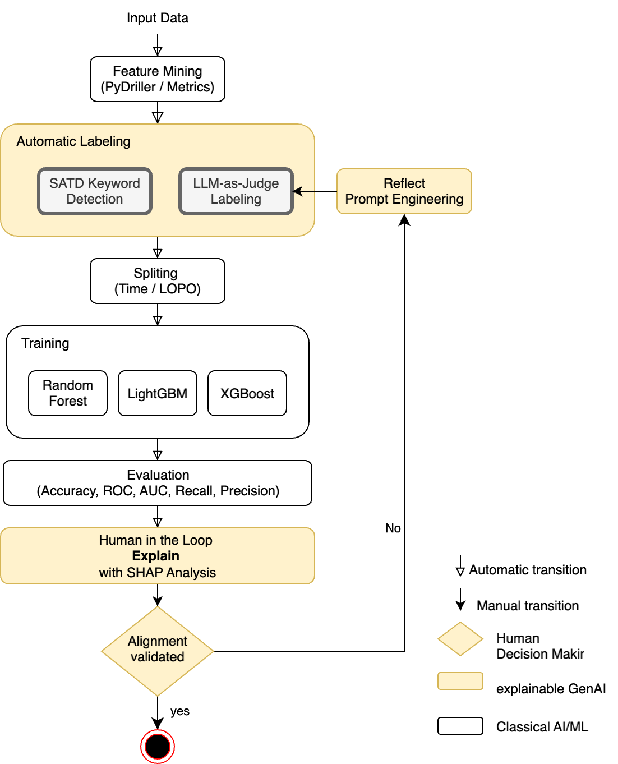
Methodology Overview
Fig. 1. CRISP-ML(Q) + XAI

Slide 8
Data & Features
Avoiding label leakage:
SATD keywords excluded in final models.
Category | Example Features | Notes
Code Complexity | Cyclomatic complexity | Higher values → more debt risk
Code Churn | Lines added / deleted | Strong predictor of debt
Size | LOC, number of functions | Larger commits → more risky
Authorship | Number of distinct authors | Higher fragmentation → risk
History | Commit age, frequency | Temporal debt indicators
…… | …… | ……

Slide 9

Tom Morgenstern & Tianxiang Lu
Automatic Labelling with LLM
You are a senior reviewer.
Commit Summary:
<summary>
DIFF: <filtered_diff>
Question: Does this commit introduce technical debt? Answer yes or no.
Notes:
We went into the case study research trying to investigate how the conceptual LPO solution can be integrated and adopted to drive strategic resilience in fintech operations using FinTech Company as the unit of analysis Primary Data: Collected via semi-structured interviews at Paystack
Sampling: Leads of 5 Engineering Units (Platforms, Observability, Data, Infrastructure & Security, DevRel)
Three themes emerged after the thematic analysis:

Slide 10
Tom Morgenstern & Tianxiang Lu
Rephrased Labelling Prompt
You are a senior code reviewer . Based on the code change and
metrics summary below, assess if this change might lead to long - term maintainability issues.
Answer with ’yes ’ or ’no ’.
Commit Summary : < metrics summary >
DIFF : < filtered_diff >
Notes:
We went into the case study research trying to investigate how the conceptual LPO solution can be integrated and adopted to drive strategic resilience in fintech operations using FinTech Company as the unit of analysis Primary Data: Collected via semi-structured interviews at Paystack
Sampling: Leads of 5 Engineering Units (Platforms, Observability, Data, Infrastructure & Security, DevRel)
Three themes emerged after the thematic analysis:

Slide 11
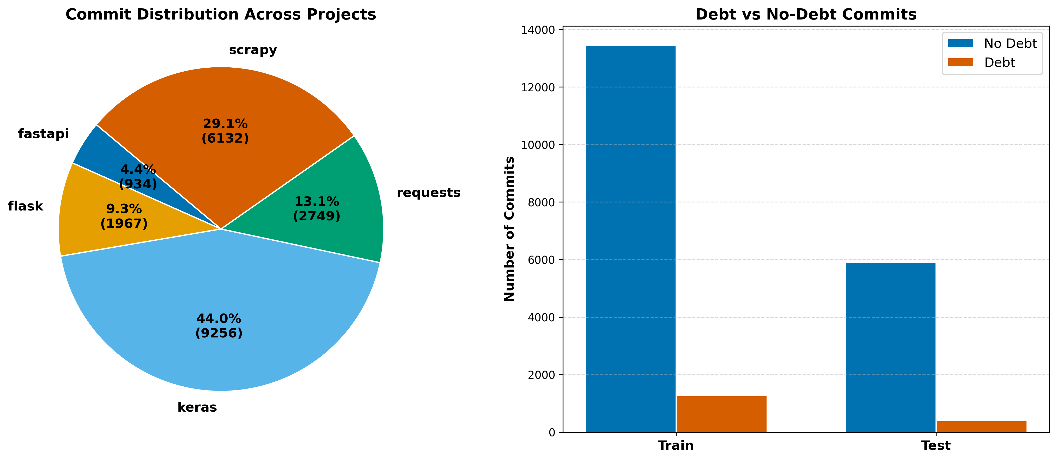
Data Splitting & Challenges
Fig. 2. Left: Commits pro project for Leave-One-Porject-Out (LOPO), Right: Debt vs. No-debt split in training and test
Notes:
Final Proposed Architecture of the LPO System. This refined agentic design
adopts the Model Context Protocol (MCP) as the orchestration layer, enabling the
central AI Agent to query disparate data sources through standardised MCP clients. An open standard introduced by Anthropic in November 2024 to unify AI-agent interactions with external tools and data sources. It enables real-time contextual memory and tool invocation via a structured JSON-RPC 2.0 interface, adopted by major platforms including OpenAI, Google DeepMind, and Microsoft. MCP facilitates seamless integration with services like GitHub, Slack, Google Drive, and Canva, and supports agentic AI workflows by allowing agents to remember, share, and reuse information across tools. Open-source SDKs are available in Python, TypeScript, Java, and other languages, with governance and security frameworks to mitigate risks like tool poisoning and unauthorized access. Anthropic. (2024, November 25). Introducing the Model Context Protocol. Retrieved from https://www.anthropic.com/news/model-context-protocol
Model Context Protocol. (2025, June 18). Specification. Retrieved from https://modelcontextprotocol.io/specification/2025-06-18
Wikipedia contributors. (2025, September 24). Model Context Protocol. In Wikipedia, The Free Encyclopedia. Retrieved from https://en.wikipedia.org/wiki/Model_Context_Protocol
Tom's Guide. (2025, July 24). Claude can now connect to Google Drive, Canva, Slack and more—here’s how to try it. Retrieved from https://www.tomsguide.com/ai/claude-can-now-connect-to-google-drive-canva-slack-and-more-heres-how-to-try-it
Reuters. (2025, September 24). Microsoft brings Anthropic AI models to 365 Copilot, diversifies beyond OpenAI. Retrieved from https://www.reuters.com/business/microsoft-brings-anthropic-ai-models-365-copilot-diversifies-beyond-openai-2025-09-24/

Slide 12
Modeling Approach
Random Forest
LightGBM
XGBoost
Tree1 Tree2 Tree3
\ | /
\ | /
Voting/Averaging
Tree1 -> Tree2 -> Tree3
Leaf-wise
Tree1 -> Tree2 -> Tree3
Level-wise
┌─┐
└─┘
┌─┐
└─┘
┌─┐ ┌─┐
┌─┐
┌─┐
└─┘
┌─┐ ┌─┐
└─┘ └─┘
┌─┐ ┌─┐ ┌─┐ ┌─┐
Notes:
Models: Random Forest, LightGBM, XGBoost
Threshold tuning for class imbalance
Metrics: precision, recall, F1 for Debt, macro-F1, ROC-AUC, MCC
Emphasis: recall prioritized to catch TD

Slide 13
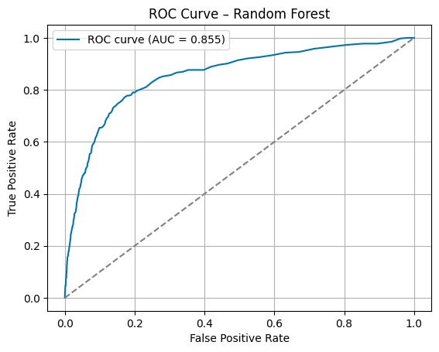
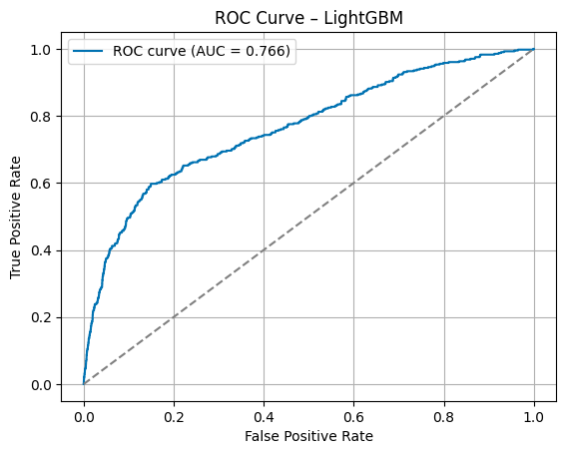
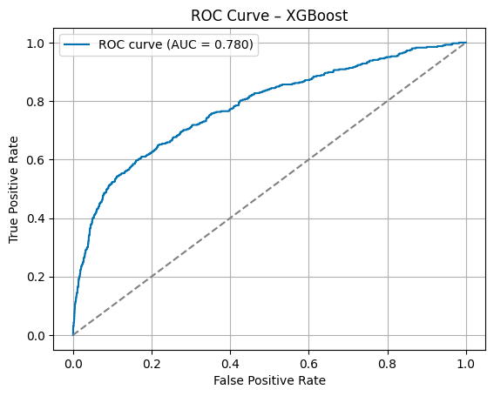
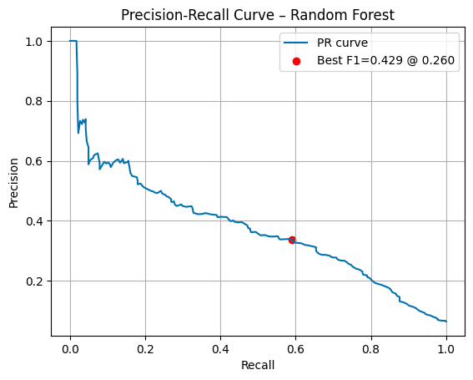
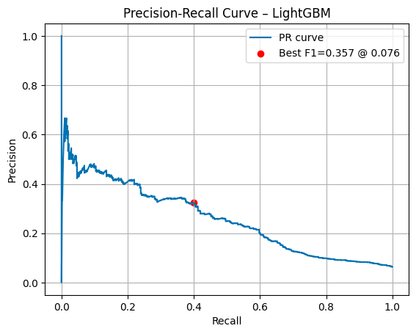
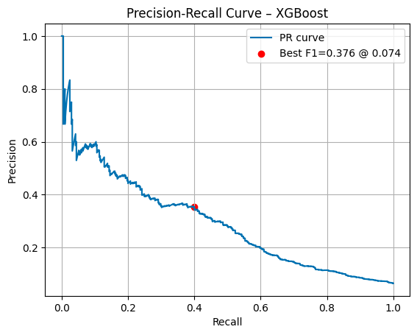
Evaluation
Fig. 3. Validation Data – ROC Curves and Precision Recall trade-off curve among the 3 tree-based models

Slide 14
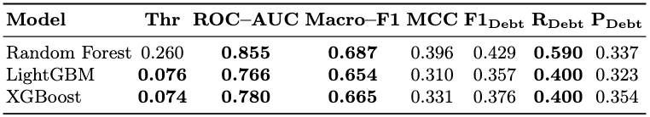

Key Results
Matthews correlation coefficient (MCC)
Predictive power (0..1)
Well above random expectation 0.0
Imbalanced data?
→ Tune the Threshold
Beyond
Random Gues 0.5
Recall on minority class of
Extremely Imbalanced data
Table 1: Performance metrics targeting debt recall, LOPO generalization performance is similar.
Notes:
Threshold tuning for class imbalance
Metrics: precision, recall, F1 for Debt, macro-F1, ROC-AUC, MCC
Emphasis: recall prioritized to catch TD

Slide 15
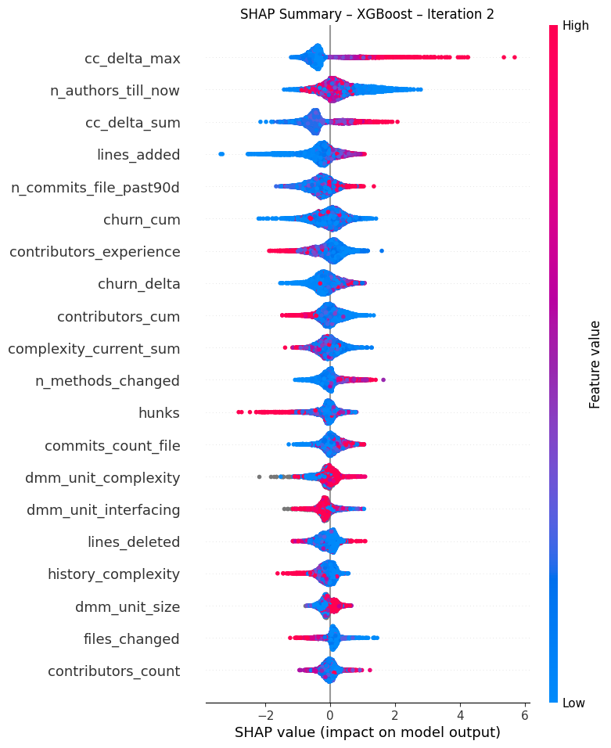
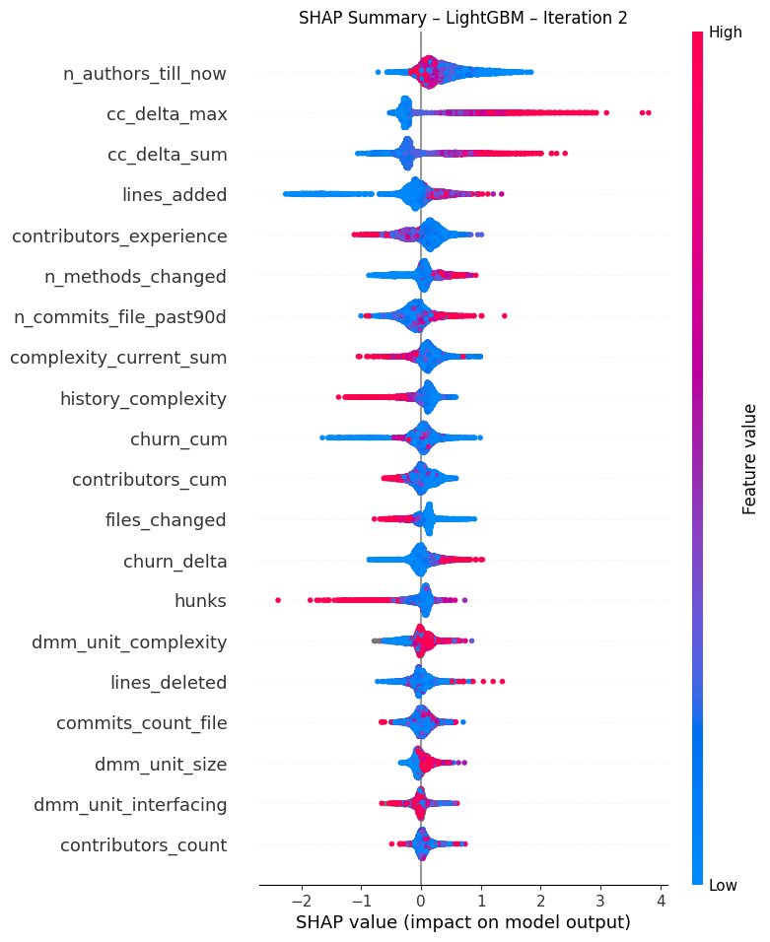
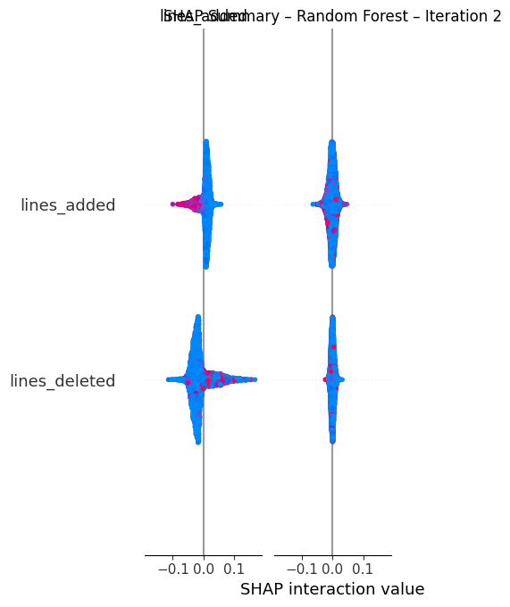
Explainability
Colour -> the feature value for that commit: red -> high, blue -> low
Points position: right → debt, left→ non-debt
Shape thick → variation, thin → strong consistent influence
Separation / clustering of colour → Strong correlation
Fig. 4. SHAP Summary of 3 models
Notes:
color -> the feature value for that commit: red -> high, blue -> low
points position: right → debt, left→ non-debt
Shape thick → variation, thin → strong consistent influence
Separation / clustering of color → Strong correlation

Slide 16
Take away & Next Steps
Explainability
Influential Features
Complexity growth, code churn, author count Boosting models capture diverse risk signals; RF less nuanced
SHAP highlights key risk drivers
Guides model selection & refinement
Limitations
Imbalanced data → recall/F1 impacted
LLM labels: shortcut risks, human verification needed
Future Outlook
Improve label stability & imbalance handling Human-in-the-loop verification for LLM labeling Integrate into agile/DevOps pipelines label
Notes:
Proof-of-concept shows commit-level technical debt prediction is feasible using gradient-boosted models and SHAP explainability.
Key indicators: complexity growth, code churn, author count.
Simple metrics can reveal actionable debt risks for DevOps workflows.
Challenges remain: class imbalance and LLM-based label limitations.
Future work: improve label quality, handle imbalance, validate in real-world settings.

Slide 17

Tom Morgenstern & Tianxiang Lu
Conclusion
Commit-level technical debt can be predicted using explainable gradient-boosted models.
Key drivers—complexity growth, code churn, and author count—provide actionable insights for DevOps adoption.

Slide 18
References
Avgeriou, P., Taibi, D., Ampatzoglou, A., Arcelli Fontana, F., Besker, T., Chatzigeorgiou, A., Lenarduzzi, V., Martini, A., Moschou, A., Pigazzini, I., Saarimaki, N., Sas, D., de Toledo, S. S., & Tsintzira, A.-A. (2021). An overview and comparison of technical debt measurement tools. IEEE Software, 38, 61–71. https://doi.org/10.1109/MS.2020.3024958
Marinescu, R. (2004). Detection strategies: Metrics-based rules for detecting design flaws. In 20th IEEE International Conference on Software Maintenance (ICSM) (pp. 350–359). IEEE. https://doi.org/10.1109/ICSM.2004.1357820
Moha, N., Gueheneuc, Y.-G., Duchien, L., & Le Meur, A.-F. (2010). DECOR: A method for the specification and detection of code and design smells. IEEE Transactions on Software Engineering, 36(1), 20–36. https://doi.org/10.1109/TSE.2009.50
Potdar, A., & Shihab, E. (2014). An exploratory study on self-admitted technical debt. In 2014 IEEE International Conference on Software Maintenance and Evolution (pp. 91–100). IEEE. https://doi.org/10.1109/ICSME.2014.31
Sas, D., & Avgeriou, P. (2023). An architectural technical debt index based on machine learning and architectural smells. IEEE Transactions on Software Engineering, 49, 4169–4195. https://doi.org/10.1109/TSE.2023.3286179
Sutoyo, E., Avgeriou, P., & Capiluppi, A. (2024). Deep learning and data augmentation for detecting self-admitted technical debt. In 2024 31st Asia-Pacific Software Engineering Conference (APSEC) (pp. 1–10). IEEE. https://doi.org/10.1109/APSEC65559.2024.00022
Tsoukalas, D., Kehagias, D., Siavvas, M., & Chatzigeorgiou, A. (2020). Technical debt forecasting: An empirical study on open-source repositories. Journal of Systems and Software, 170, 110777. https://doi.org/10.1016/j.jss.2020.110777
Tsoukalas, D., Mittas, N., Arvanitou, E.-M., Ampatzoglou, A., Chatzigeorgiou, A., & Kehagias, D. (2024). Local and global explainability for technical debt identification. IEEE Transactions on Software Engineering, 50(8), 2110–2123. https://doi.org/10.1109/TSE.2024.3422427

Slide 19
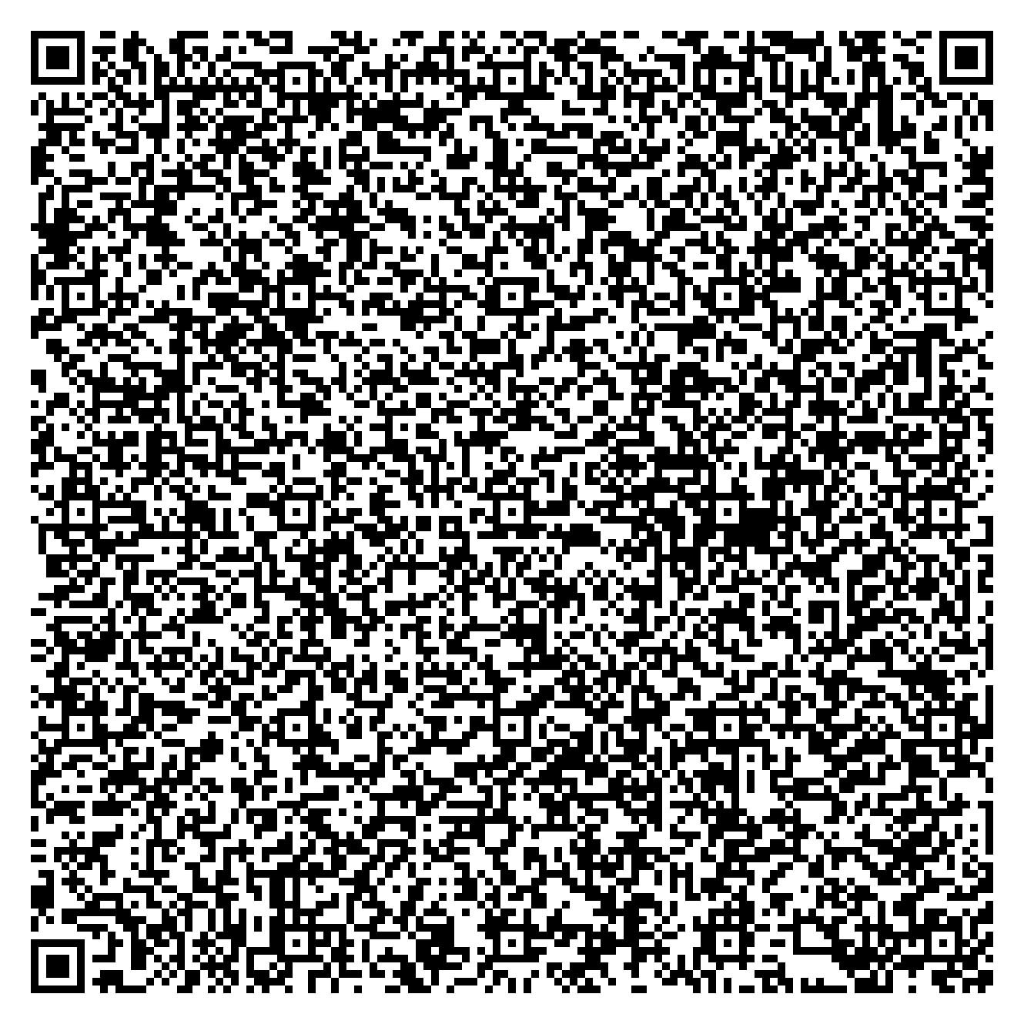
Thank you
Source Code & Data in Github:
https://github.com/Prof-it/td_prediction_llm
IU International University of Applied Sciences · IT & Technology
Juri-Gagarin-Ring 152 ·
99084 Erfurt · German
Tom Morgenstern
Professor Dr.rer.nat. Tianxiang Lu
mail@tommorgenstern.com
Tianxiang.lu@iu.org
Notes:
Source Code & Data in Github:
https://github.com/Prof-it/td_prediction_llm
IU International University of Applied Sciences · IT & Technology
Juri-Gagarin-Ring 152 ·
99084 Erfurt · German
Tom Morgenstern
Professor Dr.rer.nat. Tianxiang Lu https://orcid.org/0009-0004-0656-3581
https://orcid.org/0009−0002−8027−7343
https://www.iu.de/hochschule/lehrende/lu-tianxiang/ https://www.researchgate.net/profile/Tianxiang-Lu-3 https://www.linkedin.com/in/dr-rer-nat-tianxiang-lu
mail@tommorgenstern.com
Tianxiang.lu@iu.org

