Slide 1
P
ProfAI
Professor Exam Style Analysis Platform
UYG338 Software Project Management
Erdem Acar • Enes Albas • Ali Emir Erten
2025 – 2026

Slide 2
Project Overview
A web platform that analyzes university professors' exam styles.
Helps students prepare for exams with question type distribution, topic analysis, and difficulty scores.
📊
📖
🎯
Question Type Analysis
Topic Distribution
Difficulty Score
Multiple choice, open-ended,
true/false distribution
Shows how frequently each
topic appears in exams
Calculates the overall
difficulty level of exams
ProfAI – UYG338 Software Project Management
2/9

Slide 3
HW1: Project Planning
📋
Jira Scrum Board
4 Sprints, 30 tasks, Story Point assignments
📄
Project Plan (Excel)
Overview, Team, Timeline, Budget, Risk, SWOT
📀
UML Diagrams
Class Diagram and Use Case Diagram
💻
GitHub Repository
Monorepo structure, CI/CD pipeline
ProfAI – UYG338 Software Project Management
3/9

Slide 4
HW2: Product Documentation
Comprehensive product documentation with 14 sections.
1.
Executive Summary
8.
Clearance System
2.
Product Vision
9.
User Experience
3.
Core Features
10.
Deployment
4.
Technical Architecture
11.
Integration & Scalability
5.
Technology Stack
12.
Competitive Analysis
6.
Security Architecture
13.
Licensing Model
7.
Role Management
14.
Technical Requirements
ProfAI – UYG338 Software Project Management
4/9

Slide 5
HW3: Risk Analysis & Testing Plan
Risk Analysis
Testing Plan & Success Criteria
✓ Risk identification & assessment
✓ Unit, Integration, E2E Testing
✓ 5x5 Risk Matrix (Probability x Impact)
✓ API endpoint validation
✓ Preventive actions
✓ Page load < 2 seconds
✓ Code security & data privacy
✓ All CRUD operations work
✓ Implementation roadmap
✓ File upload successful
ProfAI – UYG338 Software Project Management
5/9

Slide 6
HW4: MVP & Working System
3
7
30
4
Docker
Containers
React
Pages
Jira
Tasks
Sprints
Deliverables
Working full-stack web application (Docker)
GitHub Actions CI/CD pipeline
Sprint board, documentation, risk updates
15-minute live demo plan
ProfAI – UYG338 Software Project Management
6/9

Slide 7
Live Demo Plan
System Startup
Exam Upload
1
2 min
4
2 min
Docker Compose with 3 containers
PDF/JPG file upload
Register & Login
Analysis & Charts
2
2 min
5
3 min
Create user, JWT authentication
Pie chart, bar chart, difficulty score
Professor Listing
GitHub & CI/CD
3
3 min
6
3 min
Search, filter, detail page
Repo structure, Actions, sprint board
ProfAI – UYG338 Software Project Management
7/9

Slide 8
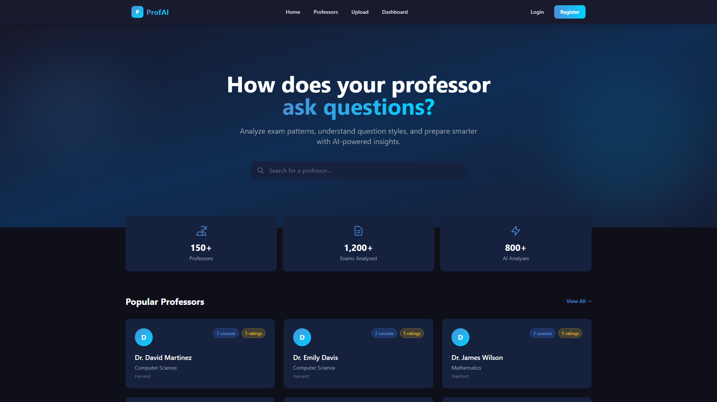
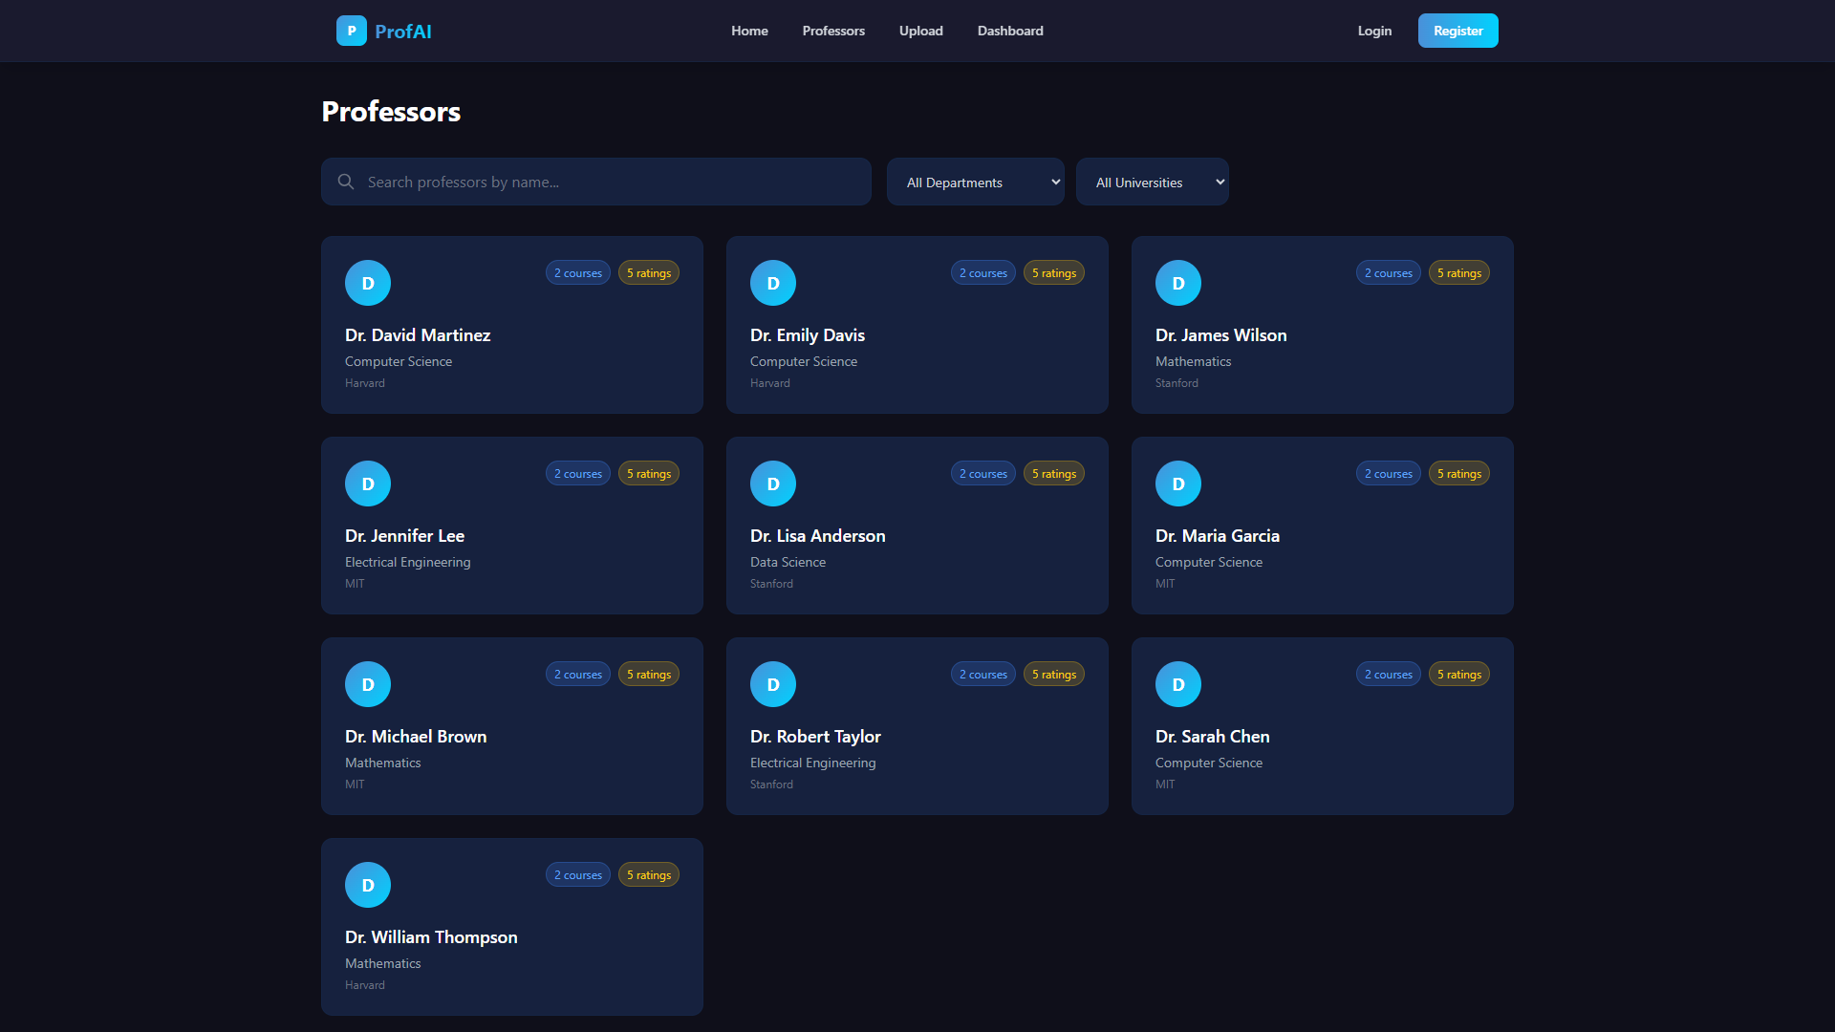
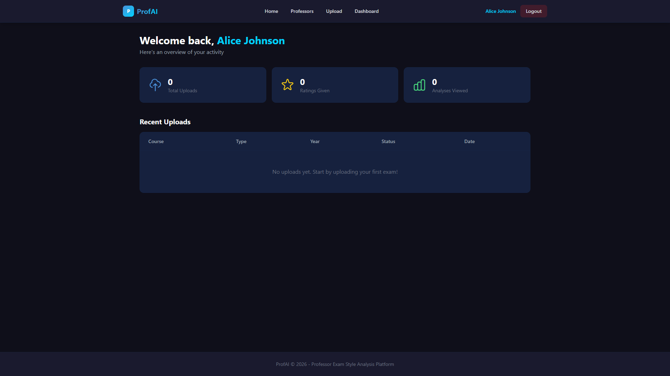
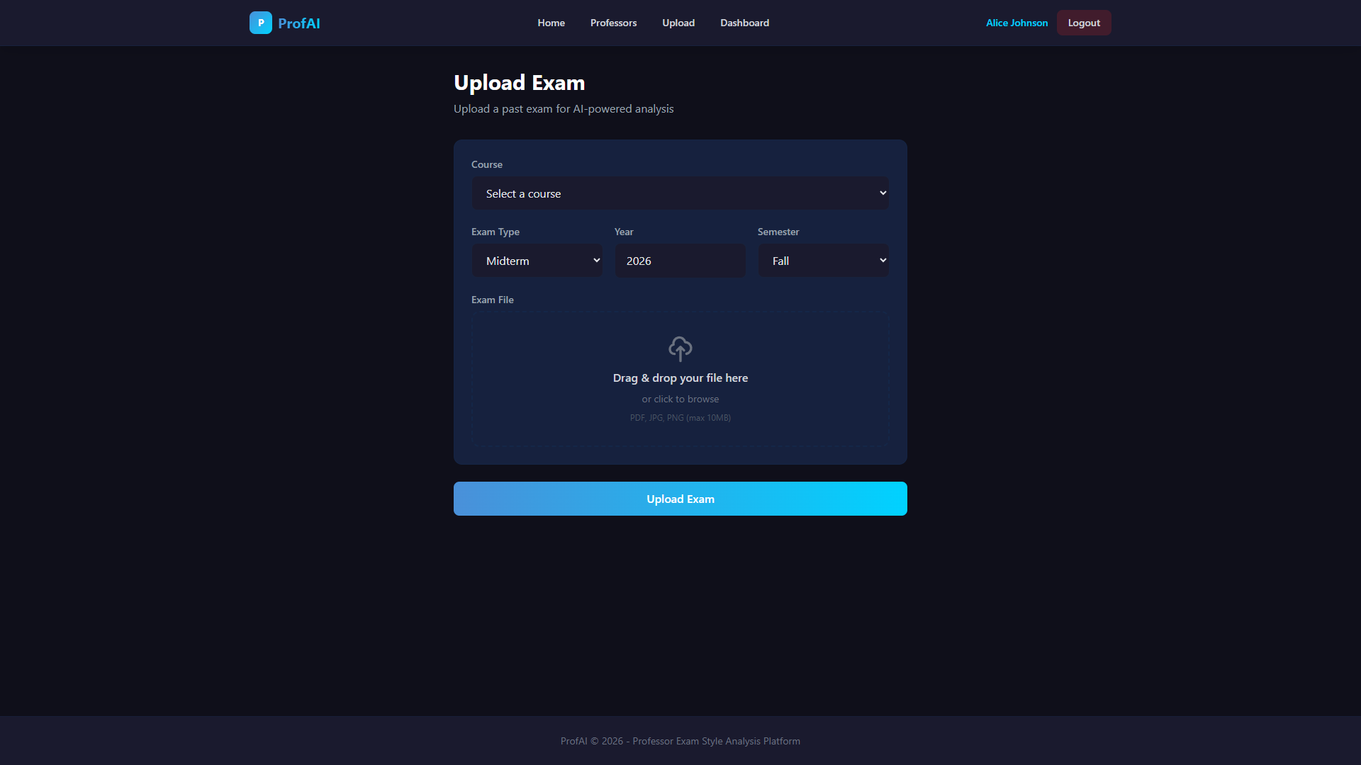
Application Screenshots
Home Page
Professors
Dashboard
Exam Upload

Slide 9
Thank You!
We appreciate your questions.
Erdem Acar • Enes Albas • Ali Emir Erten
GitHub: github.com/ProfAI-Team/ProfAI
Jira: devmeet-app.atlassian.net

