Slide 1
Knecht
Ian Fite
Patrick Feeney
Ben Carlson

Slide 2
Introduction to Knecht
Node.js
Server platform
MySQL
Database platform

Slide 3

More on Node.js
JavaScript Interpreter
Written in C++
Benefits:
Modularity
Asynchrony
Scalability
Portability

Slide 4
Knecht Functionality
Create and Management User Accounts for:
Storing user application data non-locally
Communication between applications of multiple users
Collection of analytics data

Slide 5
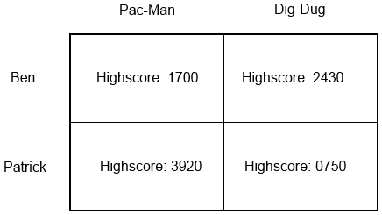
Personal Data Storage
CRUD
Create
Retrieve
Update
Delete
Accessible only to Original User
Each application has its own namespace.

Slide 6
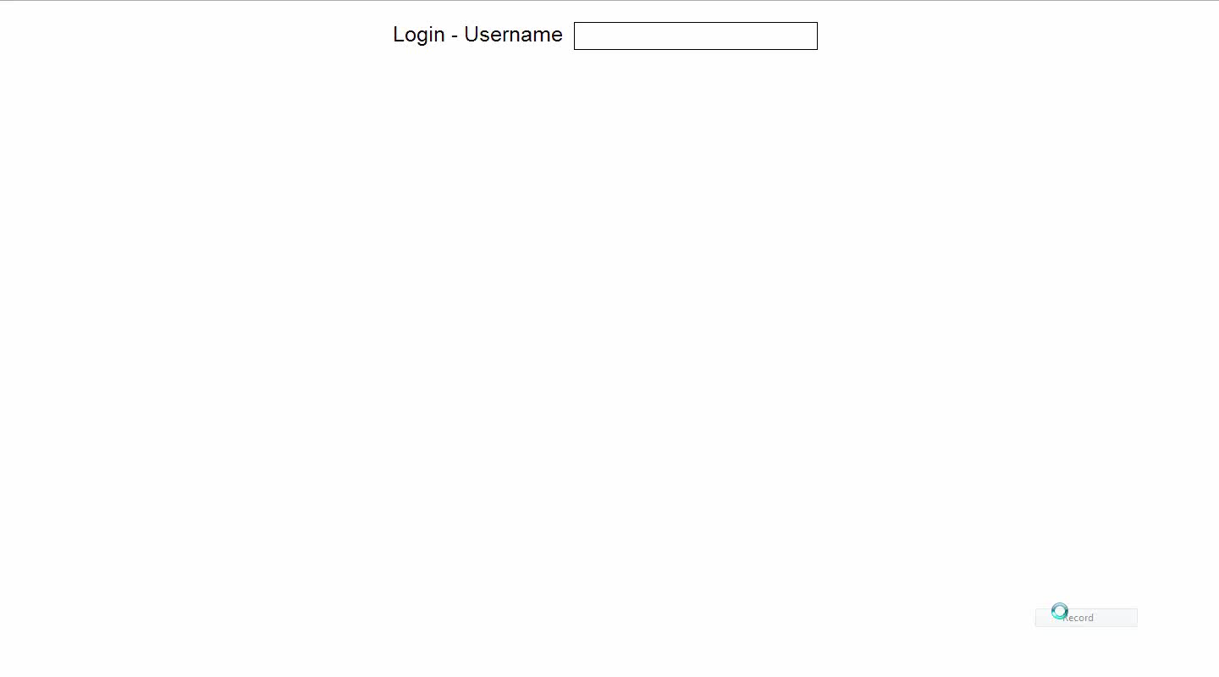
Single Player Demo

Slide 7
Group Functions
User may host group
Can post data that other users may access
Namespaced like user data
Only host may alter data

Slide 8
Group Security
No server-side application logic
Knecht is general-purpose
Host is only trusted user
Must validate all input from others
Has access to all group data
May grant access to individual fields

Slide 9
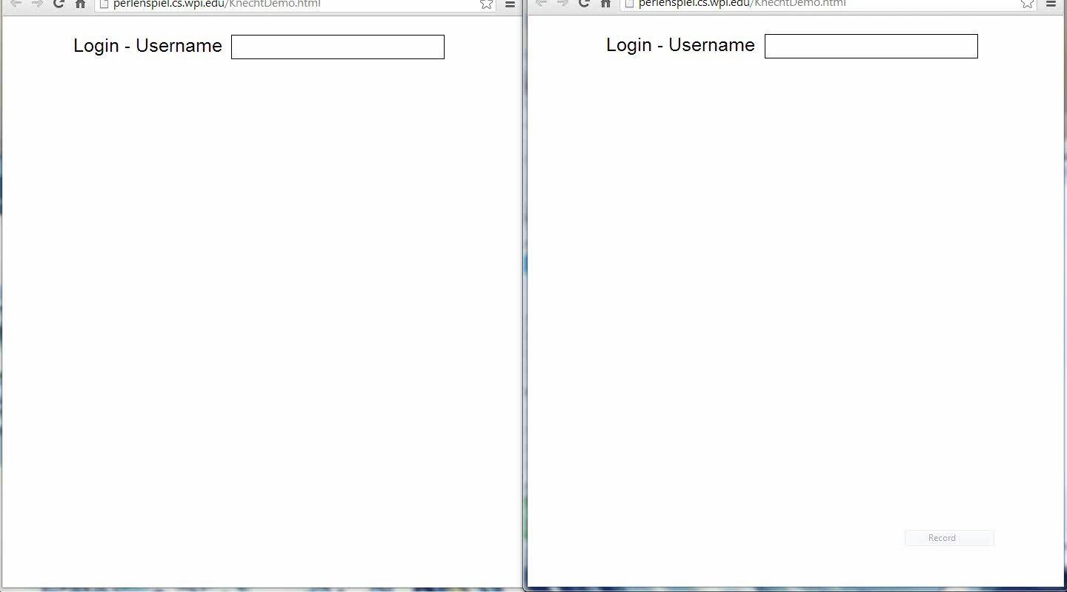
Multiplayer Demo

Slide 10
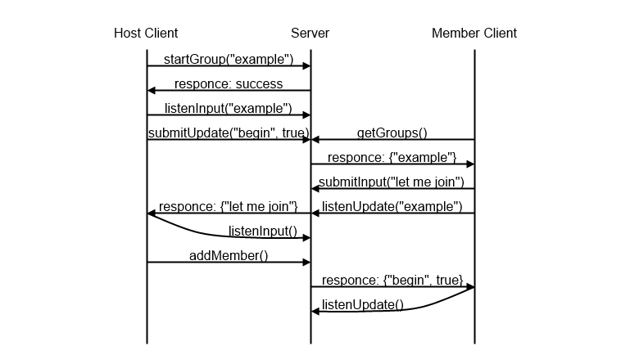
Message Control Flow

Slide 11
Key Behaviors
Non-volatile notifications
Input synchronization
Minimizes bandwidth usage

Slide 12
Obstacles
Limited group experience with database software, web development, code repositories
Organizational and personal issues
Technical difficulties
Documentation
Client listening
Compatibility

Slide 13
Q & A
Server location: http://perlenspiel.cs.wpi.edu:8080/
Demo location: http://perlenspiel.cs.wpi.edu/KnechtDemo.html

