Slide 1
Your First App: Writing the Code
CIS 399

Slide 2
Course Overview
Wk | Topic
1 | Intro + single-screen apps
1 | Activity Lifecycle + saving activity state
2 | Menus + Themes
2 | Multi-screen apps + Fragments
Wk | Topic
3 | Reading XML files + Asynch Tasks
3 | List Views
3 | SQLite Database
4 | Consuming a web service
4 | Geolocation

Slide 3
The default Java code for an activity

Slide 4
How to work with an activity

Slide 5
The v7 appcompat support library

Slide 6
How to get references to widgets

Slide 7
An activity that gets references to the widgets

Slide 8
An activity that gets references to the widgets (continued)

Slide 9
How events work

Slide 10
How to handle the EditorAction event

Slide 11
An activity that handles the EditorAction event

Slide 12
An activity that handles the EditorAction event (continued)

Slide 13
A few constants from the EditorInfo class

Slide 14
Two methods for working with widgets

Slide 15
A method that calculates and displays amounts

Slide 16
How to handle the Click event

Slide 17
How to handle the Click event (continued)

Slide 18
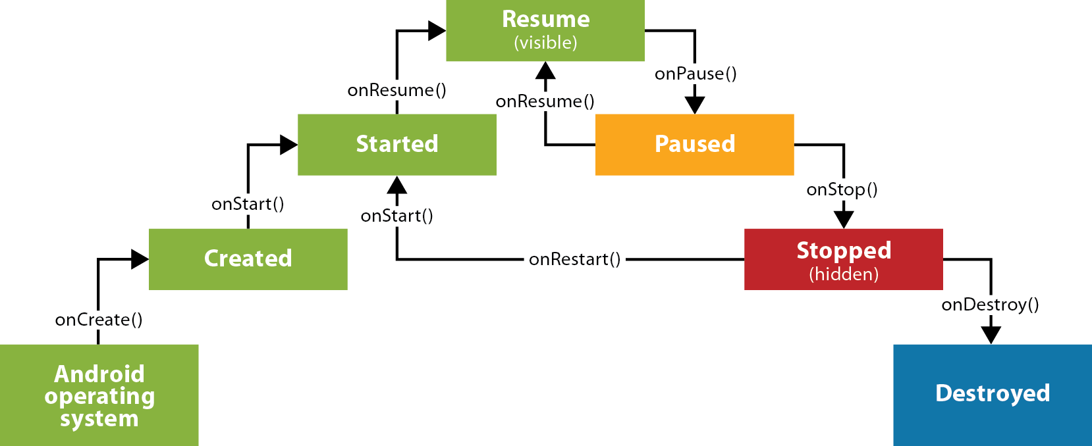
The lifecycle of an activity

Slide 19
Three common states

Slide 20
How to import the SharedPreferences classes

Slide 21
How to use onPause to save values

Slide 22
How to use onResume to restore values

Slide 23
The Java code

Slide 24
The Java code (continued)

Slide 25
The Java code (continued)

Slide 26
The Java code (continued)

Slide 27
The Java code (continued)

Slide 28
The Java code (continued)

Slide 29
The Java code (continued)

Slide 30
The Gradle build script

Slide 31
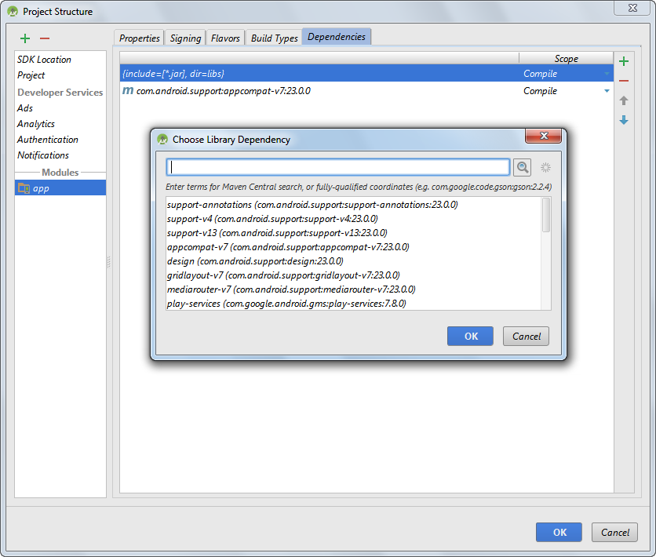
The dialogs for adding a dependency

Slide 32
A dependencies block

Slide 33
The AndroidManifest.xml file

Slide 34
An activity element that only allows portrait orientation

Slide 35
How to set the launcher icon for an app

Slide 36
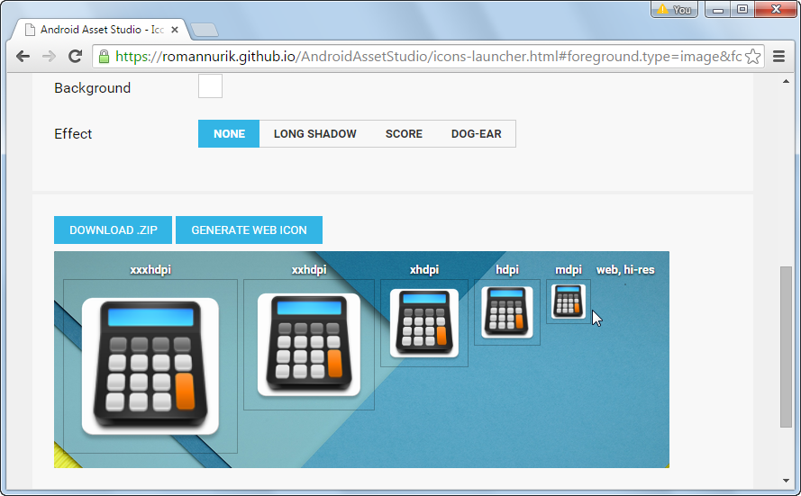
The Android Asset Studio web page for generating launcher icons

Slide 37
The directory structure for launcher icons

Slide 38
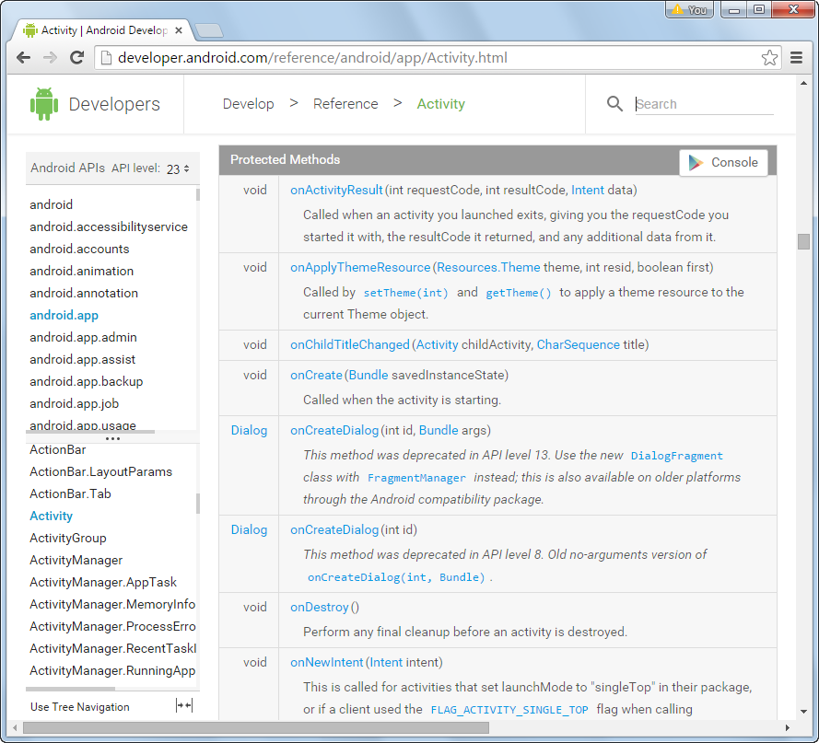
The documentation for the Activity class

