Slide 1

Databases
CIS 399
Notes:
http://sqlite.org

Slide 2
Course Overview
Wk | Topic
1 | Intro, single-screen apps
1 | Activity Lifecycle, saving activity state
2 | Layouts + widgets, Event Handlers
2 | Themes + styles, Menu + settings
2 | Multi-screen apps, Fragments
Wk | Topic
3 | Fragments
3 | Reading XML files, Asynch Tasks
3 | List Views
3 | SQLite Databases
4 | Consuming a web service
4 | Geolocation

Slide 3

SQLite
Notes:
http://sqlite.org

Slide 5
Storage Classes (aka Data Types)
NULL The value is a null value.
INTEGER The value is a signed integer, stored in 1, 2, 3, 4, 6, or 8 bytes depending on the magnitude of the value.
REAL The value is a floating point value, stored as an 8-byte IEEE floating point number.
TEXT The value is a text string, stored using the database encoding (UTF-8, UTF-16BE or UTF-16LE).
BLOB (Binary Large Object) The value is a blob of data, stored exactly as it was input.
Notes:
Note that a storage class is slightly more general than Java data types. The INTEGER storage class, for example, includes 6 different integer datatypes of different lengths. This makes a difference on disk. But as soon as INTEGER values are read off of disk and into memory for processing, they are converted to the most general datatype (8-byte signed integer). And so for the most part, "storage class" is indistinguishable from "datatype" and the two terms can be used interchangeably.

Slide 6

Relational Database Concepts
Notes:
http://sqlite.org/
Relational database theory: definition of “relation”: https://en.wikipedia.org/wiki/Relation_%28database%29

Slide 7
Example: Task List Database
The database can hold multiple lists.
Each list has multiple tasks.
Each task has
a name
notes
date completed
a hidden flag
Notes:
Entity Relationship Diagram
The list has a one-to-many relationship to the task

Slide 8
The two tables and their fields
List Table
_id | list _name
Task Table
_id | list_id | task_name | notes | date_completed | hidden

Slide 9
Each table has a primary key
List Table
_id | list _name
Task Table
_id | list_id | task_name | notes | date_completed | hidden

Slide 10
Foreign Key
The task table has a foreign key. This establishes a one-to-many relationship between the list table and the task table.
List table
_id | list _name
Task table
_id | list_id | task_name | notes | date_completed | hidden

Slide 11
PK to FK Relationships
Rows of data in the Task table are correlated with their list_name by matching PK and FK
List table
_id | list _name
1 | Personal
2 | Business
Task table
_id | list_id | task_name | notes | date_completed | hidden
1 | 2 | Write checks | high priority |  | false
2 | 1 | Plan party | surprise | 7/12/15 | true
3 | 1 | Invite guests |  | 7/20/15 | true
4 | 2 | Call lawyer |  |  | false
5 | 1 | Buy cake | carrot |  | false

Slide 12
SQL Query Syntax
SELECT column_name, column_name FROM table_name WHERE column_name operator value;
SQL Query Example
SELECT * FROM task WHERE list_id = 2 AND hidden != ‘1’;
This query selects all the fields in the task table where the list_id is 2 (Business) and the task is not hidden.

Slide 15

Android API for SQLite

Slide 16
Android Database API
Classes in the android.database.sqlite package
SQLiteClosable A closable object created from a SQLiteDatabase
SQLiteCursor A Cursor implementation containing query results
SQLiteDatabase Exposes methods to manage a database
SQLiteOpenHelper Manages database creation and version management
SQLiteProgram A base class for compiled SQLite programs
SQLiteQuery Represents a query that it’s resulting rows
SQLiteQueryBuilder Helps build SQL queries for SQLiteDatabase objects.
SQLiteStatement Represents an executable statement for a database
Notes:
We’ll only be using the ones that are highlighted

Slide 17
Android Database API (continued)
Interfaces in the android.database.sqlite package
SQLiteCursorDriver A driver for SQLiteCursors that is used to create them and get notifications from them
SQLiteDatabase.CursorFactory Used to allow returning sub-classes of Cursor when calling query.
SQLiteTransactionListener A listener for transaction events.

Slide 18
SqliteDatabase
Has methods to
Create rows
Delete rows
Execute SQL commands
Perform other common database management tasks.
SqliteDatabase objects can be created using SQLiteOpenHelper
Note: Database names must be unique within an application, not across all applications.
Notes:
https://developer.android.com/reference/android/database/sqlite/SQLiteDatabase.html

Slide 19
SqliteOpenHelper
Takes care of opening the database if it exists, creating it if it does not, and upgrading it as necessary
Transactions are used to keep the database in a sensible state
Simplifies ContentProvider implementations to defer opening and upgrading the database until first use, to avoid blocking application startup with long-running database upgrades
You declare a subclass, overriding call-back methods:
onCreate(SQLiteDatabase) Called after the database (not a table) is created.
onUpgrade(SQLiteDatabase, int, int) Called if the current version is < the one passed to the constructor. This is where you manage schema changes.
optionally onOpen(SQLiteDatabase)
Notes:
https://developer.android.com/reference/android/database/sqlite/SQLiteOpenHelper.html
See an example in: https://github.com/UO-CIS/CIS399AndroidDemos/tree/master/WeatherForecast-SAX+SQLite+ListView,
WeatherSqliteHelper.java

Slide 20
Static Inner Class DBHelper
Extends SQLiteOpenHelper class developer.android.com/reference/android/database/sqlite/SQLiteOpenHelper.html
SQLiteOpenHelper callback methods:
onCreate is called after the database is created (not the tables). The database will automatically be created if it isn’t found on the device.
onUpgrade is called if the existing database version number is lower than the one specified in the version number passed to the constructor.

Slide 21
Weather App Example:
Private Instance Object, db
Instance of SQLiteDatabase
SQLiteDatabase class: developer.android.com/reference/android/database/sqlite/SQLiteDatabase.html
The db object is created by opening a connection to the database using methods of SQLiteOpenHelper:
getReadableDatabase
getWritableDatabase
The exeSQL method is used to execute SQL statements on tables of the database.
The close method is used to close the connection to the database.
Notes:
See an example in: https://github.com/UO-CIS/CIS399AndroidDemos/tree/master/WeatherForecast-SAX+SQLite+ListView,
Dal.java

Slide 22
Task List App
Does this app have a “three-tier” architecture?
See the next slide,
or https://en.wikipedia.org/wiki/Multitier_architecture

Slide 23
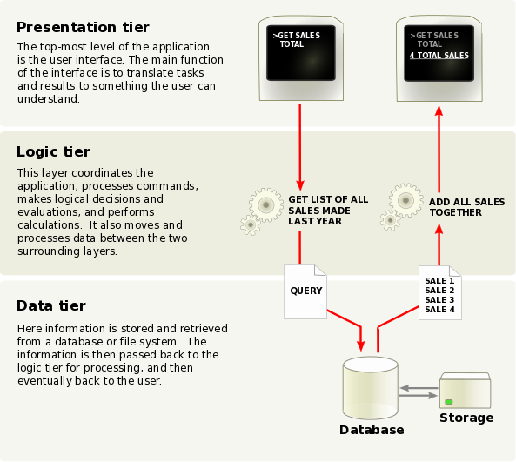
Notes:
https://en.wikipedia.org/wiki/Multitier_architecture

Slide 24
Code Tour of the Task List App
Identify three categories of code:
Presentation
Business logic
Data
Which classes are in each category?
Do the “business objects” (domain models) contain business logic?

Slide 25
Code Tour of the Task List App (continued)
Look for:
Code that opens a database
Scope of the Android SQLiteDatabase object
Code that queries the database
Notes:
Business classes: List, Task
Database access: TaskListDB
Android UI: TaskListActivity

Slide 37
Static Inner Class DBHelper
Extends SQLiteOpenHelper class developer.android.com/reference/android/database/sqlite/SQLiteOpenHelper.html
SQLiteOpenHelper callback methods:
onCreate is called after the database (not the tables) is created. The database will automatically be created if it isn’t found on the device.
onUpgrade is called if the existing database version number is lower than the one specified in the version number passed to the constructor.

Slide 40
Private Instance Object: db
Instance of SQLiteDatabase
SQLiteDatabase class: developer.android.com/reference/android/database/sqlite/SQLiteDatabase.html
The db object is created by opening a connection to the database using methods of SQLiteOpenHelper:
getReadableDatabase
getWritableDatabase
The exeSQL method is used to execute SQL statements on tables of the database.
The close method is used to close the connection to the database.

Slide 43
SQL Query Syntax
SELECT column_name,column_name FROM table_name WHERE column_name operator value;
SQL Query Example
SELECT * FROM task WHERE list_id = 2 AND hidden != ‘1’;
This query selects all the fields in the task table where the list_id is 2 (Business) and the task is not hidden.

Slide 54
Exercise: Download and View the Database File

Slide 55
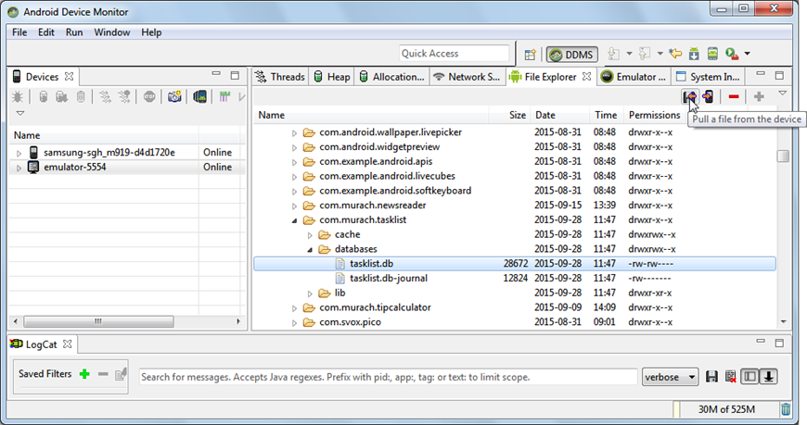

Slide 57
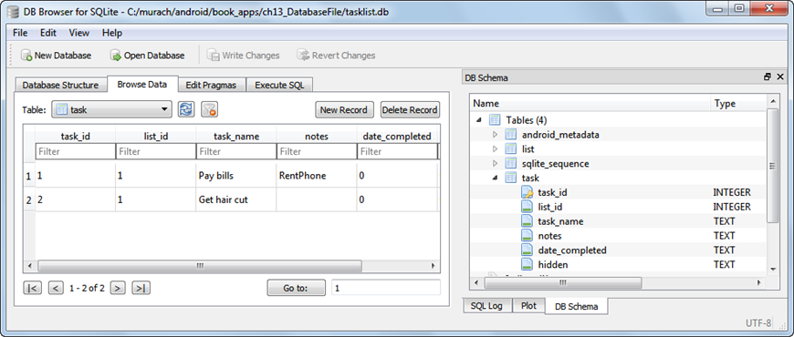
sqlitebrowser.org

Slide 58

Alternative to SQLite

Slide 59
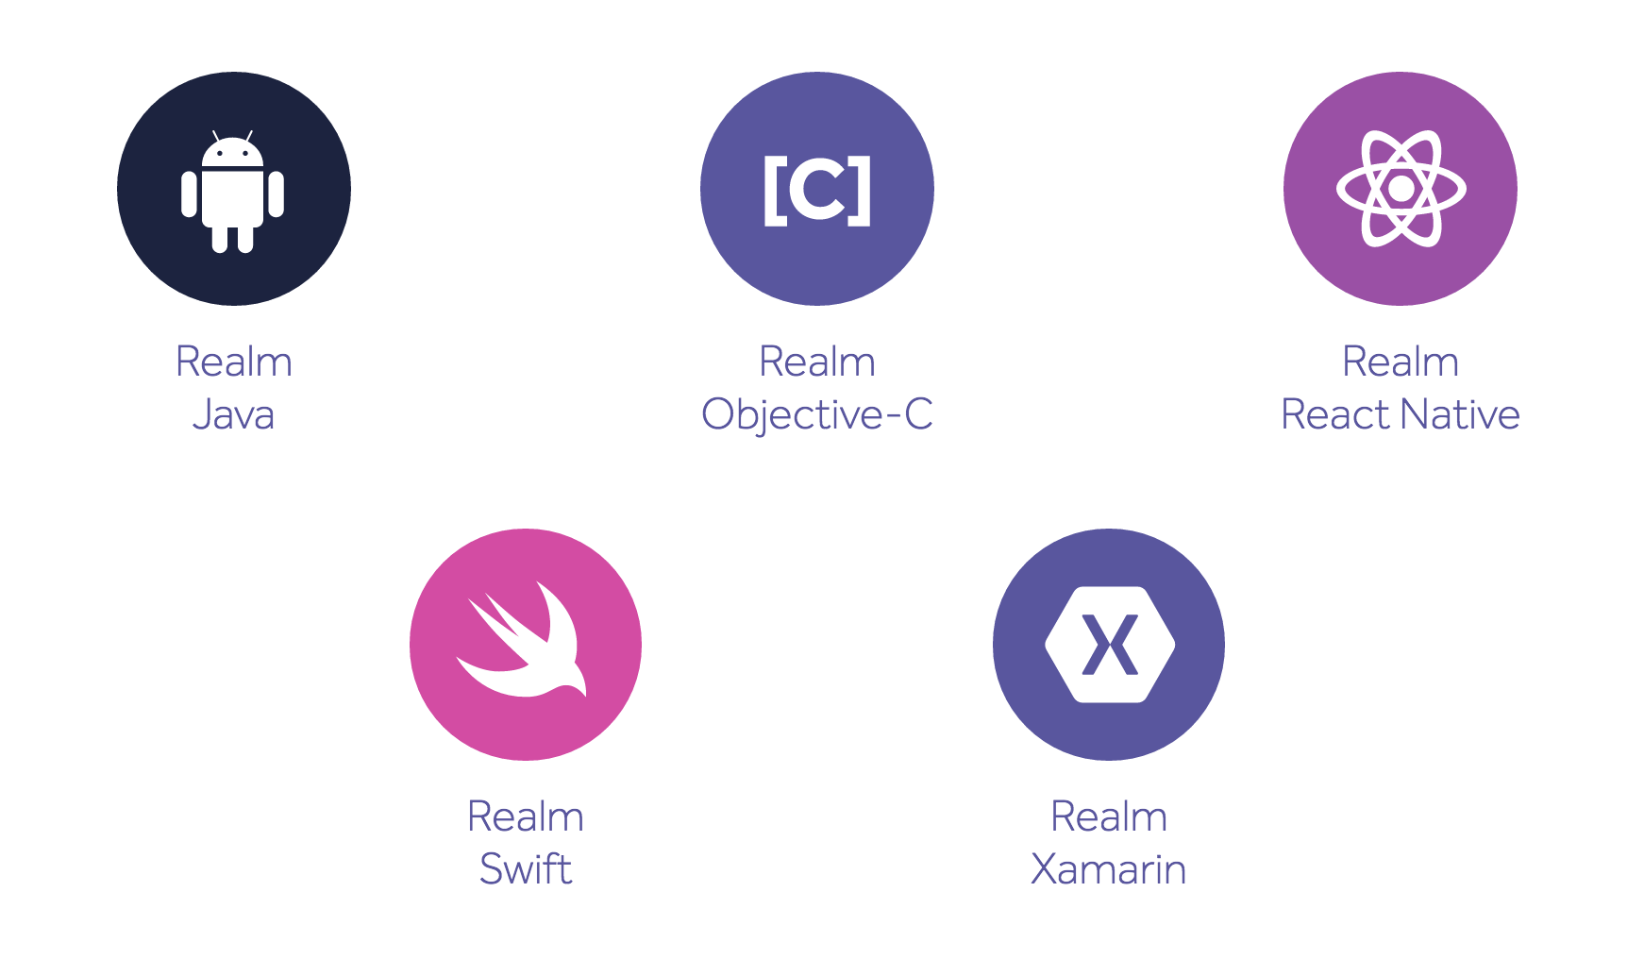
Realm is on Multiple Platforms

Slide 60
Realm Java
Almost zero-configuration setup
Realm Java is built specifically for mobile apps, so its performance is first class.
Power‑user features, like simple migrations, built-in encryption, and more
Realm Java is written in Java, for Java, with Android at heart.
Use techniques you already know, like fluent interfaces, UI adapters, and field annotations.
https://realm.io/docs/java/latest/

Slide 61
Further SQLite Reading
W3Schools SQL Tutorial
http://www.w3schools.com/SQl/default.asp
SQLite home page http://sqlite.org
Android Developers: Saving Data in SQL Databases
https://developer.android.com/training/basics/data-storage/databases.html
Android SQLite database and content provider tutorial, by Lars Vogel, 6/29/2016
http://www.vogella.com/tutorials/AndroidSQLite/article.html

