Slide 1
Your First App (continued) Writing the Code and more
CIS 399

Slide 2
Course Overview
Wk | Topic
1 | Intro + single-screen apps
1 | Activity Lifecycle +
1 | Saving activity state and more
2 | Menus + Themes
2 | Multi-screen apps + Fragments
Wk | Topic
3 | Reading XML files + Asynch Tasks
3 | List Views
3 | SQLite Database
4 | Consuming a web service
4 | Geolocation

Slide 3
Shared Preferences
The SharedPreferences class provides a general framework that allows you to save and retrieve persistent key-value pairs of primitive data types. You can use SharedPreferences to save any primitive data: booleans, floats, ints, longs, and strings. This data will persist across user sessions (even if your application is killed).
Notes:
https://developer.android.com/guide/topics/data/data-storage.html#pref

Slide 4

Key – Value Data Stores
Keys are identifiers for values
Values are the data being stored or retrieved
Examples:
Java Hashmap class
C# Dictionary class
PHP associative array
JavaScript object
Keys | Values
name | Dorothy
age | 16
homeState | Kansas

Slide 5

How to import the SharedPreferences classes

Slide 6
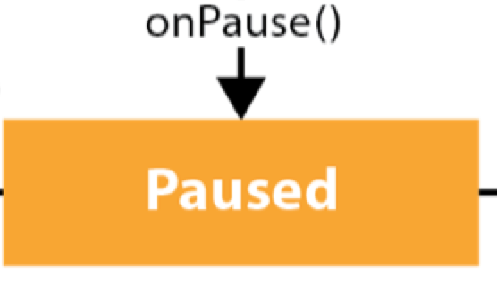
How to save values in onPause

Slide 7
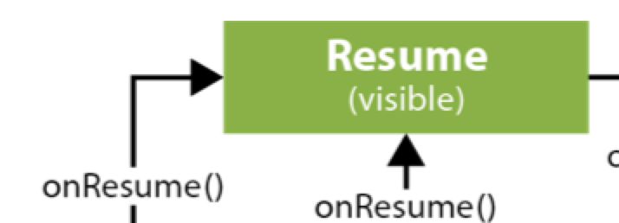
How to restore values in onResume

Slide 8

Saving Activity State Using a Bundle
The method void onSaveInstanceState (Bundle outState) is called to retrieve per-instance state from an activity before being killed so that the state can be restored in onCreate(Bundle) or onRestoreInstanceState(Bundle) (the Bundle populated by this method will be passed to both).
This method is called before an activity may be killed so that when it comes back some time in the future it can restore its state. – Android Developers
Notes:
https://developer.android.com/reference/android/app/Activity.html#onSaveInstanceState(android.os.Bundle)

Slide 9
Example of Saving Activity State Using onSaveInstanceState
static final String STATE_SCORE = "playerScore"; static final String STATE_LEVEL = "playerLevel";
private int mCurrentScore = 0;
private int mCurrentLevel = 0; ... @Override public void onSaveInstanceState(Bundle savedInstanceState) { // Save the user's current game state savedInstanceState.putInt(STATE_SCORE, mCurrentScore); savedInstanceState.putInt(STATE_LEVEL, mCurrentLevel); // Always call the superclass so it can save the view hierarchy state super.onSaveInstanceState(savedInstanceState); }
Notes:
https://developer.android.com/guide/components/activities/activity-lifecycle.html#saras

Slide 10
Example of Retrieving Activity State in onCreate
@Override protected void onCreate(Bundle savedInstanceState) { super.onCreate(savedInstanceState); // Always call the superclass first // Check whether we're recreating a previously destroyed instance if (savedInstanceState != null) { // Restore value of members from saved state mCurrentScore = savedInstanceState.getInt(STATE_SCORE); mCurrentLevel = savedInstanceState.getInt(STATE_LEVEL); } else { // initialize members with default values for a new instance }
Notes:
https://developer.android.com/guide/components/activities/activity-lifecycle.html#saras

Slide 11

Gradle Build System
Gradle is an open source build automation system that builds upon the concepts of Apache Ant and Apache Maven and introduces a Groovy-based domain-specific language (DSL) instead of the XML form used by Apache Maven of declaring the project configuration. Gradle uses a directed acyclic graph ("DAG") to determine the order in which tasks can be run.
Gradle was designed for multi-project builds which can grow to be quite large, and supports incremental builds by intelligently determining which parts of the build tree are up-to-date, so that any task dependent upon those parts will not need to be re-executed. - Wikipedia
Notes:
https://en.wikipedia.org/wiki/Gradle
http://gradle.org/

Slide 12
Gradle files
build.gradle(Project: your_app_name) - Contains configuration for all projects and modules in the application.
build.gradle(Module:app) - Contains specific configuration for the module it’s in.
Notes:
https://www.sitepoint.com/quick-tip-what-is-gradle-and-how-does-it-work-with-android-studio/

Slide 13
Gradle Projects and Tasks
Projects - A Gradle build consists of one or more projects which build or do something.
Tasks - Each project consists of tasks. A task represents a piece of work which a build performs
Notes:
http://www.vogella.com/tutorials/Gradle/article.html

Slide 14
The Gradle build script
Notes:
Project view: app, build.gradle
Project Files view: app, app, build.gradle

Slide 15
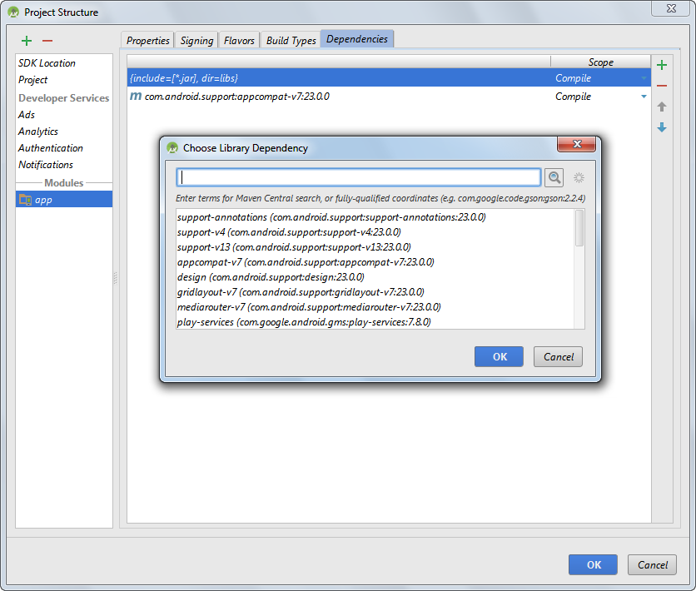
The dialogs for adding a dependency

Slide 16
A dependencies block

Slide 17

Android Manifest
Every application must have an AndroidManifest.xml file (with precisely that name) in its root directory. The manifest file presents essential information about your app to the Android system, information the system must have before it can run any of the app's code. – Android Developer’s API Guide
Notes:
https://developer.android.com/guide/topics/manifest/manifest-intro.html

Slide 18
The AndroidManifest.xml file

Slide 19
An activity element that only allows portrait orientation
Now specified in app/build.gradle:
android { compileSdkVersion 23 . . . defaultConfig { . . . minSdkVersion 16 targetSdkVersion 23
. . .

Slide 20

Android Launcher Icons
A launcher icon is a graphic that represents your application. Launcher icons are used by Launcher applications and appear on the user’s Home screen. Launcher icons can also be used to represent shortcuts into your application
Separate icons should be created for all generalized screen densities, including low-, medium-, high-, and extra-high-density screens. A high-resolution version of your application launcher icon is also required by Google Play for use in application listings.
Notes:
https://developer.android.com/guide/topics/manifest/manifest-intro.html

Slide 21
How to set the launcher icon for an app
http://romannurik.github.io/AndroidAssetStudio/

Slide 22
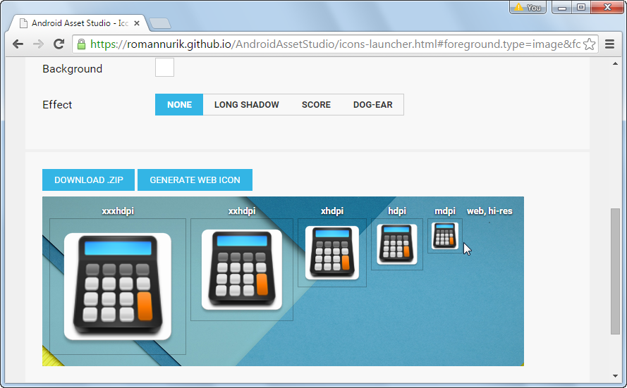
The Android Asset Studio web page for generating launcher icons
Notes:
http://romannurik.github.io/AndroidAssetStudio/

Slide 23
The directory structure for launcher icons

Slide 24
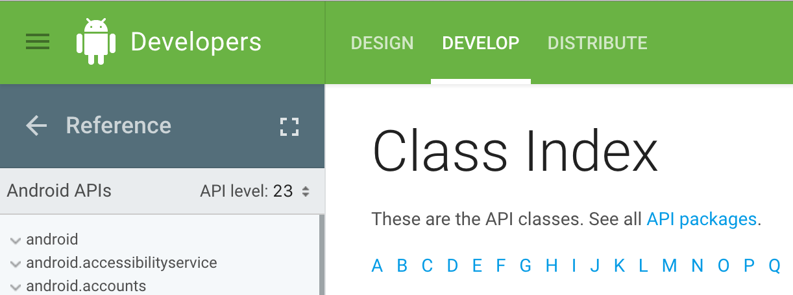
Android API Documentation
https://developer.android.com/reference/classes.html
Notes:
https://developer.android.com/reference/classes.html

Slide 25
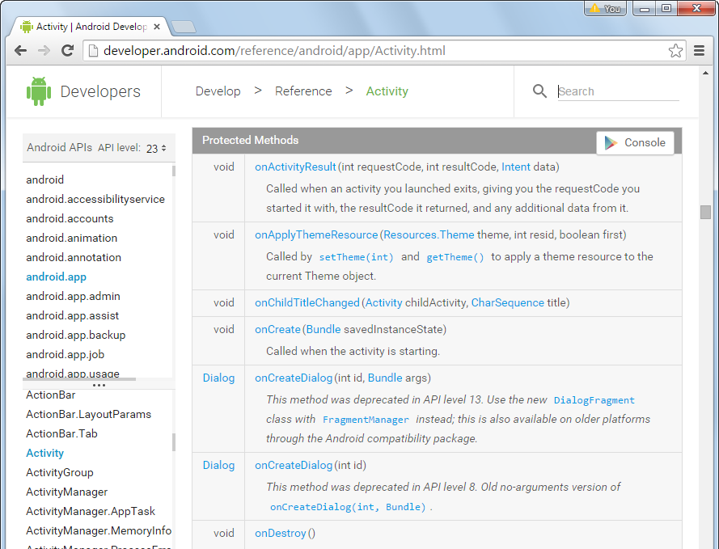
The documentation for the Activity class
https://developer.android.com/reference/android/app/Activity.html
Notes:
https://developer.android.com/reference/android/app/Activity.html

Slide 26

Exercise: Using the API documentation
Find the ImageView class
Which methods will you use (public, private, protected)?
To add an image, should you use a getter or setter?
Which methods should you use to add the image?
What methods can you use to set the image size?
Where should the images be stored (which project folder)?
Do these methods have equivalent XML properties?
Create an app with a blank activity
Add an image to the activity
Run the app and see the image displayed

