Slide 1

Android Fragments
CIS 399

Slide 2
Course Overview
Wk | Topic
1 | Intro, single-screen apps
1 | Activity Lifecycle, saving activity state
2 | Layouts + widgets, Event Handlers
2 | Themes + styles, Menu + settings
2 | Multi-screen apps
Wk | Topic
3 | Fragments
3 | Reading XML files, Asynch Tasks
3 | SQLite Database
4 | Consuming a web service
4 | Geolocation

Slide 3
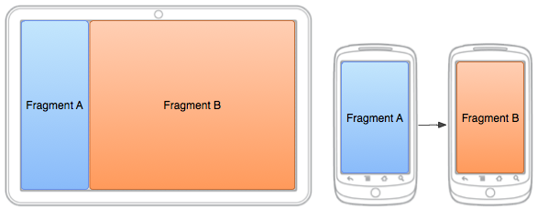
Fragment Concepts

Slide 4
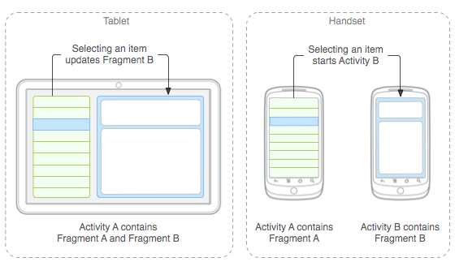
Fragments for Adaptive UIs
Large screen: Fragments can be loaded side-by-side in one activity
Small screen: Fragments can be loaded one at a time in separate activities
Notes:
https://developer.android.com/guide/topics/ui/menus.html
In this presentation, we will only look at the first type, the options menu

Slide 5
Fragment Usage
A fragment:
has its own lifecycle
receives its own input events
can be added or removed while the activity is running
Uses:
Multi-pane UI: You can combine multiple fragments in a single activity
Reuse: You can reuse one or more fragments in multiple activities.
Notes:
https://developer.android.com/guide/components/fragments.html
Note: a fragment is not required to be a part of the activity layout; you may also use a fragment without its own UI as an invisible worker for the activity.

Slide 6
Fragments Embedded in Activities
A fragment must always be embedded in an activity.
when the activity is paused, so are all fragments in it
when the activity is destroyed, so are the fragments
The fragment lives in a ViewGroup (layout) inside the activity's view hierarchy
The fragment class defines its own UI layout in either Java or XML
You can insert a fragment into your activity layout by:
Declaring the fragment in the activity's XML layout file, as a <fragment> element,
Or from your Java application code by adding it to an existing ViewGroup (layout).
Notes:
https://developer.android.com/guide/components/fragments.html
Note: a fragment is not required to be a part of the activity layout; you may also use a fragment without its own UI as an invisible worker for the activity.

Slide 7
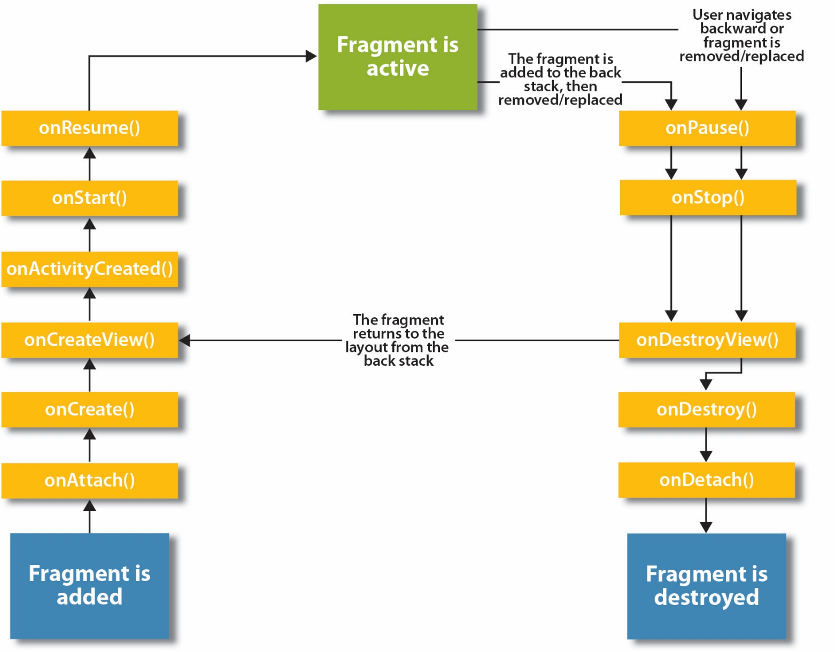

Slide 8
Declaring a Fragment
Declare fragments as subclasses of Fragment
The Fragment’s UI can be declared in XML or programmatically in Java
Fragment UIs are declared in exactly the same was as Activity UIs

Slide 9
Loading a Fragment
Fragments are loaded into an Activity at runtime
The Fragment to be loaded can be determined programmatically by the Activity’s Java code
Or the Fragment’s name can be hard-coded into the XML layout that is loaded by the Activity

Slide 10
Small Screen
Each activity loads a single fragment
Activity XML layout: instantiates a Fragment object
Fragment object: inflates fragment XML UI layout
Fragment XML UI layout is displayed by the activity
Activity: loads an XML layout

Slide 11
Large Screen
Activity: loads an XML layout
XML layout: instantiates two Fragment objects
Fragment object: inflates XML UI layout
Fragment object: inflates XML UI layout
XML UI layout is displayed by the activity
XML UI layout is displayed by the activity

Slide 12
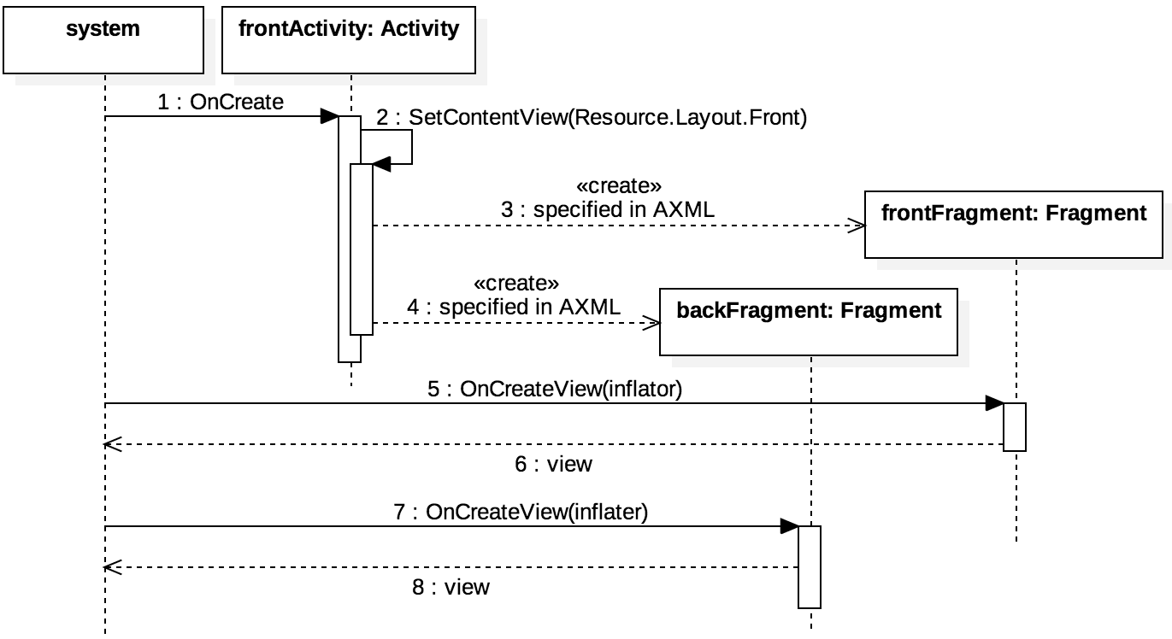
Large Screen Sequence

Slide 15
Calculating Size Qualifiers
Size qualifiers are in dp (dp = Density-independent Pixels)
dp = screen ppi / 160 ppi
Example: If the screen density is 320 pixels per inch, then pixels per dp = 320 / 160 which is 0.5
The size qualifier is the width or height in dp. Examples:
Nexus 7 (2012): 1200 x 800 pixels, 216 ppi
Width in dp: 800 * 160/216= 593 dp
Nexus 7 (2013): 1920 x 1200 pixels, 323 ppi
Width in dp: 1200 * 160/323= 594 dp
Nexus 5X: 1920 x 1080, 423 ppi
Width i dp: 1080 * 160/423 = 409 dp
Notes:
https://developer.android.com/guide/practices/screens_support.html#NewQualifiers
ppi = Pixels Per Inch

Slide 16



Fragment Example
Refactoring the Rock, Paper, Scissors Game

Slide 17
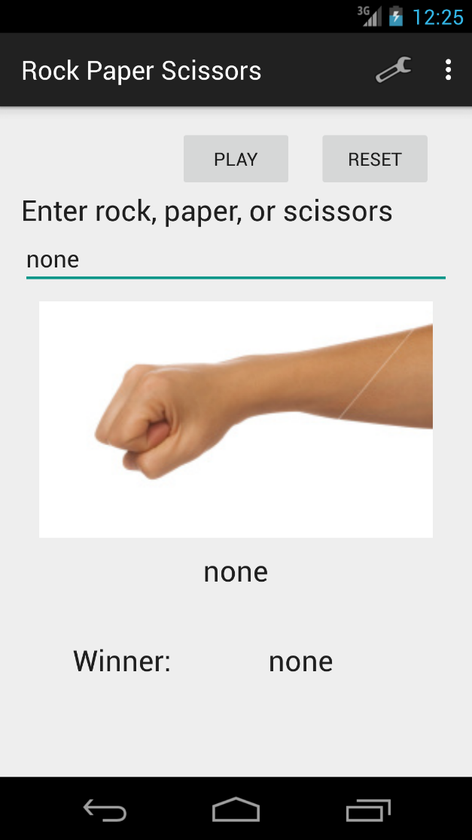
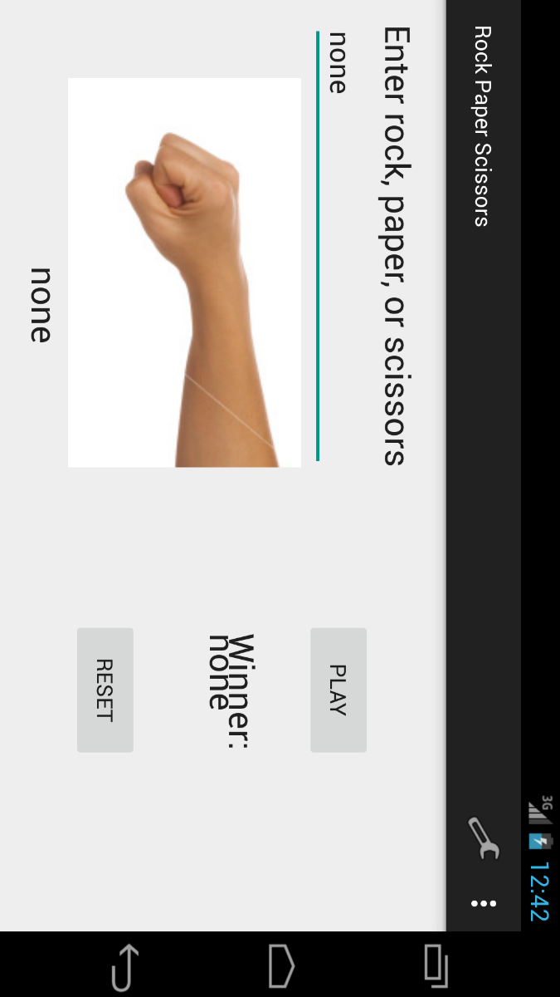
Non-Fragment RPS Game UI

Slide 18
Files in the Non-Fragment RPS Game Example
The files we are interested in are the ones that will be modified when we refactor our app to use fragments:
MainActivity.java
activity_main.xml
activity_main.xml (land)

Slide 19
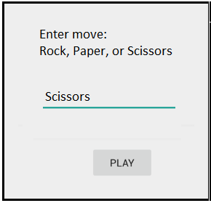
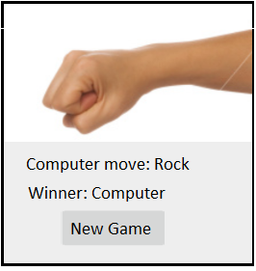
Planned Layout: Small Screen with Fragments
First Screen
Second Screen

Slide 20
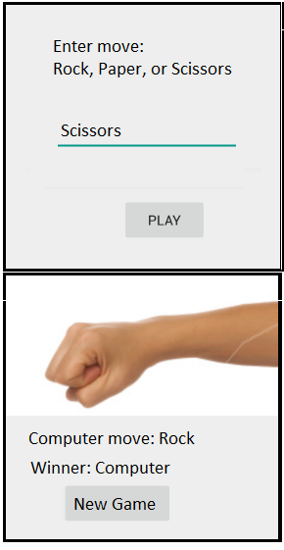
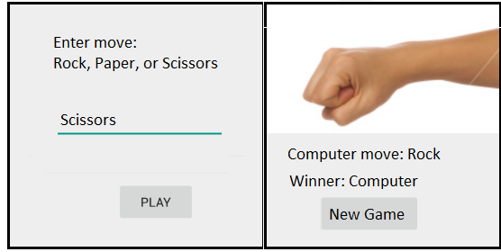
Planned Layout: Large Screen with fragments
Landscape
Portrait

Slide 21
Files for the Fragment Version
These are the files for the game UI that will be used in the fragment version of the project.
Java classes: FirstActivity FirstFragment SecondActivity SecondFragment | XML Layout Files: first_activity first_activity (sw600dp-port) first_activity (sw600dp-land) first_fragment second_activity second_fragment

Slide 22
Step 1: Implement Activities & Fragments for Small Screens
Our goals for this step are:
The FirstFragment is displayed in the FirstActivity when the app loads
The SecondFragment is displayed in the SecondActivity when a user clicks the “Play” button.
The FirstFragment is displayed again when a user clicks the “New Game” button.

Slide 23
Modify the Manifest for the New Activities
Change the name of the main activity (the one that is launched when the app starts): <activity android:name=".FirstActivity“ Add the second activity: <activity android:name=".SecondActivity“ android:label=“Computer Move“ android:parentActivityName=".FirstActivity" > </activity>
Notes:
If you create a new activity using the New, Activity menu in Android studio, it will automatically create a layout xml file and add an <Activity> element to the manifest

Slide 24
Loading sequence- small screen
FirstActivity, onCreate, loads first_activity.xml (single pane layout) setContentView(R.layout.first_activity);
first_activity, triggers automatic calls to FirstFragment methods <fragment android:name=".FirstFragment"
FirstFragment, onCreateView, loads first_fragment.xml View view = inflater.inflate(R.layout.first_fragment, container, false);

Slide 25
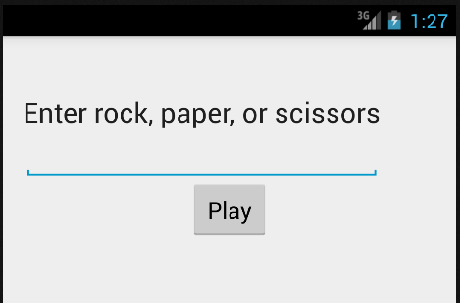
Test it!
Run the app. You should see the first fragment displayed on the opening screen:

Slide 26
Launching the Second Activity- Small Screen
Clicking the Play button starts the SecondActivity startActivity(new Intent(getActivity(), SecondActivity.class));
SecondActivity, onCreate, loads second_activity.xml (single pane layout) setContentView(R.layout.second_activity);
second_activity, triggers automatic calls to SecondFragment methods <fragment android:name=".SecondFragment"
SecondFragment, onCreateView, loads second_fragment.xml View view = inflater.inflate(R.layout.second_fragment, container, false);

Slide 27
Event Handler for the Play Button
In the FirstFragment class:
@Override public View onCreateView(LayoutInflater inflater, ViewGroup container, Bundle savedInstanceState) { View view = inflater.inflate(R.layout.first_fragment, container, false); // Set this fragment to listen for the Play button's click event Button b = (Button) view.findViewById(R.id.playButton); b.setOnClickListener(this); return view; } @Override public void onClick(View v) { startActivity(new Intent(getActivity(), SecondActivity.class));
}

Slide 28
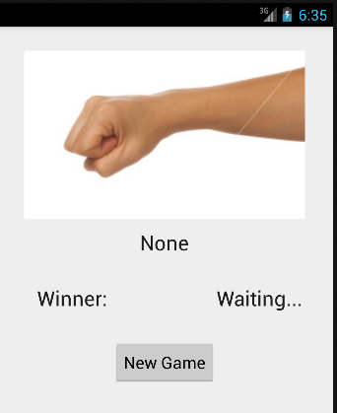
Test it!
Run the app. Click the “Play” button. You should see the second fragment displayed.
Click the “New Game” button. You should see the first fragment again.

Slide 29
Step 2: Instantiate a Game object and connect it for use with a Small Screen.
Our goal for this step is to implement the game-play logic:
The user can enter their choice (rock, paper, or scissors) on the first screen.
When the user clicks the “Play” button the second screen is shown where the computer’s choice and the winner are displayed.
When the user clicks the “New Game” button the first screen is displayed again.
Note: on a device with a small screen, the Game class will be instantiated in the 2nd Activity.

Slide 30
Creating and Accessing the Game Object with a Small Screen
FirstActivity
Holds the game object
Sends it to the SecondActivity in an intent
SecondActivity
Holds the game object
SecondFragment
Holds the game object
FirstFragment
Creates the game object
Passes it to the host Activity

Slide 31
Overview of New Code Required (Much of it isn’t “new”, we can copy it from the non-fragment version)
FirstActivity: nothing new
FirstFragment, in onClick for the “Play” button:
Get the player’s choice (rock, paper, or scissors) from rpsEditText, add it to the intent that will be sent to the SecondActivity.
SecondActivity
onCreate: get the player’s choice out of the intent, put it in a RpsGame object, and pass it to the SecondFragment by calling computerMove(game).
SecondFragment
computerMove: This new method contains essentially the same code that was in the play method of the single activity version of the game.

Slide 32
Step 3: Implement Activities & Fragments for Large Screens
Our goals for this step are:
In portrait orientation, both the first and second fragments will be displayed one above the other.
In landscape orientation, both the first and second fragments will be displayed side-by-side.
An instance of the Game class will be instantiated in the FirstActivity and gameplay logic is “hooked up” so the game can be played

Slide 33
Loading the fragments
In first_activity.xml (sw600dp-port):
Add a vertical linear layout that contains two fragment elements with the names:
FirstFragment
SecondFragment
Give each fragment a weight=“1”, width=“0dp”, and height=“match_parent”
In second_activity.xml (sw600dp-land):
Add a horizontal linear layout that contains two fragment elements with the same names as the one’s above.
Give each fragment a weight=“1”, width=“match_parent”, and height=“0dp”

Slide 34
Instantiate a Game Object
In FirstActivity:
Add an instance variable to hold a reference to a game object.
Write a setter for it. The setter will pass the game object to the SecondFragment.
In FirstFragment:
In OnActivityCreated:
Create a new instance of the game object.
Call the setter on FirstActivity to pass it a reference to the game object.

Slide 35
Hook up the Game Object
In FirstActivity, add a method named makeComputerMove that calls game.computerMove().
In FirstFragment:
Add an instance variable for keeping track of whether the single-pane or two-pane layout is loaded.
In OnActivityCreated: Add a line of code to detect which layout was loaded twoPaneLayout = activity.findViewById(R.id.second_fragment) != null;
In FirstFragment, OnClick:
Get input from rpsEditText and use it to set humanHand on the game object.
Call makeComputerMove in the FirstActivity

Slide 36
References
Documentation from Android Developers
API Guide: Fragments http://developer.android.com/guide/components/fragments.html
API Guide: Supporting Multiple Screens http://developer.android.com/guide/practices/screens_support.html
Reference: Activity http://developer.android.com/reference/android/app/Activity.html
Reference: Intent http://developer.android.com/reference/android/content/Intent.html

