Slide 1
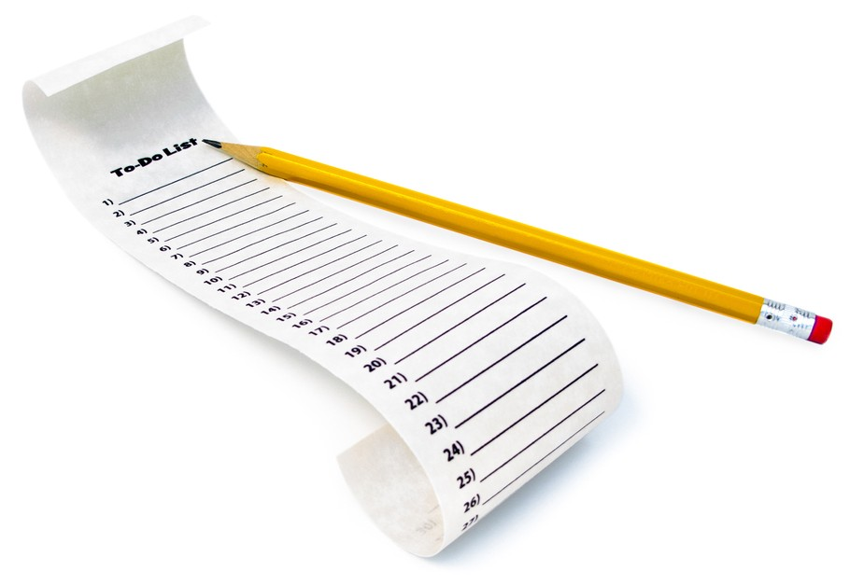
ListViews and Adapters
CIS 399

Slide 2
Course Overview
Wk | Topic
1 | Intro, single-screen apps
1 | Activity Lifecycle, saving activity state
2 | Layouts + widgets, Event Handlers
2 | Themes + styles, Menu + settings
2 | Multi-screen apps
Wk | Topic
3 | Fragments
3 | Reading XML files, Asynch Tasks
3 | List Views
3 | SQLite Database
4 | Consuming a web service
4 | Geolocation

Slide 3

ListViews
Notes:
https://developer.android.com/guide/topics/ui/layout/listview.html

Slide 4
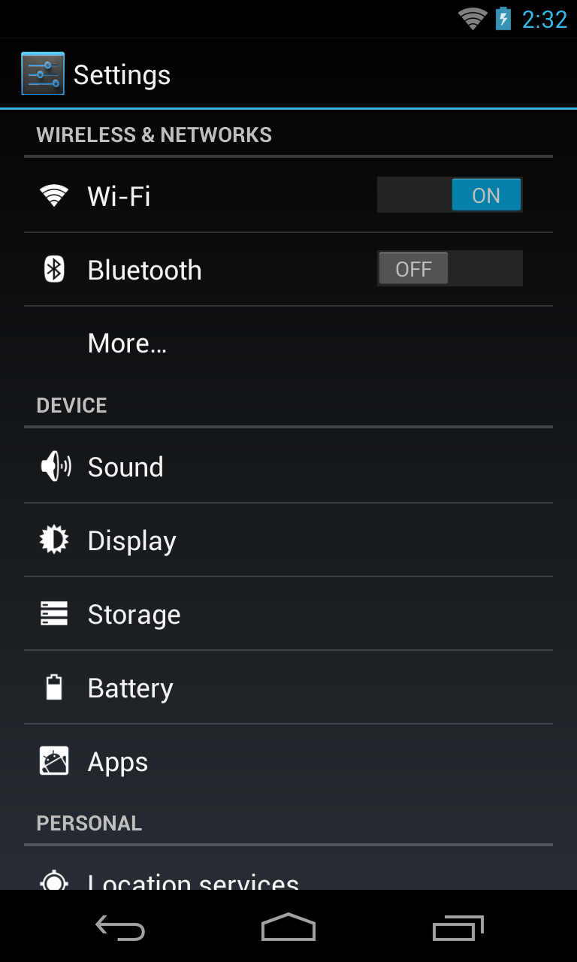
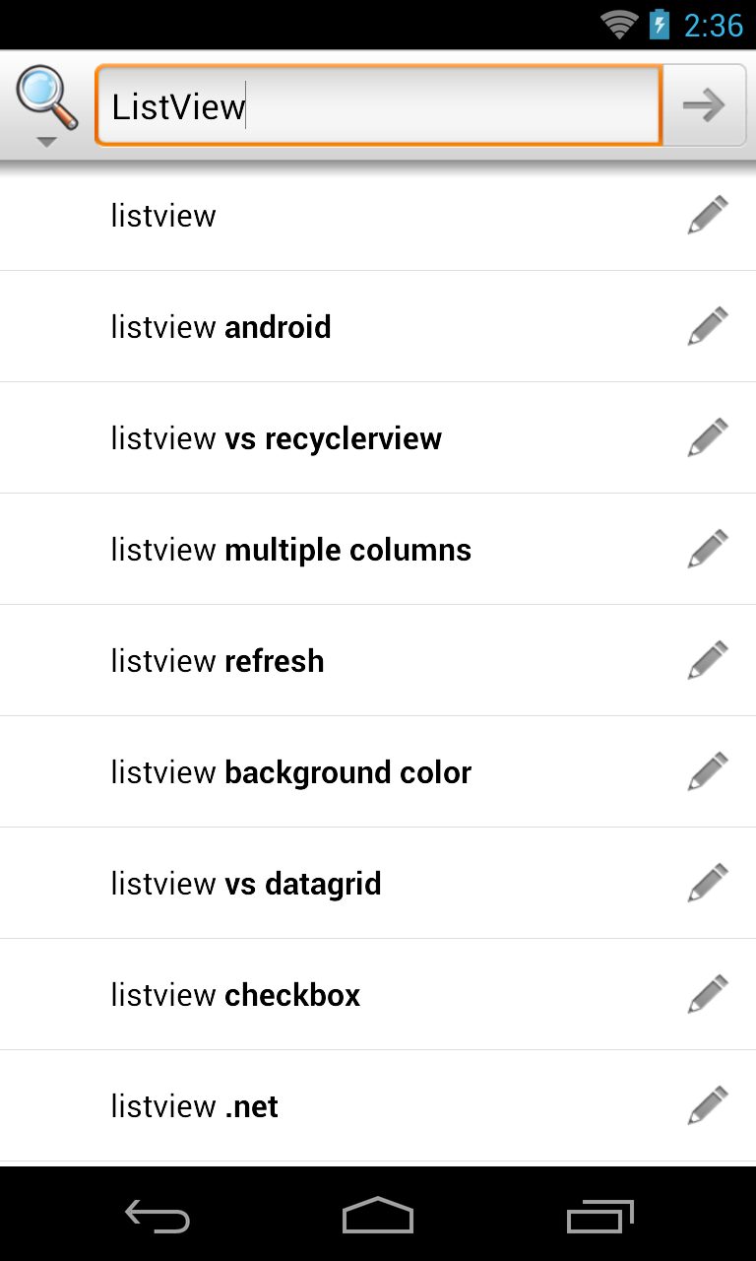
Examples of ListViews

Slide 5
Using a ListView
ListView is a subclass of ViewGroup and can be declared in an XML layout like other UI element.
The ListView displays a list of scrollable rows.
Each row is a View and it’s layout can be defined in an XML layout file.
An Adapter object inserts Items into the ListView. Either pre-defined adapters or custom adapters can be used.

Slide 6
ListView Row Layout
Can be a pre-defined layout from android.R.layout. For example:
simple_list_item_1
two_line_list_item
See more here: https://developer.android.com/reference/android/R.layout.html
Can be a custom XML layout you define
Notes:
https://docs.microsoft.com/en-us/xamarin/android/user-interface/layouts/list-view/customizing-appearance#built-in-row-views

Slide 7
Specifying a ListView Row Layout
The row layout is specified in the constructor for a ListView adapter.
Here’s an example, from my WeatherForecast app, using a custom row layout:
SimpleAdapter adapter = new SimpleAdapter( this, data, R.layout.listview_items, new String[]{IMAGE_NAME, DATE}, new int[]{R.id.iconImageView, R.id.dateTextView} );
Notes:
https://developer.android.com/reference/android/R.layout.html

Slide 8
ListActivity
The ListActivity hosts a ListView object
Screen Layout
A single, full-screen list in the center of the screen.
Customize the layout by setting your own XML layout with setContentView() in onCreate()
Row Layout
The constructor for the ListAdapter hosted by the activity has a parameter for a layout resource
Binding to Data
Done the same way as a ListView-- bind the ListActivity's ListView object to a data source using an adapter
Notes:
https://developer.android.com/reference/android/app/ListActivity.html
Note: the screen layout view and the row layout views could also be created programmatically instead of being defined in XML

Slide 9
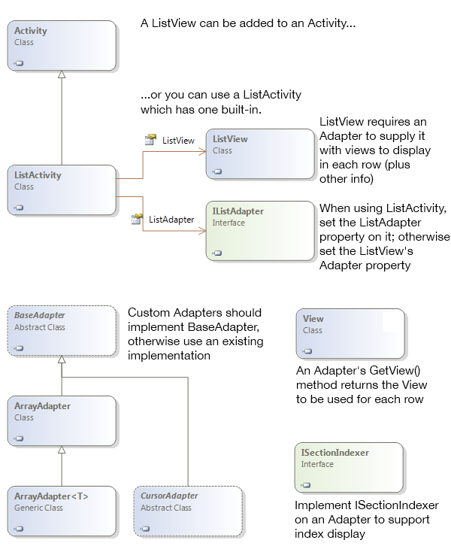
ListActivity Class Diagram

Slide 10
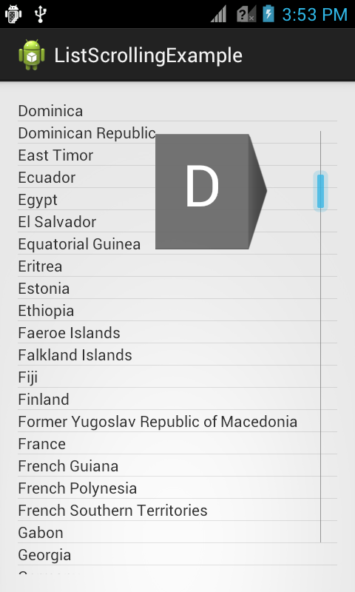
More ListView Features
Fast Scrolling
Dragging in the scroll bar traverses the list more quickly.
Customizable in API 11 and higher
https://developer.android.com/reference/android/R.attr.html#fastScrollEnabled
Section Index
Section titles appear while scrolling
https://developer.android.com/reference/android/widget/SectionIndexer.htm
Notes:
Reference: https://developer.android.com/reference/android/R.attr.html#fastScrollEnabled
Tutorial: http://androidopentutorials.com/android-listview-fastscroll

Slide 11
Code Tour
Open the Ch. 10 RSS Feed Reader App
In the activity_items layout, look at the ListView XML element.
Look at listview_item layout to see the layout used for the rows in the ListView
Look at the onItemClick event handler

Slide 14
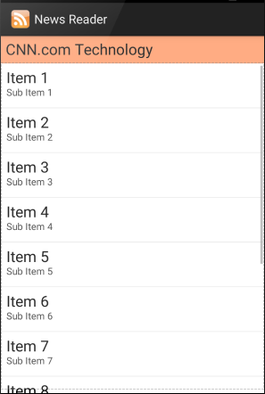
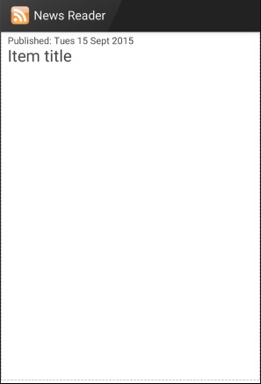

Slide 15
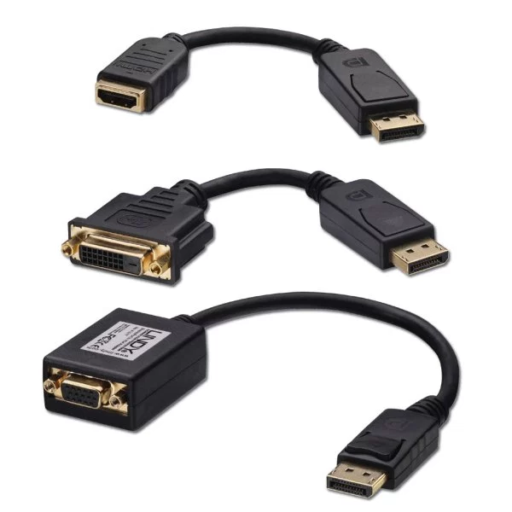
Adapters
Notes:
https://developer.android.com/reference/android/widget/Adapter.html

Slide 16
Adapters
Adapters bind a data source to a ListView
SimpleAdapter – source is an ArrayList of Java HashMap objects
ArrayAdapter<T> – source is an array of type T
SimpleCursorAdapter – source is a SQLite query
BaseAdapter – subclass this to make your own custom adapter

Slide 17
Adapters
Notes:
Doesn’t show SimpleAdapter, but SimpleAdapter extends BaseAdapter and should be shown here.
The Java version’s indexer is named without the I, just SectionIndexer
https://developer.android.com/reference/android/widget/SectionIndexer.html

Slide 18
Adapters
Simple Adapter
Notes:
https://developer.android.com/reference/android/widget/Adapter.html

Slide 19
SimpleAdapter Overview
Used with a List of Maps as a data source
Each item in the List object corresponds to one row in the ListView
Each item is a Map object which contains all the data for the row
ListView
List
First Name | Last Name | Phone
Clyde | Drexler | 456-789-1234
Satya | Nadella | 567-891-2345
John | Grisham | 678-912-3456
Map 1
Map 2
Map 3
Adapter
Notes:
Android Developers API documentation: https://developer.android.com/reference/android/widget/SimpleAdapter.html

Slide 20
SimpleAdapter Constructor
public SimpleAdapter (
Context context,
List<? extends Map<String, ?>> data,
Int32 resource,
String[] from,
Int[] to)
context: The host Activity context
data: A List of any objects that extend Map The Map objects must have string keys, but any type values
resource: ListView layout from Android.Resource.Layout
from: Map keys for data source
to: ListView widget IDs for displaying data
Notes:
Reference: https://developer.android.com/reference/android/widget/SimpleAdapter.html#SimpleAdapter
Explanation of the List<? extends blah> declaration: https://nofluffjuststuff.com/magazine/2016/09/time_to_really_learn_generics_a_java_8_perspective

Slide 21
Instantiating a SimpleAdapter
In an Activity’s onCreate method:
// Create a List that will hold Map objects
ArrayList<HashMap<String, String>> data = new ArrayList<HashMap<String, String>>();
// In a loop (not shown) create Map objects, add data and put them in the List
HashMap<String, String> map = new HashMap<String, String>(); map.put(“Date”, “7/10/18”); map.put(”Image_Name”, “sun.png”); data.add(map);
// Create the adapter object
SimpleAdapter adapter = new SimpleAdapter(this, data, R.layout.listview_items, new String[]{“Image_Name”, “Date”}, new int[]{R.id.iconImageView, R.id.dateTextView } );
Notes:
From https://github.com/UO-CIS/CIS399AndroidDemos/tree/master/WeatherForecast-SAX+ListView

Slide 22
Adapters
Cursor Adapter
Notes:
https://developer.android.com/reference/android/widget/Adapter.html

Slide 23
SimpleCursorAdapter Overview
Used with a Cursor from a SQLite Database
Each row in the Cursor object corresponds to a row in the ListView
Cursor
First Name | Last Name | Phone
Clyde | Drexler | 456-789-1234
Satya | Nadella | 567-891-2345
John | Grisham | 678-912-3456
ListView
Adapter
ListView
First Name | Last Name | Phone
Clyde | Drexler | 456-789-1234
Satya | Nadella | 567-891-2345
John | Grisham | 678-912-3456
Notes:
Android Developers API documentation: https://developer.android.com/reference/android/widget/SimpleCursorAdapter

Slide 24
SimpleCursorAdapter Constructor
public SimpleAdapter (
Context context, Cursor c,
Int32 resource,
String[] from, Int[] to,
Int flags)
context: The host Activity context
c: a cursor which was obtained from a SQL database query
resource: ListView layout from Android.Resource.Layout
from: column (field) names from the cursor (same as table columns)
to: ListView widget IDs for displaying data
flags: May be 0, or FLAG_REGISTER_CONTENT_OBSERVER, which causes onContentChanged() to be called when a content change notification occurs
Notes:
https://developer.android.com/reference/android/widget/SimpleCursorAdapter.html#SimpleCursorAdapter

Slide 25
Instantiating a SimpleCursorAdapter
In an Activity’s onCreate method:
// Do a database query Cursor cursor = db.rawQuery(query, variables);
// Create an adapter object
adapter = new SimpleCursorAdapter(
this,
R.layout.listview_items,
cursor,
new String[]{TITLE, IMAGE_ID, FCT_TEXT, POP},
new int[]{R.id.dateTextView,
R.id.iconImageView,
R.id.descriptionTextView,
R.id.popTextView },
0 );
Notes:
From https://github.com/UO-CIS/CIS399AndroidDemos/tree/master/WeatherForecast-SAX+ListView

Slide 26
Code Tour
Open the Ch. 10 RSS Feed Reader App
In the ItemsActivity class, look at the code that creates and sets the SimpleAdapter.

Slide 30
Further ListView Reading
Using lists in Android (ListView) – Tutorial
by Lars Vogel, 9/29/2015
http://www.vogella.com/tutorials/AndroidListView/article.html#arrayAdapter
Fast scroll and Section indexer tutorial
http://androidopentutorials.com/android-listview-fastscroll
Android Developers ListView Guide
https://developer.android.com/guide/topics/ui/layout/listview.html
Android Developers: Recycler View
https://developer.android.com/guide/topics/ui/layout/recyclerview.html

