Slide 1
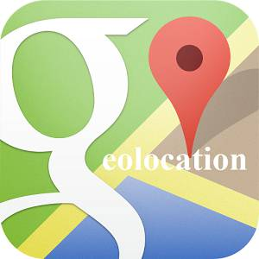
Geolocation
CIS 399
Notes:
http://sqlite.org

Slide 2
Course Overview
Wk | Topic
1 | Intro, single-screen apps
1 | Activity Lifecycle, saving activity state
2 | Layouts + widgets, Event Handlers
2 | Themes + styles, Menu + settings
2 | Multi-screen apps
Wk | Topic
3 | Fragments
3 | Reading XML files, Asynch Tasks
3 | List Views
3 | SQLite Databases
4 | Consuming web services
4 | Geolocation

Slide 3
Android Geolocation APIs
Information provided:
Latitude and longitude
Altitude
Speed
Heading

Slide 4
Location Data Sources
Source | Accuracy | Battery Drain
GPS | High | Highest
Cellular Towers | Medium | Lower
Wi-Fi | Variable: medium to low | Lower
Passive | Variable | None
Notes:
https://developer.android.com/guide/topics/location/strategies.html

Slide 5
Notes:
Pros and Cons of Network apply to both cellular and WiFi

Slide 7
Choice of APIs
Android Location Services API
Lets you choose between: GPS, Cellular, Wi-Fi
No longer recommended by Google
Fused Location Provider
Dynamically chooses the best location provider
Preferred by Google, requires Google Play Services
Notes:
https://birdsbits.wordpress.com/2016/05/27/create-location-aware-android-apps/

Slide 8
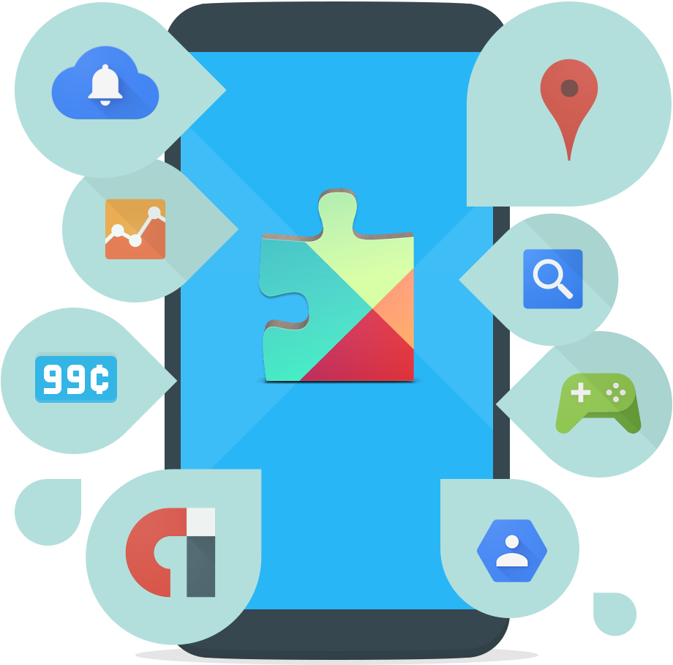
Google Play Services

Slide 9
Google Play Services APIs
The APIs are delivered in an APK that is updated via the Google Play Store
They are updated without an Android OS update- reducing Android API fragmentation
Updates are automatically and silently delivered within days of an API update being released
Available for API 9 and newer
Notes:
https://birdsbits.wordpress.com/2016/05/27/the-google-play-services-apis
GPS is also called Google API’s for android

Slide 10
A Sampling of GPS APIs
Location Awareness
Google Cast (Stream content to TVs and speakers)
Google Play Game Services
Google Fit
Google Drive
Voice Actions
Firebase APIs

Slide 11
Add GPS to Your Project
Open the build.gradle file inside your application module directory.
Add a new build rule for the latest version of play-services. For example:
Save the changes and click Sync Project with Gradle Files in the toolbar.
Notes:
GPS = Google Play Services
Add GPS to your project:
https://developers.google.com/android/guides/setup#add_google_play_services_to_your_project

Slide 12
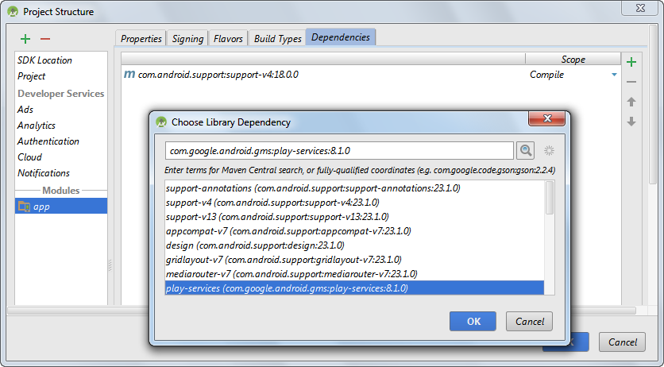

Slide 13
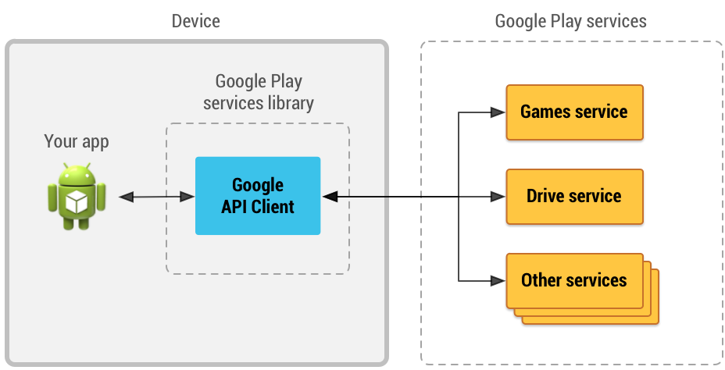
Accessing Google APIs
The Google API Client will:
Provide a common entry point to all the Google Play services
Manage the network connection with each Google Play service.
Notes:
https://developers.google.com/android/guides/api-client

Slide 14
Accessing Google APIs (continued)
Create an instance of the GoogleApiClient
In your activity’s onCreate() method:
use the GoogleApiClient.Builder to create an instance of the GoogleApiClient. Example:
addAPI adds specifies which APIs are requested for your app
addScope specifies the OAuth 2.0 scope requested for your app

Slide 15
Accessing Google APIs (continued)
Implement the OnConnectionFailedListener interface Example:
Notes:
Required for automatic management of the connection to Google Play Services

Slide 16
Accessing Google APIs (continued)
Implement additional ConnectionCallbacks
abstract void onConnected(Bundle connectionHint)
After calling connect(), this method will be invoked asynchronously when the connect request has successfully completed.
abstract void onConnectionSuspended(int cause)
Called when the client is temporarily in a disconnected state.
Notes:
Implementation of these callbacks is optional
Use these if your app needs to know when the automatically managed connection is established or suspended.
For example, if your app makes calls to write data to Google APIs, these should be invoked only after the onConnected() method has been called.
Notes:
Required for automatic management of the connection to Google Play Services

Slide 18
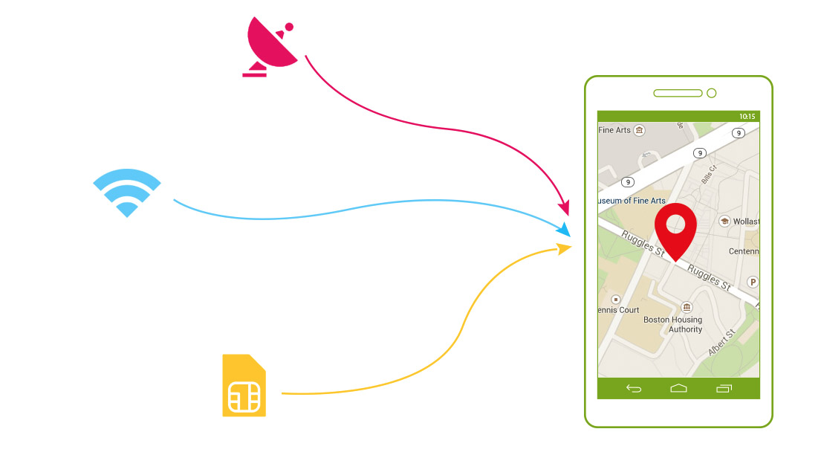
Fused Location Provider

Slide 19
Fused Location Provider
Location sources are selected based on priorities:
Balanced power/accuracy
~100 m accuracy
medium power draw
High accuracy
~5 meter accuracy
highest power draw
Low power
~10km accuracy
minimum power draw
No power
uses location data requested by other apps

Slide 20
Fused Location Provider
Gets the best available provider
Provides last known location (usually current)
Provides continuous location updates
Location client
Connects to Google Play Services
Developer needs to implement interfaces for callbacks
Notes:
https://developer.android.com/training/location/retrieve-current.html

Slide 21
Code Tour
Murach Ch. 18 Location Viewer app
First, set up your emulator to test an app that uses the Fused Location Provider, see: https://birdsbits.wordpress.com/2016/05/26/testing-location-aware-apps-on-an-emulator/
Notes:
https://birdsbits.wordpress.com/2016/05/27/create-location-aware-android-apps/

Slide 22
Notes:
https://birdsbits.wordpress.com/2016/05/27/create-location-aware-android-apps/

Slide 23
Notes:
https://birdsbits.wordpress.com/2016/05/27/create-location-aware-android-apps/

Slide 24
Notes:
https://birdsbits.wordpress.com/2016/05/27/create-location-aware-android-apps/

Slide 25
Notes:
https://birdsbits.wordpress.com/2016/05/27/create-location-aware-android-apps/

Slide 26
Notes:
https://birdsbits.wordpress.com/2016/05/27/create-location-aware-android-apps/

Slide 27
Notes:
https://birdsbits.wordpress.com/2016/05/27/create-location-aware-android-apps/

Slide 28
Notes:
https://birdsbits.wordpress.com/2016/05/27/create-location-aware-android-apps/

Slide 29
Notes:
https://birdsbits.wordpress.com/2016/05/27/create-location-aware-android-apps/

Slide 30
Related APIs
Geocoder
Get address from latitude and longitude
Get latitude and longitude from address
Geofencing
Monitor distance from a point of interest
Get notifications when entering or leaving area of interest

Slide 31
Further Geolocation Reading
Guide: Overview of Google Play Services https://developers.google.com/android/guides/overview
Tutorial: Making Your App Location-Aware https://developer.android.com/training/location/index.html
Google Play Services Location APIshttps://developers.google.com/android/reference/com/google/android/gms/location/package-summary

