Slide 1

Menus and Settings
CIS 399

Slide 2
Course Overview
Wk | Topic
1 | Intro, single-screen apps
1 | Activity Lifecycle, saving activity state
2 | Layouts + widgets, Event Handlers
2 | Themes + styles, Menu + settings
2 | Multi-screen apps, Fragments
Wk | Topic
3 | Reading XML files, Asynch Tasks
3 | List Views
3 | SQLite Database
4 | Consuming a web service
4 | Geolocation

Slide 3

Menus

Slide 4
Types of Menus
Options menu and app bar
The primary collection of menu items for an activity. It's the place for actions that affect the entire app.
Context menu and contextual action mode
A context menu is a floating menu that appears when the user performs a long-click (long press) on an element.
Contextual action mode displays action items that affect the selected content in a bar at the top of the screen.
Popup menu
Displays a list of items in a vertical list that's anchored to the view that invoked the menu.
Notes:
https://developer.android.com/guide/topics/ui/menus.html
In this presentation, we will only look at the first type, the options menu

Slide 5
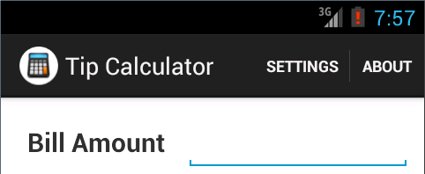
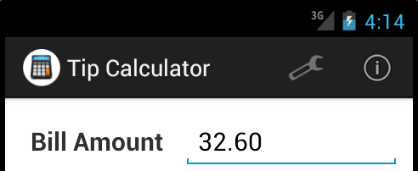

Slide 6
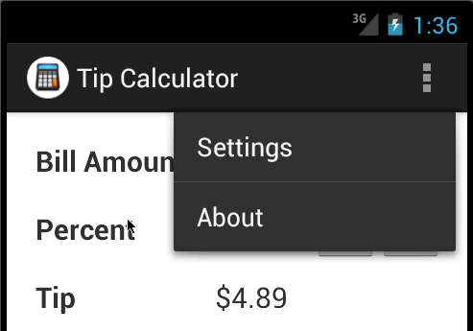
Options Menu
Options menu displayed from an action overflow icon– contains two action items
Murach's Android Programming, C8
© 2015, Mike Murach & Associates, Inc. – modified by Brian Bird 2016
Slide 6

Slide 7
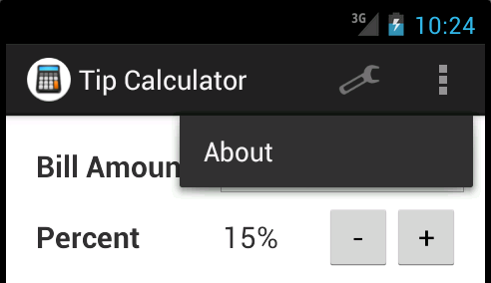

Slide 8
Exercise
Open ch08_ex1_TipCalcualtor and run it
Click on the action bar overflow icon and on each of the menu items.

Slide 9
Creating an App Bar Menu and Handling its Events

Slide 10
Note: This XML file format is used for all menu types
Notes:
https://developer.android.com/guide/topics/ui/menus.html#xml

Slide 11
Elements in a Menu XML file
<menu>
Defines a Menu, which is a container for menu items.
Must be the root node for the file
Can hold one or more <item> and <group> elements.
<item>
Creates a MenuItem, which represents a single menu item
May contain a nested <menu> element for a submenu
<group>
An optional, invisible container for <item> elements.
Allows you to categorize menu items so they share properties such as active state and visibility.

Slide 12
Attributes of the Menu Item
Commonly used attributes of the <item> element:
android:id
A resource ID that's unique to the item, which allows the application to recognize the item when the user selects it
android:icon
A reference to a drawable to use as the item's icon
android:title
A reference to a string to use as the item's title
android:showAsAction
Specifies when and how this item should appear as an action item in the app bar; values: always, never, ifRoom
android:orderInCategory
Specifies an int value for the sequence of the item in ascending order

Slide 14
Exercise
Open ch08_ex1_TipCalcualtor
Modify the XML file so that both the Settings item icon and About item icon are displayed on the action bar if there is room.
Run the app on an emulator big enough to show both menu item icons.

Slide 17
Exercise
Continue using ch08_ex1_TipCalcualtor
Look for the code that handles the menu item events
Does it currently display toasts?
Modify the code so the toasts are displayed with new messages.

Slide 18

Starting a New Activity

Slide 19
Context class
An interface to global information about an application environment. This is an abstract class whose implementation is provided by the Android system. From: https://developer.android.com/reference/android/content/Context.html

Slide 21
Questions
In the onOptionItemsSelected method shown in the previous slide:
Do you think StartActivity could be used in other contexts (not just in a menu item event hander)?
What is the purpose of the Intent objects?
What is passed to it’s constructor?
Why do you think it needs an application context argument?
What is different about the two activities that are started?

Slide 22
Adding an Activity to the Manifest
Each Activity must be listed in the manifest:
<application> <!-- Attributes removed for clarity --> <activity android:name="com.murach.tipcalculator.TipCalculatorActivity" android:label="@string/title_activity_tip_calculator" > <intent-filter> <action android:name="android.intent.action.MAIN" /> <category android:name="android.intent.category.LAUNCHER" /> </intent-filter> </activity> <activity android:name="com.murach.tipcalculator.SettingsActivity" android:label="@string/title_activity_settings" > </activity> <activity android:name="com.murach.tipcalculator.AboutActivity" android:label="@string/title_activity_about" android:theme="@style/DialogTheme"> </activity> </application>

Slide 23
Exercise
Continue using the ch08_ex1_TipCalculator project
Put a breakpoint in onCreateOptionMenu and run the app in debug mode
Put breakpoints in each of the callback methods below and then run the app in debug mode
onOptionsItemSelected
AboutActivity, onCreate
SettingsActivity, onCreate
For each of the methods below, how might they be implemented differently in a different app?
onCreateOptionMenu
onOptionsItemSelected

Slide 24
Textbook Exercise
Do Exercise 8-2, Work with Menus, in the textbook
Use the exercise starter project, ch08_ex2_TipCalcualtor
Add items to the TipCalculatorActivity menu:
Help: just a place-holder for now; shows a toast
Refresh: updates the calculations
Add a menu to the PreferencesActivity with items:
Tip Calculator: invokes the TipCalculator activity
About: invokes the About activity

Slide 25

Settings (aka Preferences)
Notes:
https://developer.android.com/guide/topics/ui/settings.html

Slide 26
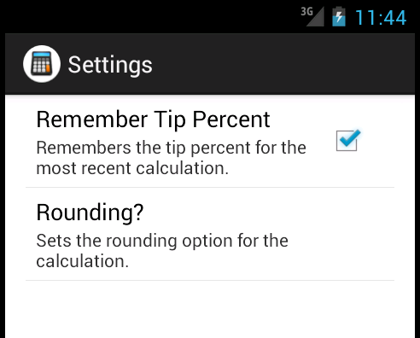
A Settings Screen (from a Settings Activity)
Murach's Android Programming, C8
© 2015, Mike Murach & Associates, Inc, modified by Brian Bird 2018.
Slide 26

Slide 27
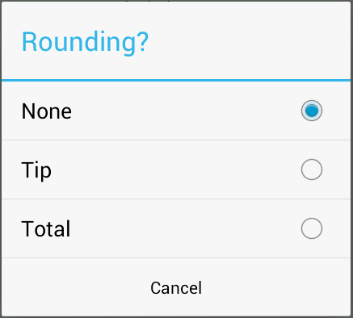
Murach's Android Programming, C8
© 2015, Mike Murach & Associates, Inc.
Slide 27

Slide 28
Notes:
Note that Preference items are used, not View items
https://developer.android.com/guide/topics/ui/settings.html#DefiningPrefs

Slide 29
Murach's Android Programming, C8
© 2015, Mike Murach & Associates, Inc.
Slide 29

Slide 30
Exercise
Open ch08_ex1_TipCalcualtor
Alter the values in the Preference elements’ attributes to see their effect. Try changing things like:
Title
Default value
Entries (in the ListPreference)
Your choice. Experiment!

Slide 31
Settings Fragments
Notes:
https://developer.android.com/guide/topics/ui/settings.html

Slide 32
Fragments
Define a UI or part of a UI
Can be defined in XML
Can be loaded into an activity by Java code in the activity

Slide 33
Murach's Android Programming, C8
© 2015, Mike Murach & Associates, Inc.
Slide 33

Slide 34
Murach's Android Programming, C8
© 2015, Mike Murach & Associates, Inc.
Slide 34

Slide 35
Exercise
Open ch08_ex1_TipCalcualtor
Put breakpoints in onCreate of both the SettingsActivity and the SettingsFragment
Run the app and see when the breakpoints are hit

Slide 36
Murach's Android Programming, C8
© 2015, Mike Murach & Associates, Inc.
Slide 36

Slide 37
Murach's Android Programming, C8
© 2015, Mike Murach & Associates, Inc.
Slide 37

Slide 38
Murach's Android Programming, C8
© 2015, Mike Murach & Associates, Inc.
Slide 38

Slide 39
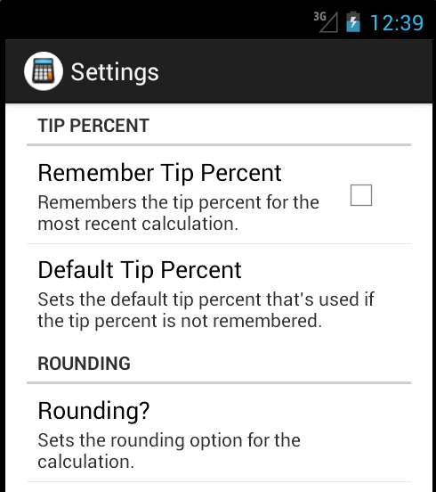
Murach's Android Programming, C8
© 2015, Mike Murach & Associates, Inc.
Slide 39

Slide 40
Murach's Android Programming, C8
© 2015, Mike Murach & Associates, Inc.
Slide 40

Slide 41
Textbook Exercise
Do Exercise 8-3, Work with Preferences, in the textbook
Use the exercise starter project, ch08_ex3_TipCalcualtor
Add a ListPreference with three default tip amounts to the menu
Add categories:
Tip Percent
Rounding
In the SettingsFragment, disable Default Tip Percent when Remember Tip Percent is unchecked

