Slide 1
COP2034C Programming in Python Module 7 Object-Oriented Programming (OOP)

Slide 2
Edited for GitHub
This is a change for the Module 9 GitHub assignment.

Slide 3
Objects and Python
Objects are Python’s abstraction for data.
All data in a Python program is represented by objects or by relations between objects
https://docs.python.org/3/reference/datamodel.html#objects-values-and-types

Slide 4
Creating and Using a Class
To use object-oriented programming in Python, you create classes that represent real-world things and situations, and you create objects based on these classes
Example:
a Product class represents a product which might be purchased in a retail store or online
The class includes attributes (properties) for the name, price, and a discount percentage rate
The class also includes methods ("special functions") which allow a program to perform operations with (or on) it

Slide 5
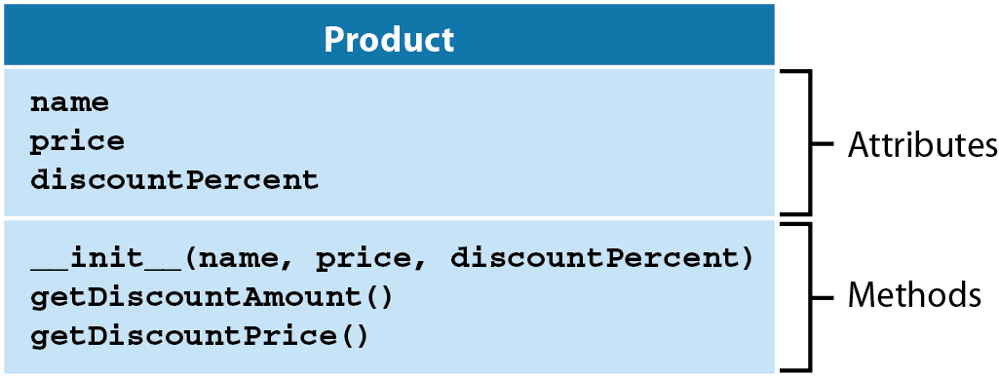
The Product Class
Unified Modeling Language (UML) is used to diagram classes and objects
By convention, class names are capitalized

Slide 6
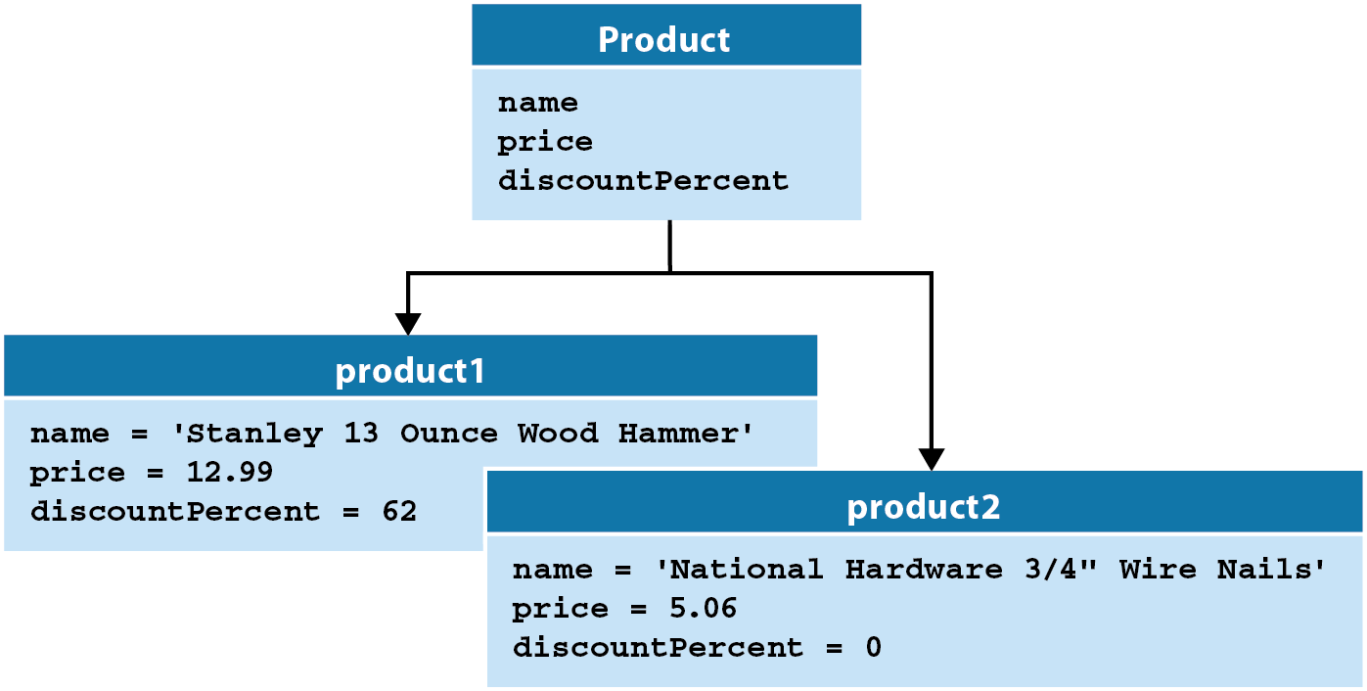
We can use UML to diagram classes and the objects instantiated (created) from them:
product1 and product2 are instances of the Product class

Slide 7
Coding the Product Class
class Product:
# an initialization method ("constructor")
def __init__(self, name, price, discountPercent): # self.name, self.price, and
# self.discountPercent are attributes
self.name = name
self.price = price
self.discountPercent = discountPercent
# a method that uses two attributes
def getDiscountAmount(self):
return self.price * self.discountPercent / 100
# a method that calls another method
def getDiscountPrice(self):
return self.price - self.getDiscountAmount()

Slide 8
Coding a Dog Class
Identify the attributes and methods
class Dog:
def __init__(self, name, age):
self.name = name
self.age = age
def sit(self):
print(f"{self.name} is now sitting.")
def roll_over(self):
print(f"{self.name} rolled over!")

Slide 9
The __init__ method
The __init__() method is a special method that Python runs automatically whenever a new instance of a class is created.
Two leading and two trailing underscores are used to prevent default Python method names from conflicting with your customized method names.
__init__() acts like a constructor in other OOP languages, but the Python documentation rarely uses that term explicitly
As with regular functions, we can declare parameters in methods, including in __init__() method.
The self parameter is specific to class methods (see next slide)

Slide 10
The self Parameter
self is the name of the object instance just created (for a constructor) or the object used to call an instance method.
self is always listed as the first parameter to the constructor or method.
there is nothing special about the name "self", it is a convention which should be followed.
omitting self from the parameter list can lead to obscure errors
self is never passed as an argument in a function call

Slide 11
Instantiating an Object from a Class
We assign a variable using the class name
The __init__() method is implicitly called
Note that we do not pass self, we only pass two arguments
def main():
my_dog = Dog('Willie', 6)
print(f"My dog's name is {my_dog.name}.")
print(f"My dog is {my_dog.age} years old.")
My dog's name is Willie.
My dog is 6 years old.

Slide 12
Accessing Attributes
dot notation is used to access attributes using the instantiated object name (variable)
def main():
my_dog = Dog('Willie', 6)
print(f"My dog's name is {my_dog.name}.")
print(f"My dog is {my_dog.age} years old.")
My dog's name is Willie.
My dog is 6 years old.

Slide 13
Calling Methods
dot notation is also used to call methods using the instantiated object name (variable)
def main():
my_dog = Dog('Willie', 6)
my_dog.sit()
my_dog.roll_over()
Willie is now sitting.
Willie rolled over!

Slide 14
Creating Multiple Instances
You can create as many instances from a class as needed.
my_dog = Dog('Willie', 6)
your_dog = Dog('Lucy', 3)
my_dog.sit()
your_dog.sit()
Willie is now sitting.
Lucy is now sitting.

Slide 15
Encapsulation
An attribute is made private in Python by prefixing the name with two underscores
__name
__price
__discountPercent
__age
Using private attributes enables data hiding, or encapsulation. We want to prevent direct modification of data; for instance, the following statements should not be allowed:
product1.price = 11.25 # change the price!
my_dog.name = 'Alf' # Alf is an alien, not a dog
Encapsulation prevents direct access and direct modification of your class's data…(this is a good thing).
Python doesn't formally support private variables, this is actually just a convention that should be followed.

Slide 16
Accessors and Mutators
In order to make the private data available to users of our class, we code accessors (getters) and mutators (setters) for each private attribute
An accessor is a method which returns the attribute's value
def getPrice(self):
return self.__price
A mutator is a method which takes a value parameter and assigns that value to the attribute (can also implement validation of the value)
def setPrice(self, price):
self.__price = price

Slide 17
# inventory.py
…
print("Name:\t\t\t{:s}".format(product1.name))
product1.setPrice(11.25) # use mutator
# use accessor print("Price:\t\t\t{:.2f}".format(product1.getPrice()))
print("Discount percent:\t{:d}%".format(product1.discountPercent))
print("Discount amount:\t{:.2f}".format(product1.getDiscountAmount()))
print("Discount price:\t\t{:.2f}".format(product1.getDiscountPrice()))
PRODUCT DATA
Name: Stanley 13 Ounce Wood Hammer
Price: 11.25
Discount percent: 62%
Discount amount: 6.97
Discount price: 4.28

Slide 18
Decorators
Python provides @-based decorators which will transparently implement accessors and mutators whenever the attribute is accessed:
# accessor/mutator for price using decorators
@property
def price(self):
# print("in price getter") # debug
return self.__price
@price.setter
def price(self, price):
# print("in price setter") # debug
self.__price = price
Decorators allow us to access the data normally, without special methods, but still take advantage of encapsulation.

Slide 19
The highlighted statements below appear to directly use the Product class attributes, but are actually using the underlying accessor and mutator.
# enabled debugging statements in Product class
# print data for product1 to console
print("PRODUCT DATA")
print("Name:\t\t\t{:s}".format(product1.name))
product1.price = 11.25 # change the price!
print("Price:\t\t\t{:.2f}".format(product1.price))
print("Discount percent:\t{:d}%".format(product1.discountPercent))
print("Discount amount:\t{:.2f}".format(product1.getDiscountAmount()))
print("Discount price:\t\t{:.2f}".format(product1.getDiscountPrice()))
PRODUCT DATA
Name: Stanley 13 Ounce Wood Hammer
in price setter
in price getter
Price: 11.25
Discount percent: 62%
Discount amount: 6.97
Discount price: 4.28

Slide 20
Car Class Using Decorators
Full file available for download in Canvas ("car.py")
#!/usr/bin/env python3
# car.py
# class representing a Car
# adapted from "Python Crash Course", Matthes 2019
class Car:
"""A simple attempt to represent a car."""
def __init__(self, make, model, year):
"""Initialize attributes to describe a car."""
self.__make = make # read-only
self.__model = model # read-only
self.__year = year # read-only
self.__odometer_reading = 0

Slide 21
Car Class Using Decorators
# getters
@property
def make(self):
return self.__make
@property
def model(self):
return self.__model
@property
def year(self):
return self.__year
@property
def odometer_reading(self):
return self.__odometer_reading

Slide 22
Car Class Using Decorators
# setter (only one needed, other attributes are read-only)
@odometer_reading.setter
def odometer_reading(self, odometer_reading):
if odometer_reading >= self.__odometer_reading:
self.__odometer_reading = odometer_reading
else:
print("You can't roll back an odometer!")
# utility methods
def get_descriptive_name(self):
"""Construct a full name from the car attributes."""
long_name = f"{self.year} {self.make} {self.model}"
return long_name.title()

Slide 23
Car Class Using Decorators
def read_odometer(self):
"""Print a message which indicates the car odometer value."""
print(f"This car has {self.odometer_reading} miles on it.")
def increment_odometer(self, miles):
"""Increment the odometer using value of miles argument."""
self.odometer_reading = self.odometer_reading + miles

Slide 24
Car Class Using Decorators
# unit test
def main():
car = Car("Dodge", "Viper SRT-10", 2010)
print(car.get_descriptive_name())
car.read_odometer()
car.odometer_reading = 1000
car.read_odometer()
car.increment_odometer(100)
car.read_odometer()
car.odometer_reading = 500
if __name__ == "__main__":
main()

Slide 25
Grouping Getters and Setters
There are two general alternatives for grouping getters and setters
# constructors
# all getters
# all setters
or
# constructors
# getter/setter for field 1
# getter/setter for field 2
# more pairs of getter/setter as necessary
Ultimately it is a personal preference (note constructors are first for both)
Some IDEs provide options to group them (and generate them!) for you

Slide 26
Inheritance in Python
We can inherit characteristics of a base (parent, or super) class in a derived (child, or sub) class.
Inheritance is a standard OOP feature.
Inheritance avoids duplication of code (attributes, methods) in similar objects
The following ElectricCar class inherits from the base (or parent) class named Car:
class ElectricCar(Car):
pass
The base class is specified in parentheses in the declaration of the subclass.
ElectricCar inherits all of the Car class's attributes and methods
pass is a no-op (no operation) statement which is used here as a placeholder to avoid "empty code" – sections of a program where a statement is required.

Slide 27
Inheritance in Python
The ElectricCar subclass on the previous slide wasn't very useful
We typically want to add attributes and methods that make the subclass a specialized version of the base class
As we move down in the inheritance hierarchy (the chain of inheritance which moves from base class to subclass, then to subclasses of the subclass, etc.) objects get bigger and more specialized
Car Inheritance Hierarchy
Car
ElectricCar
HybridElectricCar
BatteryElectricCar

Slide 28
Inheritance in Python
#!/usr/bin/env python3
# electric_car.py
# class representing an electric car
from car import Car # import our base class
class ElectricCar(Car):
"""Represent aspects of a car, specific to electric vehicles."""
def __init__(self, make, model, year):
"""Initialize attributes of the parent class."""
super().__init__(make, model, year) # "pass-through" arguments to base class
def main():
my_tesla = ElectricCar('tesla', 'model s', 2019)
print(my_tesla.get_descriptive_name()) # get_descriptive_name resides in the base class
if __name__ == "__main__":
main()
2019 Tesla Model S

Slide 29

The super Function
super( ) is a special function that allows you to call a method which resides in the parent class
def __init__(self, make, model, year):
super().__init__(make, model, year)
The __init__ function in ElectricCar instantiates an ElectricCar object, which includes all of the attributes and methods provided in the Car base class.
Calling super().__init__ tells Python to call the Car constructor as the object is being created
All of the ElectricCar constructor parameters are passed up to the Car base class constructor as arguments, since those attributes reside in the Car class and must be set there
The name super comes from the convention of calling the parent class a superclass and the child class a subclass.

Slide 30
Adding an Attribute to a Subclass
class ElectricCar(Car):
"""Represent aspects of a car, specific to electric vehicles."""
def __init__(self, make, model, year, batteryVolts = 0):
"""Initialize attributes of the parent class."""
super().__init__(make, model, year)
self.__batteryVolts = batteryVolts # read-only
# getter
@property
def batteryVolts(self):
return self.__batteryVolts
# utility methods
def get_descriptive_name(self): # concat super's string with subclass info
supStr = super().get_descriptive_name()
return supStr + "\nbattery voltage = " + str(self.__batteryVolts)

Slide 31
Overriding Methods
A subclass can override a superclass method to provide specialized behavior
The subclass method must be declared exactly the same as the superclass
The override can either replace or supplement the base class's method
"super" can be used to call the superclass's version of the method if needed
def get_descriptive_name(self): # concat super's string with subclass info
supStr = super().get_descriptive_name()
return supStr + "\nbattery voltage = " + str(self.__batteryVolts)
get_descriptive_name() in the ElectricCar class overrides (and supplements) the Car class's method of the same name.
supStr = super().get_descriptive_name() obtains the superclass's string so it can be combined with the specialized battery information of the subclass.

Slide 32
Overriding Methods
def main():
my_tesla = ElectricCar('tesla', 'model s', 2019)
print(my_tesla.get_descriptive_name())
my_tesla2 = ElectricCar('tesla', 'model s', 2019, 375)
print(my_tesla2.get_descriptive_name())
2019 Tesla Model S
battery voltage = 0
2019 Tesla Model S
battery voltage = 375

Slide 33
Class File Organization/Importing Classes
Class files can get long, especially if you include multiple classes in a single file.
Instead, break classes out into separate files (modules) using the naming convention
classname.py
and subclasses can import the necessary base class file(s)
Our full implementation of Car and ElectricCar is split out into two files:
car.py
electric_car.py

Slide 34
Class File Organization/Importing Classes
In the Electric car subclass we import the Car base class:
from car import Car
If there are multiple classes in a single module, you can just import the entire module:
import car
Aliases can also be used. If we wanted to subclass the ElectricCar, for instance, in the new class file we could use an alias such as
from electric_car import ElectricCar as EC

Slide 35
Python Supports Multiple Inheritance
A class definition with multiple base classes looks like this:
class DerivedClassName(Base1, Base2, Base3):
...
For most purposes, the search for attributes inherited from a parent class goes depth-first, left-to-right.
Thus, if an attribute is not found in DerivedClassName, it is searched for in Base1, then (recursively) in the base classes of Base1, and if it was not found there, it was searched for in Base2, and so on.

Slide 36
Introspection
Introspection allows a Python object to be dynamically examined
The type() function returns the type of the object:
print(type(my_tesla))
dir() returns attributes and methods
print(dir(my_tesla))
<class '__main__.ElectricCar'>
['_Car__make', '_Car__model', '_Car__odometer_reading', '_Car__year', '_ElectricCar__batteryVolts', '__class__', '__delattr__', '__dict__', '__dir__', '__doc__', '__eq__', '__format__', '__ge__', '__getattribute__', '__gt__', '__hash__', '__init__', '__init_subclass__', '__le__', '__lt__', '__module__', '__ne__', '__new__', '__reduce__', '__reduce_ex__', '__repr__', '__setattr__', '__sizeof__', '__str__', '__subclasshook__', '__weakref__', 'batteryVolts', 'get_descriptive_name', 'increment_odometer', 'make', 'model', 'odometer_reading', 'read_odometer', 'year']

Slide 37
Introspection
The id() function returns a unique identifier for an object (which is actually the memory address)
print(id(my_tesla))
print(id(my_tesla2))
isinstance() returns True if the first argument is an instance of the second
print(isinstance(my_tesla, ElectricCar))
print(isinstance(my_tesla, Car))
print(isinstance(my_tesla, int))
The inspect module (https://docs.python.org/3/library/inspect.html) provides a large number of additional introspection features
1888803883328
1888803448536
True
True
False

Slide 38
Polymorphism
Polymorphism means the ability to take various forms.
Overriding (covered in previous slides) is one feature of polymorpism
An override in a subclass is called based on the type of object calling it
If an instance of the subclass calls the overridden method, then the subclass's override will be called.
If a base class calls an overridden method, the base class's version is called.
print(my_tesla.get_descriptive_name())
my_car = Car('chevy', 'corvette', 2016)
print(my_car.get_descriptive_name())
2019 Tesla Model S
battery voltage = 0
2016 Chevy Corvette

Slide 39
Polymorphism
Using polymorphism, we can assign an instance of an electric car to a variable which represents the Car base class.
The Car variable still references a car, but it is a more specialized car
… and now the subclass override is called
print(my_tesla.get_descriptive_name())
my_car = Car('chevy', 'corvette', 2016)
print(my_car.get_descriptive_name())
my_car = my_tesla
print(my_car.get_descriptive_name())
2019 Tesla Model S
battery voltage = 0
2016 Chevy Corvette
2019 Tesla Model S
battery voltage = 0

Slide 40
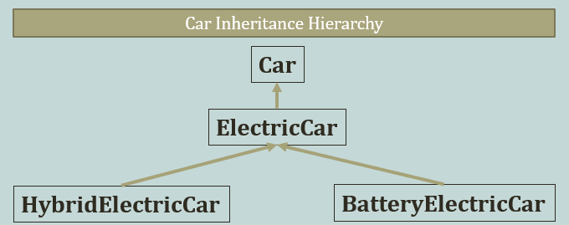
Why Use Polymorphism
The benefits of polymorphism are that we can use a base class to represent different types of related objects
If we followed through on the Car inheritance hierarchy shown previously
and created the HybridElectricCar and BatterElectricCar subclasses, we could use a single ElectricCar variable to represent either subclass at various times in a program
More importantly, we could declare a Car parameter in a function and pass instances of either subclass to that function

Slide 41
Garbage Collection in Python
As with languages like Java and C#, Python manages its own memory by implementing garbage collection.
A reference count to each object is maintained
When the count goes to 0, the object is deallocated
Python will periodically check for reference cycles (circular references) where 2 objects exclusively refer to each other, in which case both are deallocated even though the reference count is not 0
The algorithm uses heuristics by assigning objects to "generations" (relative to their age). Older objects are less likely to need garbage collection so they are not checked as often as younger generation objects.

Slide 42
Design a class named Customer which contains 3 private members:
name (first name/lastname e.g. "John Smith")
street address (e.g. 1 Oak St.)
creation date (date/timestamp when an object is created)
include a constructor / initializer, and accessors and mutators (with decorators)
Note: the creation date should not include a mutator, it is a read-only attribute that is set once in the constructor and can only be accessed using an accessor from that point
Creation date accessor returns a formatted datetime string
Write a program which uses your Customer class to create two customers and print their member values
John Smith, 1 Oak St., 2017-06-21 21:34:23.525175
Sally Brown, 3 Elm St., 2017-06-21 21:34:23.525175

Slide 43
# customer.py
# represents a Customer class
import datetime
from datetime import datetime
class Customer:
# constructor
def __init__(self, name, strAddr):
self.__name = name
self.__strAddr = strAddr
self.__creationDate = datetime.now()

Slide 44
# accessor/mutator for name
@property
def name(self):
# print("in name getter") # debug
return self.__name
@name.setter
def name(self, name):
# print("in name setter, param=" + name) # debug
self.__name = name

Slide 46
# accessor/mutator for strAddr
@property
def strAddr(self):
# print("in strAddr getter") # debug
return self.__strAddr
@strAddr.setter
def strAddr(self, strAddr):
# print("in strAddr, param=" + strAddr) # debug
self.__strAddr = strAddr
# accessor (no mutator) for creationDate
@property
def creationDate(self):
return self.__creationDate

Slide 47
# customer_list.py
from customer import Customer
# create and print two customers
cust1 = Customer("John Smith", "1 Oak St.")
cust2 = Customer("Sally Brown", "3 Elm St.")
print(cust1.name + ", " + cust1.strAddr + ", " + str(cust1.creationDate))
print(cust2.name + ", " + cust2.strAddr + ", " + str(cust2.creationDate))

