Slide 1

Forecasting Climate Change
Examining Your Carbon Footprint
OTTA-206 Lecture Content
Notes:
Information in this slide deck was primarily resourced from: McGuire, B. “Hothouse Earth: An Inhabitant’s Guide” Icon Books, Ltd. UK (2022)
This project is made possible with funding by the Government of Ontario and through eCampusOntario’s support of the Virtual Learning Strategy. To learn more about the Virtual Learning Strategy visit: https://vls.ecampusontario.ca

Slide 2
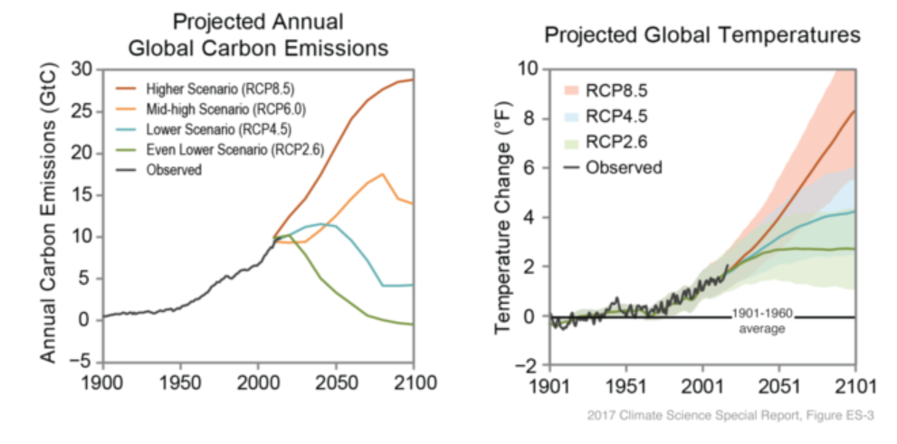
Anthropogenic Climate Change
Due to the impact caused by human activities there is a projected change in the mean global temperature and this will have drastic changes on the way life on earth is experienced.
Notes:
USGCRP, 2017: Climate Science Special Report: Fourth National Climate Assessment, Volume I [Wuebbles, D.J., D.W. Fahey, K.A. Hibbard, D.J. Dokken, B.C. Stewart, and T.K. Maycock (eds.)]. U.S. Global Change Research Program, Washington, DC, USA, 470 pp, doi: 10.7930/J0J964J6.

Slide 3
An easy metric to ‘Sea’
One impact of this increase in global mean temperature is the impact it has on the forming and melting of global ice reserves.
Over the course of the 20th century the global sea level climbed by approximately 20cm.
Traditionally we have measured and tracked the overall heigh using tidal gauges. Nowadays we can do these measurements globally using satellites to confirm these patterns.

Slide 4
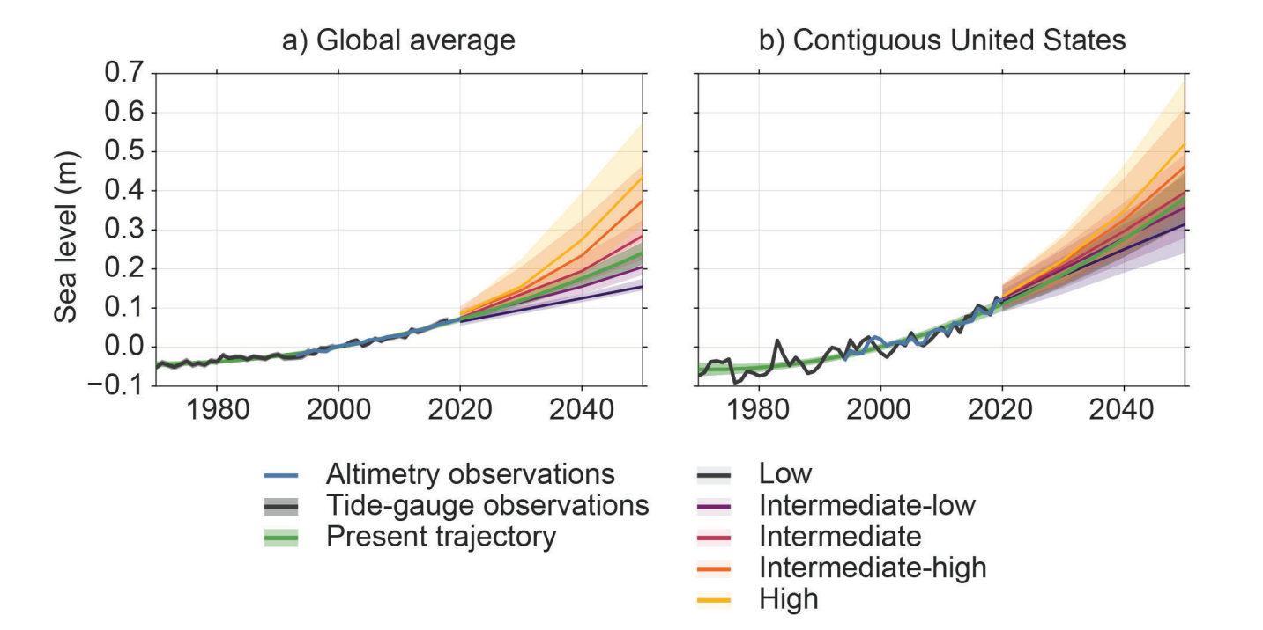
Sea Level Rise
Notes:
Title : Global and regional sea level rise scenarios for the United States
Personal Author(s) : Sweet, William (William VanderVeer);Kopp, Robert, E.;Weaver, Christopher P.;Obeysekera, J. T. B.;Horton, Radley M.;Thieler, E. Robert (Edward Robert), 1965-;Zervas, Chris Eugene, 1957-;
Corporate Authors(s) : Center for Operational Oceanographic Products and Services (U.S.)
Published Date : 2017
Series : NOAA technical report NOS CO-OPS ; 83
DOI : https://doi.org/10.7289/v5/tr-nos-coops-083

Slide 5
Varying the Impact
Associating the impact one individual causes on overall climate change is a difficult calculation.
Instead, we are assuming ‘what if everyone in the world acted as I do’
There is a Carbon Footprint feature that correlates your actions to the temperature rise
Indicating ‘1’ represents the 1.5 ° C rise while indicating ‘5’ represents the full 5°C scenario.

Slide 6
Let’s see how it impacts us!
Open the Forecasting Climate Change App (FoCl) to experience how the sea-level rise will impact your location!
Think about your actions, are you aware of your actions? Indicate what you think your impact is using the Carbon Footprint estimate.
Notes:
Image from https://thisclimatedoesnotexist.com/home

Slide 7

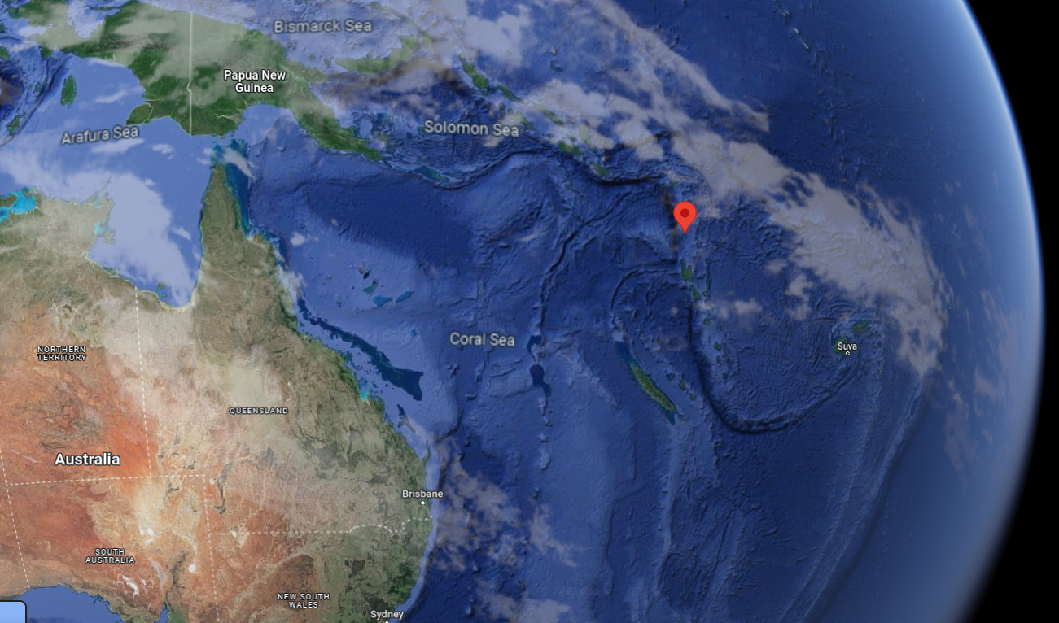
Sea Level Impact is Already Being Experienced
In 2005 residents of Tegua had to abandon their coastal villages
Notes:
Additional Resources available in: https://www.nab.vu/sites/default/files/documents/usp-adaptive-capacity-vanuatu.pdf

Slide 8

Ongoing Impact
Other Pacific islands face similar threats:
The Marshall Islands
The Solomon Islands
Tuvalu
The average height of land in the Maldives, an archipelago of 1100 islands is only 1.2m above sea level
In Bangladesh, a 65cm sea-level rise by 2080 would remove half of the arable land in the south of the country

Slide 9
I feel horrible for the fate of these people.
Do you?
How do they feel?
How do you know what they feel?
Do they know what is happening?

Slide 10
Measuring Global Empathy - #ClimateByFoCl
When using the app we measure people’s feelings towards climate change before having the experience and after.
The measurements before and after the experience should show the difference in empathy towards this particular effect of climate change.
We are tracking people’s exposure to this experience around the world and will be showcasing the results at https://xrniverse.design/focl
If you took a screenshot of your experience and want to relate your feelings in more detail be sure to post it to social media with the hashtag #ClimateByFoCl

Slide 11
Carbon Footprint
The carbon footprint in the app correlates the averaged impact of three metrics:
Transport – the ways we choose to travel impacts our carbon emissions – try to find some metrics online for how these modes of transit differ.
Food – the food choices we make have implications as well; meat consumption has a dramatic effect, and depends on the conditions of production
Electricity – we are converting to an electric future as we shift from fossil fuels. Do you know what your mix is?

Slide 12
My Impact
As a class construct a new ‘Carbon Footprint’ measurement using the three scales provided in the app.
Map your scale to the given 1-5 slider bar to estimate how each of these factors may contribute to how your group thinks these sectors contribute to climate change.
Be sure to explain how each one is compared – is it emissions of production? Use? Disposal? Try to calculate relatively how this will correlate with the 1.5°C to 5°C temperature rise scientifically as a class.

Slide 13
Measure!
Now that you have a scale developed, pair up and take turns instruct your classmates when they use the app to respond to the mapping you created.
Did they have a different conception of what mattered most for Carbon Footprint assessment?
Does it change the experience?

