Slide 1
CS 4379V Lecture 7 Spring 2023 Greg Lakomski
Comp Coding 2 Feb 10 2024

Slide 2
Agenda for today
How to understand linear DP problems

Slide 3
C++ Thing
How does c++ do substrings?
with std::substr of course
std::string s = “uiweruyew”
s.substr(3,4);
std::cout << s.substr(3,4);

Slide 4
Linear Problems
These kind of problems can be solved in O(n) time and are normally associated with sets fo things, vectors, linear arrays, so on.
Think walking pointer kind of problems
Tactically, the examples you are given are often chosen to lead you to conclusions that are false
Edge cases
Limits
Single values, repeated values, +/-

Slide 5
53. Maximum Subarray
53. Maximum Subarray
Given an integer array nums, find the subarray with the largest sum, and return its sum.
Example 1:
Input: nums = [-2,1,-3,4,-1,2,1,-5,4]
Output: 6
Explanation: The subarray [4,-1,2,1] has the largest sum 6.
Example 2:
Input: nums = [1]
Output: 1
Explanation: The subarray [1] has the largest sum 1.
Example 3:
Input: nums = [5,4,-1,7,8]
Output: 23
Explanation: The subarray [5,4,-1,7,8] has the largest sum 23.
Constraints:
1 <= nums.length <= 10⁵
-10⁴ <= nums[i] <= 1
Linear DP

Slide 6
53. Maximum Subarray
53. Maximum Subarray
[-2,1,-3,4,-1,2,1,-5,4]
Brute Force:
Do every possible subarray and choose smallest
-2,-2+1,….
1,1+-3,1+-3+4 ……
-3, -3+4,….
Then pick the biggest
n + n-1 + n-2 ……
O(n ²)
Linear DP

Slide 7
53. Maximum Subarray
Input: nums = [2,1,3,4,1,2,1,5,4]
Output = ?
Input: nums = [1,-1,1,-1,1,-1,1,-1,1]
Output = ?
Input: nums = [1,-1,2,-2,3,-3,4,-4,]
Output = ?
Input: nums = [1,1,2,2,-7,3,3,4,4,]
Output = ?
Input: nums = [1,1,-3,2,2,-7,3,3,-5,4,4,]

Slide 8
53. Maximum Subarray
Input: nums = [2, 1, -3, 3, 4, 1, -2, 1, -5, 4]
Output = sum of all the numbers, the negative numbers are what is important
[x,x,x,x,x,x,x,x,x,x]
[2] obviously [2]
[2,x,x,x,x,x,x,x,x,x]
[2,1] is either 2 or 2+1 so is 3
[2,3,x,x,x,x,x,x,x,x]
[2,1,-3] is either 3 which is best of first 2 numbers or 0 obviously including -3 bad so is 3
[2,3,3,x,x,x,x,x,x,x]
[2,1,-3,3] is either 3 which is best of first 3 numbers or 6 is 6
[2,3,3,3,x,x,x,x,x,x]
[2,1,-3,3,4,1,-2,1,-5,4]
[2,3,3,3,7,8,6,7,2,6]
…..
[2,3,3,6,10,11,11,12,12,16] so max is all numbers
Input: nums = [-2,1,-3,4,-1,2,1,-5,4]

Slide 9
53. Maximum Subarray
Input: nums = [-2, 1, -3, 4, -1, 2, 1, -5, 4]
Output = sum of all the numbers, the negative numbers are what is important
[x,x,x,x,x,x,x,x,x,x]
[-2] obviously [-2]
[-2,x,x,x,x,x,x,x,x,x]
[-2,1] is either -2 or -2+1 so is -1
[-2,-1,x,x,x,x,x,x,x,x]
[-2,1,-3] is either -1 which is best of first 2 numbers or -4
[-2,-1,-1,x,x,x,x,x,x,x]
[-2,1,-3,4] is either -1 which is best of first 3 numbers or 3 is 3
[-2,-1,-1,3,x,x,x,x,x,x]
…..
[-2,-1,-1,3,3,5,8,3,7]
so max is [-2, 1, -3, 4, -1, 2, 1-5,4] = 8

Slide 10
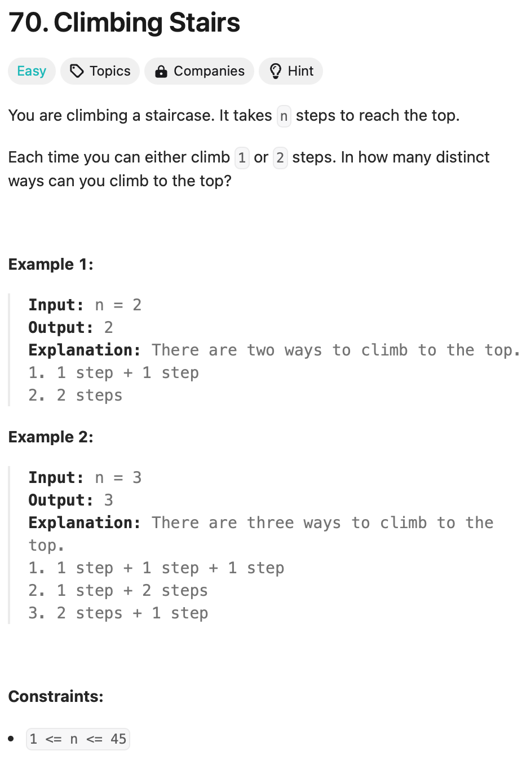
n steps
1 step or 2 steps at a time
number of distinct ways
n even, n odd
n = 1
n = 0
n=3
1+1+1
2+1
1+2
3 ways
n = 4
1+1+1+1
1+1+2
2+1+1
2+2
1+2+1
4 ways
Well lets jump to conclusions shall we!

Slide 11
n steps
1 step or 2 steps at a time
number of distinct ways
n even, n odd
n = 1
n = 0
n=1
ways using 1 step = 1
ways using 2 steps = 0
n = 2 all the ways we got to 1 using 1step
ways got to 1 using 2 steps // zero
1+1
0+2
total 2 ways
Whats the pattern?
n= 3
2 ways to get to step 2
1 way to get to step 1
total 3 ways to get to step 3
1+2
2+1
1+1=1
n = 4
3 ways to get to step 3
2 ways to get to step 2
total 5
2 +1 +1
1 + 2 + 1
1 + 1 + 1+ 1
2 + 2
1+1+2
n = 5
5 ways to get to step 4
3 ways to get to step 3
total 8 ways to get to step 5
2 +1 +1 +1
1 + 2 + 1+1
1 + 1 + 1+ 1+1
2 + 2+1
1+1+2+1
1+1+1+2
1+2+2
2+1+2
n = 6
8 ways to get to step 5
5 ways to get to step 4
total 13 ways to get to step 6

Slide 12
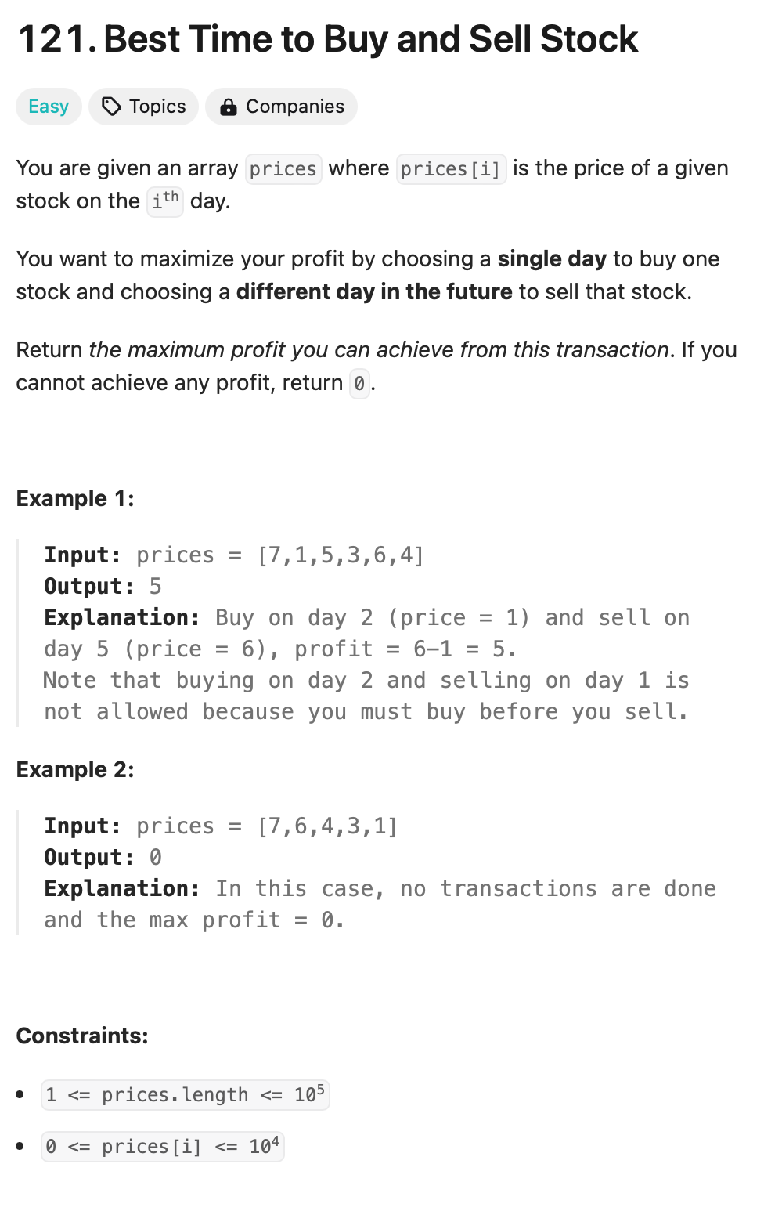
what are goals
find smallest buy price and biggest sell price
always test for smaller buy price
buy and sell same day = 0 so not valid trade
So check next day. If price is less than current low price we reset the low price
If next day is bigger than current best low price, then record best high price and best profit
repeat while not end of vector
check next day. If price is less than current low price we reset the low price
If next day is bigger than current best low price, then record best high price and best profit
7,4,3,7,1,2,1
0,0,0,4,2,1,0
3,3,1,

Slide 13
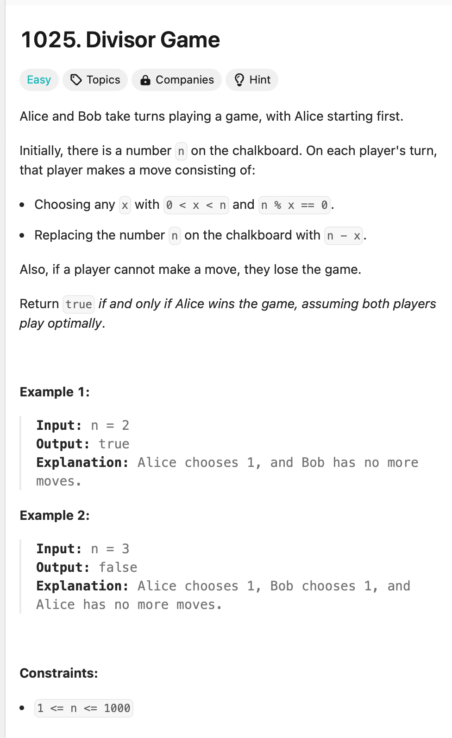

Slide 14
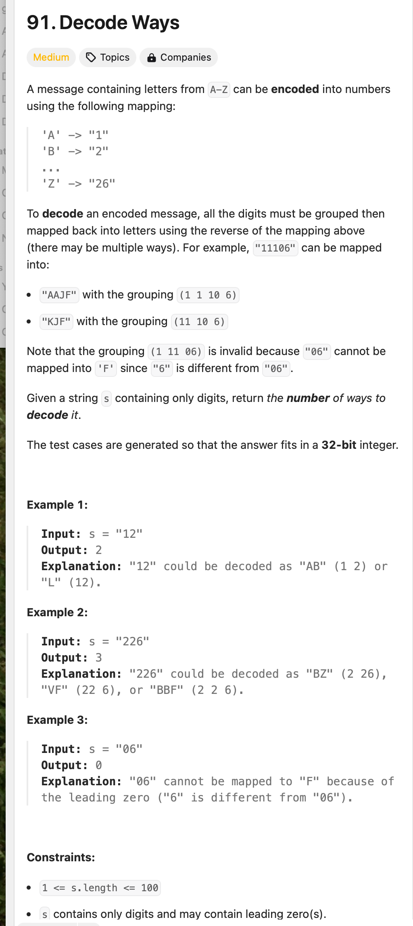
Observations:
the maximum length of the code is two characters
so it sort of looks like stair climb with - find all the ways to climb the stair case – sort of like but not really I guess
have an input string of numbers input
what are the edge cases?
numbers are 1<= n <= 26 zero is bad
a “0” cannot be decoded and only “10” anad “20” can be decoded so if input[i] = 0, then input[i-1] must be a 1 or 2
The first number cannot be a zero
input = 0245 is not decodable
input = 9045 is not decodable
input = 99999999 How many ways?
input = 34567898 How many ways?
Whats special about these?
So if you decode a number >2 it does not change the number of ways
If you can decode input[i-1:i] ( i-1 == 1 or 2) then this increases the ways
So assuming that if we find a 0 we just quit, we start with ways = 1
the only time we increase ways is if we decode 2 digit
6666626992626
for first 5 sixes only 1 way, when we get to the 2 its also only one way but the next 6 is 6 and 26 so we add another way so we now have 2 ways
when we get the last 26 the 6 by itself doesn’t add another way but the 26 does
6,6,6,6,6,2,6,9,9,2,6,2,6
6,6,6,6,6,26,9,9,2,6,,2,6 2
6,6,6,6,6,2,6,9,9,26,26 +1
6,6,6,6,6,26,9,9,26,2,6 +1
So we store the current ways (the DP part)
Keys: must use all the numbers – not a combinatorial problem
recognize and deal with “0”

