Slide 1

Let’s solve it

Slide 2






































































Slide 3





































Slide 4


























































Slide 5




























Slide 6



































































Slide 7





































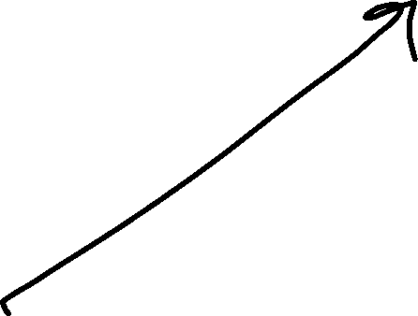










Slide 8




































Slide 9
































Slide 10






































Slide 11

































Slide 12



































































Slide 13




























Slide 14





















