Slide 1

Let’s solve it

Slide 2






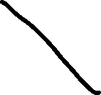


















Slide 3





































































Slide 4















































Slide 5



































































