Slide 1
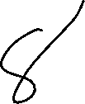
Let’s solve it

Slide 2














































Slide 3





























Slide 4




























The input string stops at white
space or at the maximum field width, whichever
occurs first.

Slide 5





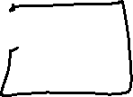



























































Slide 6


































To skip white space first, use an explicit space
in the format.

Slide 7
















