Slide 1
Introduction to MPI
Slides Available at http://www.mcs.anl.gov/~balaji/permalinks/argonne14_mpi.php
Rajeev Thakur
Argonne National Laboratory
Email: thakur@mcs.anl.gov
Web: http://www.mcs.anl.gov/~thakur
Pavan Balaji
Argonne National Laboratory
Email: balaji@anl.gov
Web: http://www.mcs.anl.gov/~balaji
Ken Raffenetti
Argonne National Laboratory
Email: raffenet@mcs.anl.gov
Web: http://www.mcs.anl.gov/~raffenet
Wesley Bland
Argonne National Laboratory
Email: wbland@mcs.anl.gov
Web: http://www.mcs.anl.gov/~wbland
Xin Zhao
University of Illinois, Urbana-Champaign
Email: xinzhao3@illinois.edu
Web: http://web.engr.illinois.edu/~xinzhao3

Slide 2
About the Speakers
Rajeev Thakur: Deputy Division Director, MCS, Argonne
Chaired the RMA working group for MPI-3
Pavan Balaji: Computer Scientist, MCS, Argonne
Group Lead: programming models and runtime systems
Lead the MPICH implementation of MPI
Chair the Hybrid working group for MPI-3 and MPI-4
Ken Raffenetti: Software Developer, MCS, Argonne
Actively participates in the fault tolerance working group for MPI-4
Wesley Bland: Postdoctoral Researcher, MCS, Argonne
Co-chairs the fault tolerance working group for MPI-4
Xin Zhao: Ph.D. student at University of Illinois, Urbana-Champaign
Ph.D. on MPI RMA and Active Messages
We are deeply involved in MPI standardization (in the MPI Forum) and in MPI implementation

Slide 3
About You
178 registered attendees
Argonne | 73
Northwestern | 42
UChicago | 17
UIUC | 16
NIU | 12
UIC | 10
IIT | 2
Loyola Univ | 2
Univ of Iowa | 1
Cornell | 1
VasSol, Inc. | 1
Ziena Opt. | 1

Slide 4
General principles in this tutorial
Everything is practically oriented
We will use lots of real example code to illustrate concepts
At the end, you should be able to use what you have learned and write real code, run real programs
Feel free to interrupt and ask questions
If our pace is too fast or two slow, let us know

Slide 5
What we will cover in this tutorial
What is MPI?
How to write a simple program in MPI
Running your application with MPICH
Slightly more advanced topics:
Non-blocking communication in MPI
Group (collective) communication in MPI
MPI Datatypes
Conclusions and Final Q/A

Slide 6
The switch from sequential to parallel computing
Moore’s law continues to be true, but…
Processor speeds no longer double every 18-24 months
Number of processing units double, instead
Multi-core chips (dual-core, quad-core)
No more automatic increase in speed for software
Parallelism is the norm
Lots of processors connected over a network and coordinating to solve large problems
Used every where!
By USPS for tracking and minimizing fuel routes
By automobile companies for car crash simulations
By airline industry to build newer models of flights

Slide 7
Sample Parallel Programming Models
Shared Memory Programming
Processes share memory address space (threads model)
Application ensures no data corruption (Lock/Unlock)
Transparent Parallelization
Compiler works magic on sequential programs
Directive-based Parallelization
Compiler needs help (e.g., OpenMP)
Message Passing
Explicit communication between processes (like sending and receiving emails)

Slide 8
The Message-Passing Model
A process is (traditionally) a program counter and address space.
Processes may have multiple threads (program counters and associated stacks) sharing a single address space. MPI is for communication among processes, which have separate address spaces.
Inter-process communication consists of
synchronization
movement of data from one process’s address space to another’s.
Process
MPI
Process
MPI

Slide 9
The Message-Passing Model (an example)
Each process has to send/receive data to/from other processes
Example: Sorting Integers
Process1
O(N log N)
8
23
19
67
45
35
1
24
13
30
3
5
Process1
Process2
8
19
23
35
45
67
1
3
5
13
24
30
O(N/2 log N/2)
O(N/2 log N/2)
1
3
5
8
13
19
23
24
30
35
45
67
O(N)
Process1

Slide 10
Standardizing Message-Passing Models with MPI
Early vendor systems (Intel’s NX, IBM’s EUI, TMC’s CMMD) were not portable (or very capable)
Early portable systems (PVM, p4, TCGMSG, Chameleon) were mainly research efforts
Did not address the full spectrum of message-passing issues
Lacked vendor support
Were not implemented at the most efficient level
The MPI Forum was a collection of vendors, portability writers and users that wanted to standardize all these efforts

Slide 11
What is MPI?
MPI: Message Passing Interface
The MPI Forum organized in 1992 with broad participation by:
Vendors: IBM, Intel, TMC, SGI, Convex, Meiko
Portability library writers: PVM, p4
Users: application scientists and library writers
MPI-1 finished in 18 months
Incorporates the best ideas in a “standard” way
Each function takes fixed arguments
Each function has fixed semantics
Standardizes what the MPI implementation provides and what the application can and cannot expect
Each system can implement it differently as long as the semantics match
MPI is not…
a language or compiler specification
a specific implementation or product

Slide 12
MPI-1
MPI-1 supports the classical message-passing programming model: basic point-to-point communication, collectives, datatypes, etc
MPI-1 was defined (1994) by a broadly based group of parallel computer vendors, computer scientists, and applications developers.
2-year intensive process
Implementations appeared quickly and now MPI is taken for granted as vendor-supported software on any parallel machine.
Free, portable implementations exist for clusters and other environments (MPICH, Open MPI)
12

Slide 13
Following MPI Standards
MPI-2 was released in 1997
Several additional features including MPI + threads, MPI-I/O, remote memory access functionality and many others
MPI-2.1 (2008) and MPI-2.2 (2009) were recently released with some corrections to the standard and small features
MPI-3 (2012) added several new features to MPI
The Standard itself:
at http://www.mpi-forum.org
All MPI official releases, in both postscript and HTML
Other information on Web:
at http://www.mcs.anl.gov/mpi
pointers to lots of material including tutorials, a FAQ, other MPI pages

Slide 14
MPI-2
Same process of definition by MPI Forum
MPI-2 is an extension of MPI
Extends the message-passing model.
Parallel I/O
Remote memory operations (one-sided)
Dynamic process management
Adds other functionality
C++ and Fortran 90 bindings
similar to original C and Fortran-77 bindings
External interfaces
Language interoperability
MPI interaction with threads
14

Slide 15
Overview of New Features in MPI-3
Major new features
Nonblocking collectives
Neighborhood collectives
Improved one-sided communication interface
Tools interface
Fortran 2008 bindings
Other new features
Matching Probe and Recv for thread-safe probe and receive
Noncollective communicator creation function
“const” correct C bindings
Comm_split_type function
Nonblocking Comm_dup
Type_create_hindexed_block function
C++ bindings removed
Previously deprecated functions removed

Slide 16
Status of MPI-3 Implementations
 | MPICH | MVAPICH | Open MPI | Cray MPI | Tianhe MPI | Intel MPI | IBM BG/Q MPI ¹ | IBM PE MPICH ² | IBM Platform | SGI MPI | Fujitsu MPI | Microsoft MPI
NB collectives | ✔ | ✔ | ✔ | ✔ | ✔ | ✔ | ✔ | Q4 ‘14 | ✔ | ✔
Neighborhood collectives | ✔ | ✔ | ✔ | ✔ | ✔ | ✔ | ✔ | Q4 ‘14 | Q3 ‘15
RMA | ✔ | ✔ | ✔ | ✔ | ✔ | ✔ | ✔ | Q4 ‘14 | Q3 ‘15
Shared memory | ✔ | ✔ | ✔ | ✔ | ✔ | ✔ | ✔ | Q4 ‘14 | Q3 ‘15
Tools Interface | ✔ | ✔ | ✔ |  |  |  | (✔) | Q4 ‘14 | Q3 ‘15
Non-collective comm. create | ✔ | ✔ | ✔ | ✔ | ✔ | ✔ | ✔ | Q4 ‘14 | Q3 ‘15 | ✔
F08 Bindings | ✔ |  | ✔ |  |  |  | ✔ | Q4 ‘14 | Q3 ‘15
New Datatypes | ✔ | ✔ | ✔ | ✔ | ✔ | ✔ | ✔ | Q4 ‘14 | Q3 ‘15 | ✔
Large Counts | ✔ | ✔ | ✔ | ✔ | ✔ | ✔ | ✔ | Q4 ‘14 | Q3 ‘15
Matched Probe | ✔ | ✔ | ✔ | ✔ | ✔ | ✔ | ✔ | Q4 ‘14 | Q3 ‘15 | ✔
Release dates are estimates and are subject to change at any time.
Empty cells indicate no publicly announced plan to implement/support that feature.
¹ Open source, but unsupported ² Beta release

Slide 17
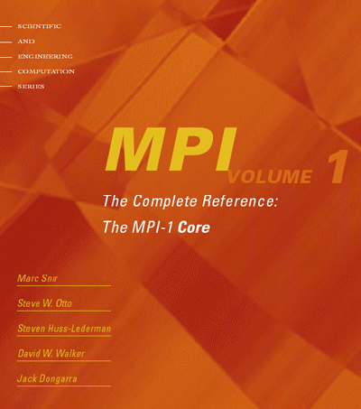
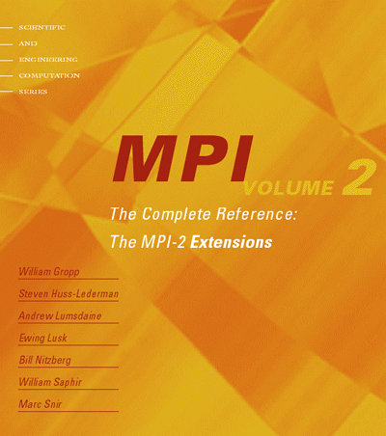
The MPI Standard (1 & 2)

Slide 18
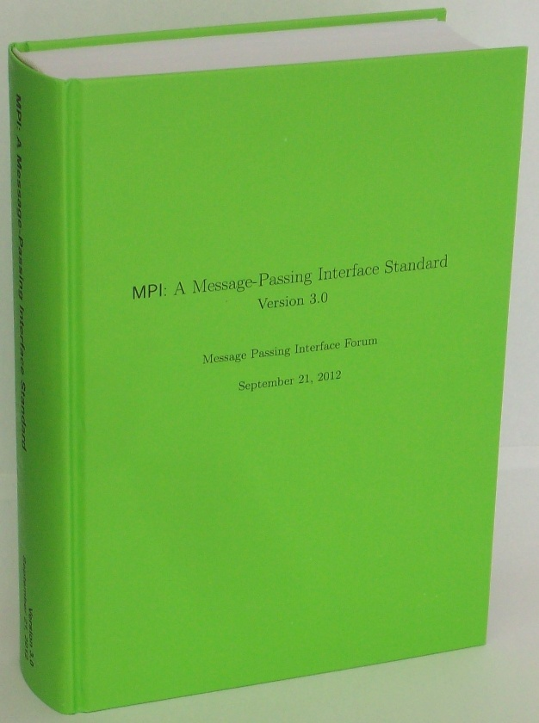
Latest MPI 3.0 Standard in Book Form
Available from amazon.com
http://www.amazon.com/dp/B002TM5BQK/

Slide 19
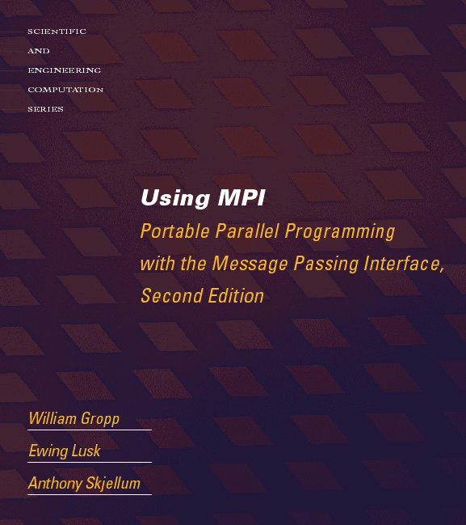
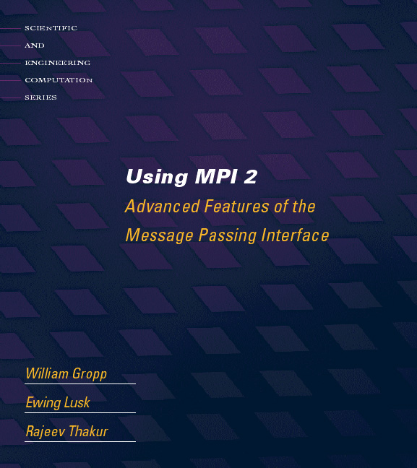
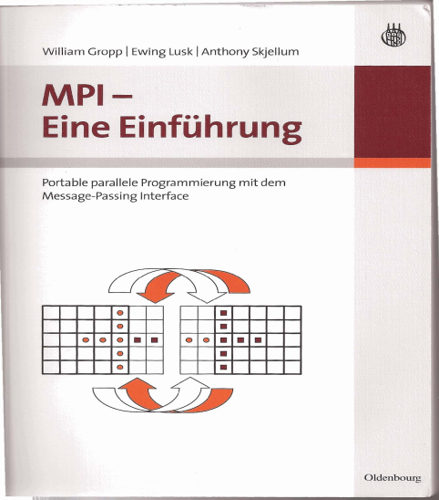

Tutorial Material on MPI-1, MPI-2
http://www.mcs.anl.gov/mpi/{usingmpi,usingmpi2}
19

Slide 20
Applications (Science and Engineering)
MPI is widely used in large scale parallel applications in science and engineering
Atmosphere, Earth, Environment
Physics - applied, nuclear, particle, condensed matter, high pressure, fusion, photonics
Bioscience, Biotechnology, Genetics
Chemistry, Molecular Sciences
Geology, Seismology
Mechanical Engineering - from prosthetics to spacecraft
Electrical Engineering, Circuit Design, Microelectronics
Computer Science, Mathematics

Slide 21


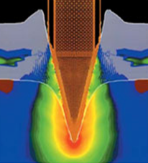
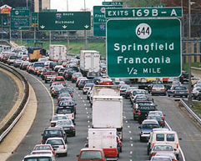

Turbo machinery (Gas turbine/compressor)
Biology application
Transportation & traffic application
Drilling application
Astrophysics application
21

Slide 22
Reasons for Using MPI
Standardization - MPI is the only message passing library which can be considered a standard. It is supported on virtually all HPC platforms. Practically, it has replaced all previous message passing libraries
Portability - There is no need to modify your source code when you port your application to a different platform that supports (and is compliant with) the MPI standard
Performance Opportunities - Vendor implementations should be able to exploit native hardware features to optimize performance
Functionality – Rich set of features
Availability - A variety of implementations are available, both vendor and public domain
MPICH is a popular open-source and free implementation of MPI
Vendors and other collaborators take MPICH and add support for their systems
Intel MPI, IBM Blue Gene MPI, Cray MPI, Microsoft MPI, MVAPICH, MPICH-MX

Slide 23
Important considerations while using MPI
All parallelism is explicit: the programmer is responsible for correctly identifying parallelism and implementing parallel algorithms using MPI constructs

Slide 24
What we will cover in this tutorial
What is MPI?
How to write a simple program in MPI
Running your application with MPICH
Slightly more advanced topics:
Non-blocking communication in MPI
Group (collective) communication in MPI
MPI Datatypes
Conclusions and Final Q/A

Slide 25
MPI Basic Send/Receive
Simple communication model
Application needs to specify to the MPI implementation:
How do you compile and run an MPI application?
How will processes be identified?
How will “data” be described?
Process 0
Process 1
Send(data)
Receive(data)

Slide 26
Compiling and Running MPI applications (more details later)
MPI is a library
Applications can be written in C, C++ or Fortran and appropriate calls to MPI can be added where required
Compilation:
Regular applications:
gcc test.c -o test
MPI applications
mpicc test.c -o test
Execution:
Regular applications
./test
MPI applications (running with 16 processes)
mpiexec –n 16 ./test

Slide 27
Process Identification
MPI processes can be collected into groups
Each group can have multiple colors (some times called context)
Group + color == communicator (it is like a name for the group)
When an MPI application starts, the group of all processes is initially given a predefined name called MPI_COMM_WORLD
The same group can have many names, but simple programs do not have to worry about multiple names
A process is identified by a unique number within each communicator, called rank
For two different communicators, the same process can have two different ranks: so the meaning of a “rank” is only defined when you specify the communicator

Slide 28
Communicators
mpiexec -n 16 ./test
When you start an MPI program, there is one predefined communicator MPI_COMM_WORLD
Communicators do not need to contain all processes in the system
0
1
0
1
2
2
3
3
Every process in a communicator has an ID called as “rank”
4
5
Can make copies of this communicator (same group of processes, but different “aliases”)
4
6
5
7
6
7
The same process might have different ranks in different communicators
Communicators can be created “by hand” or using tools provided by MPI (not discussed in this tutorial)
Simple programs typically only use the predefined communicator MPI_COMM_WORLD

Slide 29
Simple MPI Program Identifying Processes
#include <mpi.h>
#include <stdio.h>
int main(int argc, char ** argv)
{
int rank, size;
MPI_Init(&argc, &argv);
MPI_Comm_rank(MPI_COMM_WORLD, &rank);
MPI_Comm_size(MPI_COMM_WORLD, &size);
printf("I am %d of %d\n", rank + 1, size);
MPI_Finalize();
return 0;
}
Basic requirements for an MPI program
Notes:
See hello.c in examples/ folder

Slide 30
Code Example
intro-hello.c

Slide 31
Data Communication
Data communication in MPI is like email exchange
One process sends a copy of the data to another process (or a group of processes), and the other process receives it
Communication requires the following information:
Sender has to know:
Whom to send the data to (receiver’s process rank)
What kind of data to send (100 integers or 200 characters, etc)
A user-defined “tag” for the message (think of it as an email subject; allows the receiver to understand what type of data is being received)
Receiver “might” have to know:
Who is sending the data (OK if the receiver does not know; in this case sender rank will be MPI_ANY_SOURCE, meaning anyone can send)
What kind of data is being received (partial information is OK: I might receive up to 1000 integers)
What the user-defined “tag” of the message is (OK if the receiver does not know; in this case tag will be MPI_ANY_TAG)

Slide 32
More Details on Describing Data for Communication
MPI Datatype is very similar to a C or Fortran datatype
int → MPI_INT
double → MPI_DOUBLE
char → MPI_CHAR
More complex datatypes are also possible:
E.g., you can create a structure datatype that comprises of other datatypes → a char, an int and a double.
Or, a vector datatype for the columns of a matrix
The “count” in MPI_SEND and MPI_RECV refers to how many datatype elements should be communicated

Slide 33
MPI Basic (Blocking) Send
MPI_SEND(buf, count, datatype, dest, tag, comm)
The message buffer is described by (buf, count, datatype).
The target process is specified by dest and comm.
dest is the rank of the target process in the communicator specified by comm.
tag is a user-defined “type” for the message
When this function returns, the data has been delivered to the system and the buffer can be reused.
The message may not have been received by the target process.

Slide 34
MPI Basic (Blocking) Receive
MPI_RECV(buf, count, datatype, source, tag, comm, status)
Waits until a matching (on source, tag, comm) message is received from the system, and the buffer can be used.
source is rank in communicator comm, or MPI_ANY_SOURCE.
Receiving fewer than count occurrences of datatype is OK, but receiving more is an error.
status contains further information:
Who sent the message (can be used if you used MPI_ANY_SOURCE)
How much data was actually received
What tag was used with the message (can be used if you used MPI_ANY_TAG)
MPI_STATUS_IGNORE can be used if we don’t need any additional information

Slide 35
Simple Communication in MPI
#include <mpi.h>
#include <stdio.h>
int main(int argc, char ** argv)
{
int rank, data[100];
MPI_Init(&argc, &argv);
MPI_Comm_rank(MPI_COMM_WORLD, &rank);
if (rank == 0)
MPI_Send(data, 100, MPI_INT, 1, 0, MPI_COMM_WORLD);
else if (rank == 1)
MPI_Recv(data, 100, MPI_INT, 0, 0, MPI_COMM_WORLD,
MPI_STATUS_IGNORE);
MPI_Finalize();
return 0;
}

Slide 36
Code Example
intro-sendrecv.c

Slide 37
Parallel Sort using MPI Send/Recv
Rank 0
8
23
19
67
45
35
1
24
13
30
3
5
O(N log N)
Rank 0
Rank 1
8
19
23
35
45
67
1
3
5
13
24
30
O(N/2 log N/2)
Rank 0
8
19
23
35
45
67
1
3
5
13
24
30
O(N)
Rank 0
1
3
5
8
13
19
23
24
30
35
45
67

Slide 38
Parallel Sort using MPI Send/Recv (contd.)
#include <mpi.h>
#include <stdio.h>
int main(int argc, char ** argv)
{
int rank, a[1000], b[500];
MPI_Init(&argc, &argv);
MPI_Comm_rank(MPI_COMM_WORLD, &rank);
if (rank == 0) {
MPI_Send(&a[500], 500, MPI_INT, 1, 0, MPI_COMM_WORLD);
sort(a, 500);
MPI_Recv(b, 500, MPI_INT, 1, 0, MPI_COMM_WORLD,
MPI_STATUS_IGNORE);
/* Serial: Merge array b and sorted part of array a */
}
else if (rank == 1) {
MPI_Recv(b, 500, MPI_INT, 0, 0, MPI_COMM_WORLD,
MPI_STATUS_IGNORE);
sort(b, 500);
MPI_Send(b, 500, MPI_INT, 0, 0, MPI_COMM_WORLD);
}
MPI_Finalize(); return 0;
}

Slide 39
Status Object
The status object is used after completion of a receive to find the actual length, source, and tag of a message
Status object is MPI-defined type and provides information about:
The source process for the message (status.MPI_SOURCE)
The message tag (status.MPI_TAG)
Error status (status.MPI_ERROR)
The number of elements received is given by:
MPI_Get_count(MPI_Status *status, MPI_Datatype datatype, int *count)
status return status of receive operation (status) datatype datatype of each receive buffer element (handle)
count number of received elements (integer)(OUT)

Slide 40
Using the “status” field
Task 1
Task 2
Each “worker process” computes some task (maximum 100 elements) and sends it to the “master” process together with its group number: the “tag” field can be used to represent the task
Data count is not fixed (maximum 100 elements)
Order in which workers send output to master is not fixed (different workers = different source ranks, and different tasks = different tags)

Slide 41
Using the “status” field (contd.)
#include <mpi.h>
#include <stdio.h>
int main(int argc, char ** argv)
{
[...snip...]
if (rank != 0) /* worker process */
MPI_Send(data, rand() % 100, MPI_INT, 0, group_id,
MPI_COMM_WORLD);
else { /* master process */
for (i = 0; i < size – 1; i++) {
MPI_Recv(data, 100, MPI_INT, MPI_ANY_SOURCE,
MPI_ANY_TAG, MPI_COMM_WORLD, &status);
MPI_Get_count(&status, MPI_INT, &count);
printf(“worker ID: %d; task ID: %d; count: %d\n”,
status.MPI_SOURCE, status.MPI_TAG, count);
}
}
[...snip...]
}

Slide 42
MPI is Simple
Many parallel programs can be written using just these six functions, only two of which are non-trivial:
MPI_INIT – initialize the MPI library (must be the first routine called)
MPI_COMM_SIZE - get the size of a communicator
MPI_COMM_RANK – get the rank of the calling process in the communicator
MPI_SEND – send a message to another process
MPI_RECV – send a message to another process
MPI_FINALIZE – clean up all MPI state (must be the last MPI function called by a process)
For performance, however, you need to use other MPI features

Slide 43
What we will cover in this tutorial
What is MPI?
How to write a simple program in MPI
Running your application with MPICH
Slightly more advanced topics:
Non-blocking communication in MPI
Group (collective) communication in MPI
MPI Datatypes
Conclusions and Final Q/A

Slide 44
What is MPICH
MPICH is a high-performance and widely portable open-source implementation of MPI
It provides all features of MPI that have been defined so far (including MPI-1, MPI-2.0, MPI-2.1, MPI-2.2, and MPI-3.0)
Active development lead by Argonne National Laboratory and University of Illinois at Urbana-Champaign
Several close collaborators who contribute many features, bug fixes, testing for quality assurance, etc.
IBM, Microsoft, Cray, Intel, Ohio State University, Queen’s University, Myricom and many others
Current release is MPICH-3.1.1

Slide 45
Getting Started with MPICH
Download MPICH
Go to http://www.mpich.org and follow the downloads link
The download will be a zipped tarball
Build MPICH
Unzip/untar the tarball
tar -xzvf mpich-3.1.1.tar.gz
cd mpich-3.1.1
./configure –-prefix=/where/to/install/mpich |& tee c.log
make |& tee m.log
make install |& tee mi.log
Add /where/to/install/mpich/bin to your PATH

Slide 46
Compiling MPI programs with MPICH
Compilation Wrappers
For C programs: mpicc test.c –o test
For C++ programs: mpicxx test.cpp –o test
For Fortran 77 programs: mpif77 test.f –o test
For Fortran 90 programs: mpif90 test.f90 –o test
You can link other libraries are required too
To link to a math library: mpicc test.c –o test -lm
You can just assume that “mpicc” and friends have replaced your regular compilers (gcc, gfortran, etc.)

Slide 47
Running MPI programs with MPICH
Launch 16 processes on the local node:
mpiexec –n 16 ./test
Launch 16 processes on 4 nodes (each has 4 cores)
mpiexec –hosts h1:4,h2:4,h3:4,h4:4 –n 16 ./test
Runs the first four processes on h1, the next four on h2, etc.
mpiexec –hosts h1,h2,h3,h4 –n 16 ./test
Runs the first process on h1, the second on h2, etc., and wraps around
So, h1 will have the 1st, 5th, 9th and 13th processes
If there are many nodes, it might be easier to create a host file
cat hf
h1:4
h2:2
mpiexec –hostfile hf –n 16 ./test

Slide 48
Trying some example programs
MPICH comes packaged with several example programs using almost ALL of MPICH’s functionality
A simple program to try out is the PI example written in C (cpi.c) – calculates the value of PI in parallel (available in the examples directory when you build MPICH)
mpiexec –n 16 ./examples/cpi
The output will show how many processes are running, and the error in calculating PI
Next, try it with multiple hosts
mpiexec –hosts h1:2,h2:4 –n 16 ./examples/cpi
If things don’t work as expected, send an email to discuss@mpich.org

Slide 49
Interaction with Resource Managers
Resource managers such as SGE, PBS, SLURM or Loadleveler are common in many managed clusters
MPICH automatically detects them and interoperates with them
For example with PBS, you can create a script such as:
#! /bin/bash
cd $PBS_O_WORKDIR
# No need to provide –np or –hostfile options
mpiexec ./test
Job can be submitted as: qsub –l nodes=2:ppn=2 test.sub
“mpiexec” will automatically know that the system has PBS, and ask PBS for the number of cores allocated (4 in this case), and which nodes have been allocated
The usage is similar for other resource managers

Slide 50
Debugging MPI programs
Parallel debugging is trickier than debugging serial programs
Many processes computing; getting the state of one failed process is usually hard
MPICH provides in-built support for debugging
It natively interoperates with commercial parallel debuggers such as Totalview and DDT
Using MPICH with totalview:
totalview –a mpiexec –n 6 ./test
Using MPICH with ddd (or gdb) on one process:
mpiexec –n 4 ./test : -n 1 ddd ./test : -n 1 ./test
Launches the 5th process under “ddd” and all other processes normally

Slide 51
What we will cover in this tutorial
What is MPI?
How to write a simple program in MPI
Running your application with MPICH
Slightly more advanced topics:
Non-blocking communication in MPI
Group (collective) communication in MPI
MPI Datatypes
Conclusions and Final Q/A

Slide 52
Blocking vs. Non-blocking Communication
MPI_SEND/MPI_RECV are blocking communication calls
Return of the routine implies completion
When these calls return the memory locations used in the message transfer can be safely accessed for reuse
For “send” completion implies variable sent can be reused/modified
Modifications will not affect data intended for the receiver
For “receive” variable received can be read
MPI_ISEND/MPI_IRECV are non-blocking variants
Routine returns immediately – completion has to be separately tested for
These are primarily used to overlap computation and communication to improve performance

Slide 53
Blocking Communication
In blocking communication.
MPI_SEND does not return until buffer is empty (available for reuse)
MPI_RECV does not return until buffer is full (available for use)
A process sending data will be blocked until data in the send buffer is emptied
A process receiving data will be blocked until the receive buffer is filled
Exact completion semantics of communication generally depends on the message size and the system buffer size
Blocking communication is simple to use but can be prone to deadlocks
if (rank == 0) {
MPI_SEND(..to rank 1..)
MPI_RECV(..from rank 1..)
Usually deadlocks → else if (rank == 1) {
MPI_SEND(..to rank 0..) ← reverse send/recv
MPI_RECV(..from rank 0..)
}

Slide 54
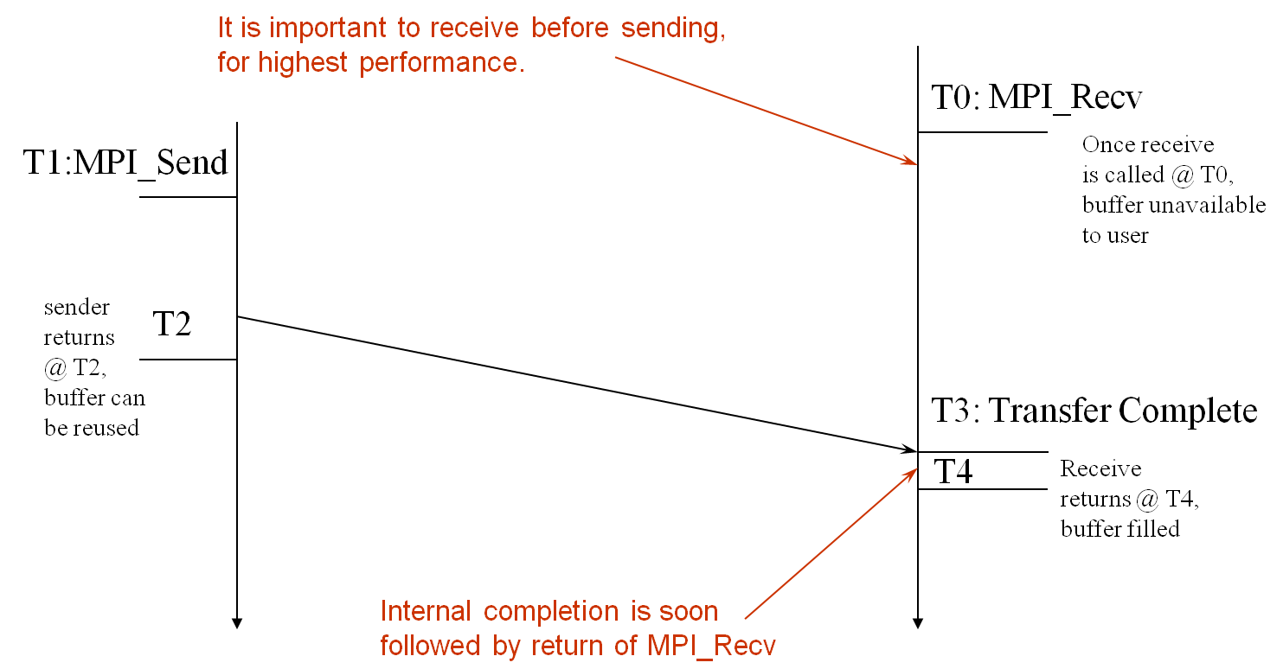
Blocking Send-Receive Diagram
time
54
Notes:
54

Slide 55
Non-Blocking Communication
Non-blocking (asynchronous) operations return (immediately) ‘‘request handles” that can be waited on and queried
MPI_ISEND(buf, count, datatype, dest, tag, comm, request)
MPI_IRECV(buf, count, datatype, src, tag, comm, request)
MPI_WAIT(request, status)
Non-blocking operations allow overlapping computation and communication
One can also test without waiting using MPI_TEST
MPI_TEST(request, flag, status)
Anywhere you use MPI_SEND or MPI_RECV, you can use the pair of MPI_ISEND/MPI_WAIT or MPI_IRECV/MPI_WAIT

Slide 56
Multiple Completions
It is sometimes desirable to wait on multiple requests:
MPI_Waitall(count, array_of_requests, array_of_statuses)
MPI_Waitany(count, array_of_requests, &index, &status)
MPI_Waitsome(incount, array_of_requests, outcount,
array_of_indices, array_of_statuses)
There are corresponding versions of TEST for each of these

Slide 57
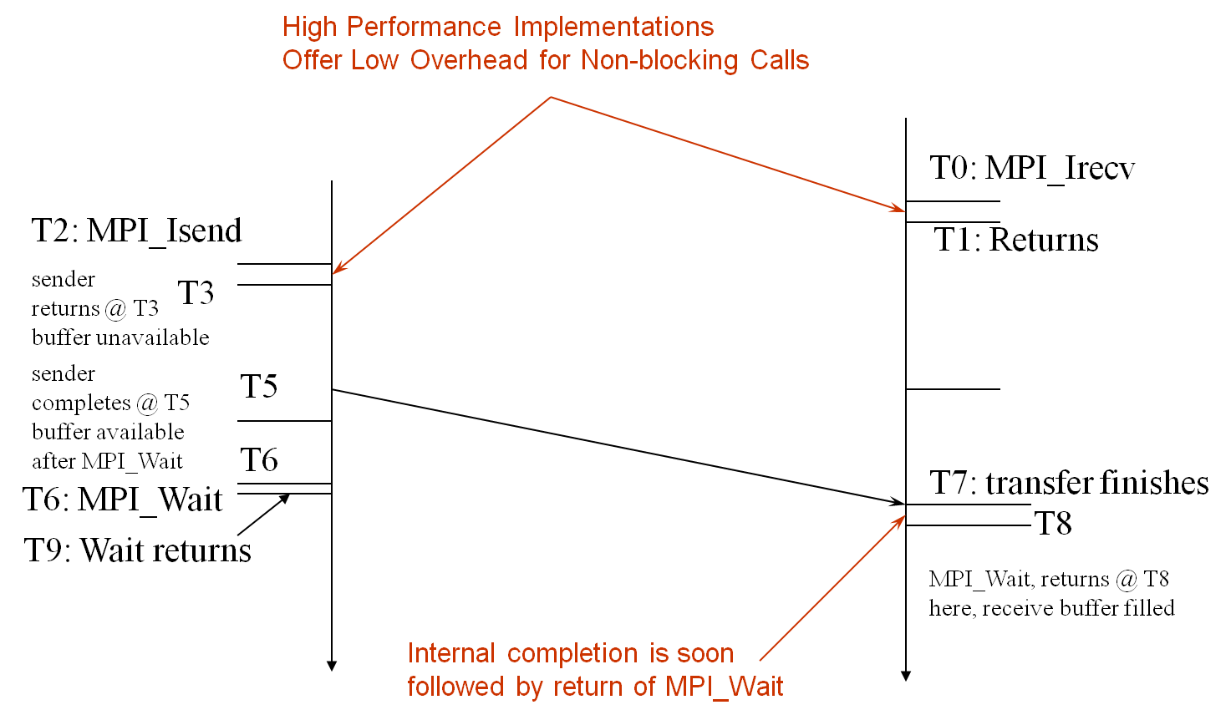
Non-Blocking Send-Receive Diagram
time
57
Notes:
57

Slide 58
Message Completion and Buffering
For a communication to succeed:
Sender must specify a valid destination rank
Receiver must specify a valid source rank (including MPI_ANY_SOURCE)
The communicator must be the same
Tags must match
Receiver’s buffer must be large enough
A send has completed when the user supplied buffer can be reused
Just because the send completes does not mean that the receive has completed
Message may be buffered by the system
Message may still be in transit
*buf =3;
MPI_Send(buf, 1, MPI_INT …)
*buf = 4; /* OK, receiver will always receive 3 */
*buf =3;
MPI_Isend(buf, 1, MPI_INT …)
*buf = 4; /*Not certain if receiver gets 3 or 4 or anything else */
MPI_Wait(…);

Slide 59
A Non-Blocking communication example
P0
Blocking Communication
P1
P0
Non-blocking Communication
P1

Slide 60
A Non-Blocking communication example
int main(int argc, char ** argv)
{
[...snip...]
if (rank == 0) {
for (i=0; i< 100; i++) {
/* Compute each data element and send it out */
data[i] = compute(i);
MPI_Isend(&data[i], 1, MPI_INT, 1, 0, MPI_COMM_WORLD,
&request[i]);
}
MPI_Waitall(100, request, MPI_STATUSES_IGNORE)
}
else {
for (i = 0; i < 100; i++)
MPI_Recv(&data[i], 1, MPI_INT, 0, 0, MPI_COMM_WORLD,
MPI_STATUS_IGNORE);
}
[...snip...]
}

Slide 61
2D Poisson Problem
(i,j+1)
(i,j)
(i-1,j)
(i+1,j)
(i,j-1)

Slide 62
Regular Mesh Algorithms
Many scientific applications involve the solution of partial differential equations (PDEs)
Many algorithms for approximating the solution of PDEs rely on forming a set of difference equations
Finite difference, finite elements, finite volume
The exact form of the differential equations depends on the particular method
From the point of view of parallel programming for these algorithms, the operations are the same
Five-point stencil is a popular approximation solution

Slide 63
Necessary Data Transfers

Slide 64
Necessary Data Transfers

Slide 65
Necessary Data Transfers
Provide access to remote data through a halo exchange (5 point stencil)

Slide 66
Understanding Performance: Unexpected Hot Spots
Basic performance analysis looks at two-party exchanges
Real applications involve many simultaneous communications
Performance problems can arise even in common grid exchange patterns
Message passing illustrates problems present even in shared memory
Blocking operations may cause unavoidable memory stalls

Slide 67
Mesh Exchange
Exchange data on a mesh
9
10
11
6
7
8
3
4
5
0
1
2
Notes:
No periodic exchange

Slide 68
Sample Code
for (i = 0; i < n_neighbors; i++) { MPI_Send(edge, len, MPI_DOUBLE, nbr[i], tag, comm); }
for (i = 0; i < n_neighbors; i++) { MPI_Recv(edge, len, MPI_DOUBLE, nbr[i], tag, comm, status); }
What is wrong with this code?

Slide 69
Deadlocks!
All of the sends may block, waiting for a matching receive (will for large enough messages)
The variation of if (has up nbr) MPI_Recv( … up … )
…
if (has down nbr) MPI_Send( … down … ) sequentializes (all except the bottom process blocks)

Slide 70
Fix 1: Use Irecv
for (i = 0; i < n_neighbors; i++) { MPI_Irecv(edge, len, MPI_DOUBLE, nbr[i], tag,
comm, requests[i]); }
for (i = 0; i < n_neighbors; i++) { MPI_Send(edge, len, MPI_DOUBLE, nbr[i], tag, comm); }
MPI_Waitall(n_neighbors, requests, statuses);
Does not perform well in practice. Why?

Slide 71
Mesh Exchange
Exchange data on a mesh
Step 1
Step 1
Step 1
Step 1
Step 1
Step 1
Step 1
Step 1
Step 1
Step 1
Step 1
Step 1

Slide 72
Mesh Exchange
Exchange data on a mesh
Step 2
Step 2
Step 2
Step 2
Step 2
Step 1
Step 2
Step 1
Step 1
Step 1
Step 1
Step 1

Slide 73
Mesh Exchange
Exchange data on a mesh
Step 2
Step 3
Step 2
Step 3
Step 3
Step 2
Step 3
Step 2
Step 2
Step 2
Step 2
Step 2

Slide 74
Mesh Exchange
Exchange data on a mesh
Step 2
Step 3
Step 2
Step 3
Step 3
Step 3
Done
Step 3
Step 3
Done
Step 3
Done

Slide 75
Mesh Exchange
Exchange data on a mesh
Done
Done
Done
Done
Step 4
Step 3
Done
Step 3
Done
Done
Done
Done

Slide 76
Mesh Exchange
Exchange data on a mesh
Done
Done
Done
Done
Done
Done
Done
Step 4
Done
Done
Done
Done

Slide 77
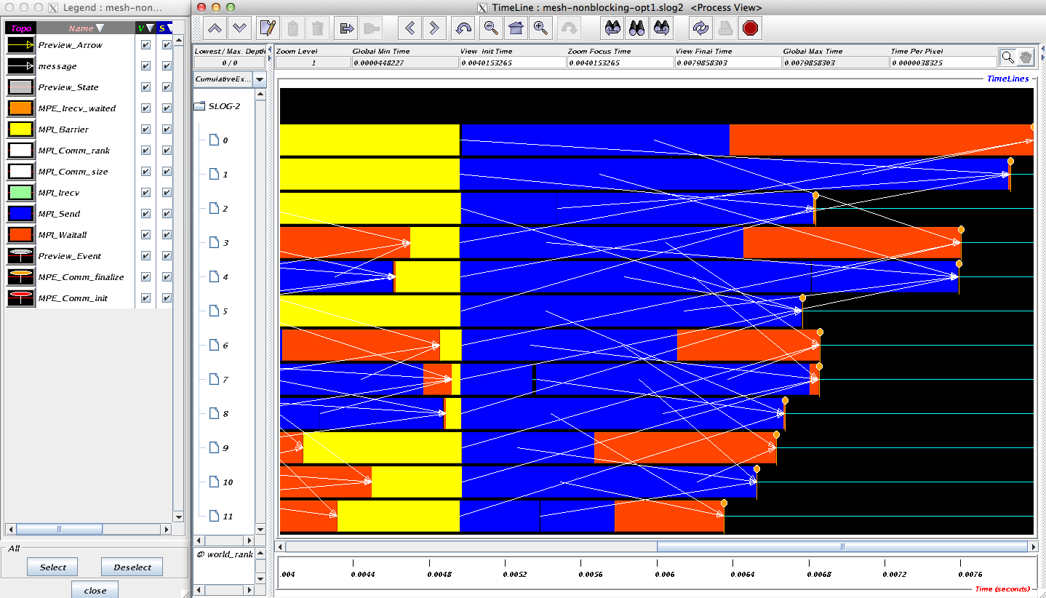
Timeline from IB Cluster

Slide 78
Fix 2: Use Isend and Irecv
for (i = 0; i < n_neighbors; i++) { MPI_Irecv(edge, len, MPI_DOUBLE, nbr[i], tag,
comm, requests[i]); }
for (i = 0; i < n_neighbors; i++) { MPI_Isend(edge, len, MPI_DOUBLE, nbr[i], tag, comm,
requests[n_neighbors + i]); }
MPI_Waitall(2 * n_neighbors, requests, statuses);

Slide 79
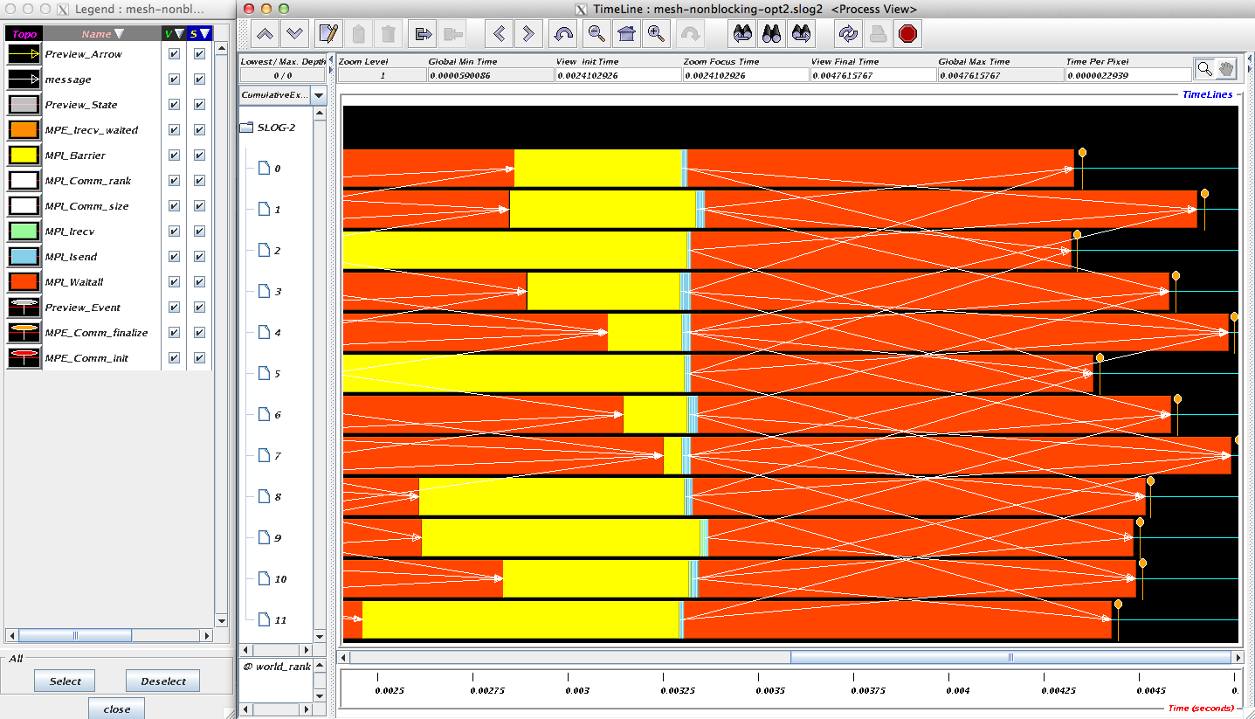
Timeline from IB Cluster
Note processes 4 and 7 are the only interior processors; these perform more communication than the other processors

Slide 80
Lesson: Defer Synchronization
Send-receive accomplishes two things:
Data transfer
Synchronization
In many cases, there is more synchronization than required
Use non-blocking operations and MPI_Waitall to defer synchronization
Tools can help out with identifying performance issues
MPE, Tau and HPCToolkit are popular profiling tools
Jumpshot tool uses their datasets to show performance problems graphically

Slide 81
Code Example
stencil_mpi_nonblocking.c
Non-blocking sends and receives
Manually packing and unpacking the data
Additional communication buffers are needed
Display message queue state using Totalview
totalview mpiexec –a –n 4 ./stencil_mpi_nonblocking 300 250 100 2 2

Slide 82
What we will cover in this tutorial
What is MPI?
How to write a simple program in MPI
Running your application with MPICH
Slightly more advanced topics:
Non-blocking communication in MPI
Group (collective) communication in MPI
MPI Datatypes
Conclusions and Final Q/A

Slide 83
Introduction to Collective Operations in MPI
Collective operations are called by all processes in a communicator.
MPI_BCAST distributes data from one process (the root) to all others in a communicator.
MPI_REDUCE combines data from all processes in the communicator and returns it to one process.
In many numerical algorithms, SEND/RECV can be replaced by BCAST/REDUCE, improving both simplicity and efficiency.

Slide 84
MPI Collective Communication
Communication and computation is coordinated among a group of processes in a communicator
Tags are not used; different communicators deliver similar functionality
Non-blocking collective operations in MPI-3
Covered in the advanced tutorial (but conceptually simple)
Three classes of operations: synchronization, data movement, collective computation

Slide 85
Synchronization
MPI_BARRIER(comm)
Blocks until all processes in the group of the communicator comm call it
A process cannot get out of the barrier until all other processes have reached barrier

Slide 86
Collective Data Movement
P0
A
A
P1
Broadcast
A
P2
A
P3
A
P0
A
B
C
D
Scatter
A
P1
B
P2
C
Gather
P3
D

Slide 87
More Collective Data Movement
P0
A
A
B
C
D
P1
B
Allgather
A
B
C
D
P2
C
A
B
C
D
P3
D
A
B
C
D
P0
A0
A1
A2
A3
A0
B0
C0
D0
P1
B0
B1
B2
B3
Alltoall
A1
B1
C1
D1
P2
C0
C1
C2
C3
A2
B2
C2
D2
P3
D0
D1
D2
D3
A3
B3
C3
D3

Slide 88
Collective Computation
P0
A
f(ABCD)
P1
Reduce
B
P2
C
P3
D
P0
A
f(A)
P1
B
Scan
f(AB)
P2
C
f(ABC)
P3
D
f(ABCD)

Slide 89
MPI Collective Routines
Many Routines: MPI_ALLGATHER, MPI_ALLGATHERV, MPI_ALLREDUCE, MPI_ALLTOALL, MPI_ALLTOALLV, MPI_BCAST, MPI_GATHER, MPI_GATHERV, MPI_REDUCE, MPI_REDUCESCATTER, MPI_SCAN, MPI_SCATTER, MPI_SCATTERV
“All” versions deliver results to all participating processes
“V” versions (stands for vector) allow the chunks to have different sizes
MPI_ALLREDUCE, MPI_REDUCE, MPI_REDUCESCATTER, and MPI_SCAN take both built-in and user-defined combiner functions

Slide 90
MPI Built-in Collective Computation Operations
MPI_MAX
MPI_MIN
MPI_PROD
MPI_SUM
MPI_LAND
MPI_LOR
MPI_LXOR
MPI_BAND
MPI_BOR
MPI_BXOR
MPI_MAXLOC
MPI_MINLOC
Maximum
Minimum
Product
Sum
Logical and
Logical or
Logical exclusive or
Bitwise and
Bitwise or
Bitwise exclusive or
Maximum and location
Minimum and location

Slide 91
Defining your own Collective Operations
Create your own collective computations with: MPI_OP_CREATE(user_fn, commutes, &op); MPI_OP_FREE(&op);
user_fn(invec, inoutvec, len, datatype);
The user function should perform: inoutvec[i] = invec[i] op inoutvec[i]; for i from 0 to len-1
The user function can be non-commutative, but must be associative

Slide 92
Example: Calculating Pi
Calculating pi via numerical integration
Divide interval up into subintervals
Assign subintervals to processes
Each process calculates partial sum
Add all the partial sums together to get pi
1
1
“n” segments
Width of each segment (w) will be 1/n
Distance (d(i)) of segment “i” from the origin will be “i * w”
Height of segment “i” will be sqrt(1 – [d(i)]^2)

Slide 93
Example: PI in C
#include <mpi.h>
#include <math.h>
int main(int argc, char *argv[])
{
[...snip...]
/* Tell all processes, the number of segments you want */
MPI_Bcast(&n, 1, MPI_INT, 0, MPI_COMM_WORLD);
w = 1.0 / (double) n;
mypi = 0.0;
for (i = rank + 1; i <= n; i += size)
mypi += w * sqrt(1 – (((double) i / n) * ((double) i / n));
MPI_Reduce(&mypi, &pi, 1, MPI_DOUBLE, MPI_SUM, 0,
MPI_COMM_WORLD);
if (rank == 0)
printf("pi is approximately %.16f, Error is %.16f\n", 4 * pi,
fabs((4 * pi) - PI25DT));
[...snip...]
}

Slide 94
What we will cover in this tutorial
What is MPI?
How to write a simple program in MPI
Running your application with MPICH
Slightly more advanced topics:
Non-blocking communication in MPI
Group (collective) communication in MPI
MPI Datatypes
Conclusions and Final Q/A

Slide 95
Necessary Data Transfers
Provide access to remote data through a halo exchange (5 point stencil)

Slide 96
The Local Data Structure
Each process has its local “patch” of the global array
“bx” and “by” are the sizes of the local array
Always allocate a halo around the patch
Array allocated of size (bx+2)x(by+2)
by
bx

Slide 97
Introduction to Datatypes in MPI
Datatypes allow to (de)serialize arbitrary data layouts into a message stream
Networks provide serial channels
Same for block devices and I/O
Several constructors allow arbitrary layouts
Recursive specification possible
Declarative specification of data-layout
“what” and not “how”, leaves optimization to implementation (many unexplored possibilities!)
Choosing the right constructors is not always simple

Slide 98
Simple/Predefined Datatypes
Equivalents exist for all C, C++ and Fortran native datatypes
C int → MPI_INT
C float → MPI_FLOAT
C double → MPI_DOUBLE
C uint32_t → MPI_UINT32_T
Fortran integer → MPI_INTEGER
For more complex or user-created datatypes, MPI provides routines to represent them as well
Contiguous
Vector/Hvector
Indexed/Indexed_block/Hindexed/Hindexed_block
Struct
Some convenience types (e.g., subarray)

Slide 99
Derived Datatype Example
0
1
2
3
4
5
6
7
8
9
10
11
12
13
14
15
16
17
18
19
20
21
22
23
contig
contig
contig
indexed
vector
struct

Slide 100
MPI_Type_contiguous
MPI_Type_contiguous(int count, MPI_Datatype oldtype,
MPI_Datatype *newtype)
Contiguous array of oldtype
Should not be used as last type (can be replaced by count)
0
1
2
3
4
5
6
7
8
9
10
11
contig
0
1
2
3
4
5
6
7
8
9
10
11
12
13
14
15
16
17
18
struct
struct
struct
contig

Slide 101
MPI_Type_vector
MPI_Type_vector(int count, int blocklength, int stride,
MPI_Datatype oldtype, MPI_Datatype *newtype)
Specify strided blocks of data of oldtype
Very useful for Cartesian arrays
0
1
2
3
4
5
6
7
8
9
10
11
vector
0
1
2
3
4
5
6
7
8
9
10
11
12
13
14
15
16
17
18
19
20
struct
struct
struct
struct
vector

Slide 102
MPI_Type_create_hvector
MPI_Type_create_hvector(int count, int blocklength,
MPI_Aint stride, MPI_Datatype oldtype,
MPI_Datatype *newtype)
Create non-unit strided vectors
Useful for composition, e.g., vector of structs
0
1
2
3
4
5
6
7
8
9
10
11
12
13
14
15
16
17
18
19
struct
struct
struct
struct
hvector

Slide 103
MPI_Type_create_indexed_block
MPI_Type_create_indexed_block(int count, int blocklength,
int *array_of_displacements, MPI_Datatype oldtype,
MPI_Datatype *newtype)
Pulling irregular subsets of data from a single array
dynamic codes with index lists, expensive though!
blen=2
displs={0,5,8,13,18}
0
1
2
3
4
5
6
7
8
9
10
11
12
13
14
15
16
17
18
19
20
Indexed_block

Slide 104
MPI_Type_indexed
MPI_Type_indexed(int count, int *array_of_blocklengths,
int *array_of_displacements, MPI_Datatype oldtype,
MPI_Datatype *newtype)
Like indexed_block, but can have different block lengths
blen={1,1,2,1,2,1}
displs={0,3,5,9,13,17}
0
1
2
3
4
5
6
7
8
9
10
11
12
13
14
15
16
17
18
19
20
indexed

Slide 105
MPI_Type_create_struct
MPI_Type_create_struct(int count, int array_of_blocklengths[],
MPI_Aint array_of_displacements[],
MPI_Datatype array_of_types[],
MPI_Datatype *newtype)
Most general constructor, allows different types and arbitrary arrays (also most costly)
0
1
2
3
4
struct

Slide 106
MPI_Type_create_subarray
MPI_Type_create_subarray(int ndims, int array_of_sizes[],
int array_of_subsizes[], int array_of_starts[],
int order, MPI_Datatype oldtype,
MPI_Datatype *newtype)
Convenience function for creating datatypes for array segments
Specify subarray of n-dimensional array (sizes) by start (starts) and size (subsize)
(0,0)
(0,1)
(0,2)
(0,3)
(1,0)
(1,1)
(1,2)
(1,3)
(2,0)
(2,1)
(2,2)
(2,3)
(3,0)
(3,1)
(3,2)
(3,3)

Slide 107
MPI_BOTTOM and MPI_Get_address
MPI_BOTTOM is the absolute zero address
Portability (e.g., may be non-zero in globally shared memory)
MPI_Get_address
Returns address relative to MPI_BOTTOM
Portability (do not use “&” operator in C!)
Very important to
build struct datatypes
If data spans multiple arrays

Slide 108
Commit, Free, and Dup
Types must be committed before use
Only the ones that are used!
MPI_Type_commit may perform heavy optimizations (and will hopefully)
MPI_Type_free
Free MPI resources of datatypes
Does not affect types built from it
MPI_Type_dup
Duplicates a type
Library abstraction (composability)

Slide 109
Other DDT Functions
Pack/Unpack
Mainly for compatibility to legacy libraries
You should not be doing this yourself
Get_envelope/contents
Only for expert library developers
Libraries like MPITypes¹ make this easier
MPI_Create_resized
Change extent and size (dangerous but useful)
http://www.mcs.anl.gov/mpitypes/

Slide 110
Datatype Selection Order
Simple and effective performance model:
More parameters == slower
predefined < contig < vector < index_block < index < struct
Some (most) MPIs are inconsistent
But this rule is portable
Advice to users:
Try datatype “compression” bottom-up
W. Gropp et al.: Performance Expectations and Guidelines for MPI Derived Datatypes

Slide 111
Code Example
stencil-mpi-ddt.c
Non-blocking sends and receives
Data location specified by MPI datatypes
Manual packing of data no longer required
by
bx

Slide 112
What we will cover in this tutorial
What is MPI?
How to write a simple program in MPI
Running your application with MPICH
Slightly more advanced topics:
Non-blocking communication in MPI
Group (collective) communication in MPI
MPI Datatypes
Conclusions and Final Q/A

Slide 113
Conclusions
Parallelism is critical today, given that that is the only way to achieve performance improvement with the modern hardware
MPI is an industry standard model for parallel programming
A large number of implementations of MPI exist (both commercial and public domain)
Virtually every system in the world supports MPI
Gives user explicit control on data management
Widely used by many scientific applications with great success
Your application can be next!

Slide 114
Web Pointers
MPI standard : http://www.mpi-forum.org/docs/docs.html
MPICH : http://www.mpich.org
MPICH mailing list: discuss@mpich.org
MPI Forum : http://www.mpi-forum.org/
Other MPI implementations:
MVAPICH (MPICH on InfiniBand) : http://mvapich.cse.ohio-state.edu/
Intel MPI (MPICH derivative): http://software.intel.com/en-us/intel-mpi-library/
Microsoft MPI (MPICH derivative)
Open MPI : http://www.open-mpi.org/
Several MPI tutorials can be found on the web

